Slide 1

PhD track: academic career
Introduction and methodology
Liza CHARROIN (Eco): liza.charroin@univ-paris1.fr
Alain GUILLAUME (Psycho): alain.guillaume@parisdescartes.fr

Slide 2
What is this course about?
18 hours of courses: Wednesday mornings, 3h per session.
6 classes of 3 hours: september 22, october 6, november 10, 17, 24 and december 1.
Interactive course to help you in your master thesis preparation and to prepare you for an academic career (PhD).
3 masters involved:
  Economics and Psychology
  PCFA: Psychologie cognitive fondamentale appliquée
  Ergonomie (no student this year)

Slide 3
What is this course about?
4 objectives/parts of the course:
  Presentation of the research system, career opportunities, funding possibilities, etc.
  Methodology: how to write your master thesis (literature review, etc.).
  Presentation of master thesis project: you will present your master thesis project (or another research project if you are not sure of your topic) and will have to discuss the project of another student.
  Write a Cover Letter and prepare your CV
We are here to help you, orientate your research, guide you…
Small group, so let‘s make this course interactive and adapted to your needs and interests.

Slide 4
What is this course about?
Orals to present:
  Your research idea, the question you want to study.
  The existing literature: the reference paper and others, and how you would fit/complete the literature.
  The methodology you want to use and why.
The presenter sends his/her slides a week in advance.
Others work too!
  We will form groups (today maybe?): 2 discussants (one “expert” and one from another field). The discussants have to discuss/criticize/advise their colleague.
  All other students have to read the slides of the others before coming to the course and be ready to ask questions.
In addition, you have to provide us a CV and cover letter as if you were applying for a PhD grant. Again, this is to help you for your future academic career.

Slide 5
Calendar
1st session:
  Why doing a PhD + tour de table
  Methodology on writing your master thesis
  Your presentation in this class
  CV and cover letter
2nd session:
  Academic/research system
  PhD fundings
4 other sessions for presentations/discussion

Slide 6
Grading
60%: presentation of Master thesis project.
20%: discuss/criticize your colleague.
20%: CV and cover letter.
+ bonus: attendance and active participation in class.

Slide 7
EPI (Espace Pédagogique Interactif)
https://cours.univ-paris1.fr/fixe/M2PhDtrack
For Paris 1 students, you should know this tool.
For U. of Paris students, you can log in with your username/password.
Password of the course (clef d’inscription) : M2PHDTRACK
What you will find here:
  More references, papers on “writing in economics/psychology”
  Slides of methodology and academic world parts
  Slides of presentations and discussions
  Contacts of PhD students!

Slide 8
Why doing a PhD?

Slide 9
Why should you do (or not a PhD)?
If you want to work in academics, you need one
  To become a « Maitre de conférences »
  or a « CNRS researcher ».
But even in the private sector, it has value.
  It shows you know your field
  It demonstrates some big qualities
  More or less value depending on the country…
Many PhD students did not plan to do one.
Who would like to do one? Why? (tour de table)

Slide 10
Reasons to do a PhD
You want to do work on something you love.
You want to improve yourself and learn.
You really want to become an academic researcher.
You want to be at the best of your field.

Slide 11

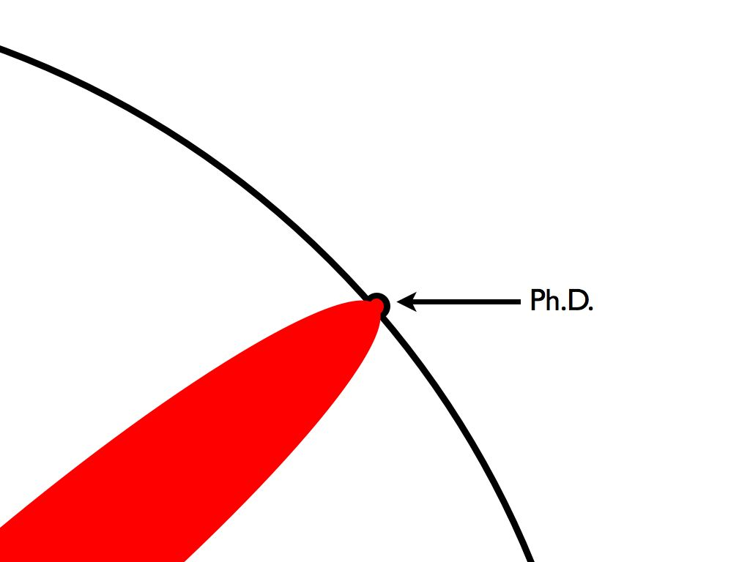
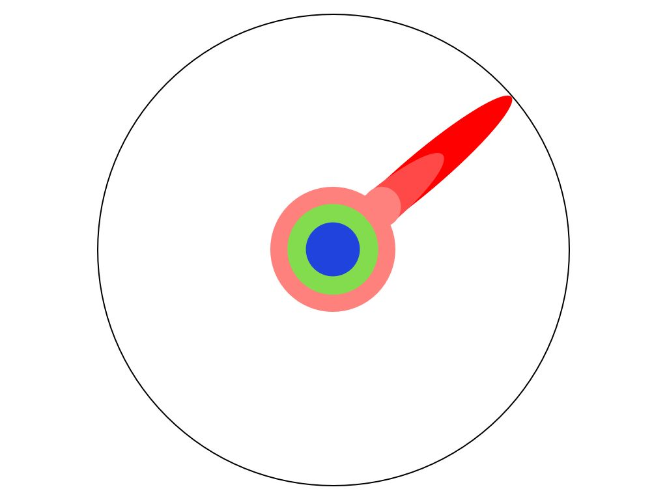
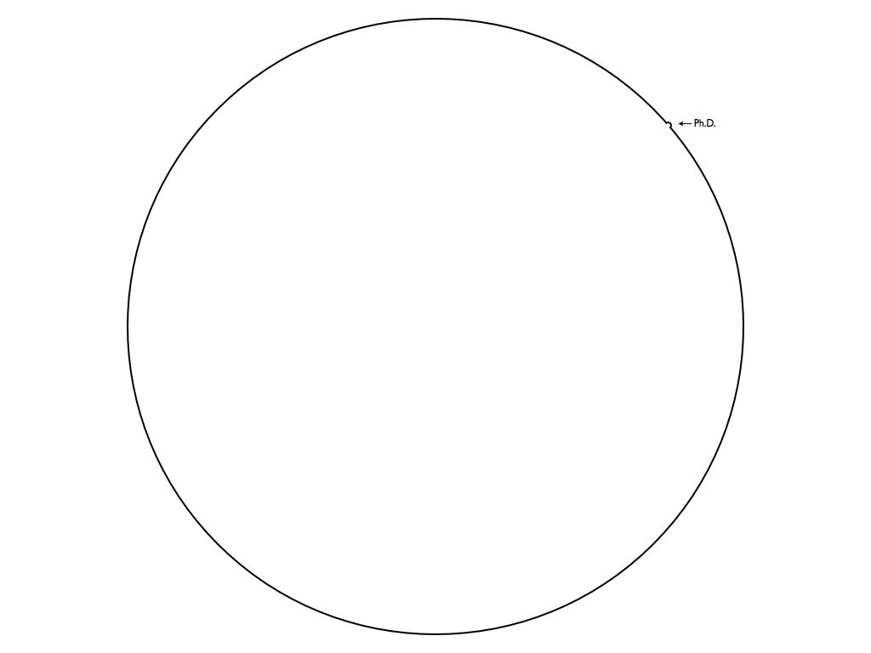

http://matt.might.net/

Slide 12
The importance of the Master thesis
Your master thesis is very important to get a PhD funding.
Why?
  It shows your qualities
  Your grade is usually the first step to get a grant
  The topic of your master thesis is usually the topic of your PhD
We will see the important methodological points to write your master thesis.

Slide 13
Methodology: steps to write your Master thesis

Slide 14
Steps to write your Master thesis
Find a topic you are interested in.
Find a supervisor.
Make the literature review.
Specify clearly your research question.
Write your Master thesis.
First advice: begin early!

Slide 15
Steps to write your Master thesis
Find a topic you are interested in.
Find a supervisor.
Make the literature review.
Specify clearly your research question.
Write your Master thesis.

Slide 16
1- Find a topic you‘re interested in
You need to find a topic:
  That you are interested in and that may interest one supervisor in particular and also the research world
  That is not too wide and not too narrow…
  That has been discussed recently in the literature (hot topic?)
  That does not overlap with what has already been done.
  It must be a new but also feasible project (don‘t be unrealistic).
Choose wisely, for some of you this topic will be the topic of your PhD and a specialty in your academic career.

Slide 17
1- Find a topic you‘re interested in
You may find ideas everywhere:
In the economics/psychology literature. Go on the webpage of research journals: for ex https://www.journals.elsevier.com/journal-of-economic-psychology
In other fields of research (pluridisciplinary: neuroeconomics, biology/economics, environment, criminality, etc.)
In the newspaper, radio, TV, youtube (Science étonnante, dessine moi l‘éco, hygiène mentale, etc.), Twitter... Be CURIOUS!
TED conferences https://www.ted.com/#/
REPEC Newsletter: http://nep.repec.org/ You can subscribe to different newsletters (Cognitive and Behavioural Economics, Experimental Economics, etc)
Seminars at the Uni.
By talking to your supervisor, other professors, other students, your family, etc.

Slide 18
1- Find a topic
You need to find a new topic.
It is not because no paper has been published that there exists no work on it. You also need to check if there exists working papers on this topic:
  Google scholar
  https://ideas.repec.org/
  Research gate or webpages of authors you like. They often talk about their projects.

Slide 19
Steps to write your Master thesis
Find a topic you are interested in.
Find a supervisor.
Make the literature review.
Specify clearly your research question.
Write your Master thesis.

Slide 20
2- Find a supervisor
Maybe even the 1st step… Your supervisor may propose you a topic.
You can find the names of all the teachers of the Master Economics and Psychology here: http://www.economics-and-psychology.org/jml/index.php/faculty
You can very often choose your supervisor (can be from another University, but check that with your Master’s director)
Look at their field of research, publications, interests and contact them (the sooner, the better).
You will need to meet him/her multiple times during the year.
2 supervisors may be a good idea.

Slide 21
Steps to write your Master thesis
Find a topic you are interested in.
Find a supervisor.
Make the literature review.
Specify clearly your research question.
Write your Master thesis.

Slide 22
3- Make your literature review (1/2)
Find all the important papers that deal with the topic you want to study.
There are always one or two papers that are closer to what you want to study, these are your main references. They usually need to be well published, cited many times, etc. Example.
Rankings of economic journals (CNRS): https://www.gate.cnrs.fr/IMG/pdf/categorisation37_liste_juin_2020-2.pdf (example: Journal of Economic Psychology)
Ranking of psychology journals
https://www.apa.org/pubs/journals/resources/impact-factors
https://www.scimagojr.com/journalrank.php

Slide 23
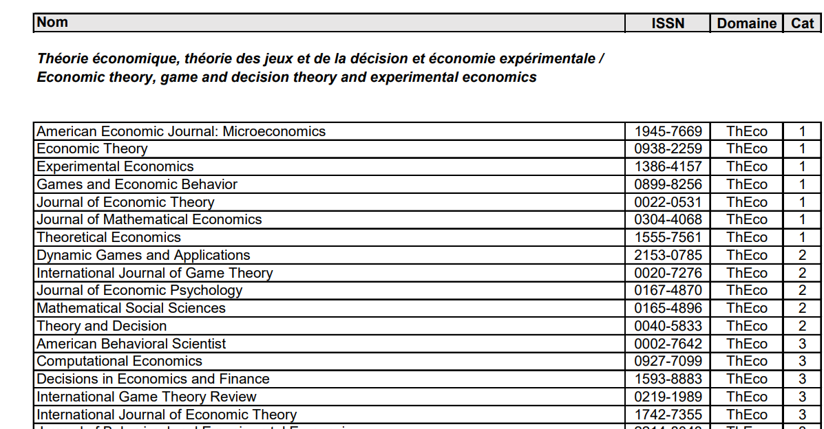

Slide 24
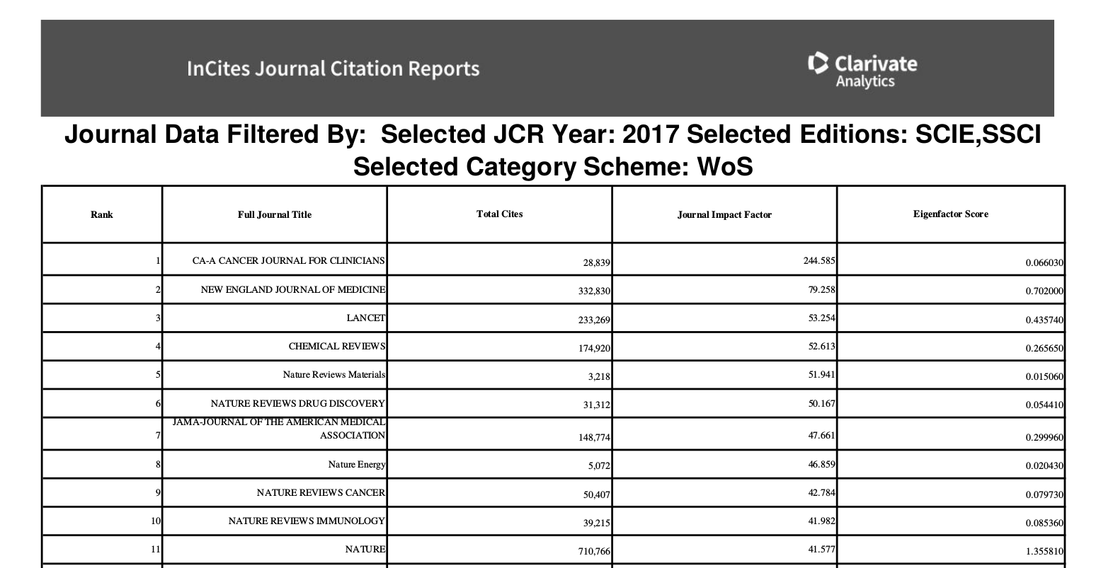
https://www.researchgate.net/publication/326212036_Journal_Citation_Reports_2018_Thomson_Impact_Factor_2018
Journal Impact Factor / 12271 academic journals are listed !!
It’s a PDF, you can search for the journal you have in mind for your publication

Slide 25
3- Make your literature review (2/2)
You need an exhaustive literature review (not to copy another author )
but also know when to stop
You don’t have to read all the papers you see (first read the abstract and then decide whether or not to go further)
Take notes when you read an important paper
Keep track of what you have already read

Slide 26
Useful websites and software (free access)
https://scholar.google.fr/
  Make research by title, author, journal.
  Create alerts Example
  Reference paper: what does it cite? Who cited it? Example
JSTOR https://www.jstor.org/
https://pubmed
https://ideas.repec.org/
Latex: https://www.latex-project.org/get/ You can do your bibliography automatically with a .bib document. (Latex is often used to write research articles.)
Overleaf (online editor of LaTeX): https://www.overleaf.com/

Slide 27
Search for papers
Mendeley or Zotero
  You can put all the articles you have seen
  You can create folders
  You can search by keywords
  You can use it for references
  You can use it to take short notes

Slide 28
Search for papers
Use different keywords!
For articles that interest you, check the reference list of the article (papers written before) and who cited this article (papers written after)
Make sure the articles are credible (how many citations? In good journals?)
Notes:
Competition + cheating vs. Competition + lying

Slide 29
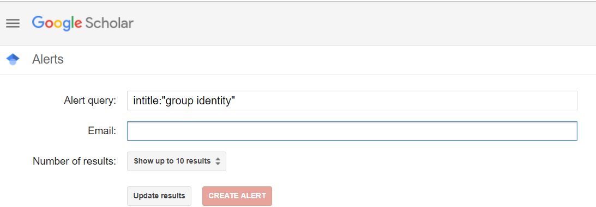
Alert Google scholar

Slide 30
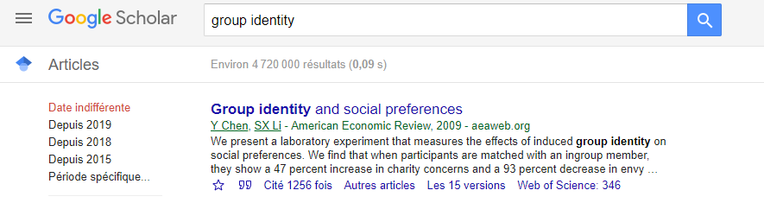
Example of a main reference

Slide 31
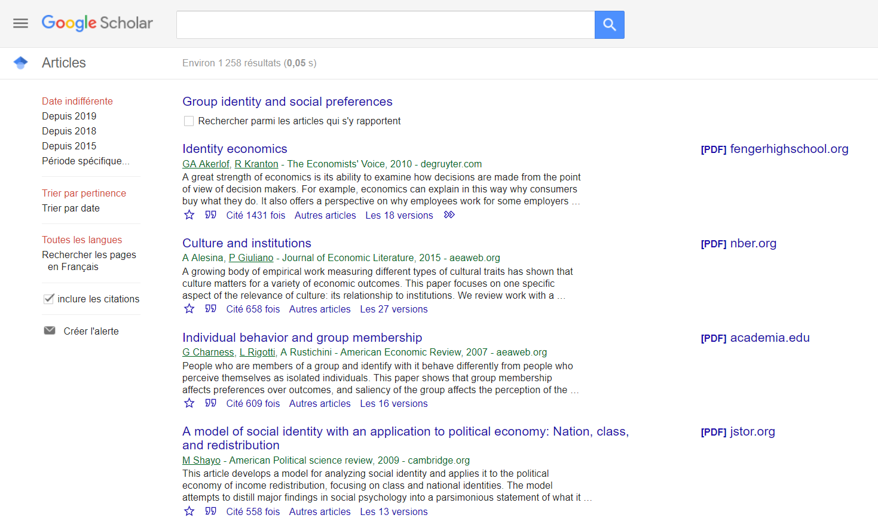

Slide 32
Steps to write your Master thesis
Find a topic you are interested in.
Find a supervisor.
Make the literature review.
Specify clearly your research question.
Write your Master thesis.

Slide 33
4- Specify clearly your research question
Refine your research question depending on what you have found in the literature and what you can/cannot do.
You need to have one clear research question.
Know how to position your research question in the existing literature.

Slide 34
Steps to write your Master thesis
Find a topic you are interested in.
Find a supervisor.
Make the literature review.
Specify clearly your research question.
Write your Master thesis.

Slide 35
5- Write your Master thesis
Your approach may be:
  Only theoretical
  Theoretical and experimental/empirical
  Only experimental/empirical (still need to make some hypotheses)
For experimental works or works with physio measures (neuro, etc), begin very early if you want to collect data and include some results.
For all types of works, do not wait until the end of the year to start writing. Take notes during the whole year.
Maybe your Master thesis will be publishable in the next years.

Slide 36
General advice
Talk to people about your work:
  To other students.
  To economists/psychologists: multi-disciplinary approach.
  Even to your grand mother, little brother, etc. It may give you ideas, consider other options, etc. It is a very good exercise to explain clearly your research project to different populations.

Slide 37
General advice
Your thesis must be clearly written:
  Short sentences: go straight to the point: subject + verb + object. Do not repeat what you already said.
  Structure your thesis: paragraphs are logically written.
Your thesis does not have to be long:
  A good master thesis (or PhD thesis or research article) is not a long one…
  If you can express the same idea in less words, do it.
  Papers in “Science”: usually less than 10 pages.
  For your Master thesis, around 40 pages seem good.
A lot of the advice can be applied to other pieces of work: research articles, PhD thesis, etc.
No plagiarism! We have tools to detect it very easily.

Slide 38
General advice
Use active tense:
  instead of « Participants are randomly assigned to the different treatments », it is better to use « We randomly assigned participants to the different treatments ».
  Instead of « Data were collected… », write « I collected data… »
For me, it is fine to use « I » instead of « we » if you’re the single author. But careful…
Use present tense: « we find that » instead of « we have found that ». Even for the literature : « Fehr and Schmidt (1999) show that… ». Or at least, keep the same tense everywhere.

Slide 39
Content of your Master thesis
Title
Abstract
Introduction
Literature review
Body of the text: methodology (theory, experimental design…) and results.
Conclusion
References
Appendix
Does not mean that you first need to write your title, then your abstract, etc. On the contrary!

Slide 40
Content of your Master thesis
Title
Abstract
Introduction
Literature review
Body of the text: methodology (theory, experimental design…) and results.
Conclusion
References
Appendix

Slide 41
The title
You need to include the main “keywords” of your research.
You can show the methodology you will use.
Ex:
  Does competition enhance performance or cheating? A laboratory experiment (paper by Schwieren and Weichselbaumer in JEP)
  Luck or cheating? A field experiment on honesty with children (paper of Bucciol and Piovesan in JEP)
Probably the last thing to do.

Slide 42
Content of your Master thesis
Title
Abstract
Introduction
Literature review
Body of the text: methodology (theory, experimental design…) and results.
Conclusion
References
Appendix

Slide 43
Abstract
The abstract is very important. It is a condensed version of your paper. We need to know here what is the main interest of your paper and what you found.
Readers may want to read the rest of the paper after reading your abstract.
It must be short (around 100-150 words).
No literature and no notations/citations in the abstract (some exceptions).
This is the last thing (with the title) that you should write.

Slide 44
How to write an abstract? Example
Truth Telling Under Oath
Nicolas Jacquemet, Stéphane Luchini, Julie Rosaz , Jason F. Shogren
Oath taking for senior executives has been promoted as a means to enhance honesty within and toward organizations. Herein we explore whether people who voluntarily sign a solemn truth-telling oath are more committed to sincere behavior when offered the chance to lie. We design an experiment to test how the oath affects truth telling in two contexts: a neutral context replicating the typical experiment in the literature, and a “loaded” context in which we remind subjects that “a lie is a lie.” We consider four payoff configurations, with differential monetary incentives to lie, implemented as within-subjects treatment variables. The results are reinforced by robustness investigations in which each subject made only one lying decision. Our results show that the oath reduces lying, especially in the loaded environment—falsehoods are reduced by 50%. The oath, however, has a weaker effect on lying in the neutral environment. The oath did affect decision times in all instances: the average person takes significantly more time deciding whether to lie under oath.
Topic
Research question
Methodology
Results

Slide 45
Abstract
After the abstract:
  Keywords (from the previous article: deception, lies, truth-telling, oath, laboratory experiment).
  JEL classification codes (economics): https://www.aeaweb.org/econlit/jelCodes.php?view=jel (from the previous article: C92 Laboratory, Group Behavior, D03 Behavioral Microeconomics: Underlying Principles, D63 Equity, Justice, Inequality, and Other Normative Criteria and Measurement)
  Acknowledgments (you can thank your Master supervisor here ;) )

Slide 46
Content of your Master thesis
Title
Abstract
Introduction
Literature review
Body of the text: methodology (theory, experimental design…) and results.
Conclusion
References
Appendix

Slide 47
Introduction
Your introduction must:
  Introduce your topic, explain why it is interesting.
  Explain how it contributes to the existing literature.
  Specify clearly your problematic/research question.
  Explain your methodology.
  Highlight your main result(s).
  Describe the outline of your thesis.
The introduction should not be too long: 5 pages MAXIMUM (2 pages may be enough, 3 is the average).
The introduction is linked with your conclusion.
This is the MOST important part of your Master 2 thesis. If it is not good, readers won‘t want to go further or will have a very bad feeling.

Slide 48
Introduction
Start with giving an introduction of your topic.
You need to contextualize your topic, to connect it to reality. Show that you want to solve a real world problem.
Do not start with “Since hundreds of years…”, “The literature on … has always been interested in…”.
Start directly with the topic.

Slide 49
Introduction
Start with giving an introduction of your topic.
In “Does competition enhance performance or cheating? A laboratory experiment” (Schwieren, Weichselbaumer, 2010, JEP)
“Economic theory typically considers competition as desirable, since competition improves the functioning of markets, fosters innovation, guarantees efficiency by forcing firms to produce at lowest costs, encourages highest effort among employees and reduces possibilities of discriminatory behavior of employers […] Lately, however, economists began to become interested in other than purely economic effects of competition. For example, Shleifer (2004) suggests that competition may favor unethical behavior such as corruption or cheating.”

Slide 50
Introduction
Present your research question, your objective.
It needs to be clear and straight to the point.
“In this paper, we are interested in the effect of competitive pressure on cheating.”

Slide 51
Introduction
Explain why your research question is important and why the answer to your question is not obvious.
Different reasons/mechanisms at work:
“With respect to competition the ‘‘rational cheater model” would predict that the higher the competition, i.e. the higher the benefit of doing better than the others, the more cheating we should observe. […] But also behavioral/psychological motives may lead towards increased cheating under competitive pressure. Competition emphasizes the importance of personal success. As a result, people who do not bring about the desired achievements may feel pressured to engage in pretence of such. Furthermore, competition draws the attention from the well-being of the group towards the individual and thereby lessens the social cohesion within a group. Consequently, individuals may find themselves less bound to adhere to standards of fairness but may find it legitimate to gain their personal share by cheating.”

Slide 52
Introduction
Explain your contribution to the literature.
You may either present the literature and your contribution in the introduction or make a literature review in another section. But in both cases, you need to explain how you contribute to the literature, which gap you fill.

Slide 53
Introduction
Methodology: how do you answer to your research question?
If theoretical: explain your model briefly (do not put equations in the introduction).
If experimental: present your design, treatments.
If surveys: present your questionnaire.
“In our experiment, individuals also have the possibility to distort information among a number of cheating opportunities. Subjects have to conduct a task under two different treatments: a non-competitive and competitive treatment. The level of competitiveness is induced by the structure of the payments awarded which either depend on absolute or relative performance. As we can observe the subjects’ behavior without their knowing we can test whether cheating is indeed increased by competition”

Slide 54
Introduction
Present your results:
Present your theoretical results and experimental/empirical results.
“In our experiment we find that indeed competitive pressure causes individuals to cheat, however, this is only the case for individuals, who have a relatively low ability at the task at hand. This corresponds with the predictions of the economics of crime that people who have more to gain are more likely to engage in unethical cheating behavior.”

Slide 55
Introduction
Outline of your master thesis.
In Section 1, I review the literature on… In Section 2, I explain the experimental design … Finally Section … concludes.

Slide 56
Content of your Master thesis
Title
Abstract
Introduction
Literature review
Body of the text: methodology (theory, experimental design…) and results.
Conclusion
References
Appendix

Slide 57
Literature
Main reference papers of your research field and some additional papers.
Only present papers that are close to your research question. Know where to stop.
Show that you understand the literature and have a global vision of what has been done and what needs to be done (what are the gaps).
Highlight how your research would contribute to this literature and fill some gaps.
The literature review may be a section on its own or be part of the introduction.

Slide 58
Read papers
Do not read all the papers, be effective and selective. Start reading the abstract, then if necessary the introduction (or even conclusion) and then the body of the text.
Then if you think the paper is essential and needs to be in your literature review, read it carefully.
Write short note on each paper:
  Topic, intro: what do they study?
  Methodology, design: how do they study it?
  Results: what do they find?
  Discussion: why is it interesting and is linked to your research?

Slide 59
Read papers
Find connections/links between the paper you found, “identify relations, contradictions, gaps, and inconsistencies” and “suggest next steps to solve the research problem” (APA Publication Manual 2010, p. 10).
  https://apastyle.apa.org/index
It may be useful to do some graphs/maps to visualize the literature and where you would locate your work.

Slide 60
Write your literature review
Do not just make a list of papers.
Structure your literature review:
  Chronological: how the study of the topic evolved over time, what were the contributions made one after the other?
  Thematic: you can categorize papers in different subsections depending on their topic
  Methodology: research in economics, then research in psychology and finally in both for ex.

Slide 61
Write your literature review
Do not make a list of papers.
Need to show the links between the papers, the global thinking, the “big picture” behind all these research papers (debate behind these multiple papers).
It is not just a summary of books/articles, but:
  You should analyze the research that has been done
  You should highlight patterns, gaps and debates behind research
  Show the state of the art
Two goals: describe works done in your area + explain why your work is different/necessary/fills a gap
Do not copy/paste a sentence of each abstract… Use your own words to explain what the authors did.

Slide 62
Write your literature review
Usually, one or two sentences about a paper are sufficient to describe the main idea to the reader. If it is your reference paper, a short paragraph may be needed.
At the end (or after every subsection), show the limitations of the literature: the gaps, what has not been checked, what other mechanism may be at work… ➔ your contribution.
Show the limitations but do not “judge” the articles! Never say “bad”, “not good”, etc.

Slide 63
Content of your Master thesis
Title
Abstract
Introduction
Literature review
Body of the text: methodology (theory, experimental design, survey…) and results.
Conclusion
References
Appendix

Slide 64
Body of the text
Depends on the methodology you use.
  Theoretical: present your settings, your model.
  Experimental: presents your design (treatments, information participants have, number of rounds, composition of groups, etc.)
  Surveys: tool you used (limesurvey), questions you asked, etc.
“Usual” parts (not obviously in this order):
  Data or Participants: who are the subjects of your study, how did you recruit them?
  Design of the experiment or Survey or Data collection (blood, physiological measures: what did they do, which questions they answered, etc.
  Procedures: additional information on the procedure of data collection (sequence of the experiment for ex).
  Results.

Slide 65
Results
Results:
  Put your main result first. Do not do a “surprise” or joke effect at the end.
  Select the main results (we have a tendency to think that all our results are primary results, but not true) and structure them (Result 1, Result 2, etc.)
  Use figures and tables to make your results more visual.

Slide 66
Results
Have a clear structure for your results section:
  Be precise, put your result close to the table showing this result
  Go from one result to another in a logical order.
  It has to be fluid.
Do not use too many footnotes! Either it is important and deserves to be in the paper or it is not important and does not need to be here. It may be useful if you think some readers (but not all) will be interested in this point.

Slide 67
Content of your Master thesis
Title
Abstract
Introduction
Literature review
Body of the text: methodology (theory, experimental design…) and results.
Conclusion
References
Appendix

Slide 68
Conclusion
Two phases in a conclusion:
  First, you need to summarize your thesis (topic, research question, methodology and results). The conclusion “replies“ to the introduction, but do not repeat everything… Some authors even think a conclusion is useless.
  Second, you need to “open“:
    What is next?
    What is the limitation of your study and how you can go further?
    What can be done to go further? Or to study a question that is close to yours?
You can also have (before the conclusion) a discussion section.

Slide 69
Content of your Master thesis
Title
Abstract
Introduction
Literature review
Body of the text: methodology (theory, experimental design…) and results.
Conclusion
References
Appendix

Slide 70
References/bibliography
It shows to the reader whether you know the literature well and if you have a clear and global view of the main papers.
Do not need to make a long list, but do not forget to cite the most important papers in the field of study. Show that you know which one are most suited for your study.

Slide 71
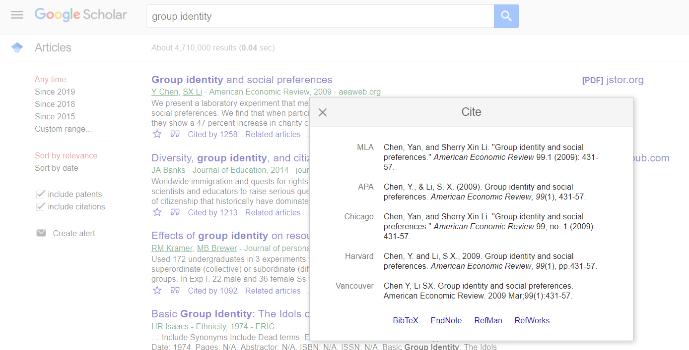
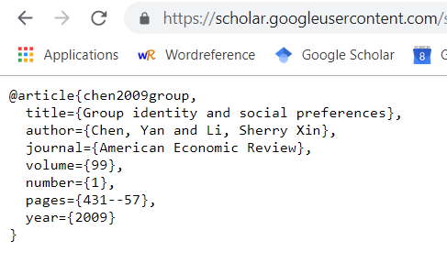
Cite a paper

Slide 72
Content of your Master thesis
Title
Abstract
Introduction
Literature review
Body of the text: methodology (theory, experimental design…) and results.
Conclusion
References
Appendix

Slide 73
Appendix
You can add here things that are not essential to your master thesis but still useful for the reader (anticipate what the readers may ask):
  Additional graphs
  Extensions of your model
  Instructions of your experiment
  All the robustness checks you did, the alternative explanations that are not significant.

Slide 74
Useful websites
Writing in economics:
  https://static1.squarespace.com/static/58991b1546c3c4da5df402e4/t/589c5b0f37c58162f7acb007/1486641936481/A+Guide+to+Writing+in+Economics.pdf
  https://twp.duke.edu/sites/twp.duke.edu/files/file-attachments/econ.original.pdf
  https://inomics.com/insight/top-writing-tips-for-economics-papers-1141763
Writing in psychology:
  http://writing2.richmond.edu/writing/wweb/psychology/BG%20Psychology.pdf

Slide 75
What’s next?
Is there a methodology part you want to talk about next time?
  Specific point you want us to talk about?
  Master thesis defense?
  More on literature review?
  How to use Mendeley/LaTeX?
  Something else?

Slide 76
Your presentation in this class
(and for your defense)

Slide 77
Your presentation
Orals to present:
  Your research idea, the question you want to study.
  The existing literature: the reference paper and others, and how you would fit/complete the literature
  The methodology you want to use and why.
You need to convince us that:
  Your research question is interesting
  Your research will fill a gap of the literature
  You know how to deal with this question.
Four parts:
  Introduction: topic, research question
  Literature review and contribution to the literature
  How you (will) answer your research question
  Your hypotheses and/or your results

Slide 78
General advice
Do not write too much things on your slides ➔ minimalism
Structure your reasoning
  Introduction
  Literature
  Your research question = the gap you fill in the literature
  Methodology: how you answer your research question
  Results
Make something visual (figures, pictures, etc.)
Use the time you have (time to be defined depending on the number of students), not less, not more!

Slide 79
Your role of discussant
You will have the slides of your colleague a week in advance on the EPI and/or by mail.
You have to:
  Summarize your colleague’s work (very briefly)
  Comment his/her work: say what is good, what is less good, what can be improved, how you would have done it, etc.
  Prepare few questions.
You can make few slides if that helps you or just a word document.

Slide 80
CV and cover letter

Slide 81
Write a cover letter and prepare your CV
Your CV:
      Prepare your CV (if not done yet)
      2 pages (or more) with classical sections :
        Personal details, Career summary, Education, …
        (more on that later)
      We will help you to improve it
A cover letter:
      Write a cover letter for your actual application in a lab/compagny
      Or let’s do AS IF you were applying for a PhD grant or a given position
General aim : to help you for your future academic career

Slide 82
Your CV :
2 pages – but academic CV can be much more longer
Classical sections:
  Personal details, Education (1st), Employment, Skills,
  If you have already some items : Teaching, Research
Reverse chronological order
Be scannable, concise and effective
Make it easy to read / uncluttered. It's important : if it's clear and easy to follow, you really increase your chances
Be consistent : it makes the reading easier... but it also shows that your mind is well structured
Show that you are professional

Slide 83
Your CV :
Adapt the presentation / wording of items to the field of the position
Consider your audience : do they value publication over teaching
small college with a lot of importance to teaching...
Don’t mix unimportant publications with important ones just to make some numbers !
If the CV is rather long : add a Summary Statement

Slide 84
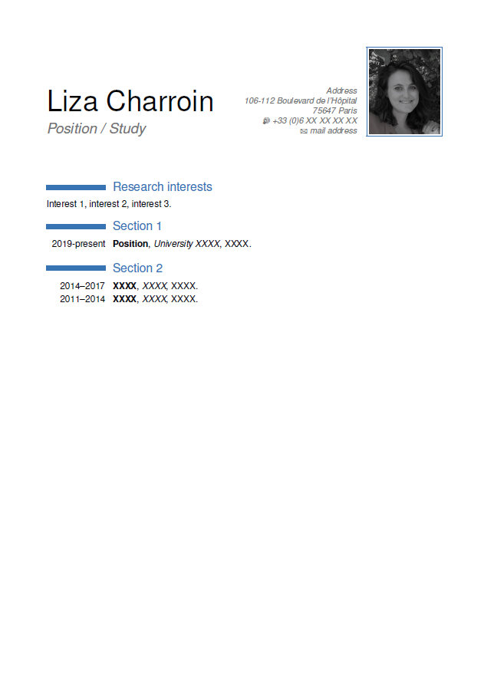
Template (LaTeX)
If interested, we can provide a LaTeX template.

Slide 85
Cover Letter :
"The power of the cover letter in making an effective job application should never be underestimated"
www.jobs.ac.uk
How to Write a Cover Letter for Academic Jobs
2 pages maximum !!
The first part is very important :
Dear NAME of the person in charge of the hiring
“I am writing to apply to the advertised position of Assistant Professor in XX. I have a Ph.D. in XXX/I am completing a Ph.D. in XXX and will be defending my dissertation on XX, 2018. Currently I am a…. My research focuses on XX and YY.”

Slide 86
Write a cover letter
Cover letter: address it to someone!
Different options:
  You send a letter to a professor who is looking for a PhD student.
  You write a letter to get to a doctoral program (Paris 1, Université de Paris or somewhere else)
  You write a letter to get a CIFRE grant
You need to talk about:
  You: background, thesis project, skills, etc.
  The other person/institution: the lab, the University, etc.
  Both: how you would be a perfect match!
  ➔ Show you’re the best candidate for this position.

Slide 87
Cover Letter :
What to include in a cover letter ?
When writing your cover letter, be sure to:
Introduce yourself
Reference the position you’re applying for
Describe your skills, experience achievements and educational background
Tell a story or describe a project you’ve worked on
Show that you did your homework : show some knowledge of the department that recruits
Explain why you are highly qualified for the role and a perfect match
Close with a signature and a call-to-action (such as encouraging the reader to view your resume or requesting an interview)

Slide 88
CV and cover letter
We strongly encourage you to send us the 1st version of your CV and cover letter as soon as possible.
We will look at them and advise you.
The final version of your CV and cover letter has to be sent at the end of the semester (we will give you the exact deadline soon).

Slide 89
Last points
Don’t hesitate to ask us if you want to do “special” research, if you have questions, remarks, etc. or if you want us to talk about some aspects of research we did not talk about.
Good luck for the semester!!

