Slide 1
GLOBAL HEALTH ECONOMICS
MASTER IN PUBLIC POLICY, M2
HEALTH care FINANCING
Pr lise Rochaix
Paris 1 & Paris school of economics

Slide 2
2 - Insurance issues

Slide 3
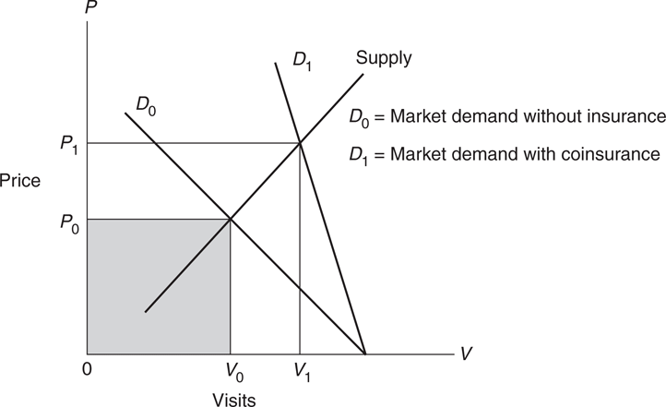
MARKET IMPACT OF COINSURANCE
For the market as a whole, coinsurance shifts the market demand curve from D₀ to D₁, resulting in an increase in the price of office visits and an increase in the number of visits.
Overall health expenditures will rise from P₀V₀ to P₁V₁.
Source: Folland et al, 2017

Slide 4
demand FUNCTIONS FOR health CARE WITH insurance
The demand function for health care, referred to as V:
V = f (P, r, t, P₀, Y, HS, AGE, ED,…)
P is price of health care,
r is the patient’s coinsurance rate,
t is a time price,
P₀ is the price of other goods,
Y is a measure of income,
HS is the patient’s health status,
AGE and ED stand for variables such as age and education to reflect other need and taste factors.

Slide 5
Impact of coinsurance rates
Suppose that sicker individuals choose plans with low out-of-pocket payments (low co-insurance)
It would then appear that low co-insurance caused more medical utilization and worse health
But this would not result from the effect of the co-insurance; rather, it would simply reflect the choice of more generous insurance schemes by sicker individuals
=> An experimental study was set up in the US to analyze the impact of different types of out-of-pocket payments: the RAND Health Insurance Experiment - HIE

Slide 6
LESSONS FROM The RAND HIE
The experiment set-up
The HIE began enrolling families in 6 locations around the U.S in 1974 for 3-5 years
Across locations, 2,000 non-elderly families, containing about 5,800 persons, were recruited
Families were randomly assigned to plans with widely varying co-insurance and maximum out-of-pocket dollar expenditure (MDE) amounts
Randomization => differences in utilization and health across the plans clearly reflect differences in patient costs, not differences in patient characteristics

Slide 7
LESSONS FROM The RAND HIE
The experiment set-up
Four types of of Fee for Service (FFS) plans with different co-insurance arrangements (the percentage of medical charges that the consumer must pay):
FFS1: free care (no co-insurance);
FFS2: 25% co-insurance
FFS3: 50% co- insurance
FFS4: 95% co-insurance
A fifth type: HMO (Health Maintenance Organization), with a deductible of $150/person, or $450/family that applied to outpatient care only

Slide 8
LESSONS FROM The RAND HIE
The experiment set-up
For poor families assigned to FFS plans with cost-sharing, payments were income adjusted and capped
The maximum annual out-of-pocket (OOP) varied between 5%, 10%, and 15% of income, with a maximum dollar expenditure (MDE) of $1,000 (3000$ for current prices)
Under all plans, OOP never exceeded $1,000, no matter what the level of co-insurance was
All medical services were covered, although in some cases co-insurance rates varied by service
Individuals were followed for up to five years after enrollment (health questionnaires at beginning and end of study and physical tests)

Slide 9
LESSONS FROM The RAND HIE
Main results from the Rand Health Insurance Experiment (HIE)
1: The co-insurance rate matters for medical utilization and expenditures
2: Co-insurance effects are relatively constant across services
3: Higher co-insurance rates do not have adverse health consequences for the average person
4: Differential effects on the sick and poor
The one clear negative impact on health occurs only for those who are at high medical risk, particularly if they are also of lower income
=> This suggests considering targeted co-insurance approaches that minimize the costs to this sub-group

Slide 10
LESSONS FROM The RAND HIE
1 - Effects on care use
Reduced use of services resulted primarily from participants deciding not to initiate care
=> Once patients entered the health care system, cost sharing only modestly affected the intensity or cost of an episode of care
Consumers with an HMO plan had 39 percent fewer hospital admissions than consumers with free care in the FFS system
They had similar use of outpatient services

Slide 11
LESSONS FROM The RAND HIE
2 - Appropriateness of care
Specific conditions were ranked into categories according to the degree to which outpatient care and therapies were known to be effective in treating each condition
=> The categories ranged from conditions for which care is highly effective to conditions for which care is rarely effective
Results: Cost sharing reduced the use of effective and less-effective care across the board
Ex: The proportion of inappropriate hospitalizations was the same (23 percent) for cost-sharing and free-plan participants, as was the inappropriate use of antibiotics

Slide 12
LESSONS FROM The RAND HIE
3 - Quality of care
Based on process measures of the quality of ambulatory and dental care received by HIE participants (ex: appropriate use of visits and diagnostic tests by providers or appropriate use of therapeutic interventions after participants sought care)
Results:
1 - Cost sharing did not significantly affect the quality of care received by participants
2 – The overall level of quality for process measures was surprisingly low for all plans: criteria were met only 62% of the time

Slide 13
LESSONS FROM The RAND HIE
4 - Effects on health
Results:
1 - In general, the reduction in services induced by cost sharing had no adverse effect on participants’ health
2 – Exceptions: the poorest and sickest 6% of the sample at the start of the experiment had better outcomes under FFS1 (free care) for some of the 30 conditions measured:
- hypertension control: 10% reduction in mortality
- vision
- dental care
3 – Patient satisfaction did not vary between FFS1 to 4 and was higher in FFS than in HMO
4 – No change in risky behaviour (rate of smoking and obesity)

Slide 14
Evaluating The RAND HIE
Three main limitations according to Gruber (2006)
The time frame of the HIE (3 to 5 years): not sufficient for free care to produce benefits relative to the co-insurance plans
For children, a longer follow-up may be required to find health effects (particularly given the reduction in preventive care in the co-insurance plans)
These effects only hold in a world of (often quite low) maximum limits to out-of-pocket medical exposure
There is now a large literature which consistently documents the enormous negative implications of being uninsured on health care outcomes
Uninsured individuals who face unlimited exposure to medical costs are no longer on the “flat of the curve of the effectiveness curve”: they are clearly forgoing care which matters in a real way for health care.

Slide 15
Evaluating The RAND HIE
Three main limitations according to Gruber (2006)
The past 30 years have seen enormous advances in treatment effectiveness for a variety of conditions and the nature of the care has changed since the HIE :
The care that is reduced by OOP in today’s medical environment may be more important for health outcomes than in the 1970s
Treatment in general has become much more expensive and intensive
Thus, there is substantial uncertainty in extending the results of the RAND study to the 21st century.

Slide 16
revisiting The RAND HIE
Recent research corroborates HIE main results
More recent work in a variety of settings and for a wide variety of subpopulations has confirmed the main conclusion of the HIE: higher patient co-payments reduced medical utilization
In the absence of another large scale experiment, work is carried out on existing data and micro simulations are used to compare the expected performance of various scenarios.
Recent research confirms the conclusion from the HIE that reduced care is harmful for those in poor health
Aviva Aron-Dine et al (2013) reexamined the findings of the RAND experiment from the perspective of three subsequent decades of progress in empirical work on the design and analysis of randomized experiments

Slide 17
Implications for HEALTH FINANCING REFORMS
Can cost sharing be used to achieve fundamental goals: containing costs and reducing waste without damaging health or quality of care?
Cost sharing is a blunt tool that reduced both needed and unneeded health services and did not improve appropriateness of care.
Proposal for US reform: combine some form of cost sharing and managed care (HMO type) to exploit cost sharing’s benefits (reduced costs and unnecessary care, small overall health effects) while avoiding its negatives (reduction in needed care, some health effects for poorer and sicker patients)
=> Additional tools must be developed to improve appropriateness of care : incentives, evaluation of health care technologies

