Slide 1
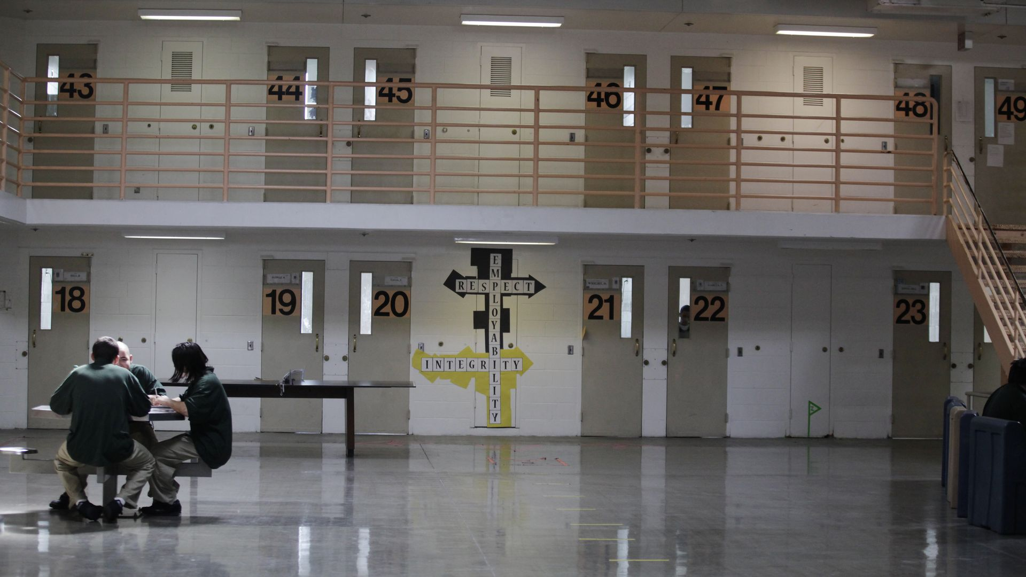
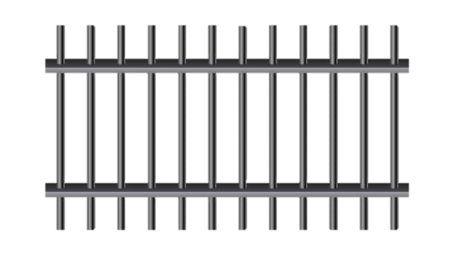
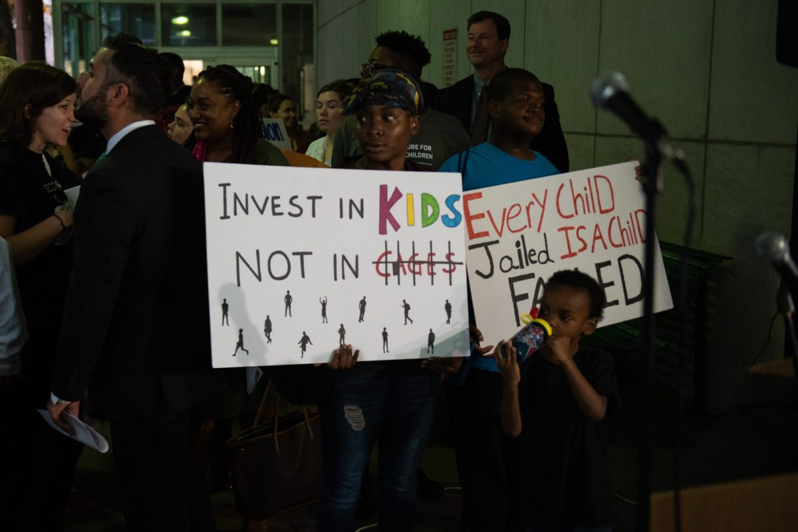
Introduction
XXth : growing belief that children have specific needs and should be send to specific courts and prisons. Concurringly, entrenched practice of sending juveniles to adults’ court for serious crimes, as opposed to petty crimes. Still true today even if there is a slight evolution : 2005 (Roper v. Simmons) > abolition of death penalty under 18s / 2012 (Miller v. Alabama) > abolition of mandatory life sentence without parole for children, BUT it is still allowed in 25 states.
Juvenile Detention
I. What is juvenile detention
-625 facilites classified as juvenile detention centers
-detention after the commission of a crime or an offense
-similar to the adult criminal system from arrest to probation and reentry
-but system tries to avoid incarceration of minors
-goals : to develop skills, habilitation and public safety
-195 000 minors are admitted to facilites and 156 000 on any given night
-majority between 15 and 17 years
-stay from 3 to 18 months
II. The population of juvenile detention and its challenges
-possibility of detention even under the age of 14 if ability of discernement is proven
-racial and ethnical disparities from the arrest to the detention : 1/3 of the cases involve black adolescents
-also adjudication : minority youth more frequently sentenced than others in similar cases
-centers are overcrowded and understaffed
-lack of minimal care
-frequency of physical and sexual abuse
III. The consequences of juvenile detention
-damaging consequences on the physical and mental level : worsenes health outcomes
-exposition to high risk of substance abuse and incarceration later
-limitates the access to education
-high rates of suicides and suicide attempts
IV. The alternatives to juvenile detention
-house arrest : confinement at home in order to work or go to school
-community-based programs in order to provide youth with supervision and services
-multisysyemic therapy programs : reduce recidivism rates by 70% in juvenile offenders
-Functional Family Therapy
-specialized foster care

