Slide 2

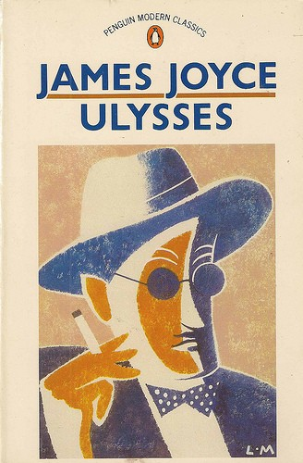
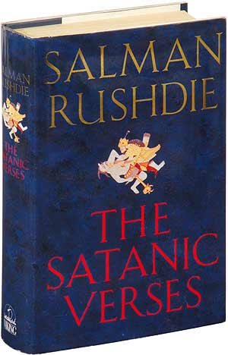
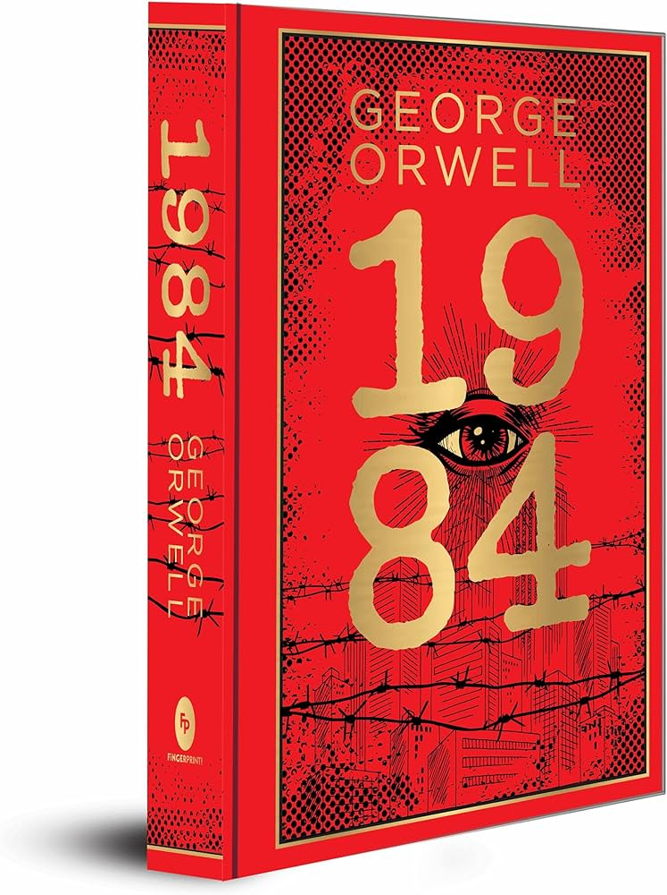

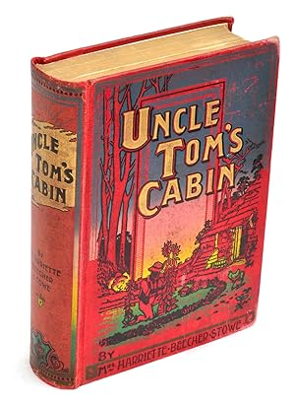
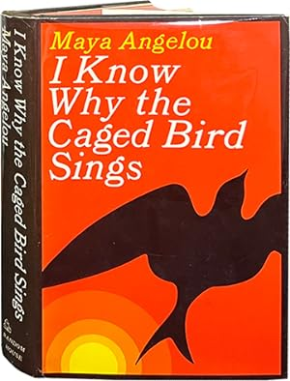
What do the following books
have in common?

Slide 3


Slide 4
DEFINITION
Give your own definition of CENSORSHIP
NOW READ THE FOLLOWING DEFINITIONS
« CENSORSHIP » is the changing or the suppression or prohibition of speech or writing that is deemed subversive of the common good. (definition of Encyclopedia Britannica)
« CENSORSHIP » is the censoring of books, plays, films, or reports, especially by government officials, because they are considered immoral or secret in some way. (definition of Collins dictionary)

Slide 5

WORDCLOUD
Which of the following terms and idioms are not related to the semantic field of CENSORSHIP ?
Muzzling
Red tape
Blue-pencilling
Silencing
Bane
Gag
Expurgation
Brainstorm
Thought-control
To sit on a fence
Content moderation
Inquisition
Elation
Autodafé
Muzzling
Red tape
Blue-pencilling
Silencing
Bane
Gag
Expurgation
Brainstorm
Thought-control
To sit on a fence
Content moderation
Inquisition
Elation
Autodafé

Slide 6
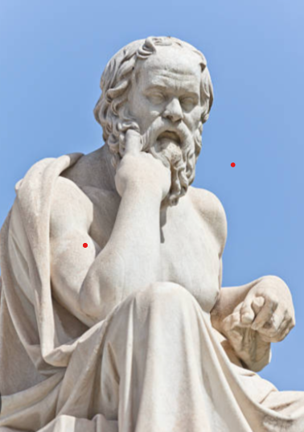
QUIZZ – CENSORSHIP, BOOK BANNING &
BOOK BURNING THROUGH THE AGES
Read the following multiple-choice questions and choose the correct answer :
Question 1 In Ancient Greece, which famous philosopher was put on trial for corrupting the youth and disrespecting the Gods?
A. Pythagoras
B. Socrates
C. Heraclitus
Question 2 What Roman practice involved erasing a person's name from history as a form of censorship?
A. Damnatio Memoriae
B. Cognomen Renunciation
C. Lexicon Obliteration

Slide 7
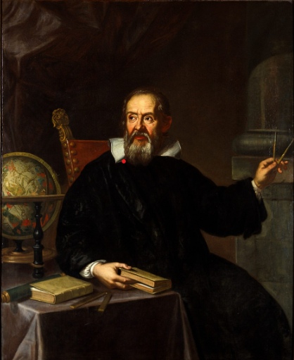
QUIZZ – CENSORSHIP, BOOK BANNING &
BOOK BURNING THROUGH THE AGES
Read the following multiple-choice questions and choose the correct answer :
Question 3 Which Renaissance scientist had his works banned by the Catholic Church for supporting the heliocentric model of the solar system?
A. Galileo Galilei
B. Johannes Kepler
C. Nicolaus Copernicus
Question 4 What was known as the “Index Librorum Prohibitorum”?
A. An index of books kept hidden from sight in the libraries of Oxford university
B. An imaginary index invented by Umberto Eco’s novel in “The Name of the Rose”
C. A list of books Catholics were forbidden to print or read

Slide 8
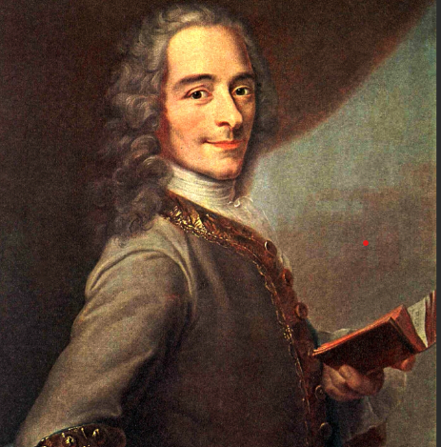
QUIZZ – CENSORSHIP, BOOK BANNING &
BOOK BURNING THROUGH THE AGES
Read the following multiple-choice questions and choose the correct answer :
Question 5 In the 18th century, what French philosopher and writer faced censorship for challenging the authority of the Catholic Church and promoting free speech?
A. Jean-Jacques Rousseau
B. Voltaire
C. Montesquieu
Question 6 In what year did Thomas Bowdler publish "The Family Shakespeare," a censored version of William Shakespeare's works?
A. 1656
B. 1807
C. 1906

Slide 9
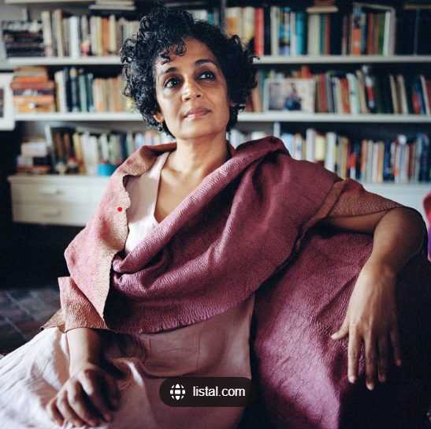
QUIZZ – CENSORSHIP, BOOK BANNING &
BOOK BURNING THROUGH THE AGES
Read the following multiple-choice questions and choose the correct answer :
Question 7 Ray Bradbury's "Fahrenheit 451," published in 1953, explores a future American society where:
A. Books are worshipped
B. Books are outlawed and burned
C. Books are printed on demand
Question 8 Which Indian author faced an obscenity trial in 1997 for her novel "The God of Small Things"?
A. Salman Rushdie
B. Arundhati Roy
C. Vikram Seth

Slide 10

QUIZZ – CENSORSHIP, BOOK BANNING &
BOOK BURNING THROUGH THE AGES
Read the following multiple-choice questions and choose the correct answer :
Question 9 Which Iranian author and artist faced censorship and persecution after the publication of her graphic novel "Persepolis"?
A. Marjane Satrapi
B. Azar Nafisi
C. Shirin Ebadi
Question 10 In 2019 and 2020, a graphic novel by author Maia Kokabe became one of the most banned books in the US because of the topic it tackles. Which topic is that ?
A. Eco-feminism
B. Anorexia
C. Nonbinary identity

Slide 11
LEAD-IN
In pairs or in groups of three students, choose two or three
questions from the list of questions below. Discuss them, provide examples, and compare your ideas and opinions:
In your opinion, should there be any limits on freedom of expression in literature, and if so, what should those limits be?
Do you believe that censorship can protect society, or does it hinder freedom of expression?
Can you think of any famous books that have been banned in history? Why were they banned?
Consider cases where authors wrote under pseudonyms to avoid censorship. What impact does anonymity have on the freedom of expression in literature?
Explore the idea of banned authors as "persona non grata." Can you think of examples where authors faced ostracism due to their work?
In your opinion, what are the reasons for altering a book or rewriting it? Do you consider this to be a form of censorship?
Discuss the concept of self-censorship. Can authors be influenced to alter their work without external pressure?
How do you think advancements in technology, like the internet or AI, have influenced the ability to censor or rewrite literature?

Slide 12
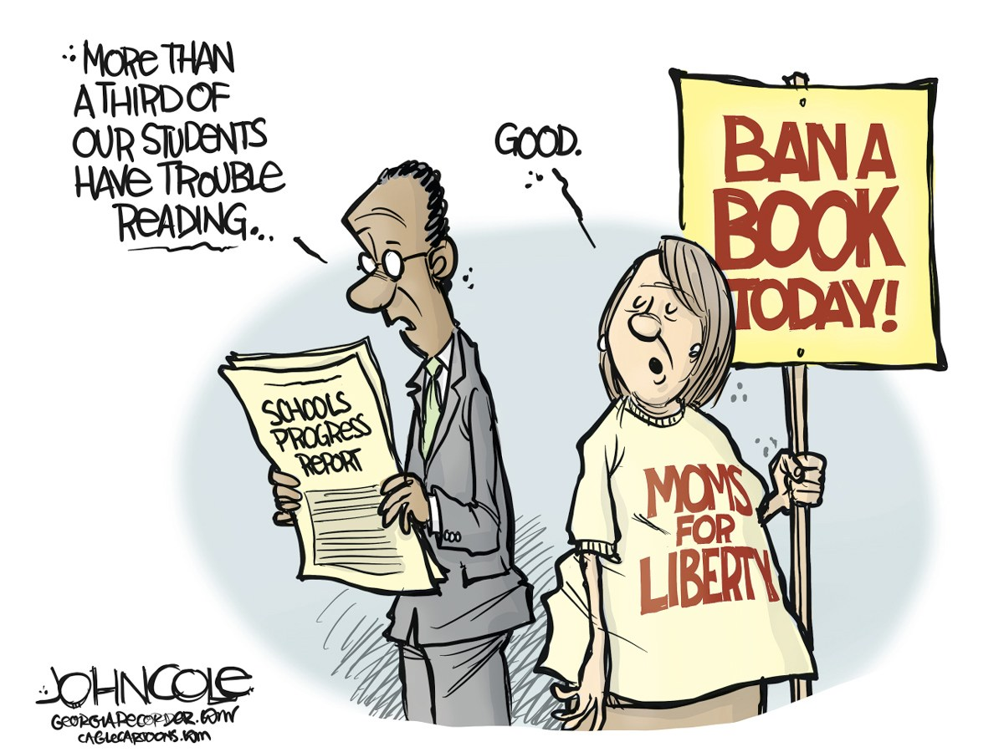
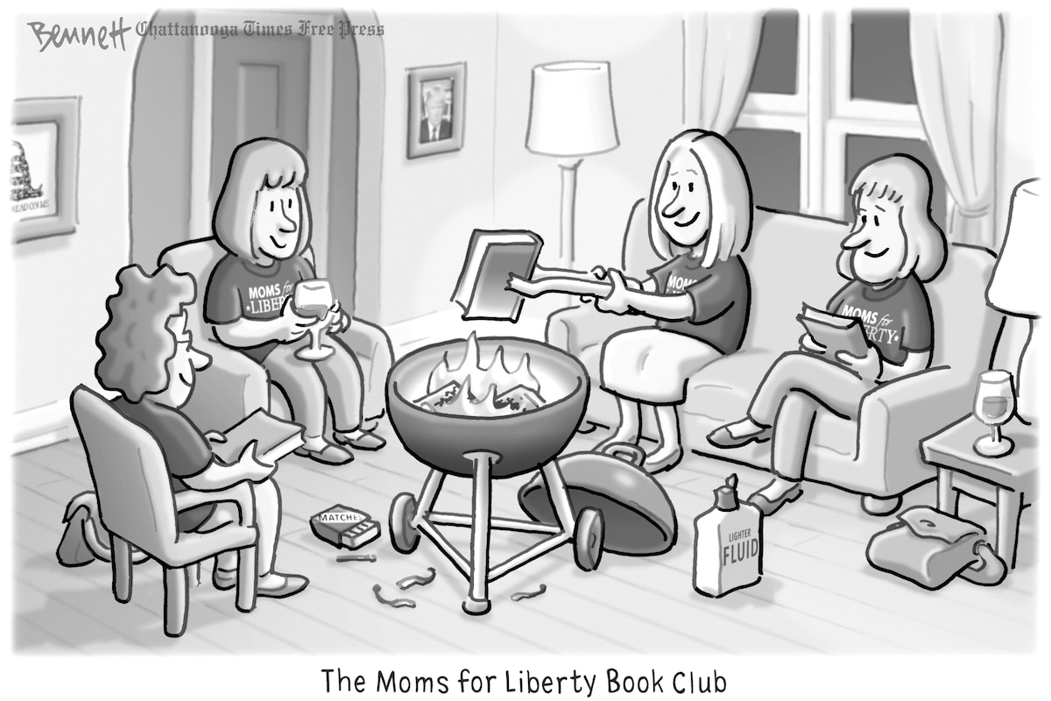
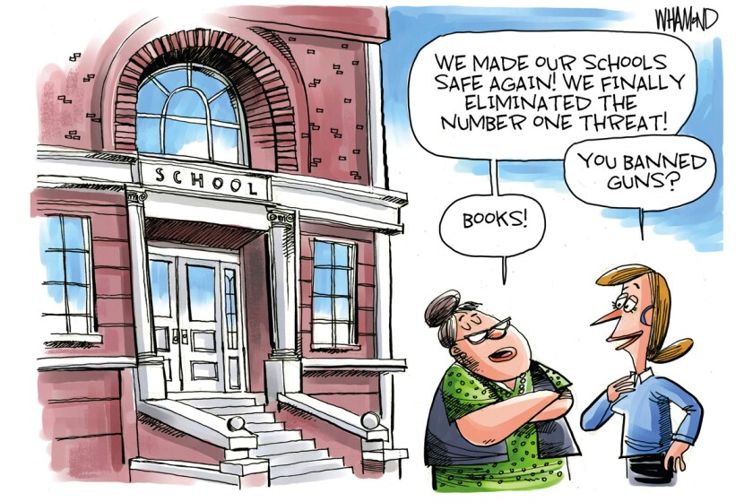
Look at the following cartoons about censorship and book banning. Describe them and explain what they refer to:

