Slide 1
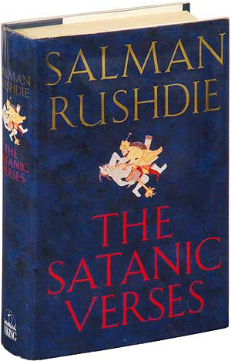
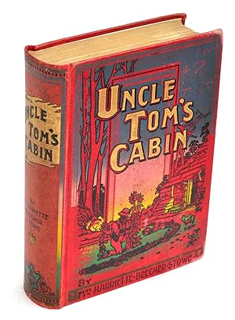
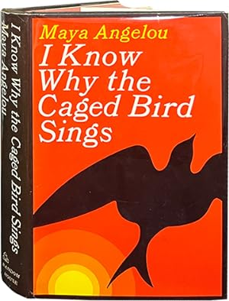
What do the following books
have in common?

Slide 3
DEFINITION
Give your own definition of CENSORSHIP
NOW READ THE FOLLOWING DEFINITIONS
« CENSORSHIP » is the changing or the suppression or prohibition of speech or writing that is deemed subversive of the common good. (definition of Encyclopedia Britannica)
« CENSORSHIP » is the censoring of books, plays, films, or reports, especially by government officials, because they are considered immoral or secret in some way. (definition of Collins dictionary)

Slide 4
LEAD-IN
In pairs or in groups of three students, choose two or three
questions from the list of questions below. Discuss them, provide examples, and compare your ideas and opinions:
In your opinion, should there be any limits on freedom of expression in literature, and if so, what should those limits be?
Do you believe that censorship can protect society, or does it hinder freedom of expression?
Can you think of any famous books that have been banned in history? Why were they banned?
Consider cases where authors wrote under pseudonyms to avoid censorship. What impact does anonymity have on the freedom of expression in literature?
Explore the idea of banned authors as "persona non grata." Can you think of examples where authors faced ostracism due to their work?
In your opinion, what are the reasons for altering a book or rewriting it? Do you consider this to be a form of censorship?
Discuss the concept of self-censorship. Can authors be influenced to alter their work without external pressure?
How do you think advancements in technology, like the internet or AI, have influenced the ability to censor or rewrite literature?

Slide 5
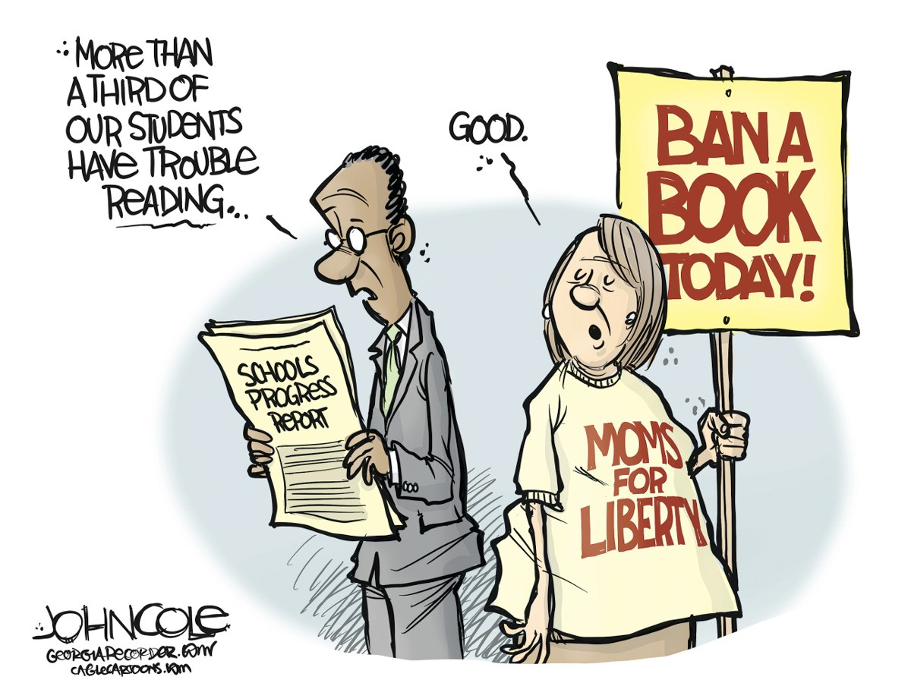
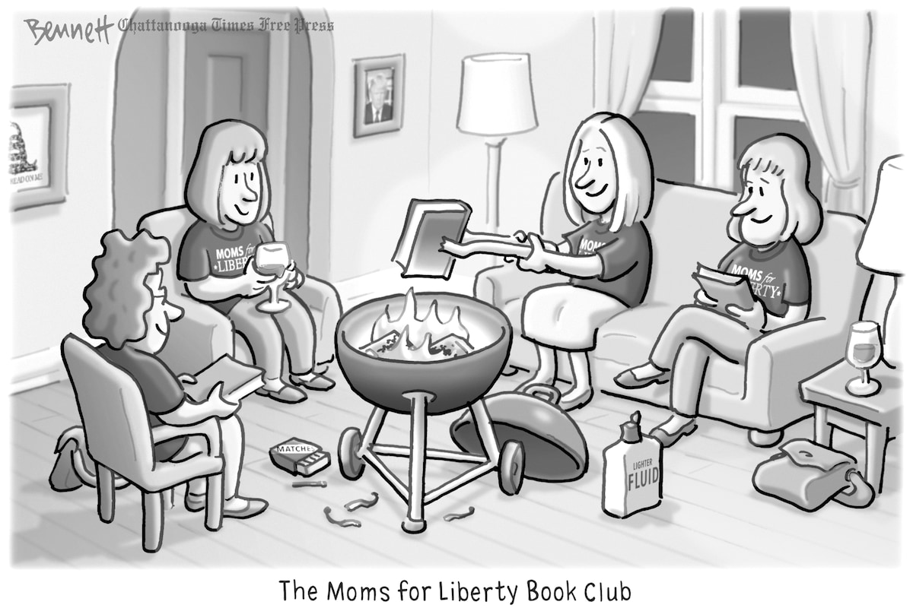
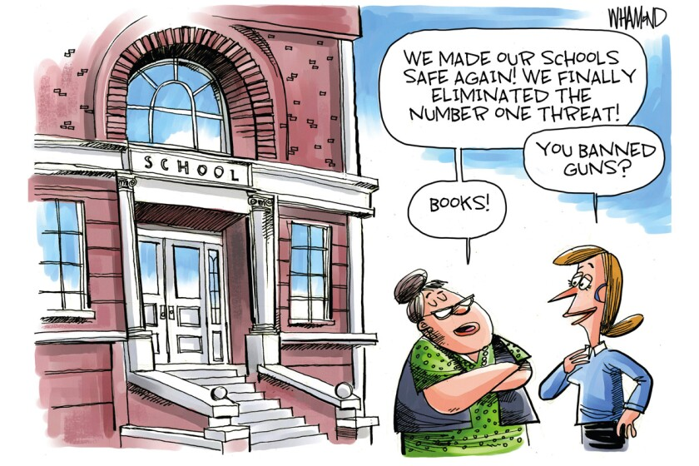
Look at the following cartoons about censorship and book banning. Describe them and explain what they refer to:

