Slide 1
English for Data ScientistsQ+ IMC&DS M2-S3
WELCOME!
AND HAVE A NICE DAY(-TAH)!
COURSE INTRO M2 IMCDS - S1/S3 2024-2025
Université Paris 1 – Panthéon-Sorbonne

Slide 2
Contact info / Email address: Cyril.Selzner@univ-paris1.fr
In English (preferred)
or in French…
NB: I usually reply within 48 hours, in the same language as the original message

Slide 3
Specific Course EPI:
EPI NAME:
Anglais M2 IMC & Data Science 2024-2025 S1 C. Selzner
Basically, all the information you need to know about will be posted there:
Texts and docs we study in class in pdf format + potential homework assignments
Oral presentation details and schedule + Assessment recap
Various documents and teaching materials and links.
Please check access as soon as possible

Slide 4
Timetable for first term/semester (dates)
Week 1: Thursday 10 October 2:30pm-5:30pm
Week 2: Thursday 17 October 1:30pm-4:30pm
Week 3: Thursday 7 November 1:30pm-4:30pm
Week 4: Thursday 14 November 1:30pm-4:30pm
Week 5: Thursday 21 November 1:30pm-4:30pm (incl. Oral Pres.)
Week 6: Thursday 5 December 1:30pm-4:30pm (incl. Oral Pres.)
Final Exam (‘partiel’): Wednesday 15 January (10am-noon)

Slide 5
Marks and Grades
= Assessment
- 40% Oral Presentation (TBE)
- 20% In-class Participation and Homework - 40% Final Exam (TBE)

Slide 6
FINAL EXAM: * two-hour long * scheduled on 15 January [10am-noon]

Slide 7
FINAL EXAM: Four sections: A. Vocabulary (3 pts): define/explain and use in a sentence six words or expressions we’ve seen in class. B. Grammar (3 pts): rewrite sentences containing mistakes C. Comprehension (6 pts): one text (4-5 pages), three questions D. Essay Question on DataQ+ themes (8 pts) – 500 words +/- 10%

Slide 8
More about the FINAL EXAM in due time

Slide 9
What a great oral presentation! I can’t believe they are still students at Paris 1
Me neither, they look sooo professional to me
ORAL PRESENTATION:
what, when and how

Slide 10
Oral presentation requirements:
Groups of three (except for the odd one)
- singles or crowd NOT accepted -
5 minutes (+1 max) each, followed by questions from the audience (teacher included)
Notes allowed but no reading please
Continuous reading will be penalised (as will plagiarism as a matter of course)

Slide 11
Oral presentation format:
WHEN? During the last two S1 sessions on 21 November, and 5 December: (maximum 4 groups per session)
WHAT? any topic/issue/subject matter related to data, data science, data management etc., even remotely (please notify me about your chosen topic by 7 November at the very latest)

Slide 12
Oral presentation format:
HOW? Any format you wish to opt for. Standard, debate, talk show, short fictional piece/roleplay, etc. I am open to any suggestion from you but will have final say in the matter.

Slide 13
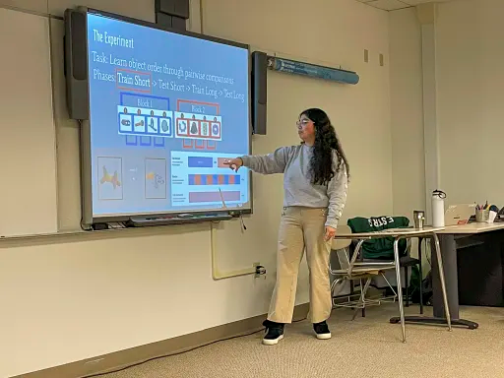
Available:
Plain, Regular, Old-fashioned OP!

Slide 14
Or: Choose a setting / background story
E.G.: ‘’you are setting up your own start-up company and are addressing business angels and presenting your business plan’’
OR: ‘’you are reporting the results of an internal survey you’ve just conducted about your company’s new data-driven strategy’’
ETC.

Slide 15
Or: Talk show (TV, Radio show), American style, with one host and two guests for example

Slide 16
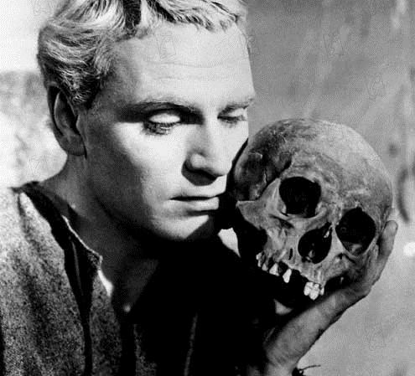
Fiction/Roleplay welcome

Slide 17
REMEMBER

Slide 18
Oral presentation format:
TECHNICAL REQUIREMENT/constraint: No flash drives (pleeeeease), no attachments sent to me: if you want to present a slideshow, please provide your own computer with standard HdMi (not micro Hdmi) or VGA port (or an adapter that works)

Slide 19
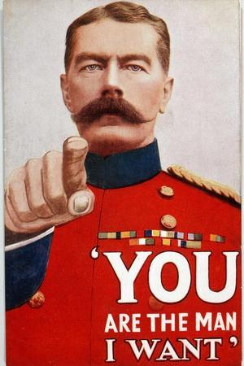
FORMING GROUPS of THREE (Two only if it can’t be helped)

Slide 20
In addition to the OP itself, you will have one more (short and individual) oral assignment during the semester; only two up to three minutes of talking this time. Either: > ‘‘Breaking News’’ OR > ‘‘Sales Pitch’’

Slide 22
Deliver a convincing sales pitch, trying to sell ANYTHING by using the raw power of your speech

Slide 23
Breaking News?

Slide 24
Breaking news / In the news
When? At the beginning of each session
Who? The students scheduled for the day if they are assigned Breaking News over Sales Pitch (about 2-3 minutes each + any volunteers
What? = anything newsmaking that’s happened during the past week or so
Related in any way to the economy or to business in general, not necessarily about data: corporate news, world finance, economic policies and so on
NB: Preferably, but by no means exclusively, news concerning the English-speaking world

Slide 26
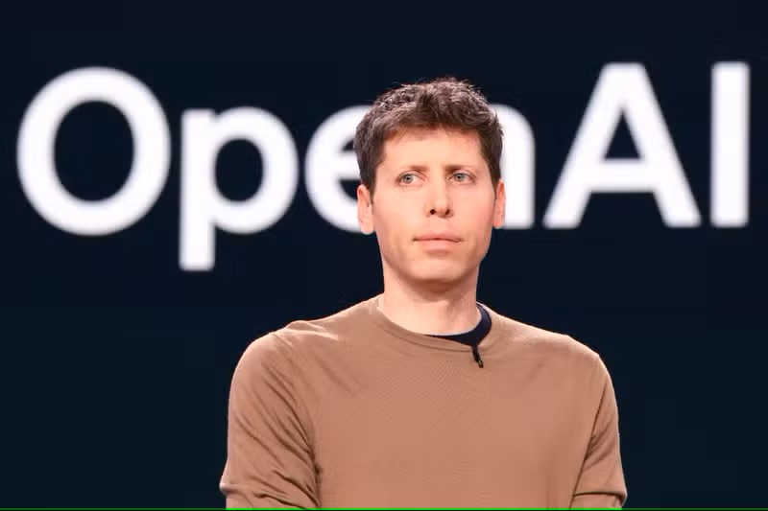

Slide 27
ChatGPT maker OpenAI confirms Paris and Brussels offices as company sets sights on Europe
[Source: Euronews]

Slide 28
ChatGPT maker OpenAI confirms Paris
“OpenAI’s presence in France will "enable the company to better collaborate with French developers, companies, and civic organisations, helping more people, businesses, and society realise the benefits of AI," the company told Euronews Next in a statement.”

Slide 30
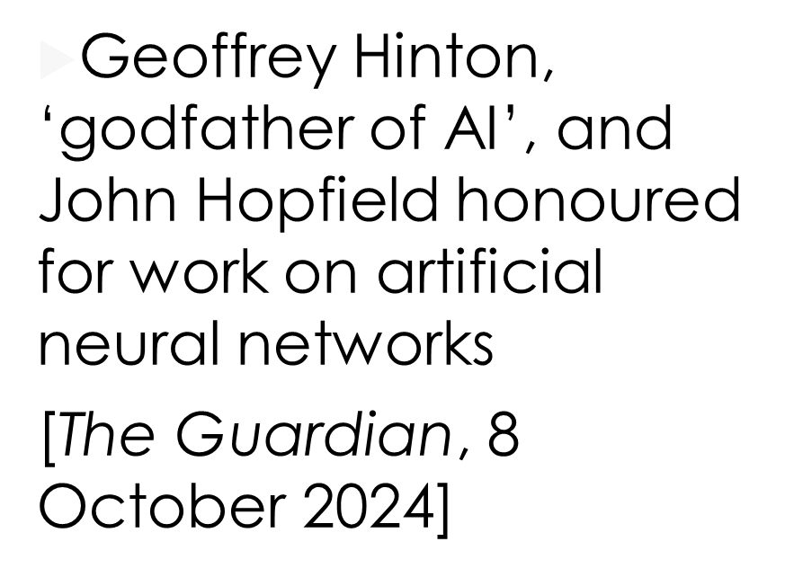
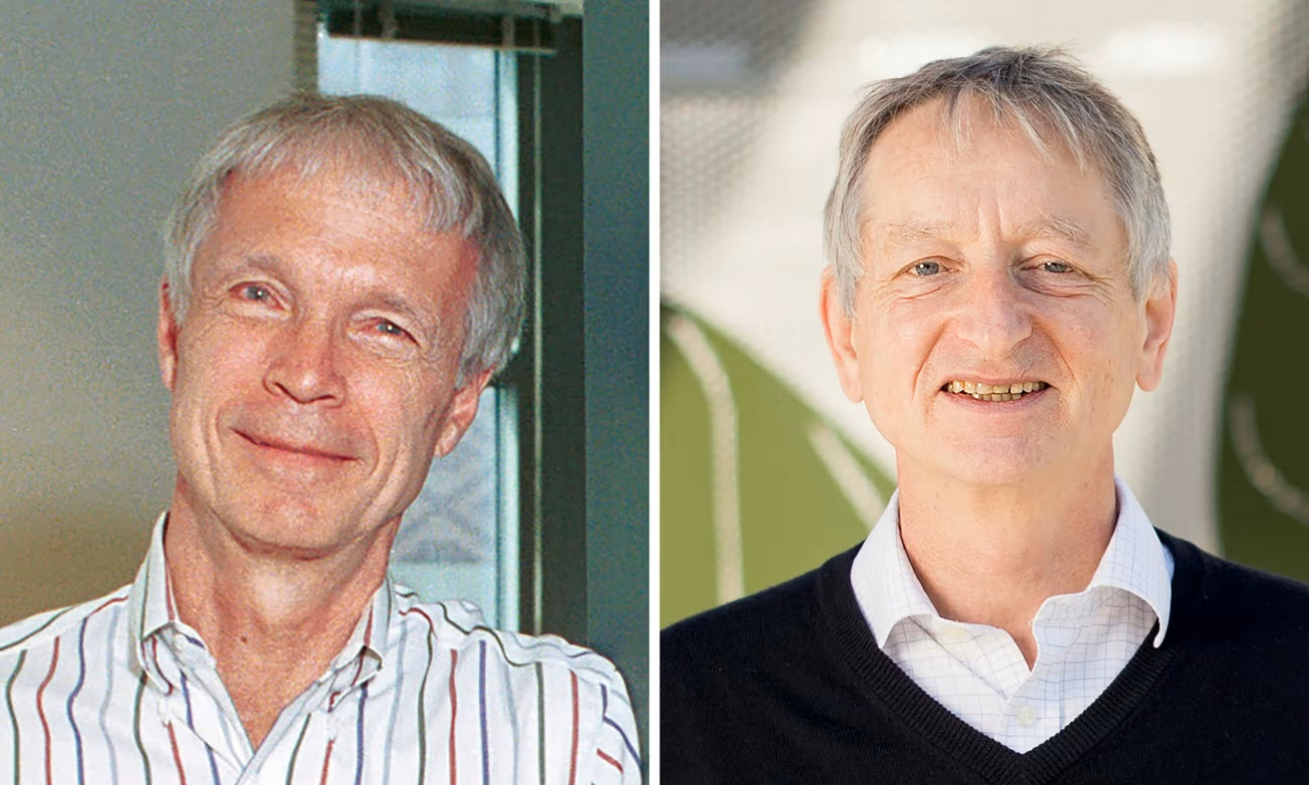
Machine learning pioneers win Nobel prize in physics

Slide 31
Machine learning pioneers win Nobel prize in physics
“Inspired by the workings of the brain, John Hopfield, a US professor emeritus at Princeton University, and Geoffrey Hinton, a British-Canadian professor emeritus at the University of Toronto, built artificial neural networks that store and retrieve memories like the human brain, and learn from information fed into them.
The scientists’ pioneering work began in the 1980s and demonstrated how computer programs that draw on neural networks and statistics could form the basis for an entire field, which paved the way for swift and accurate language translation, facial recognition systems, and the generative AI that underpins chatbots such as ChatGPT, Gemini and Claude.”

Slide 32
Machine learning pioneers win Nobel prize in physics
“Hinton, 76, who is often called “the godfather of AI”, made headlines last year when he quit Google and warned about the dangers of machines outsmarting humans.”

Slide 33
Machine learning pioneers win Nobel prize in physics
“Asked how AI might affect the world, Hinton told reporters: “I think it will have a huge influence. It will be comparable with the Industrial Revolution. But instead of exceeding people in physical strength, it’s going to exceed people in the intellectual ability.””

