Slide 2
Read the following headlines. Complete them with the
correct words (some words can be used more than once):
DIVERSITY / ASIAN / INVISIBLE / OSCARS /
HOLLYWOOD / NETFLIX / STEREOTYPES / STUDY
« Michelle Yeoh Makes History as the First ......................................... Best Actress Winner at the ......................................... », The New York Times, by Nicole Sperling March 12, 2023
« What ......................................... movies do to perpetuate racial ......................................... », DW article, by Kira Schacht 02/21/2019
« Latinos continue to be ......................................... in ......................................... and the media, a new report finds », NPR news by Mandalit del Barco October 6, 2022
« ......................................... has made 'no progress' in on-screen ........................................, report finds », The Guardian, by Sam Levin, Tue 31 Jul 2018
« Nine years after #......................................... SoWhite hashtag and movement, a look at what’s changed », The Conversation, 14 March 2024
« ......................................... Productions Are More Diverse Than Studio Films, ......................................... Shows », The New York Times, by Nicole Sperling Feb. 26, 2021

Slide 3
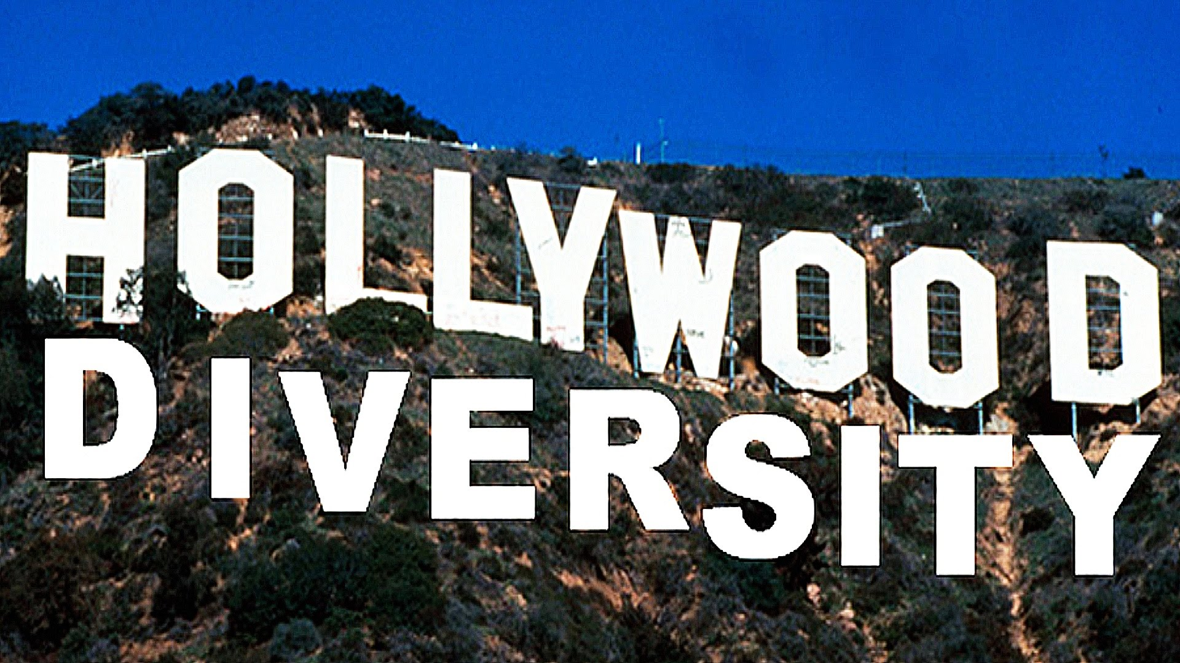

Slide 4
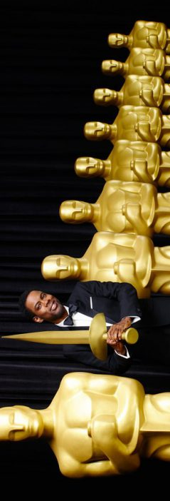
What do you think is the role of cinema in representing different cultures and ethnicities?
Can you think of any films or filmmakers that highlight multiculturalism or ethnic diversity? How are they received by audiences?
Why do you think diversity in front of the camera (actors) is important? What about behind the camera (directors, writers, producers)?
Do you believe that historically movies have helped promote ethnic diversity and inclusion? On the contrary, do you think the movie industry has lagged behind society’s evolution in dealing with multiculturalism?
Over the past few years which efforts have been made to bring about changes in the film industry? Can you give examples of recent films including people of colour in the leading roles? Speak about the Hollywood movie industry as well as the French film industry.
Today, are cable television and streaming platforms such as Netflix better at portraying and embracing ethnic diversity? Give examples.
How do you think the portrayal of Asian characters in Western cinema has changed over the years? What more needs to be done?

Slide 5
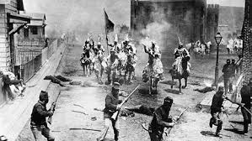
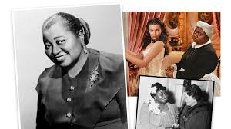
QUIZZ – HOLLYWOOD DIVERSITY
Read the following multiple-choice questions and choose the correct answer :
Question 1 Which controversial film released in 1915 glorified the Ku Klux Klan and influenced racism in the U.S.?
a) Birth of a Nation
b) The Jazz Singer
c) Gone with the Wind
Question 2 In what year did Hattie McDaniel become the first African American to win an Oscar?
a) 1927
b) 1940
c) 1960

Slide 6
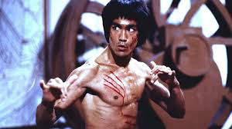
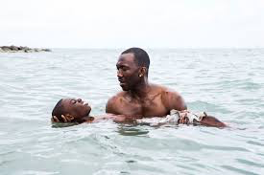
QUIZZ – HOLLYWOOD DIVERSITY
Question 3 What 1973 film starring Bruce Lee marked a shift in the portrayal of Asian men in Hollywood?
a) The Jazz Singer
b) Enter the Dragon
c) Do the Right Thing
Question 4 What film became the first Black LGBTQ+ movie to win the Best Picture award in 2017?
a) Black Panther
b) Do the Right Thing
c) Moonlight

Slide 7
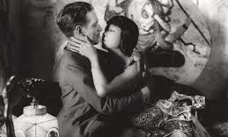
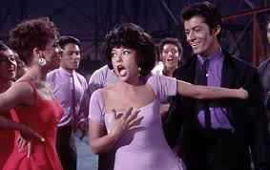
QUIZZ – HOLLYWOOD DIVERSITY
Question 5 What was the name of the code, in effect from 1934 to 1966, that condemned interracial relationships in Hollywood films?
a) The Motion Picture Production Code
b) The McCarthy Commission
c) The Hays Code
Question 6 Which actress, born in Puerto Rico, won an Oscar for her role in the 1962 film “West Side Story”?
a) Rita Moreno
b) Natalie Wood
c) Halle Berry

Slide 8
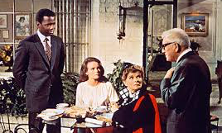
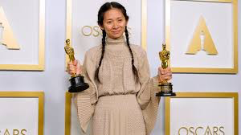
QUIZZ – HOLLYWOOD DIVERSITY
Question 7 Which film featured the first interracial kiss in American cinema in 1967?
a) Guess Who’s Coming for Dinner
b) The Man
c) Do the Right Thing
Question 8 Who became the first woman of color to win the Best Director Oscar in 2021?
a) Chloé Zhao
b) Lucie Lu
c) Ang Lee

Slide 9
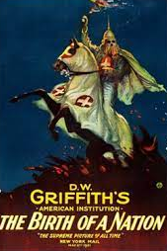
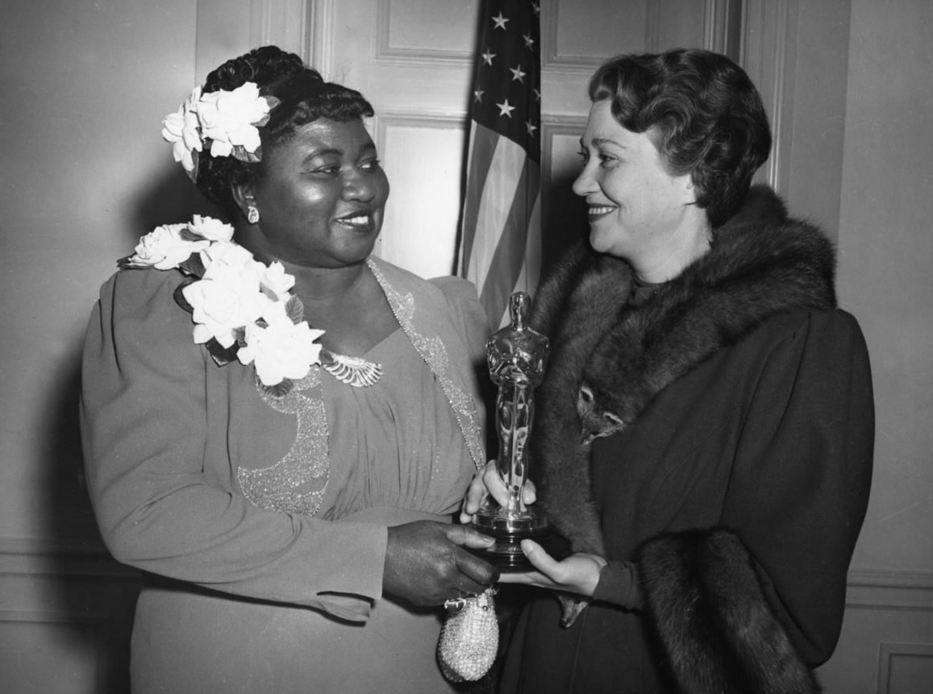
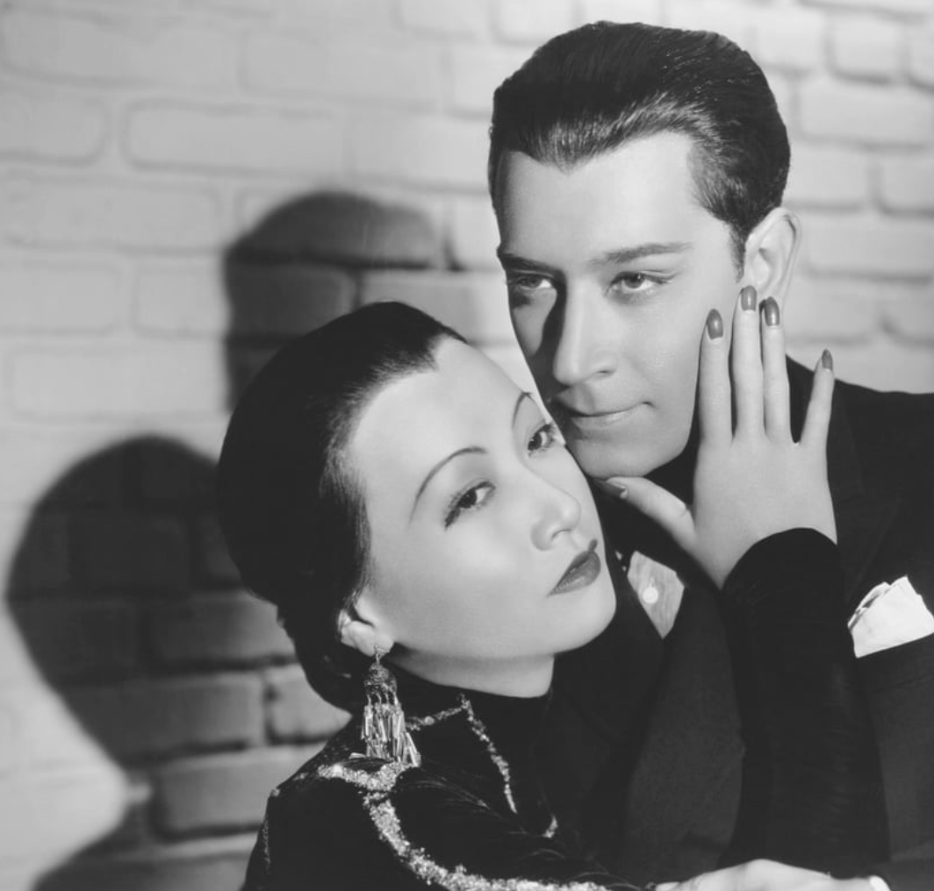
1830’s & 1840’s - before the invention of cinema, “Minstrel shows” gained popularity, with blackface and white actors representing other ethnicities
1912 – the first film with an all-Black cast is shot by female French filmmaker Alice Guy Blaché, “ A Fool and his Money”
1915 – the film « Birth of a Nation » is released. The first major motion picture and super-production, it celebrated the Ku Klux Klan and influenced the growth of racism in the United States
1922 - under the leadership of Alvaro Obrador, Mexico bans Hollywood films that portray Mexicans in a derogatory way
1927 – The « Jazz Singer » , one of the first « talkies » is released with other examples of white actors using blackface
1940 Hattie McDaniel is the first ever African American to win an Oscar for Best Actress in a Supporting Role for « Gone with the Wind »
1934 to 1966 – The Hays Code is adopted and enforced. Among other things, it condemns the interbreeding of people who are considered to be of different races or ethnic backgrounds.

Slide 10
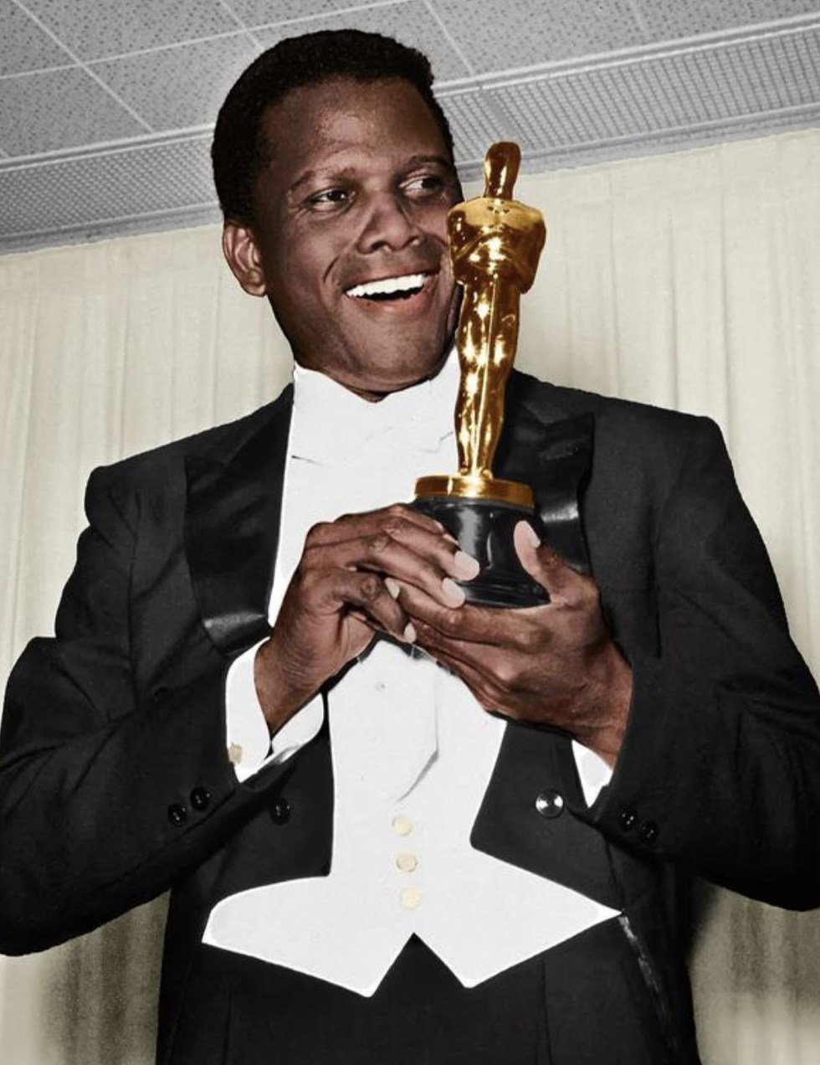
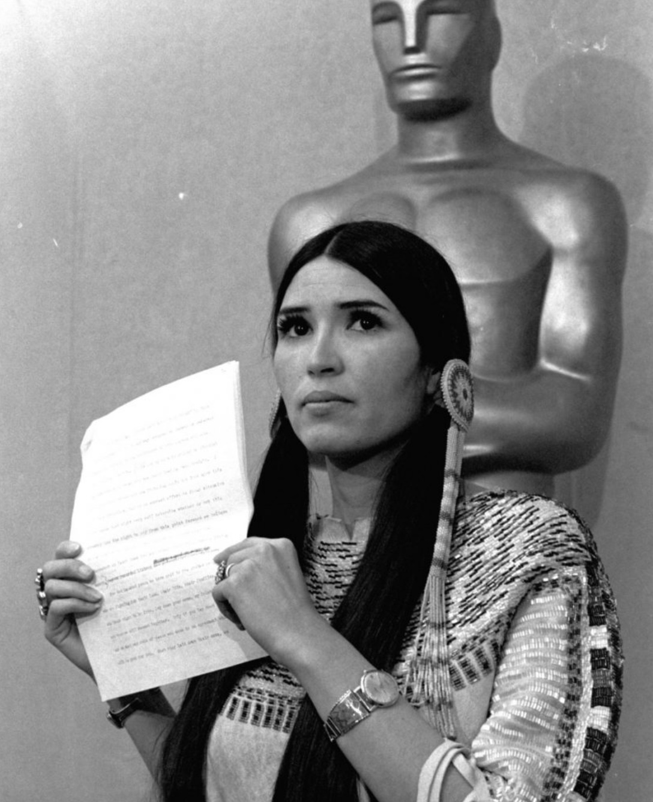
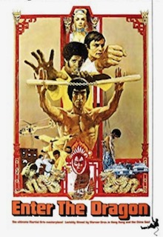
1962 - Puerto Rican actress Rita Moreno becomes the first latina to win an Oscar for best supporting role in “West Side Story” in which non-Latina actress Natalie Wood plays the lead role of Maria
1964 - actor Sidney Poitier is the first Black man to take home the best actor award at the Oscars and the Golden Globes
1967 - The first interracial kiss comes to American cinema with the comedy-drama “Guess Who’s Coming For Dinner”. Interracial marriage was made legal just six months before the movie came out.
1972 - political drama “The Man” stars James Earl Jones as the first Black president.
1973 - Marlon Brando shocked millions by boycotting the Oscar ceremony and sending an Apache woman named Sacheen Littlefeather to reject his best actor statuette
1973 - Bruce Lee’s first Hollywood film, “Enter the Dragon”, is one of the most profitable films of all time, earning 410 times its original budget. It marked a shift in the portrayal of Asian men in the movie industry
1989 – Spike Lee releases “Do the Right Thing” and explores simmering racial tension in a Brooklyn neighbourhood

Slide 11
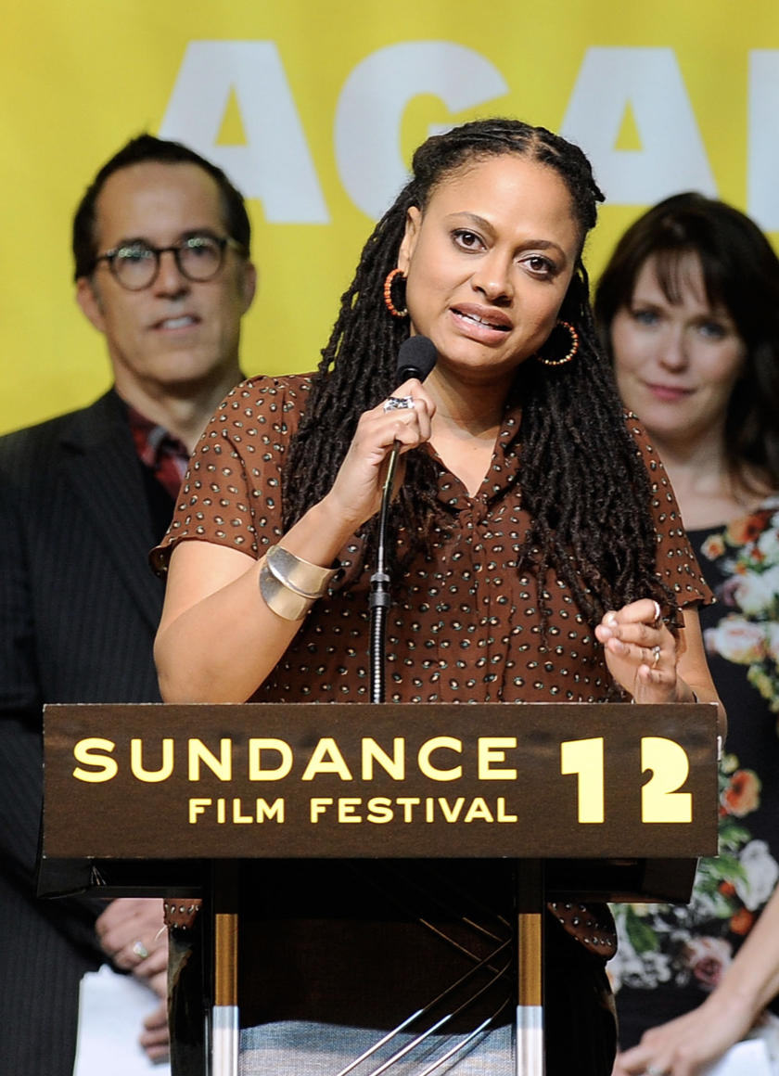
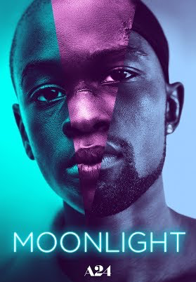
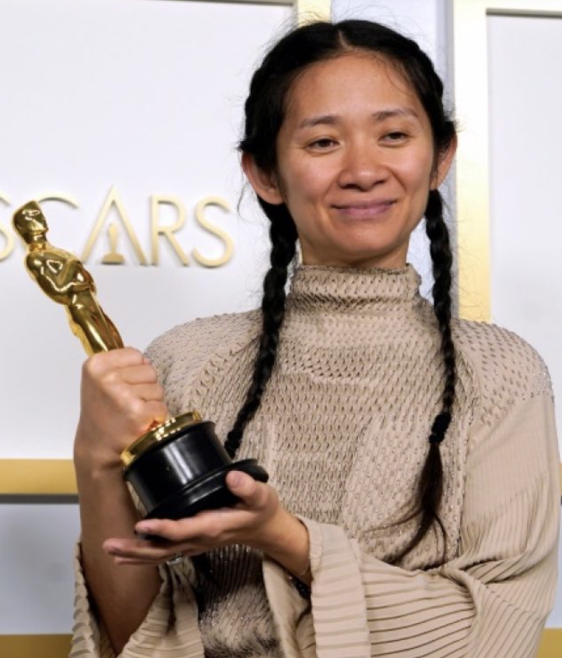
2002 – Ang Lee’s “Crouching Tiger, Hidden Dragon”, a Mandarin-Chinese film is nominated for best picture
2002 - Halle Berry and Denzel Washington win an Oscar
2012 - Ava du Vernay is the first Black woman to win Best Director at Sundance Film Festival
2013 -2014 - Alfonso Cuaron and Alejandro Gonzalez Inarritu win the directing Oscar for “Gravity” and “Birdman”
2015-2016 - The #OscarsSoWhite hashtag and movement begin as a push to make the Academy Awards more inclusive and racially diverse. It sparks a critical reexamination for representation across the media industry, which includes TV, film, broadway, music, and news.
2017 - « Moonlight » is the first Black LGBTQ+ film to win award for Best Picture
2018 - « Black Panther » is the first ever Black Marvel superhero film to be released / Jordan Peele is the first Black screenwriter to win an award
2021 – Chinese filmmaker Chloé Zhao wins the best director award at the 93rd annual Academy Awards for « Nomadland », becoming the first woman of colour to win the Oscar

Slide 12
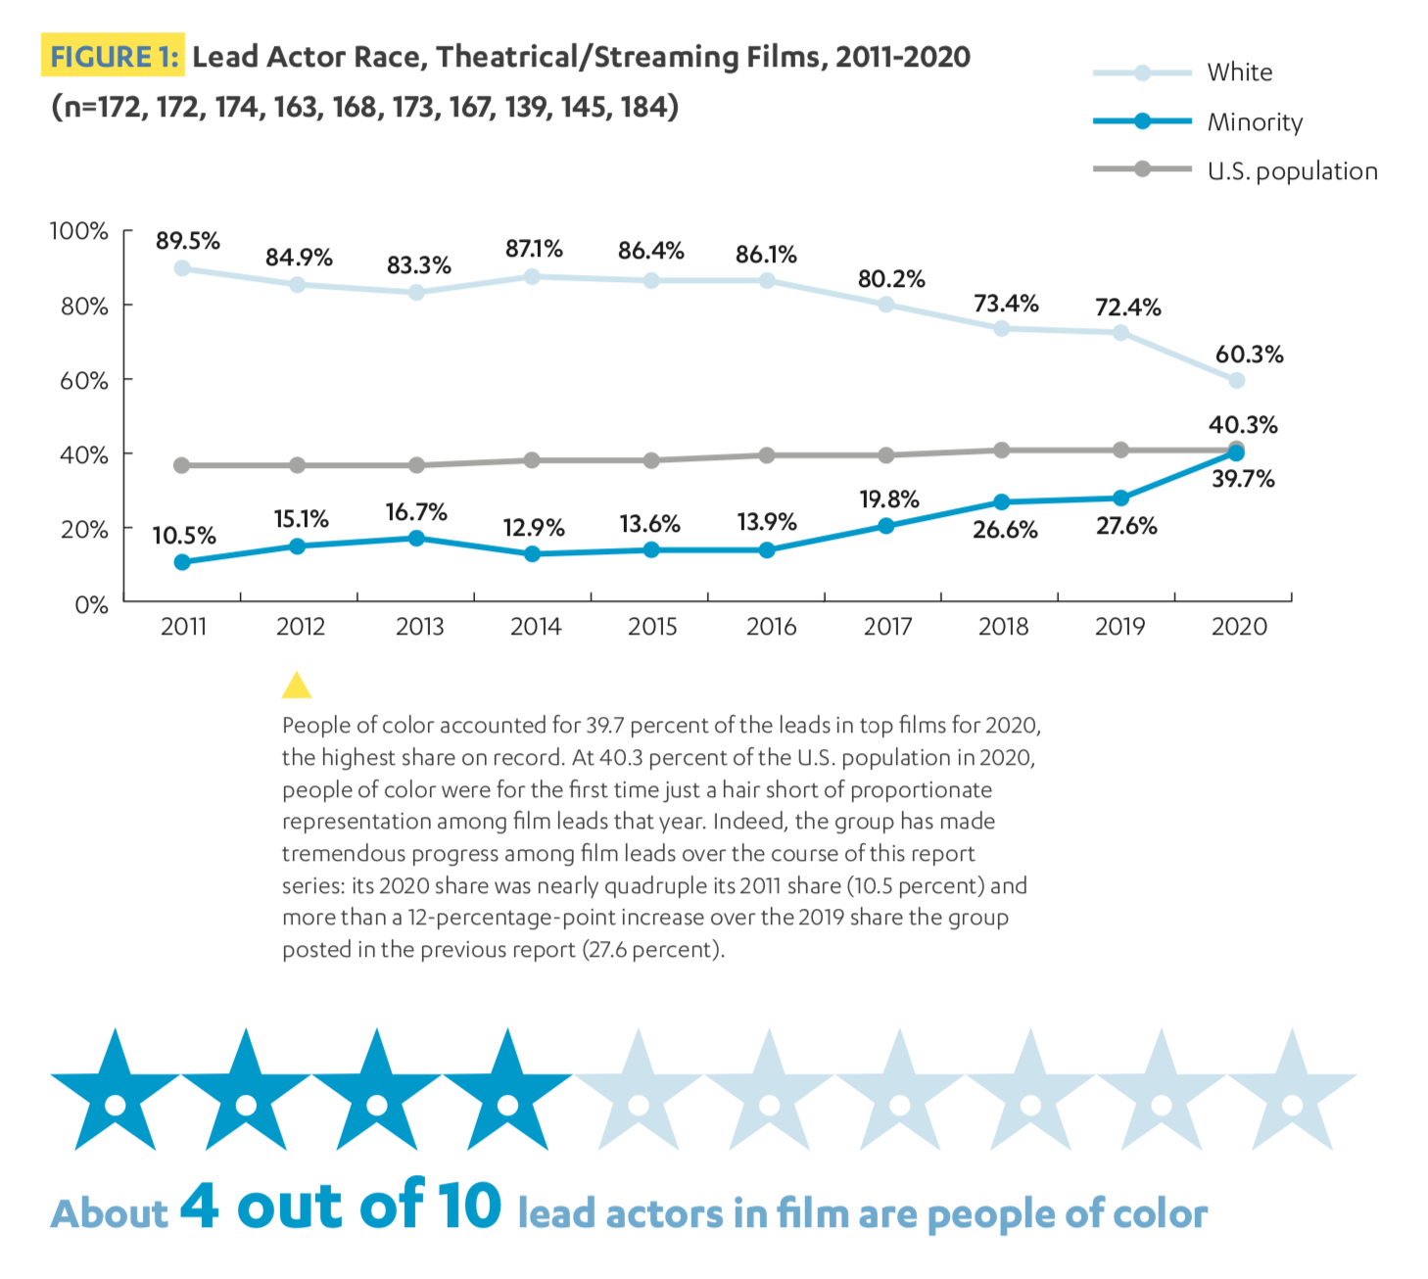
Inclusion report from the
University of California Los Angeles
For full report:
https://socialsciences.ucla.edu/wp-content/uploads/2021/04/UCLA-Hollywood-Diversity-Report-2021-Film-4-22-2021.pdf

