Slide 1
Europe, transnational mobilisations, civil society
2024-25
Valentin Behr
Valentin.Behr@univ-paris1.fr

Slide 2
Introduction
Valentin Behr, CNRS research fellow.
Research topics/interests:
Sociology of intellectuals; history of political ideas (intellectual history): conservatism, illiberalism.
Sociology of (political) elites: trajectories of former APAs at the EP (revolving doors, public/private circulations, lobbying, …).
Focus on right-wing movements (conservative mobilisations) and CEE (Poland).
Introduce yourselves.

Slide 3
Introduction
Europe, Transnational mobilisations, Civil society…
???

Slide 4
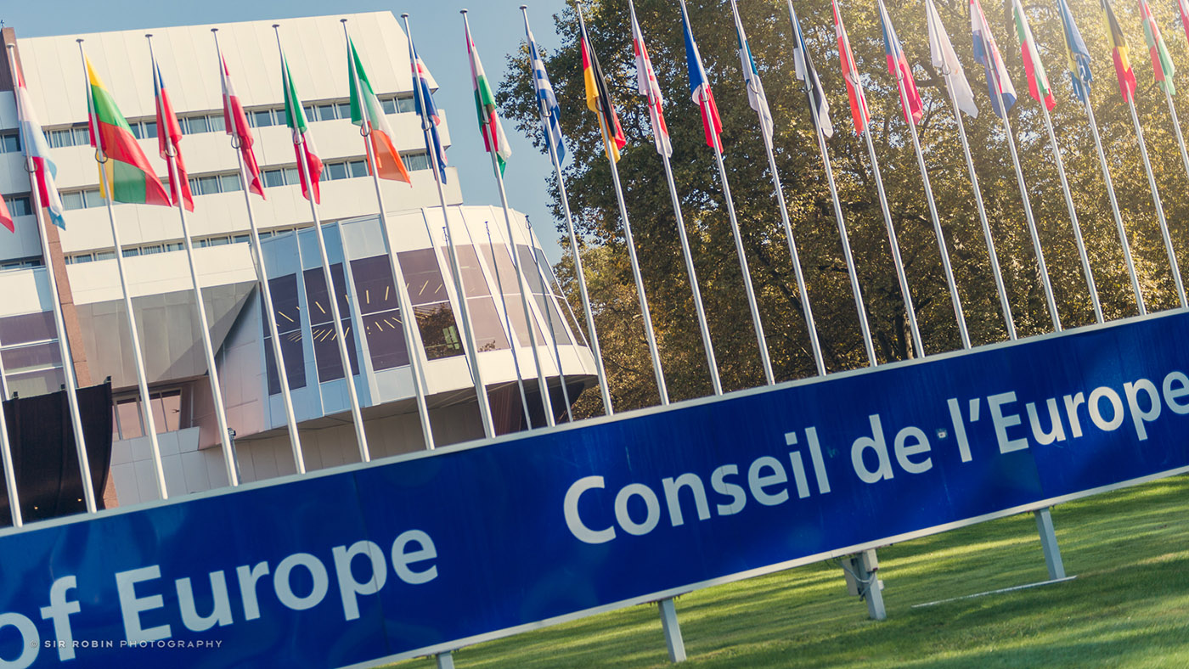
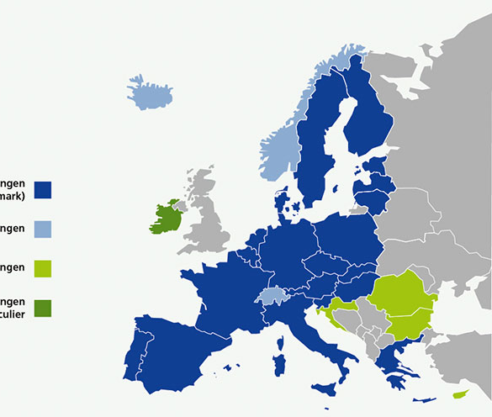
Europe?

Slide 5
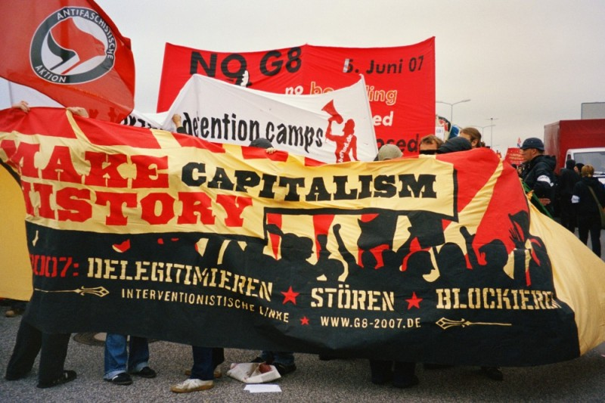
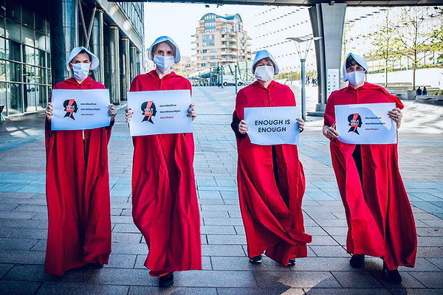
Transnational mobilisations?
Transnational mobilisations?

Slide 6
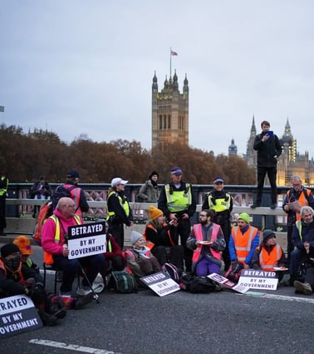
Collective Action vs Political Action.
Conventional vs non-conventional.
Conventional pol. action = elections, pol. parties, pol. debates, pol. participation.
Non-conventional pol. action = protest (contention) cf. petitioning, demonstrations, occupations, blocking, … but also influence (lobbying, advocacy).

Slide 7
Civil society?

Slide 8
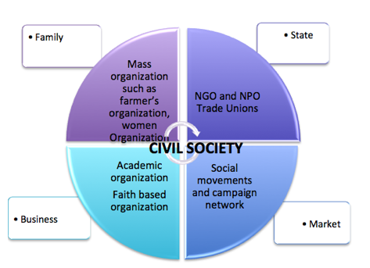
Civil society?

Slide 9
General outline
Lecture 1/ 28 January 2025 – Introduction – historical perspective
Lecture 2/ 11 February 2025 – Chapter 1 – Transnational society, transnational politics
Lecture 3/ 4 March 2025 – Chapter 1 – Transnational society, transnational politics
Lecture 4/ 11 March 2025 – Chapter 2 – Lobbying the EU
Lecture 5/ 18 March 2025 – Chapter 2 – Lobbying the EU
Lecture 6/ 25 March 2025 – Chapter 3 – The Global Right
Lecture 7/ 1 April 2025 – Chapter 3 – The Global Right
Lecture 8/ 8 April 2025 – Chapter 4 – Transnational activism

Slide 10
Date | Reading | Presentation
28 January 2025
11 February 2025 | Tilly & Tarrow, Contentious Politics, OUP, 2015 (introduction). | The “Battle of Seattle” (1999)
4 March 2025 | De Swaan: “The European void. The democratic deficit as a cultural deficiency”, in The European Union and the Public Sphere, 2007. | The BDS movement
11 March 2025 | Lahusen, European Lobbying. An Occupational Field between Professionalism and Activism, Routledge, 2023 (introduction). | Protests against the “Bolkestein directive”
18 March 2025 | Slobodian & Plehwe, “Neoliberals Against Europe”, in Mutant Neoliberalism: Market Rule and Political Rupture, 2020. | The Mont-Pèlerin Society
25 March 2025 | Tilly & Tarrow, Contentious Politics, OUP, 2015 (chapter 7, Social Movements). Screening of the movie Solidarność. How Solidarity Changed Europe (Ania Szczepańska) | The Congress for Cultural Freedom
1 April 2025 | Paternotte & Kuhar, “Disentangling and Locating the ‘Global Right’: Anti-Gender Campaigns in Europe”, Politics and Governance, 2018. | The World Congress of Families
8 April 2025 | Oleart, “The political construction of the ‘citizen turn’ in the EU: disintermediation and depoliticisation in the Conference on the Future of Europe”, Journal of Contemporary European Studies, 2023. | The First International (International Workingmen’s Association)
Lectures, reading list and presentations

Slide 11
Student assessment
For each lecture, a group of students will be asked to prepare a presentation on a given topic. The aim is to propose a focus on an organisation, a social movement or an event that is characteristic of a transnational mobilisation. Your presentation should last about 20 minutes and include the following elements:
A short (about 5 minutes) factual introduction to the topic of your presentation: something rather factual: what, who, when, where?
- A presentation (approximately 10 minutes) of a set of (5 to 8) source documents related to the topic of your presentation: this ensemble of documents should include both academic references (at least 2) and sources such as print or online media sources, including video and/or iconography. You will have the opportunity to enrich your set of documents after your in-class presentation (which will be assessed separately from the presentation).
A short conclusion in which you emphasise the relevance of your topic to the study of contentious politics at the transnational level, make links to the concepts and texts covered throughout the semester, and ask 2-3 more general questions that your topic raises for the audience. These questions might, for example, ask for comparisons between the topic of your presentation and other examples of contentious politics that you are aware of, or for the relevance of your topic to contemporary politics.

Slide 12
Student assessment
This work will result in two marks which will make up your grade for the semester:
One mark for your in-class presentation.
A further mark will be awarded for the relevance of your ensemble of documents, which will be uploaded to the EPI together with an introductory text (about 2 pages) summarising the main points of your in-class presentation. Make sure that you have taken into account the class discussion and the teacher’s feedback before sending me (valentin.behr@univ-paris1.fr) your set of documents (by the end of the semester).
WARNING: Students are also required to read the text proposed for each lecture and to participate in the discussion of the text.
WARNING: Participation (in general discussions) + attendance are also part of the evaluation.

Slide 13
General introduction: a historical perspective

Slide 14
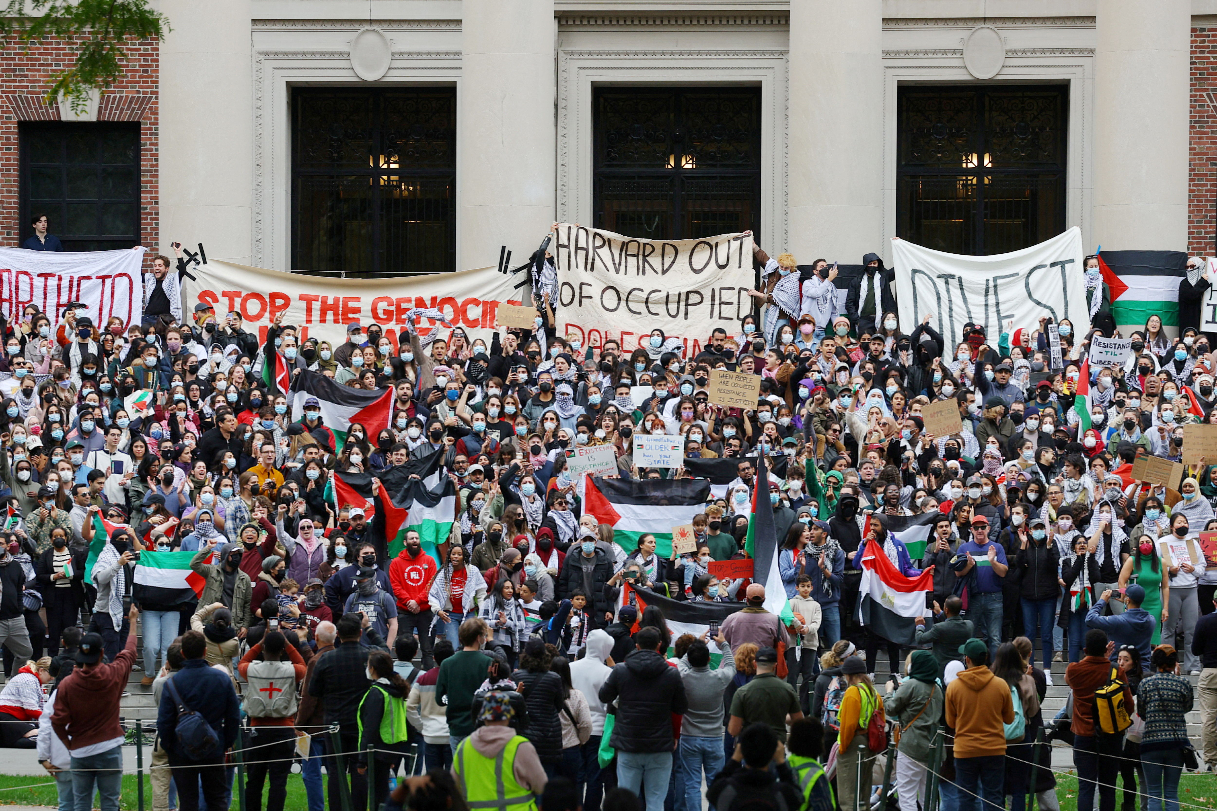
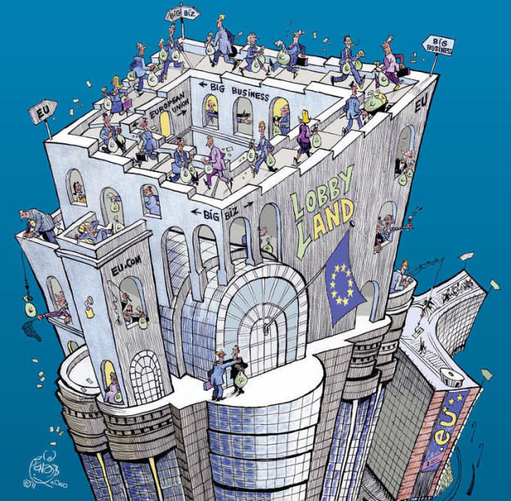
Conventional vs non-conventional.
Conventional pol. action = elections, pol. parties, pol. debates, pol. participation.
Non-conventional pol. action = protest (contention) cf. petitioning, demonstrations, occupations, blocking, … but also influence (lobbying, advocacy).

Slide 15
I: From one revolution to another (1789-1848)

Slide 16
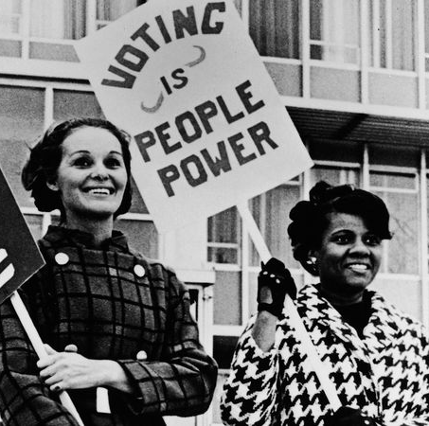
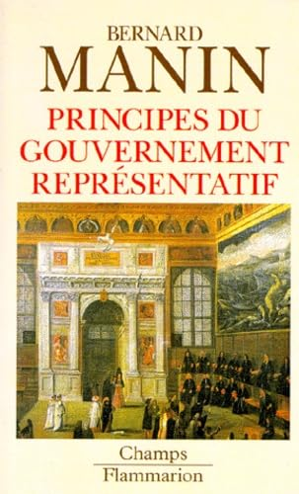
Deconstruct democratic myths.
The link between voting (representation) and democracy is a construction; it was not given or natural.
Representative democracy has been constructed through a process of division of labour: between professionals in politics (the representatives) and the citizens (the electors, the voters).
Today, democracy and universal suffrage seem to be connected.
Nonetheless, this has not always been the case.
Insights from Jacques Rancière:
https://www.youtube.com/watch?v=84760JnuNlI
https://www.youtube.com/watch?v=vEyq-E_IuZU

Slide 17
Other principles of legitimation have existed long before the election or universal suffrage:
Lottery (Athens).
Divine right: French Absolutism, monarchies, “Ancien-Régime”.
Acclamation (acclaim, applause): this is how the French Republic was proclaimed, from the Paris city Hall’s balcony in 1848, during the popular riots.
In France, the principle of universal suffrage is proclaimed in 1848, half a century after the Revolution.
A that time, it is a male suffrage, but also almost exclusively a “white” suffrage.
One could even argue that the vote it still not “universal”: conditions of age, citizenship, …

Slide 18
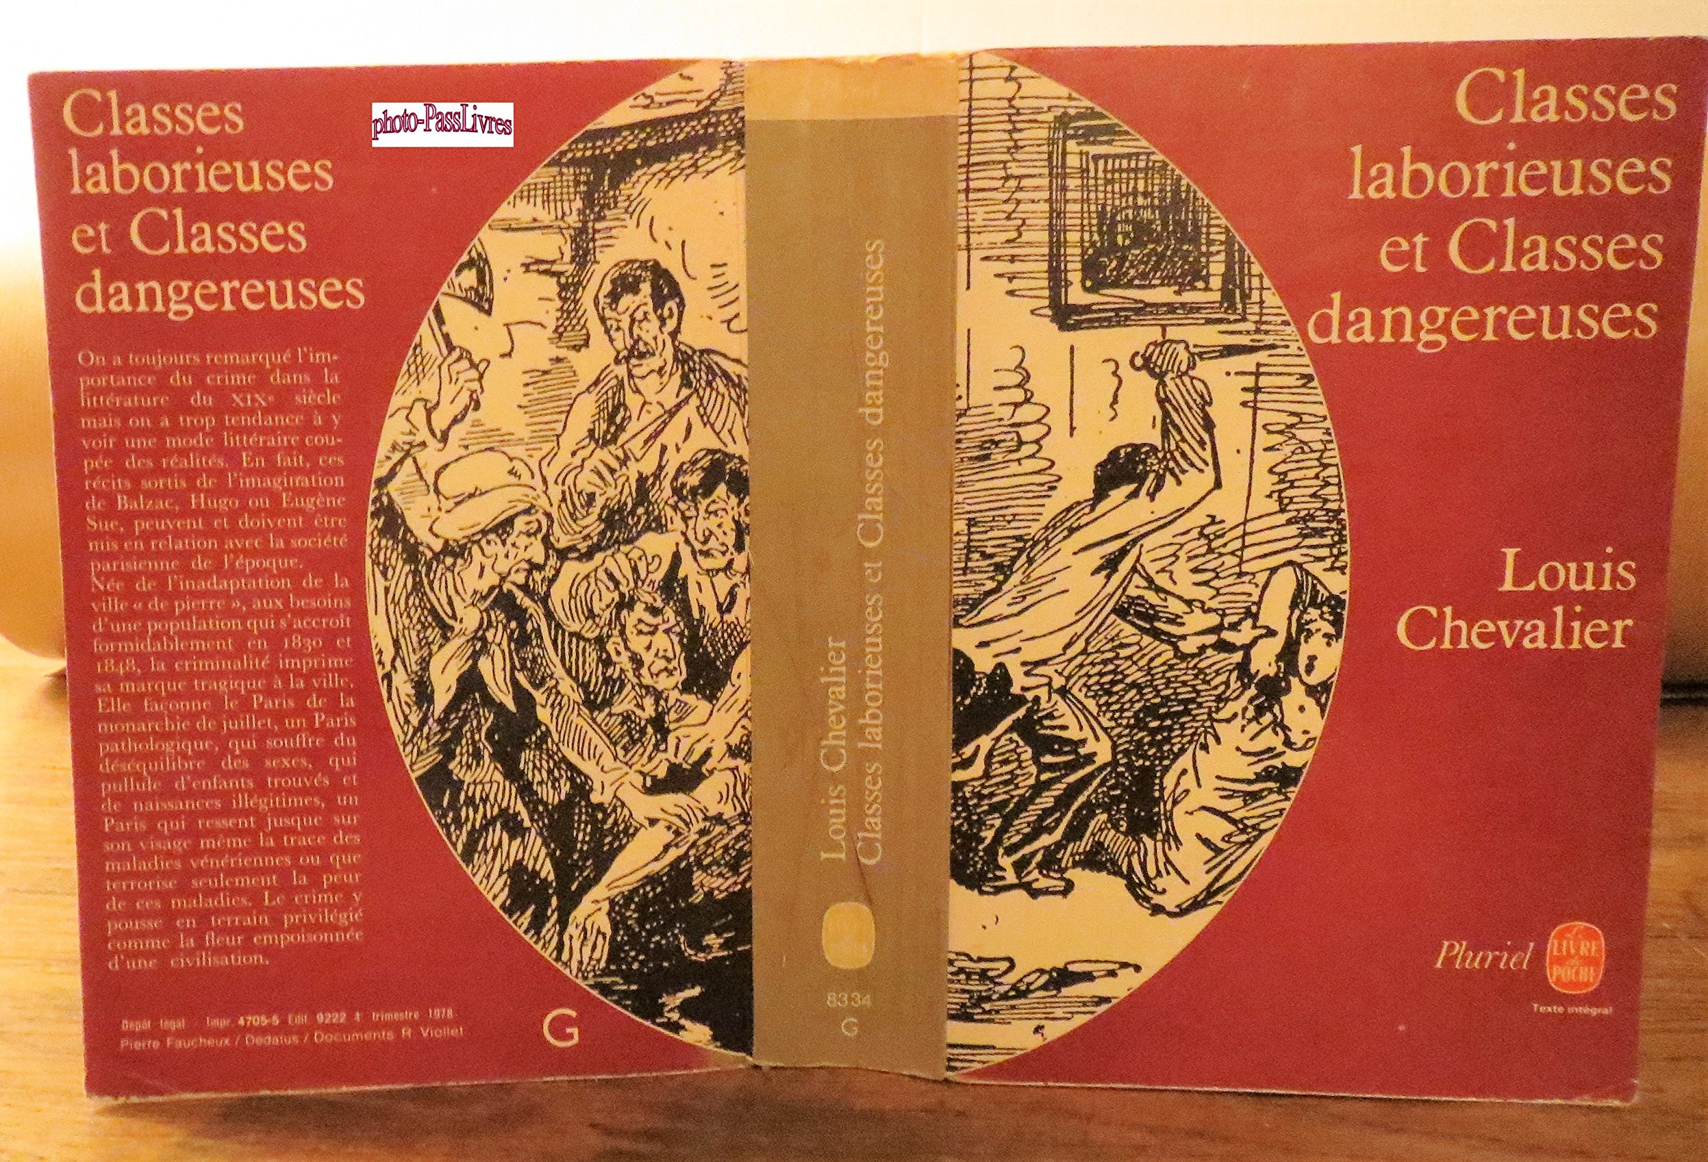
If we take a look at the texts that were published from 1789 to the end of the 19th century, and to the first laws framing universal suffrage, the anxiety of the elite vis à vis the people transpires.
Fear of the masses, perceived as angry, irrational and dangerous.
Cf. the phrase “les classes dangereuses”.
Social Darwinism = quite common to think of society in biological terms at that time.

Slide 19
The concept of citizenship is historically linked with the development of democracy.
18th century: American and French revolutions.
Thomas Humphrey Marshall (Citizenship and Social Class, 1950) distinguishes three main steps in the establishment of the modern citizenship:
The affirmation of civil rights in the 18th century: democratic revolution (Declaration of Independence in the US in 1776; Declaration of Human and Civic Rights in France in 1789): freedom of speech, of religion, property rights, equality of citizens in rights.
Political rights in the 19th century: development of representative democracy, right to vote and to be elected.
Social rights in the 20th century: development of the Welfare State: right to education, healthcare, work, housing.
This three-steps model fits well to the US and British cases, but less to Germany (where social rights were adopted prior to political rights, cf. Bismarck) and to France (where civil and political rights appear jointly, even if political rights become effective only after 1848).

Slide 20
Structural factors favouring the nationalization and democratization of Western societies:
The nationalization of the agricultural and industrial markets;
The increase of administration to administer those markets;
The development of the liberal doctrine (individualism);
The development of industry and the need of workforce;
The development of industrial (capitalist) bourgeoisie;
The gradual homogenization of culture among the different peoples living on the national territory (creation of a national language).
As a consequence, the new social groups (industrial bourgeoisie) who benefit from those profound social changes are looking for new ways to organize and to distribute the political power.

Slide 21
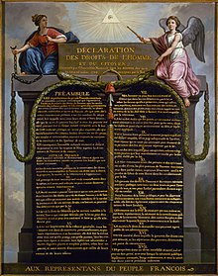
On which criteria should citizenship be based?
French Revolution: citizen-owner vs citizen-individual.
The dominant conception of the people is that most of them are uneducated, untalented with Reason.
Women and colonized people are even not considered.
The Constituent Assembly adopts a solution in 1791, according to a proposal from Abbé Sieyès. At the heart of this resolution is the distinction between “active” citizens and “passive” citizens.
- Passive citizens = members of the nation, enjoy civil rights (Declaration of Human and Civil Rights).
Active citizens enjoy the right to vote.

Slide 22
The main argument in favour of such a distinction derives from the idea of Reason: only individuals who have their self-will, who are considered as autonomous, are supposed to be able to have their own opinions, and so have the right to vote.
Three different criteria are used to define self-will and the autonomy of judgement:
Intellectual independence: a voter should be a grown man gifted with Reason. Childs are considered to be under the influence of their parents. Women are considered as being dependent on their husband’s or father’s will.
Sociological independence: a voter should be an autonomous individual and no the member of an order. This is why monks are not given the right to vote.
Cf. Loi Le Chapelier (1791): ban on religious congregations and trade unions (until 1884).
Economic independence: a voter should earn his living by exercising an independent profession. Exclusion of servants. Women are also considered as being dependent from their husbands.

Slide 23
Census suffrage.
Hence, the concrete exercise of the political power is reserved to the dominant parts of the society, but on a basis of principals that have been completely redefined in line with the Revolution.
The new political regime and principles established after 1789, even though they rest on social grounds which are far larger than those of the Ancien-Régime, are still based on the political exclusion of major parts of the whole population.
1848, universal suffrage: what consequences?

Slide 24
II: Universal suffrage as domestication of citizens

Slide 25
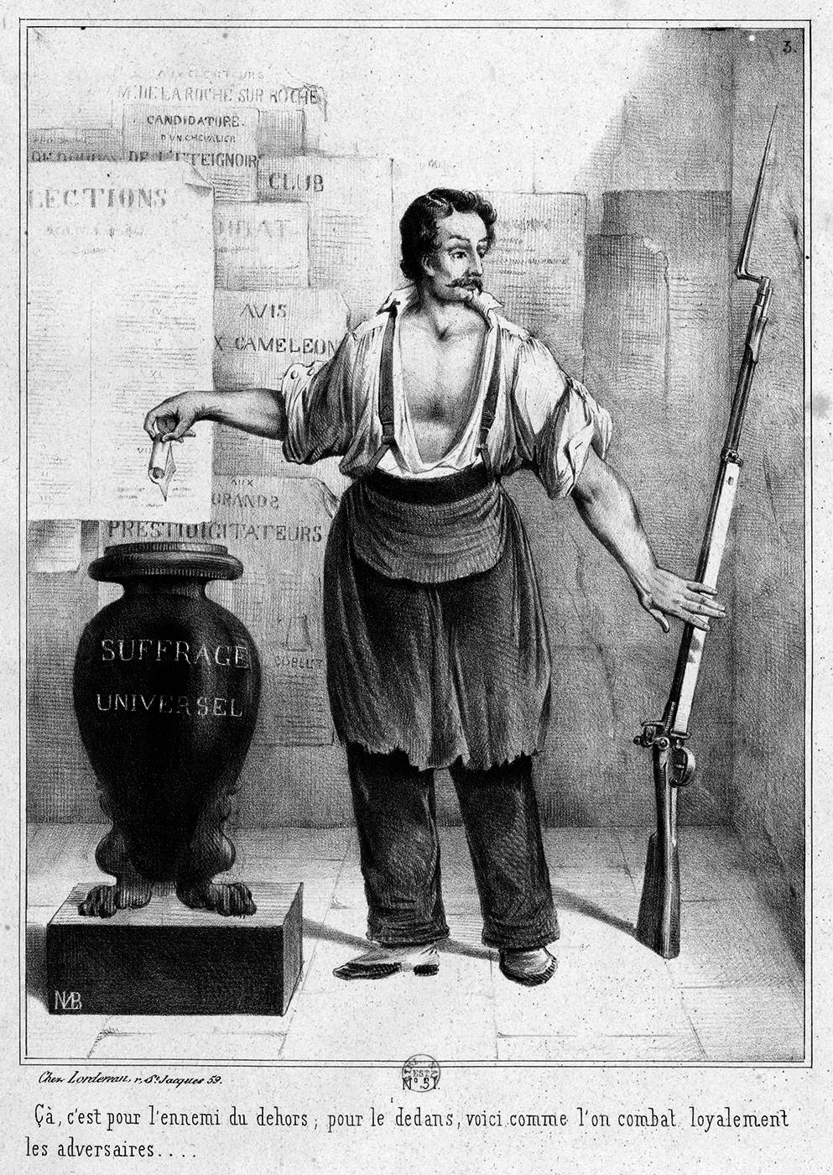
“L’urne et le fusil”,
Marie Louis Bosredon, 1848

Slide 26
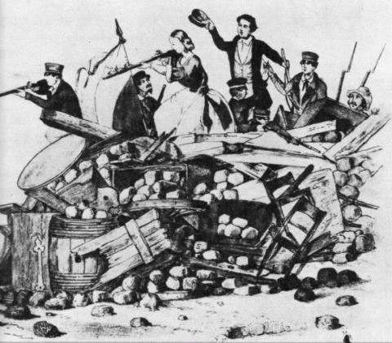
Universal suffrage = new mode of regulation of the political competition.
Implies the banishment of other means/modes such as violence.
Tocqueville: the universal suffrage opposes “the idea of law to that of violence”.
Victor Hugo, speech in front of the National Assembly on 31 May 1850: universal suffrage gives a ballot to those who suffer, instead of a rifle; this means the end of violence, the end of uprisings.
Universal suffrage = to pacify the competition between different political camps.
However, … contestation of results, pressures, frauds and cheats, but also violence and barricades, not to mention coups, were pretty common means to be used in the political competition throughout the 19th century.

Slide 27
We know quite well that the 1848 ballot was far from being calm and peaceful.
Scholars (Garrigou, Ihl, …) have worked on police and judiciary archives, but also on the local press.
Far from being a means to pacify the political competition, the universal suffrage did not encourage the search for compromise.
Invites to consider the necessary conditions for democratic competition: rule of law, freedom of speech, free media, intermediary organisations (political parties, civil society org°), etc.
At that time the results of a ballot are not easily accepted by the losers; and sometimes the winners consider it gives them the right to humiliate the losers. Hence, the ballot is just one step in a broader political struggle, a struggle that can sometimes use violent means.

Slide 28
Example taken from Ihl, Olivier. « L'Urne et le fusil. Sur les violences électorales lors du scrutin du 23 avril 1848 », Revue française de science politique, vol. 60, no. 1, 2010, pp. 9-35.
“In southern France, in a village near the city of Nîmes, the supporters of the monarchist candidates organized a demonstration of joy after their victory.
Thousands of people were partying in the streets, including women and children.
They marched to a café which was known as a republican headquarter.
This was perceived as a provocation and republican supporters shot at them and threw stones at them.
In the end, two people were killed and fifteen injured.
The village had to remain under military control for a couple of days.
Some witnesses spoke of a ‘civil war’ going on.”

Slide 29
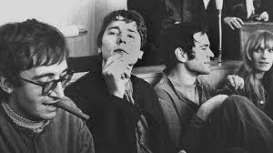
There is no linear history of democratization, however.
Cf. “cycles of contention” (Tilly and Tarrow), like in the 1960s/1970s.

Slide 30
III: The professionalization of politics

Slide 31
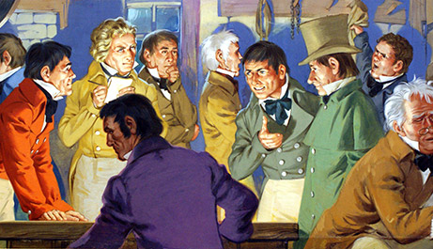
Invention of the universal suffrage also means new ways of doing politics.
Professionalization of politics throughout the 19th century.
Invention of modern politics.
Pattern: representative democracy => professionalization of politics in each parliamentary democracy in Europe.
End of Notables = amateurs in politics.
Cf. Weber: those who, thanks to their economic situation, can do politics as a hobby, without any salary.
Next to the notables, the 19th century sees the emergence of new political entrepreneurs.
Cf. “new strata” (“nouvelles couches”), according to Gambetta: republican bourgeois elite (lawyers, doctors, teachers).
+ Workers’ movements (socialists).
See Heinrich Best & Maurizio Cotta (eds), Parliamentary Representatives in Europe 1848-2000. Legislative Recruitment, and Careers in Eleven European Countries, Oxford University Press, 2000.

Slide 32
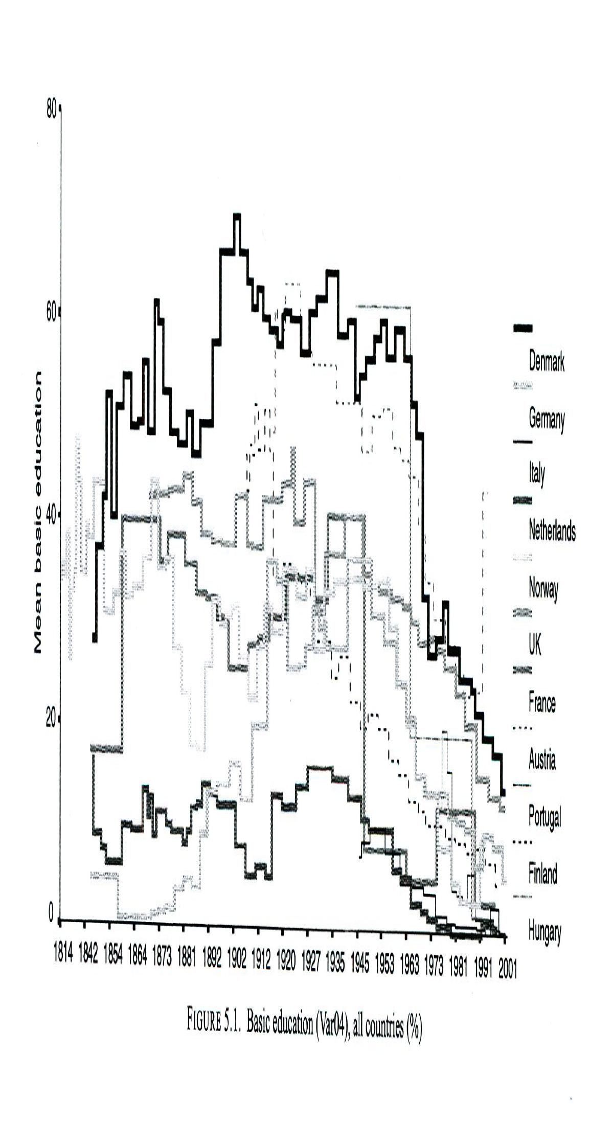

Slide 33
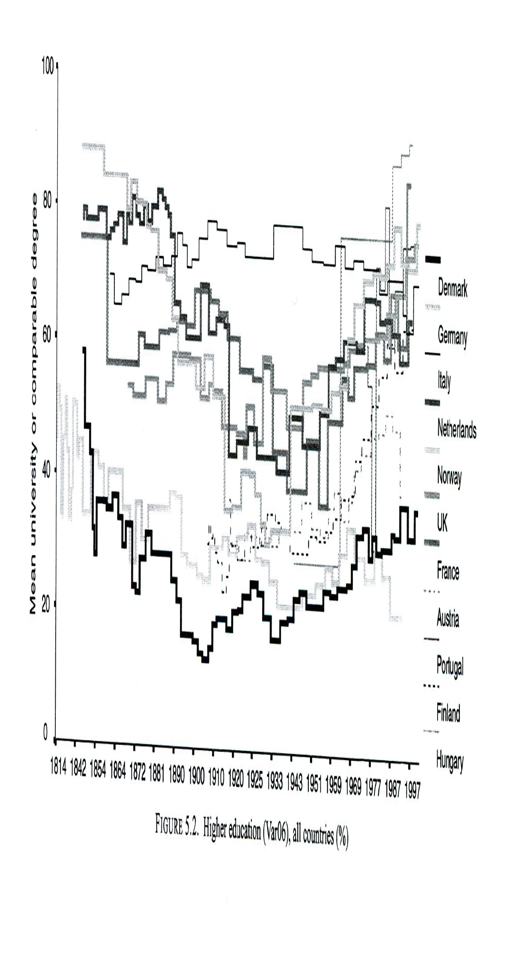

Slide 34
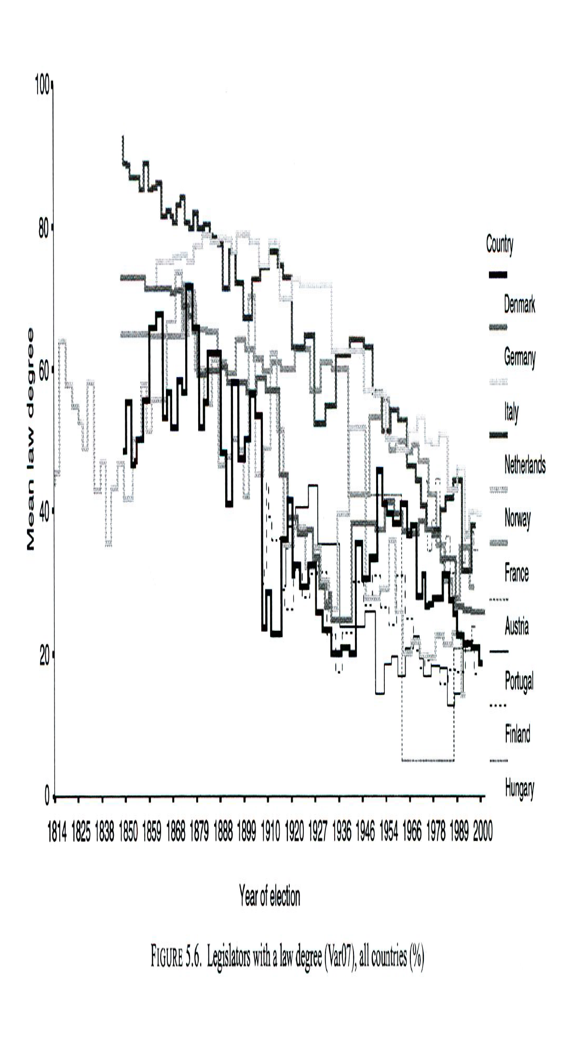

Slide 35
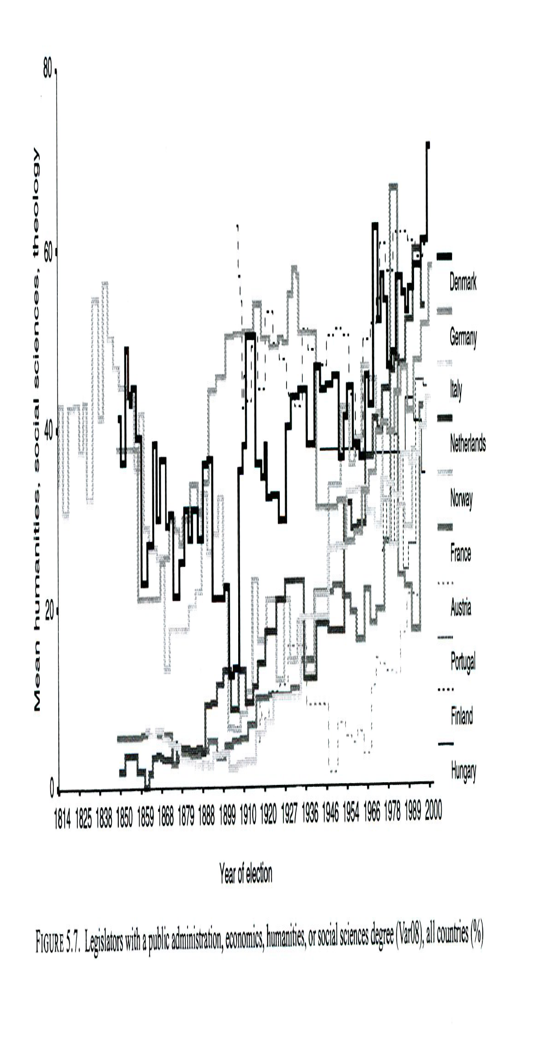

Slide 36
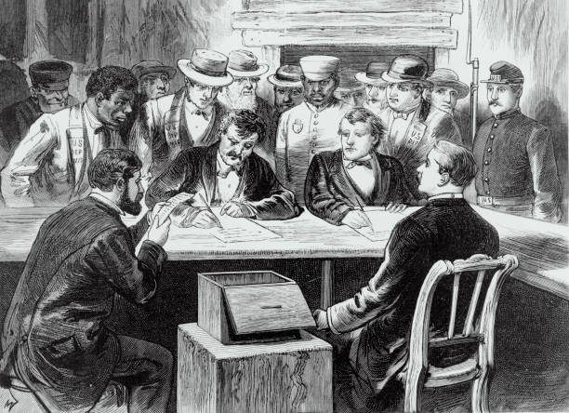
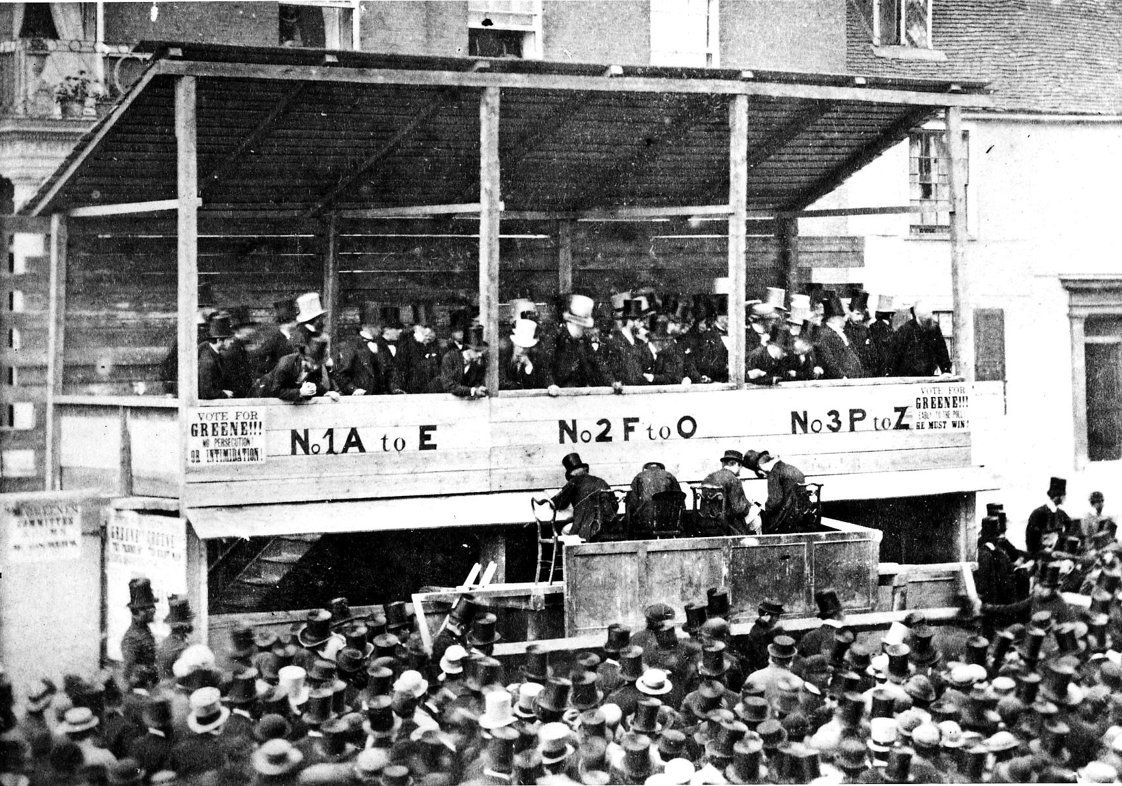
Emergence of political parties: political programs.
Development of electoral campaigns, techniques of mobilization: public meetings, political propaganda.
Be able to speak in public => favors the bourgeois elite and partly explains why the political recruitment is so socially selective.
As a result:
Notables professionalize themselves. They are forced to politicize their discourse in order to survive. Cf. Baron de Mackau (study by Eric Phélipeau), clientelism is gradually replaced with the professionalization of his campaigns: programs, discourses, budget, advisors.
The new political entrepreneurs (republicans) become notables for some of them. Their electoral successes provide them with local resources. They become the new notables, even though they do not have a personal wealth.
Emergence of a new social figure, the professional politician, according to Weber’s definition: to live off politics and for politics.
They live off politics because they earn their living off politics, this is their principal professional activity.
They live for politics because it is their vocation.
“Iron law of oligarchy” (Robert Michels, 1911, Political Parties): rule by an elite is inevitable within any democratic organization as of the “tactical and technical necessities” of the organization.

Slide 37
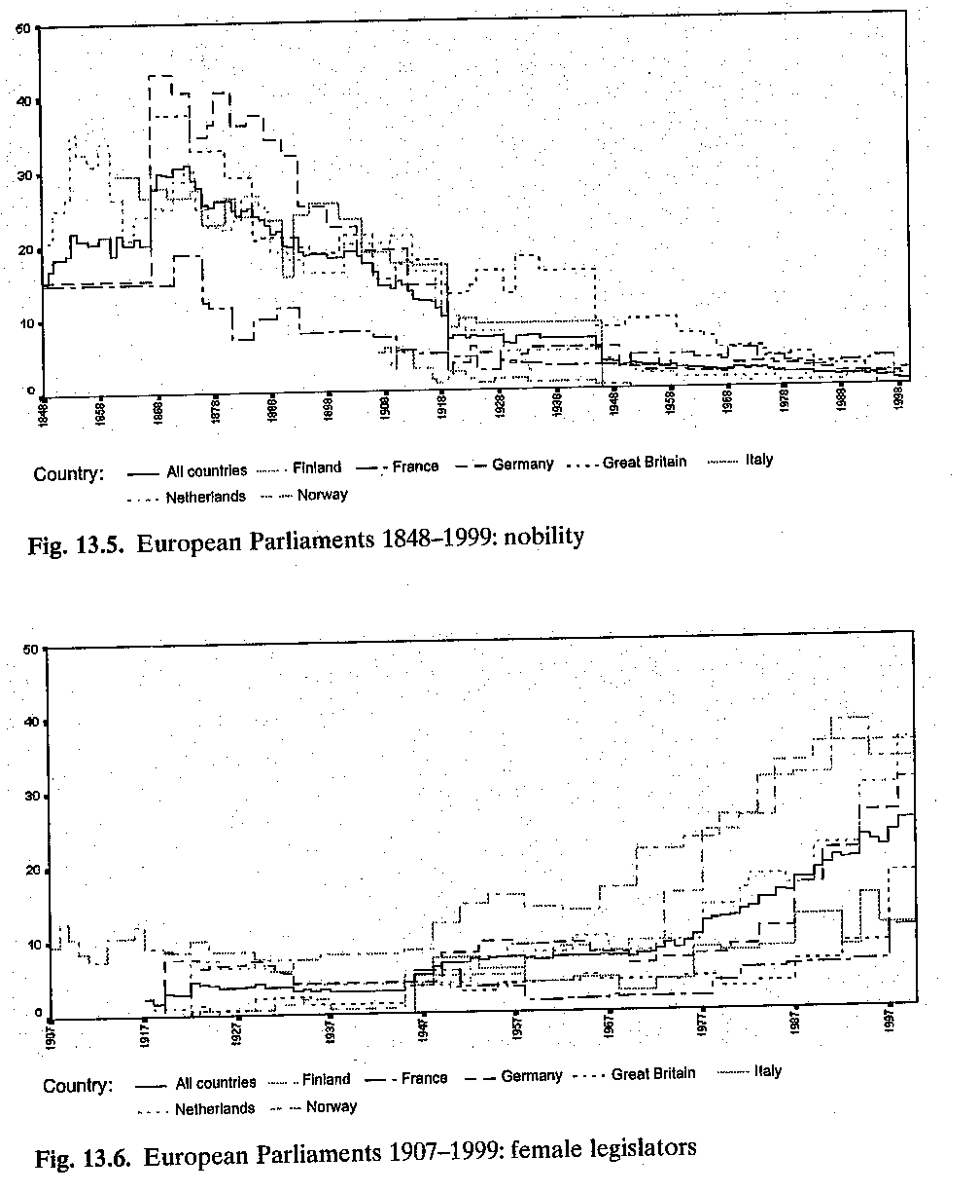
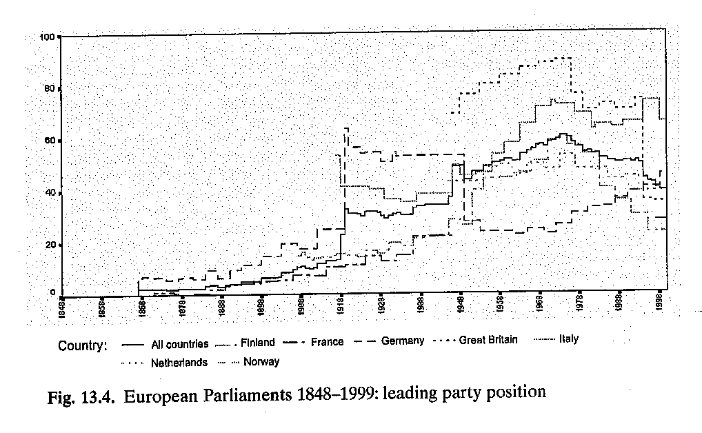

Slide 38
IV: A “crisis” of democracy? The issue of disintermediation

Slide 39
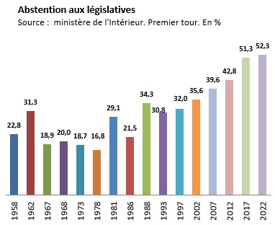

Slide 40
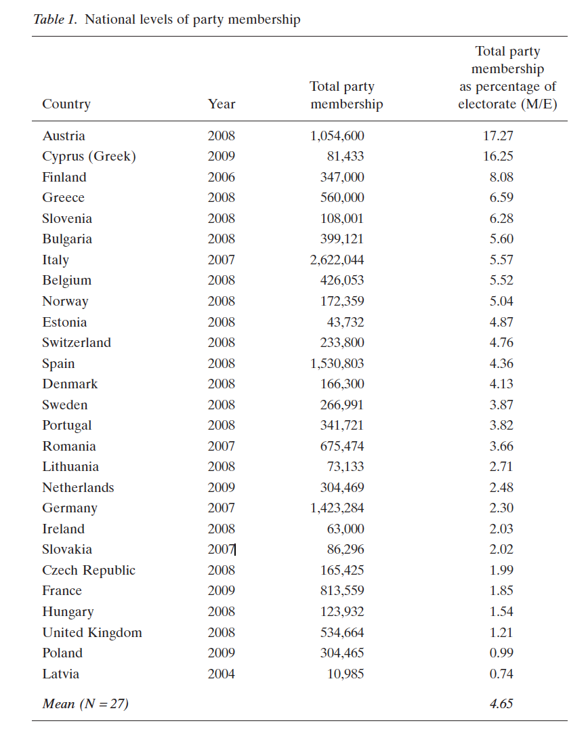
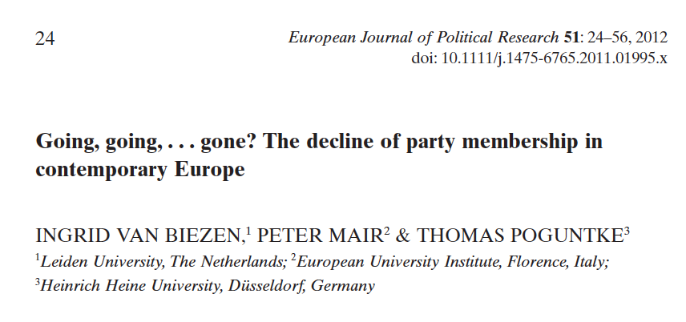

Slide 41
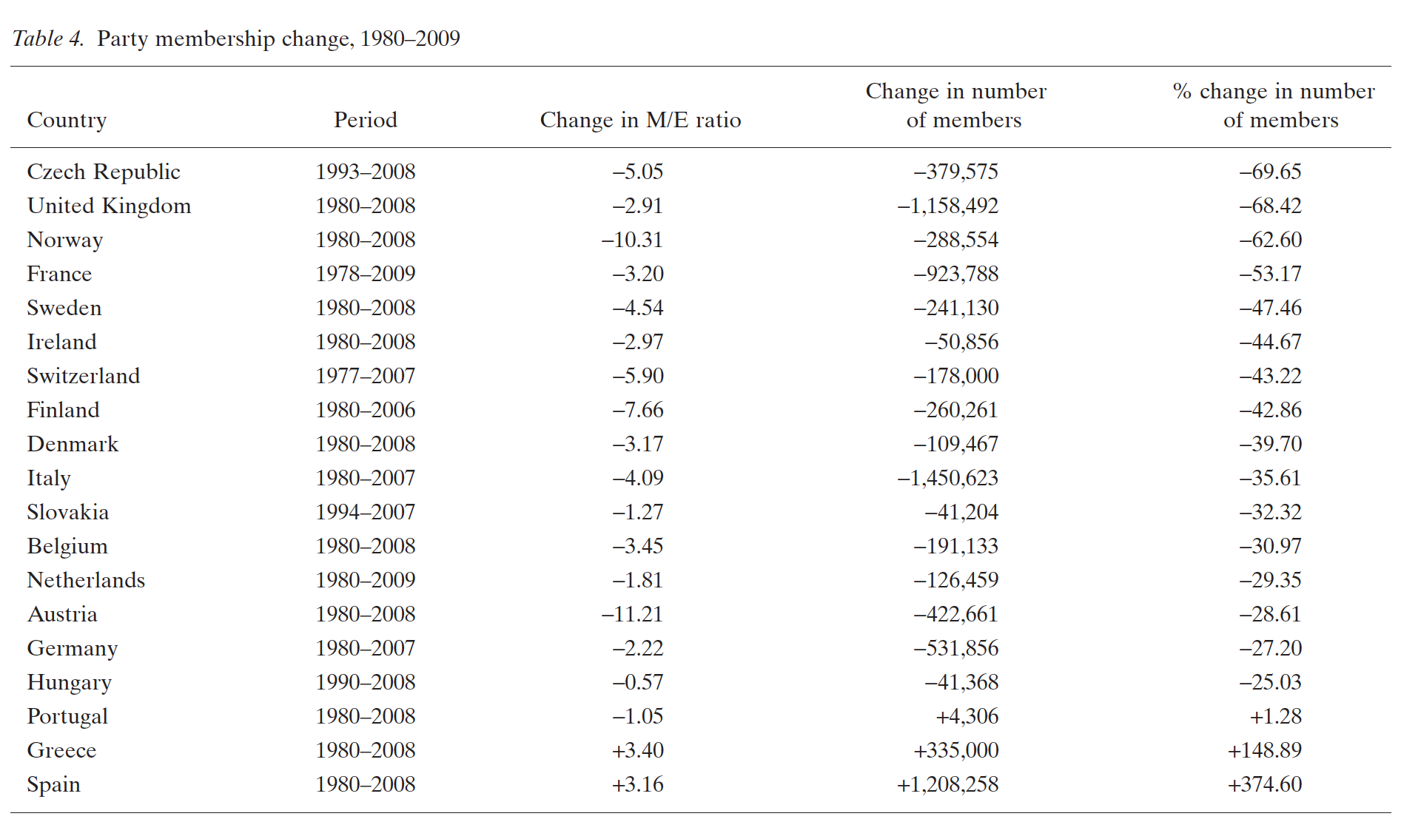

Slide 42
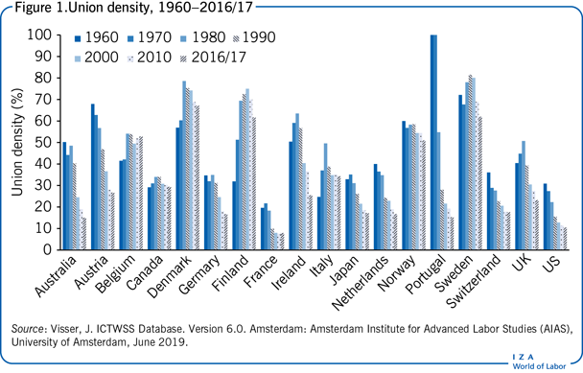

Slide 43
Peter Mair, Ruling the void. The Hollowing of Western Democracy (2013).
“The age of party democracy has passed.”
“Although the parties themselves remain, they have become so disconnected from the wider society, and pursue a form of competition that is so lacking in meaning, that they no longer seem capable of sustaining democracy in its present form.”
“What we now see emerging is a notion of democracy that is being steadily stripped of its popular component – easing away from the demos.”

Slide 44
“In the political discourse of the twenty-first century we can see clear and quite consistent evidence of popular indifference to conventional politics, and we can also see clear evidence of an unwillingness to take part in the sort of conventional politics that is usually seen as necessary to sustain democracy.” (Mair)
Générations désenchantées? Jeunes et démocratie (eds. Laurent Lardeux & Vincent Tiberj, INJEP).
https://www.youtube.com/watch?v=Loohqd_m6KE
Indifference to conventional politics does not mean indifference to politics tout court, cf. opinions regarding “cultural matters” womens’ rights, LGBTIQ rights, support to refugees, cosmopolitanism, …) and climate issues; involvement in social movements and/or NGOs active on those topics.
More “direct” action, echoing disintermediation and the loss of influence of political parties.

Slide 45
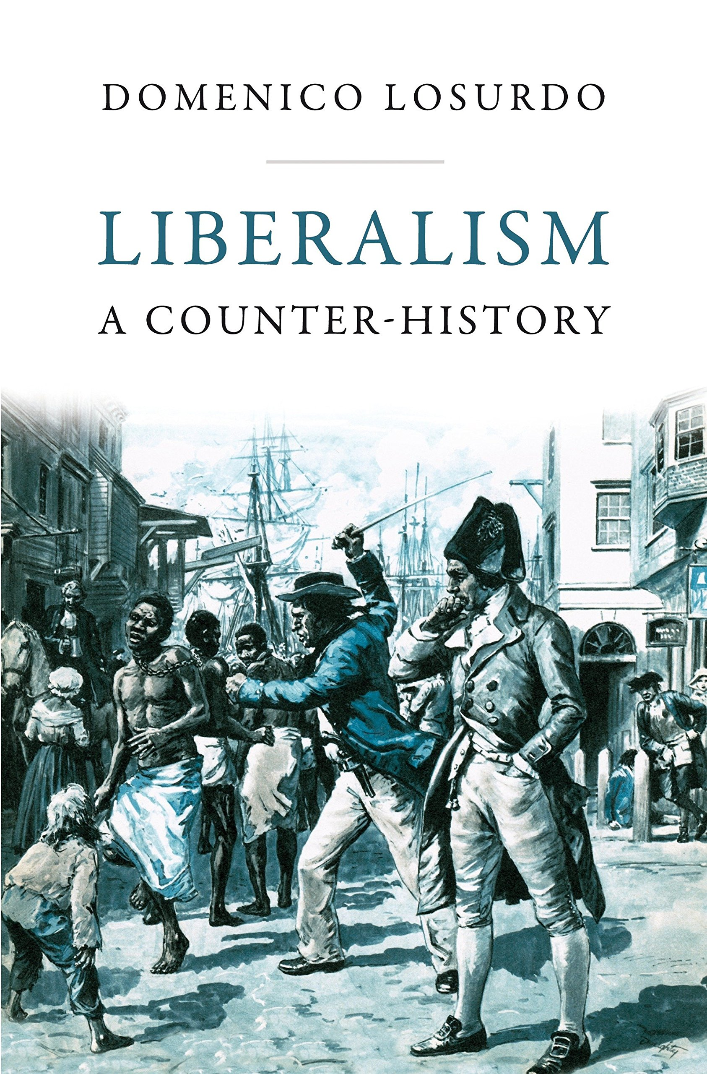
CONCLUSION
Democratization as a long process, not univocal: anti-democratic and anti-liberal elements throughout its history: cf. slavery, social Darwinism, etc.
Not a linear process (authoritarian restorations, Paris Commune), and not taken for granted (Vichy).
Democracy is not only formal: beyond elections and majority will, there is an array of institutionnal arrangements (Rule of Law, checks and balances, …) + complementary channels of participation and representation of citizens (unions, pol. parties, civil society org°, protests, petitioning, deliberation, …).
Disintermediation + search for alternative ways of doing politics (single-issue politics, “participatory turn”) as the main characteristic of contemporary democracies?

