Slide 1
Africa and Compassionate Relationality
UNIVERSITÉ DE PARIS 1 PANTHÉON SORBONNE

Slide 2
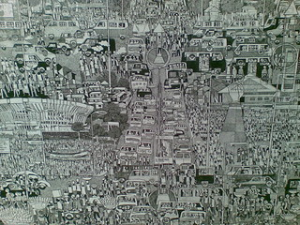
Pictural evocations
‘‘Kinshasa” Houston Malodi

Slide 3
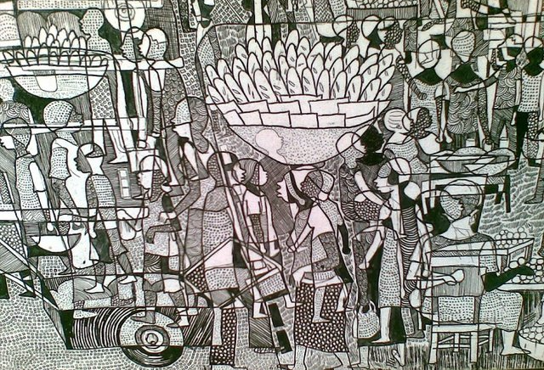
« Malodi detail : bread moteki » by FredR is marked with CC BY-NC-ND 2.0

Slide 4
Houston Malodi, This detail of a cityscape
Photo Fred R, 2010. Creative Commons CC BY-NC-ND 2.0.
Thinking Africa in the grip of the world's compassion, in a systematic effort to reproduce on a flat surface the way objects are perceived by our eyes in reality: standing in the middle of railroad tracks, the parallel rails seem to converge on the horizon, even though we know they do not.
To see, we need depth to see three-dimensional representations, not flat images or realities.
Reading Africa through a compassionate relational lens is an imperfect perspective, but we need to look at the fault lines (A. Mbembé, Lire l'Afrique à partir d'une faille).

Slide 5
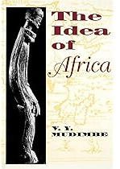
Compassion as an essential marker of Africa’s presence-absence in the world.
Africa as idea, concept, place, epistemic project an dan opened question. It does not call for absolute otherness; it is not an essence or a reified monolithic entity even as the « most tormented continent on earth » (Richard Dowden).
Compassion appears to be a central category in the way the world understand, describe, think about and interact with Africa. This compassionate grip entangles a continent that is itself perceived as saturated with emotions.
It’s the endogenous and exogenous apprehension show Africa caught up in concern for itself and for others, Africa is gripped by a compassionate relationnality framed in the desire to put an end to its suffering, improve its condition and ensure its happiness (Joan Tronto called ‘support for life’)
What are the mechanisms and processes, policies, players and dynamics involved? What are the factors determining Africa's involvement in the production of compassionnate relationnality?

Slide 6
Compassion as an essential marker of Africa’s presence-absence in the world.
If Africa's presence in the world is, we postulate, marked by a relationnality of compassion, the choice is made here to base the analysis on the modern era by retaining three privileged territories of compassionate undertakings: the goods of salvation and civilisation, development aid and humanitarian interventions. Consequently, far from any form of rigidification, a history of the present time of compassion must be built on the historicity of compassionate enterprises through the past, which infinitely reproduces its effects in the present through the metaphorical figure of Michel Serres' folded time. It is a time that 'folds and twists' like a crumpled handkerchief at the bottom of a pocket because it is made up of ruptures and stopping points, of lightning acceleration, of collapses, of gaps, of tears, of uncertain, unstable and non-linear contours.
As I have argued recently in « Cum Patior Africa » (Mbembe/Saar 2023), this power structure shall be tackled from a Southern perspective and in a long-term perspective.

Slide 7
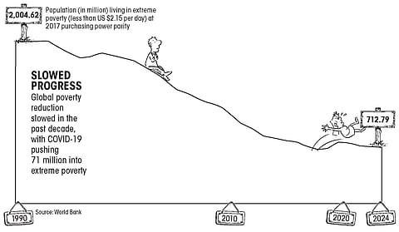
Africa as a « global burden »
Global Burden of Disease and poverty
World Bank. 2024. “Poverty, Prosperity, and Planet Report 2024: Pathways Out of the Polycrisis.” Overview booklet. World Bank, Washington, DC. License: Creative Commons Attribution CC BY 3.0 IGO (https://openknowledge.worldbank.org/server/api/core/bitstreams/f75dd18d-4e3f-44f9-b455-7f0d8e189609/content)
The majority of the 689 million people still living on less than $2.15 a day are in sub-Saharan Africa.

Slide 8
Compassion as …
from the Latin cum patior, is intimately linked to an experience of suffering - it is a question of suffering with the other. It is expressed in a passion capable of selflessness or altruism (unlike pity, although this feeling is often close to it). Arendt would call it “a natural fellow-feeling for a suffering other »
an "ethical interpellation in the face-to-face encounter. The compassionate experience is constitutive of a bond marked by an ethics of the face and a responsibility for the other in the sense of Emmanuel Lévinas. The regime of compassion is based on "being 'caught', in practice and not necessarily reflectively, by a feeling of responsibility for the distress of others, in the face-to-face and proximity of bodies.
a regime of proximity (or of the near) with Africa, which were partly built, in the name of compassion, on a fiction of the elsewhere, of the distant, made close by the force of feelings. This trade in proximity leads to the crystallisation of sediments of familiarity that cannot be grasped in a singular colloquy between the world (especially the West) and Africa, but are part of an entanglement of networks and plural springs. Of course, Africa is not the sole target of the rhetoric of good intentions, but it is a privileged recipient of them.

Slide 9
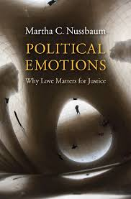
Compassion is
“a feeling of pain at the suffering of another person or another creature that necessarily involves (at least in humans) three thoughts:
first, that the suffering is serious;
second, that the suffering is not entirely the victim’s fault;
and third, what Nussbaum calls the eudaimonistic thought, the thought that the suffering person is among one’s most important goals and projects, and thus that their suffering matters to oneself”.
For her, human compassion has a tendency toward narrowness – preferring those nearby and similar over those far away and different – and also a tendency to be fickle and fleeting. Compassion can also lead to favouritism, subordination, humiliation and enslavement
Martha C. Nussbaum Political Emotions: Why Love Matters for Justice, Cambridge, Massachusetts, Belknap Press of Harvard University Press, 2013 (457 pp)

Slide 10
Compassion is
Snapshots of compassion’s configuration and interactions show that there are winners and loosers of compassion, just as there is compassion’s dominants and dominated.
However, this compassion relationality is not a zero-sum game, though ridiculed by Hannah Arendt as “effeminate virtue’ to be eradicated from public sphere
This political emotion builds a moral and economic exchange et a sociopolitical and historical construction
Todays presentation is based on of course not addressing the essential elements of historical complexity.
Paul Hoggett and Simon Thompson (eds) Politics and the Emotions: The Affective Turn in Contemporary Political Studies, New York, Bloomsbury Publishing, 2012 (192 pp)
Nicolas Demertzis (ed) Emotions in Politics: The Affect Dimension in Political Tension, Basingstoke, Palgrave Macmillan, 2013 (336 pp)
Hannah Arendt, The Jew as Pariah (1978)
Judith Shklar, Ordinary Vices, Cambridge, Harvard University Press, 1984
Richard Rorty, Contengency, Irony, and Solidarity, Cambridge, Cambridge University Press, 1989
John Kekes, “Cruely and liberalism”, Ethics, 106(4), 1996, pp.834-844
Michael Ure and Mervyn Frost (eds.), The Politics of Compassion, Routledge, 2013

Slide 11
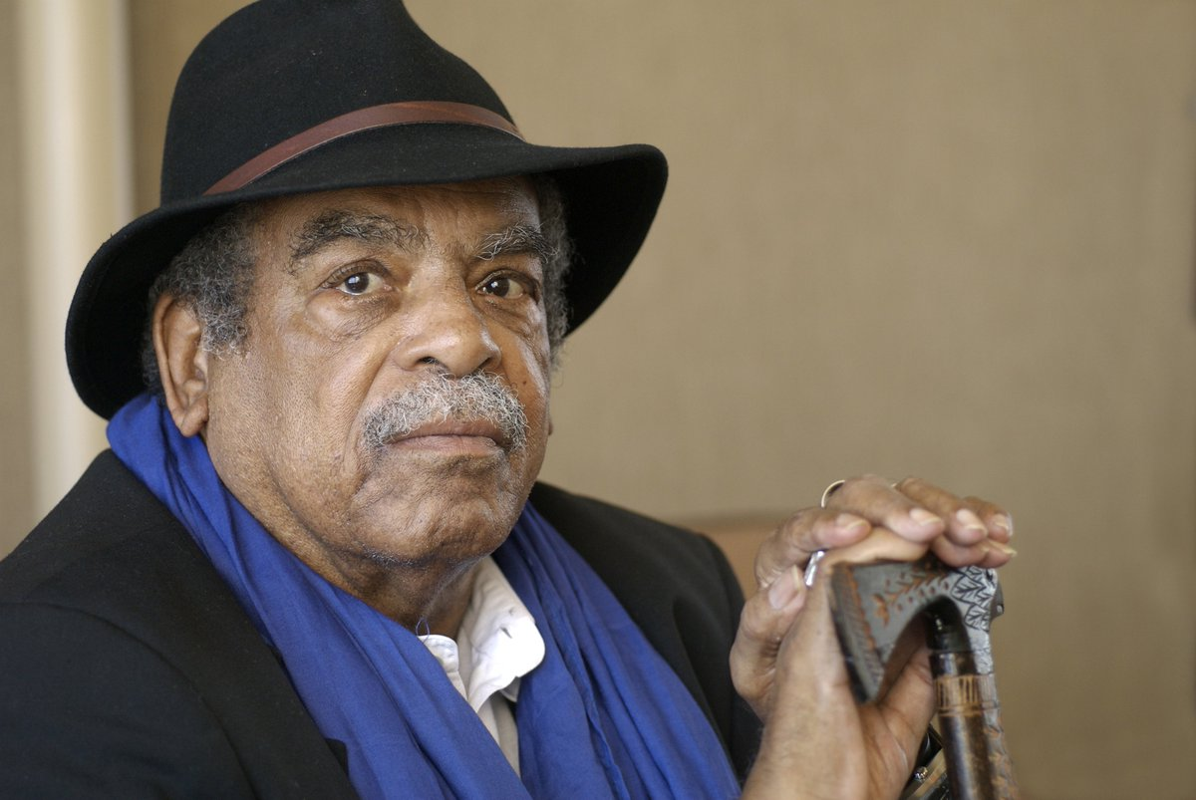
Relationality as …
Worldling through compassion (Glissant perspective) Martinican poet, novelist and theorist (1928-2011)
Relations between the local and the global, especially the effects of globalisation. Against this ‘mondialisation’ (globalisation), he proposes a mondialité (variously translated as worldmentality, worldliness or worlding).
Relational belonging as a decolonial poetic intervention which appears threefold both located and non located, material and non material, colonial and decolonial:
as tout-monde (the world in its entirety),
écho-monde (the world of things resonating with one another) and
chaos-monde (a world that cannot be systematized) .

Slide 12
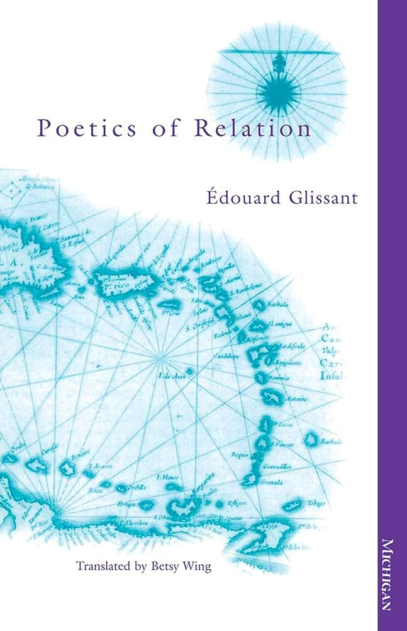
Relationnality as …
The West is ‘anxiously determined to cling to their conception of a world in which they dominate and control rather than ‘a world in which one is, quite simply, one agrees to be, with and among others’ (Glissant, 2010: 128).
Compassionnate relationality rooted in an infinate litany possible relations made of pains, grievances, hopes, and desires: “the fear, the wasting away, the tortured extinction, the obstinate means of resistance, the famines that go unmentioned, the naive belief, the trepidation, the stubborn determination to learn, the imprisonments, the hopeless struggles, […] the slums, the sophisticated techniques, the simple games, the subtle games, the desertions and betrayals […] the strokes of luck, the ghettos, the assimilations, the immigrations […] the musics of passion, the rages of what we so simply call libido, the pleasures of our urges and athletic pleasures (PR 125)

Slide 13
Compassionnate Relationality as …
Self determination opportunity:
“Africa is not merely the place where part of the planet’s future is currently playing itself out. Africa is one of the great laboratories from which unprecedented forms of today’s social, economic, political, cultural, and artistic life are emerging” (viii) […] we are witnessing the emergence and crystallisation of a new cycle in the redistribution of power, resources, and value ” (ix, Preface).
“As we enter the third decade of the twenty-first century, the world is undergoing a major historical shift: Africa, and the Global South more generally, is increasingly becoming a principal theatre in which the future of the planet plays itself out. But not only this: Africa is at the same time emerging as one of the great laboratories for novel forms of social, economic, political, intellectual, cultural, and artistic life. Often arising in unexpected places, these new forms of life materialize in practices that draw deeply from collective memory while simultaneously assuming distinctly contemporary, even futuristic, guises”
Rethinking the way engaging with African suferings was frame, leaving behind the Eurocentrism tied to linear, progressive schemas of History, and of dropping Europe’s master-narrative, whose model the world’s other peoples are condemned to adopt or unhappily repeat. It is about accepting the plurality of collective ways of being, the multitudinous forms of societal life, the diverse modalities for producing being that we call cultures – and it is about accepting the possibility of there being many worlds within the world” (119).

Slide 14
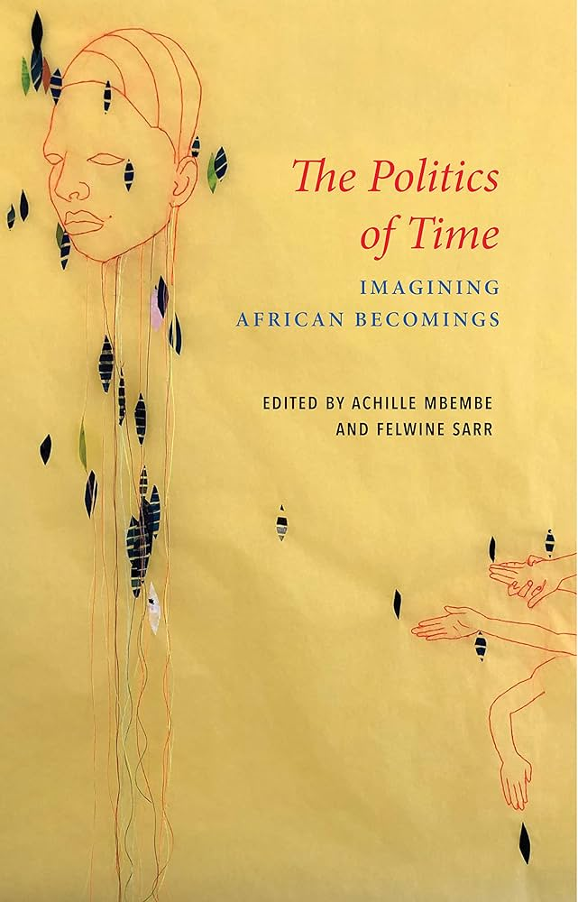
Compassionnate Relationality as …
Nadine Machikou, “Cum patior Africa: The Political Production of Regimes of ‘the Nigh’”, Achille Mbembe, Felwine Sarr (eds.), The Politics of Time: Imagining African Becomings, Polity Press, translated by Philip Gerard, 2023.
A “common place” of diversity, errantry, turbulence, chaos, opacity, baroque, unpredictable, beauty, circularity, entanglement
Compassion has been at the center of Western politics since the Enlightenment, becoming also paramount internationally. Compassion is a politically tool distributing places and ressources in the human contemporary history

Slide 15
Compassionnate Relationality as …
A “common place” of diversity, errantry, turbulence, chaos, opacity, baroque, unpredictable, beauty, circularity, entanglement
Compassion has been at the center of Western politics since the Enlightenment, becoming also paramount internationally, at least since anti-cruelty became its alleged primary civilizing concern. Compassion is a politically charged virtue, and yet we know surprisingly little about the uses (and abuses) of compassion in political environments.
Compassion has been at the center of Western politics since the Enlightenment, becoming also paramount internationally, at least since anti-cruelty became its alleged primary civilizing concern.

Slide 16
The structuralist perspective
Gains from doing good
‘rules of disinterestedness, objectivity, neutrality, etc.’
the most disinterested actions, humanitarian actions, all those things we celebrate, are always subject to the question: what interest does he have in doing that? Why is he doing it? [What good does he get from doing good?’ (pp. 539-540).

Slide 17
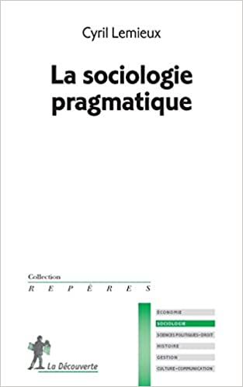
Socio-pragmatic perspective
Against the ‘reification’ of the social world - to find the individuals behind the ‘social categories’ (the ‘State’, the ‘Church’, ‘managers’, ‘youth’, etc.) - to study the genesis of social categories - inspired by Austin's ‘Speech Act theory’, which distinguishes between two types of statements: descriptive (being) vs. performative (action): condition of truth vs. conditions of felicity.

Slide 18
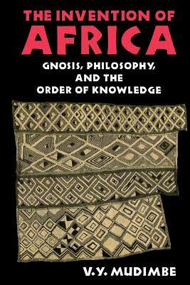
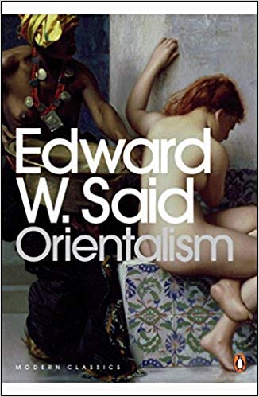
Decolonial perspective

Slide 19
Criticism of modernisation theory and dependency theories (same dichotomies: developed/underdeveloped, modern/traditional, etc.) Linearity and same future
- Argument: Africa did not exist as an identity before European descriptions of ‘Africa’ Invention- 18th century: Hobbes: Africa = violence
‘Colonial Library’. ‘Knowledge of otherness’.
- Africa as Europe's other (Opposition: darkness/light, emotion/reason, etc.).

Slide 20
Rethinking compassionnate relationnality through epistemic freedom
- "seek ye epistemic freedom first"
"the urgent need for epistemic freedom, which restores African people a central position within human history as independent actors. This epistemological concern is fundamentally decolonial"
"Africans always had their own valid, legitimate and useful knowledge systems and education systems. This is the decolonial tale at the centre of this book"
concepts: "epistemic line" "epistemic justice",
"epistemicides", "rethinking thinking"

Slide 21
The conceptual tool of the colonial library : discourses of Otherness and ideologies of alterity.
The colonial library based on a Eurocentric systems of illustration of Africa lack, suffering, despair and need, framing it’s image and it’s destiny
enormous body of written material and framework of illustrations that have over generations jointly developed and keeps going to invent Africa as an example of variations and alterity.
They are traces of how Africa has existed and is being invented within the archive of colonial contemporary life, with far-reaching political, philosophical, substance, epistemic, and fundamental implications for not only the African continent and its inhabitants but also for the international governance supported by the fundamental reasoning of such concepts.
Africa's misery is the product of a porous concatenation of systems of representation and discourse by both the colonisers and the colonised.The term ‘colonial library’ refers to the body of texts and epistemological order which construct Africa as a symbol of otherness and inferiority. They are archive of knowledge on Africa that is inevitably drawn from when any person speaks, writes or thinks about Africa today

Slide 22
I. Three main territories of imperial compassion :
Civilization, developmentalist and humanitarian reason
salvation and civilization colonial goods
development and aid
humanitarian interventions.

Slide 23
1. The civilization reason
Andrew Linklater, The Idea of Civilization and the Making of the Global Order , Bristol University Press, 2020
Framing imperialistic compassion: the “standard of civilization” as an attempt to create a global order confronting 'civilised' versus 'barbarian’.
Routinized “caricatural dramatisation” of the African continent (Achille Mbembe) with a morbid attraction to violence echoing the justification for conquest and colonial domination
a method to measure, put in hierarchies and manage between civilized, semi-civilized and savage peoples.
For centuries, compassion is associated with European expansion and domination of the rest of the world, and becomes even more obvious within imperialism become more pronounced and far more effective.
In the universalizing project, the logic of lack and improvement is strong: the constant presence of racialised, gendered and infantilising bodies in the writings of the discipline’s ‘fathers’ and their insistence that capitalist modernity was the only path to civilisation and, by implication, to equal rights and duties under international law.
Civilizing initiatives to provide ‘progress’ to backward societies.
Le grand blanc de Lambaréné
https://www.ina.fr/ina-eclaire-actu/video/caf91066704/docteur-schweitzer
Jamot un grand “docteur (https://www.ina.fr/ina-eclaire-actu/video/cpc81051693/jamot-un-grand-docteur

Slide 24
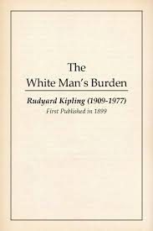
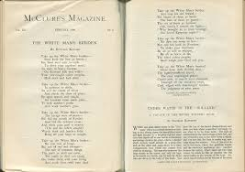
1. The civilization reason

Slide 25
1. The civilization reason
In a poem originally published in February 1899 in Mc Clure's magazine under the title The White Man's Burden, the Nobel Prize-winning author Rudyard Kipling, a fervent defender of colonisation, enjoins the white man to civilise, provide for and administer the colonised populations in the name of a 'burden' and a duty based on his superiority and progressive civilisation. He will say "Take on the White Man's burden / Cruel wars to impose peace / Feed the hungry / Stop the disease".
Faced with ungrateful colonised people who are 'restless and savage', 'half-children, half-demons', the white man is invited to hide his fatigue and accept 'the blame of those whose lot you have improved/ the hatred of those you have protected'.) This sacrificial invitation is rooted in 'the great contemporary colonial period, at a time when all the actors - military, missionaries, civil servants and merchants - are deeply persuaded of the superiority of Western civilisation and convinced of their duty to spread progress to the ends of the world'.

Slide 26
1. The civilization reason
This aspiration had been expressed four years earlier by Jules Ferry who, in his speech to the Chamber of Deputies on 28 July 1885, praised the work of Savorgnan de Brazza ("he is an apostle; he pays with his own hands, he is walking towards a goal that is very high and very far away; he has conquered a personal influence on these populations of equatorial Africa that is unparalleled; but who can say that one day, in the settlements he has formed, which have just been consecrated by the European Areopagus and which are now the domain of France, who can say that at some point the black populations, sometimes corrupted, perverted by adventurers, by other travellers, by other explorers less scrupulous, less paternal, less fond of the means of persuasion than our illustrious Brazza, who can say that at some point the populations will not attack our settlements? "
Western help is essential to "civilise the inferior races". Compassion as a duty of civilisation poorly conceals France's desire for greatness in the face of its European competitors: "To shine without taking action, without getting involved in world affairs, by keeping out of all European combinations, by looking upon the East as a trap, as an adventure, to live in this way, for a great nation, believe it or not, is to abdicate, and in a shorter time than you might think; it is to fall from the first rank to the third and the fourth. Compassion fuels a doctrine of colonisation whose trajectory is one of brutality, inhumanity and racism despite schools, hospitals and bridges.
Discuss the idea of positive aspects/legacy of colonization

Slide 27
1. The civilization reason archives
“Congo -Océan: Retour glaçant sur une page oublié de notre histoire coloniale”
https://www.youtube.com/watch?v=lHXTcTMPP5g (5.36 mn)
Mission chrétienne au CongoBelge
https://www.youtube.com/watch?v=y0S-Qcn9B64 (9.43mn)
The Berlin Conference of 1884-1885. Africa’s great civilizations
https://www.pbslearningmedia.org/resource/6031c3a2-ada9-42b4-8045-52006e2a2b07/the-berlin-conference-of-1884-1885/ (6.57mn)
The records the British Empire didn’t want you to see- Audra A. Diptée https://www.youtube.com/watch?v=oPGVGckn7kQ (4.58)
Chinua Achebe critic of the civilization enterprize in Africa in Things Fall Apart,

Slide 28
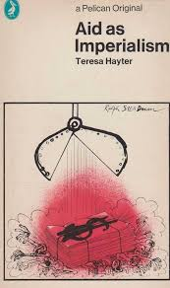
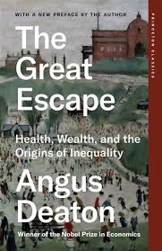
2. The developmentalist reason

Slide 29
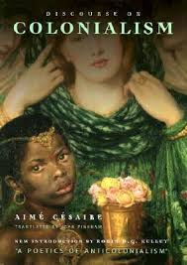
2. The developmentalist reason
Development as growth, progress or empowerment, a failed project ? : extractivism, fetishism of economic growth, the invention of the third world through discourses and practices, the global division of labour and the marginalisation of non-Western worldviews, persistent and increasing global inequalities, cosmovisions, imaginaries.
“They talk to me about progress, about ‘achievements,’ diseases cured, improved standards of living. I am talking about societies drained of their essence, cultures trampled underfoot, institutions undermined, lands confiscated, religions smashed, magnificent artistic creations destroyed, extraordinary possibilities wiped out. They throw facts at my head, statistics, mileages of roads, canals, and railroad tracks. […] I am talking about natural economies that have been disrupted – harmonious and viable economies adapted to the indigenous population – about food crops destroyed, malnutrition permanently introduced, agricultural development oriented solely toward the benefit of the metropolitan countries, about the looting of products, the looting of raw materials.”
– Aime Césaire (1950): ‘Discourse on Colonialism’

Slide 30
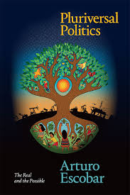
2. The developmentalist reason
After independence, development aid was deployed to support numerous public investments, technical cooperation and sometimes, secondarily, the payment of salaries to public officials in many states in crisis or bankruptcy due to export and import price setbacks, an inability to cover public deficits with tax revenues or, more broadly, poor governance.
The paradigm of catching up with countries that do not belong to the first circle of prosperity and sometimes translates into a form of reparation for the colonial fault.
International development cooperation has provided grants, loans and other technical assistance as important catalysts of this solicitude. In many cases, recipient countries have little room for manoeuvre to express preferences about the forms and sectors targeted by development assistance. They sometimes end up with support that is irrelevant to their development priorities.
The pluriverse (A. Escobar) : other ways of seeing the world and to acknowledge a multiplicity of ways of living, well-being, good life, which does not take the West as the standard.

Slide 31
2. The developmentalist reason
According to some, sub-Saharan Africa has been the region where official development assistance has played the most decisive role (unlike the Maghreb, Asia or Latin America).
The World Bank's catechism, the ideal of the "donor", is built "between the economic theory of partial equilibrium welfare in the framework of dependent economy models and liberal political economy". It is based on three more or less implicit principles, namely "the introduction of the liberal norm of the minimum state and in particular the free-trade norm; the search for simplicity at all costs; and the desire to circumscribe the political".
This generated: socio-historical and political processes of dehumanisation of non-Europeans, exploitation, genocide and epistemicide and seemingly permanent subordination to the socio-cultural and political interests of the West/Europe/the”Global North”.
The legitimacy, credibility and value of African societies, their epistemic products and social relations have been consistently and systematically delegitimised, discredited and devalued.

Slide 32
3. The humanitarianism reason
Critical studies of humanitarianism definition as a “passion for compassion” ̶ to use the classic Arendtian formulation ̶ that is embodied in specific programs and organizations. These are characterized by the desire to alleviate suffering and preserve human lives, acting in situations defined as crisis and according to the temporalities of emergency
Embodiment of universal compassion as a tool of global governance of world disorders . Africa has largely been the target of all kinds of assistance ‘at various levels of an international aid system, governed by a certain number of principles and implemented (in the name of values considered to be universal) for the benefit of populations whose living conditions have been disrupted by nature (disasters) or by the actions of other people (internal or international armed conflicts), and whose physical integrity has been damaged, or even whose very survival has been compromised’.

Slide 33
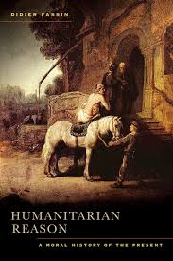
3. The humanitarianism reason
Didier Fassin takes the case materials from France, South Africa, Venezuela, and Palestine to explore the meaning of humanitarianism in the contexts of immigration and asylum, disease and poverty, disaster and war. It traces and analyzes recent shifts in moral and political discourse and practices—what it terms “humanitarian reason”—and shows how humanitarianism is confronted by inequality and violence. Illuminating the tensions and contradictions in humanitarian government, the book reveals the ambiguities confronting states and organizations as they struggle to deal with the intolerable.

Slide 34
3. The humanitarianism reason
Humanitarian aesthetics: The face of the humanitarian target is the essential black child on the cover of many books or as an illustrative accompaniment to many articles and other work guides. Whether driven by governments, international organisations, agencies or collective or individual players, humanitarian action is carried out by a wide range of agents, including doctors, nurses, first-aiders and the military.
Humanitarian power imbalance : In war zones, this equipment has become a symbol of power, wealth and superiority. It separates aid workers from aid recipients in terms of wealth and opportunity’

Slide 35
II. Compassion an a legitimacy of victimhood : 1.Africa, “continent of victims”
dissatisfaction with Africa's condition and an establishment of responsibility (finger pointing). Sometimes bipolar, it articulates the exaltation of the qualities, merits, wealth and assets of Africa and the injustice of its situation
Three canonical meanings (Achille Mbembe):
The first is separation from the self, which ‘would have led to a loss of familiarity with the self to the point where the subject, rendered a stranger to himself, would have been relegated to a form of alienated and lifeless identity: the spectacle of being torn apart’.
The second is disappropriation, which is expropriation and material dispossession (between subjugation through the falsification of the self by others and ontological impoverishment).
The final meaning is debasement, in that ‘the servile condition not only plunged the African subject into humiliation, debasement and nameless suffering.
The injunction to come to the aid of the suffering continent has essentially turned Africa into a ‘continent of victims’, where it is considered that the world has duties towards Africa while it has rights towards the world. This has given rise to a series of struggles and demands for the recognition of suffering and the advent of reparative policies.

Slide 36
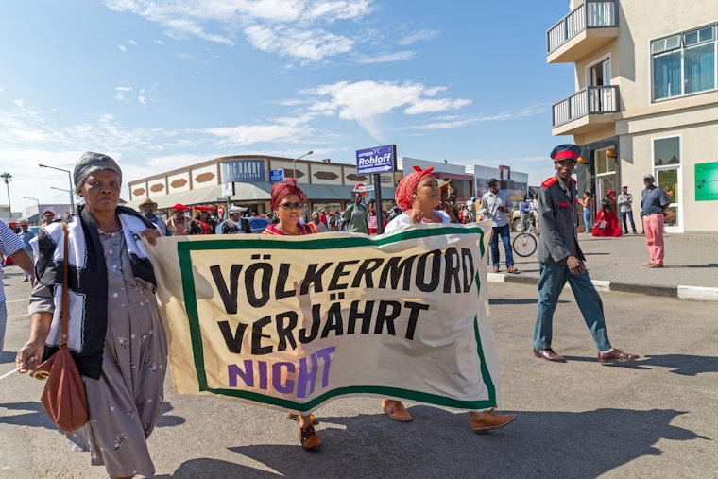
II. Compassion an a legitimacy of victimhood : 2.the injunction to repair
The world is presented as bearer of duties towards Africa while it has rights towards the world.
This has led to a series of struggles and demands for the recognition of suffering and the development of reparative policies with three interconnected pillars: community power-building, advancing jurisprudence on reparations, and strengthening academic collaboration.
The move underlined a historic commitment to pursuing the “reparations owed to Africans both on the continent and in the diaspora, acknowledging the profound harm caused by the transatlantic slave trade, slavery, colonialism, and neo-colonialism.”
Case study: the ranscontinental alliance of five interlinked UWI entities: the Centre for Reparations Research, the PJ Patterson Institute for African-Caribbean Advocacy, the University of Lagos-UWI Institute of African and Diaspora Studies, the University of Johannesburg-UWI Centre for Global African Studies, and UWItv.
Berlin, Germany, at the Dekoloniale Berlin Conference 2024, to mark the 140th anniversary of the Berlin Africa Conference of 1884/5.
African Union declared reparations as their newest flagship and the theme for 2025 as “Justice for Africans and people of African descent through reparations.”
The issue of restitution. Discuss the Atlas of absence (https://www.tu.berlin/en/kuk/research/projects/current-research-projects/reversed-history-of-collections-cameroons-cultural-heritage-in-german-museums/atlas-der-abwesenheit)

Slide 37
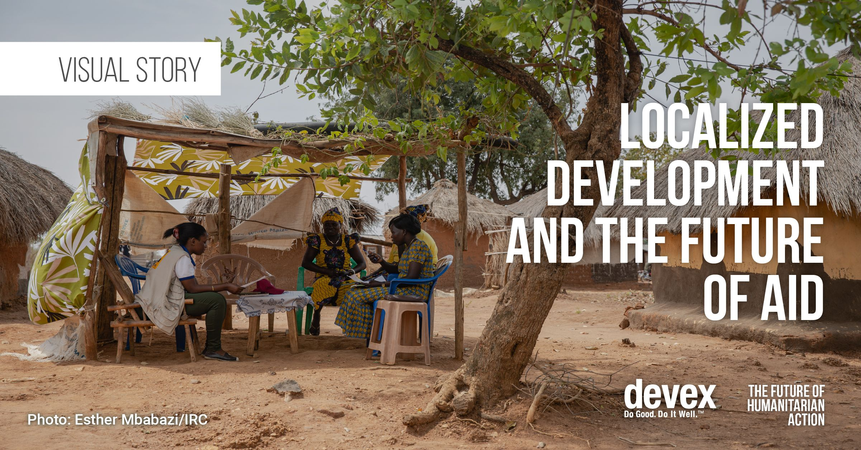
1. Decolonizing compassion by decentralization

Slide 38
1. Decolonizing compassion by decentralization
The localization turn: another buzz word?
Systems of humanitarian and development assistance that are dominated by actors from the Global North and lack participation from local communities affected by these policies.
Since the World Humanitarian Summit of 2016, Localization is on the agenda of the development and humanitarian sector (“local as possible, as international as necessary”)
“Localization is a policy commitment and reform process with the goal of shifting power and resources to local and national actors and supporting and strengthening the existing leadership, capacity, and expertise of local and national first responders”.
George Washington University, Power and Inequality in the Humanitarian Sector, May 2021

Slide 39
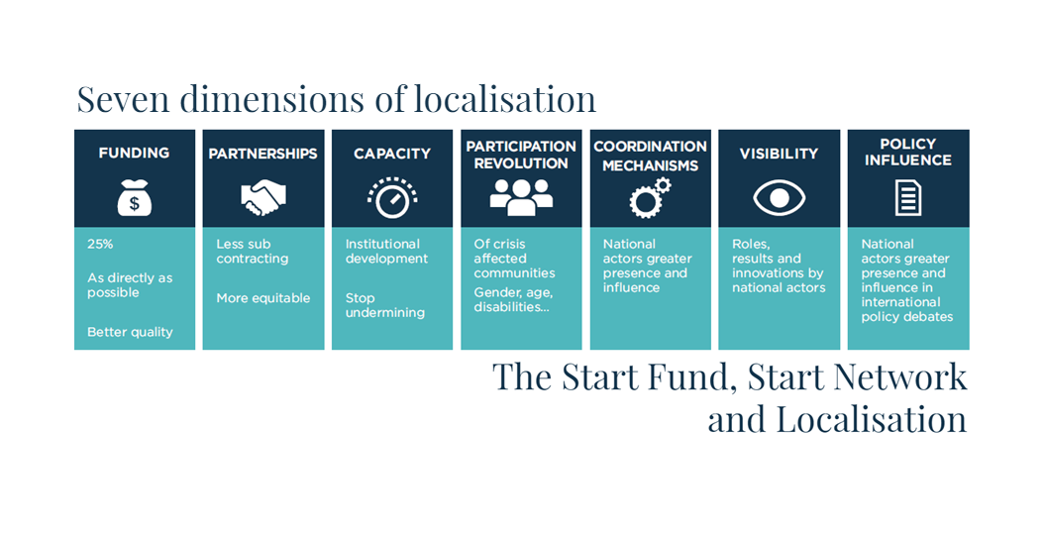
The localization turn: another buzz word?

Slide 40
The localization turn: another buzz word?
(Re)localizing compassion
to enhance capacity exchange, increase direct funding, and empower local groups to lead initiatives. Quid of the structural and political economy of power imbalance with well-nourished northern sector and a resource-starved southern sector, which parallels the distribution of power and authority
Localizing knowledge generation (What do non-Western systems of humanitarian assistance look like and what norms, principles, and practices do they emphasize? How do local systems interact and intersect with global humanitarian assistance? Case of the Ubuntu Philosophy
the importance of language in maintaining power hierarchies in the aid system by the use of English, French of Spanish: shifting to local languages

Slide 41
Re)localizing compassion The African compassionnate relationnality
You are, therefore I am
the definition of our humanity is in how we relate to others
What does it mean in terms of compassion?
Case study: the war in Gaza
Valentin-Yves Mudimbe, philosophe, poète, essayiste congolais, professeur à Duke University et Standford University
L’Invention de l’Afrique. Gnose, philosophie et ordre de la connaissance, Paris, Présence africaine, 2021, 520 p
la possibilité d’un savoir «authentiquement africain» parce qu’absolu et sans médiation, en même temps qu’elle maintient – c’est l’hypothèse défendue ici – un modèle de connaissance typique des sociétés initiatiques africaines

Slide 42
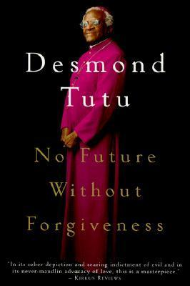
No future without forgiveness
“Ubuntu [...] speaks of the very essence of being human. [We] say [...] "Hey, so-and-so has ubuntu." Then you are generous, you are hospitable, you are friendly and caring and compassionate. You share what you have. It is to say, "My humanity is caught up, is inextricably bound up, in yours." We belong in a bundle of life. We say, "A person is a person through other persons. »
A person with ubuntu is open and available to others, affirming of others, does not feel threatened that others are able and good, for he or she has a proper self-assurance that comes from knowing that he or she belongs in a greater whole and is diminished when others are humiliated or diminished, when others are tortured or oppressed, or treated as if they were less than who they are.”

Slide 43
“Ubuntu is very difficult to render into a Western language. It speaks of the very essence of being human.
Being human means simply that « you are generous, you are hospitable, you are friendly and caring and compassionate »
It is to say, “My humanity is caught up, is inextricably bound up, in yours.” We belong in a bundle of life. We say, “A person is a person through other persons.”
A person with ubuntu is open and available to others, affirming of others, does not feel threatened that others are able and good, for he or she has a proper self-assurance that comes from knowing that he or she belongs in a greater whole and is diminished when others are humiliated or diminished, when others are tortured or oppressed, or treated as if they were less than who they are.”

Slide 44
Preliminary points for thoughts
Decolonizing compassion for the world and especially in the context of the Gaza War
Framing an Ubuntu Diplomacy (see Dikeledi Madise and Christopher Isike)
BUT CHALLENGES AND OPPORTUNITIES IN KWOWING, BEING AND DOING
– ESPISTEMICALLY: Addressing the difference expressions, meanings and interpretations
- PRACTICALLY: addressing the change of scale to frame politics of forgiveness and togetherness in the Gacaca and South African Model

Slide 45
Merci de votre attention

