Slide 2
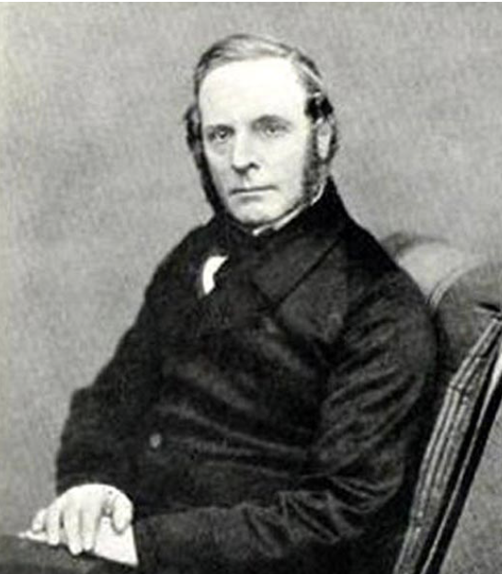
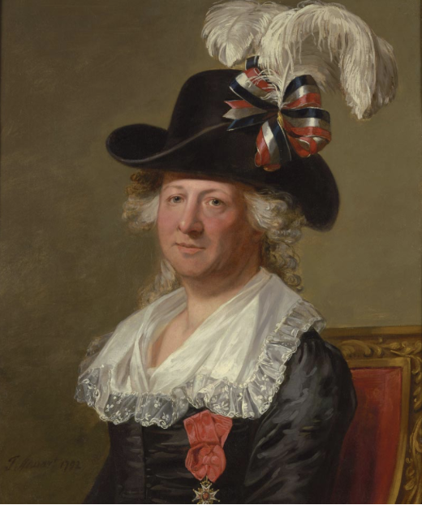
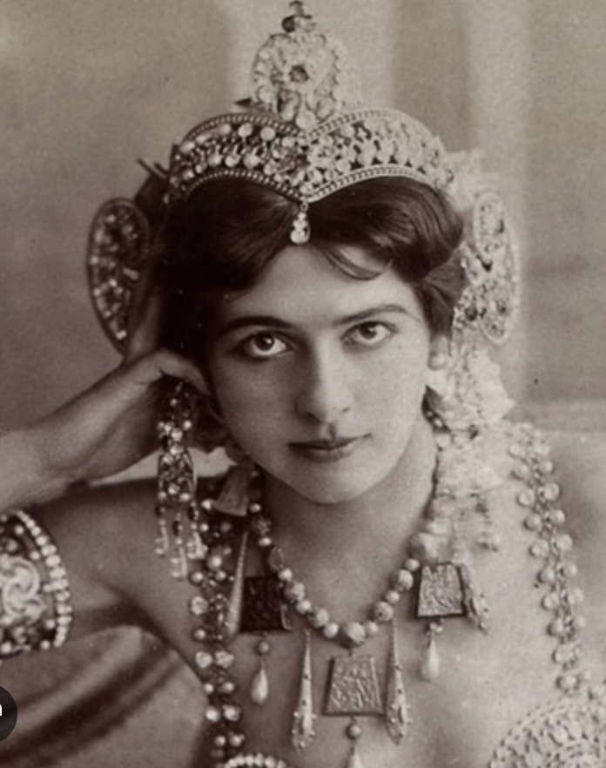
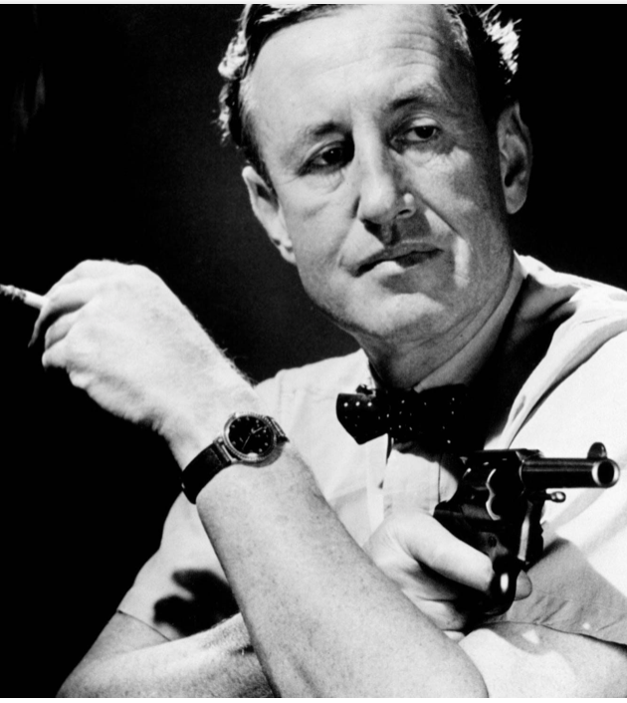
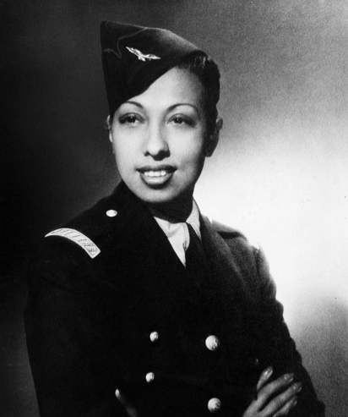
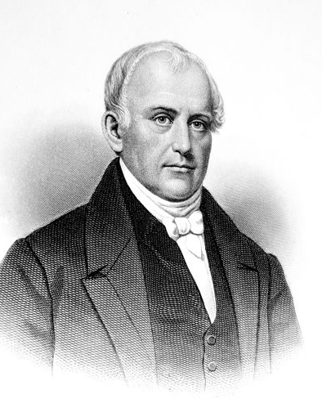
Look at the following pictures below. The photographs and the painting all represent famous and lesser-known historical figures. Can you recognize any of them? Have you heard of them or about what they did? What is the link between all of them? :

Slide 3
Look at the following pictures below. The photographs and the painting all represent famous and lesser-known historical figures. Can you recognize any of them? Have you heard of them or about what they did? What is the link between all of them? :
CHARLES D’EON DE BEAUMONT
ROBERT FORTUNE
MATA HARI
IAN FLEMMING
JOSEPHINE BAKER
SAMUEL
SLATER

Slide 4
Read the following headlines carefully .
Complete them with the correct missing word:
HUB / trade secrets / intelligence agent / NSA / traitor /
« One of the Earliest Industrial Spies Was a French Missionary Stationed in China. When he wasn’t converting people, Father Francois Xavier d’Entrecolles was extracting 4.............................. from porcelain producers », by Cara Giaimo, April 20 2017, Atlas Obscura.com
« How Industrial Espionage Started America’s Cotton Revolution – To the British, Samuel Slater was ‘Slater the 1...............................,’ but to the Americans, he was the father of the American industrial revolution »,by Kat Eschner December 20, 201, Smithsonian Magazine
« Snowden says 2.............................. engages in industrial espionage », by Erik Kirschbaum, January 26, 2014, Reuters
« Back to the Cold War: Russia uses Mexico as a 3.............................. for spying on the U.S. », By Dan De Luce and Owen Hayes, Sept. 21, 2024, NBC News
« The Daring Ruse That Exposed China’s Campaign to Steal American Secrets – How the downfall of one 5............................. revealed the astonishing depth of Chinese industrial espionage. » By Yudhijit Bhattacharjee, Published March 7, 2023, The New York Times

Slide 5
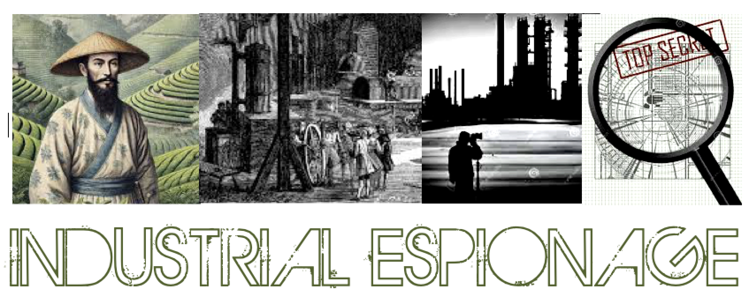
.
Corporate espionage is espionage conducted for commercial or financial purposes.
Corporate espionage is also known as industrial espionage, economic espionage or corporate spying.
To be precise, economic espionage is more specifically orchestrated by governments and is international in scope, while industrial or corporate espionage generally occurs between organizations/companies.

Slide 6
Read the following multiple-choice questions and choose the correct answer :
Question 1
What did Emperor Justinian’s Christian monks smuggle out of China in A.D. 550?
a) White clay and kaolin to make porcelain
b) Camelia plants to make tea
c) The formula for gunpowder
d) Worm eggs to produce silk
Question 2
Which Americans copied British industrial machines recreated them back home, in violation of British law at the beginning of the 19th century?
a) Robert Fortune
b) Samuel Slater
c) Francis Cabot Lowell
d) Karl Heinrich Stohlze

Slide 7
Read the following multiple-choice questions and choose the correct answer :
Question 3
What did Scottish botanist Robert Fortune do to steal the secrets of tea processing from China in 1848?
a) He bribed local tea farmers to sell him their seeds in secret
b) He bought tea plants at a market and hid them in crates labeled as silk goods
c) He disguised himself as a Chinaman and travelled to a tea plantation
d) He broke into a Chinese tea-processing facility at night and stole trade secrets
Question 4
In 1926, representatives from which country stole Ford tractor blueprints during a visit to Ford plants in the U.S.?
Germany
China
The Soviet Union
Japan

Slide 8
Read the following multiple-choice questions and choose the correct answer :
Question 5
What was the goal of French intelligence’s espionage activities against U.S. electronics firms such as IBM and Texas Instruments between 1987 and 1989?
To retaliate for a massive US-led espionage operation against European institutions
To support the struggling Compagnie des Machines Bull
To develop an early French version of the internet named « Minitel »
d) To develop the first French supercomputer
Question 6
In 2015, the United States accused China of stealing secrets from which two major U.S. companies, leading to a short-lived cease-fire on cyberattacks?
Boeing and Coca-Cola
b) IBM and General Motors
c) Microsoft and Pfizer
d) Google and Apple

Slide 9
LEAD IN
In pairs or in groups of three students, choose two or three questions from the list of eight questions below. Discuss them, provide examples, and compare your ideas and opinions:
Why might a company or a country want to steal another company’s secrets or technology?
How is industrial espionage carried out?
What are some of the ethical issues related to spying on competitors or other countries for industrial secrets?
Can you name any industries or fields where industrial espionage might be particularly common or important?
How do you think industrial espionage has changed from the past to the present? Is it easier or harder today?
In what ways did Western countries historically spy on Eastern nations for industrial secrets? Can you think of any specific cases?
How do you think globalization has influenced the rise of industrial espionage between the East and the West?
What kind of information do you think is most valuable to companies or governments in industrial espionage today?

Slide 10
…. eyes.
.... under the rug, but it eventually leaked to the press.
.... the bag during a lunch meeting, unintentionally revealing key research to a competitor.
… wool over his boss’s eyes by hiding the company's financial losses.
…. garden path with false promises of growth.
…. handed trying to steal confidential documents.
…. ground to stay ahead of any competitors' moves.
.... the radar, so the rival company never suspected a thing.
…. he wall during their meetings to find out what they’re planning.
…. for information about the competitor’s upcoming launch.
The company keeps an ear to the …
I wish I could be a fly on …
They went to great lengths to protect the new design from prying …
He tried to pull the …
The CEO led investors up the …
The security team caught the employee red- …
The espionage operation was designed to stay under …
The undercover agent was sent to the conference to fish …
The firm tried sweeping the industrial espionage incident ....
The employee let the cat out of ....

Slide 11
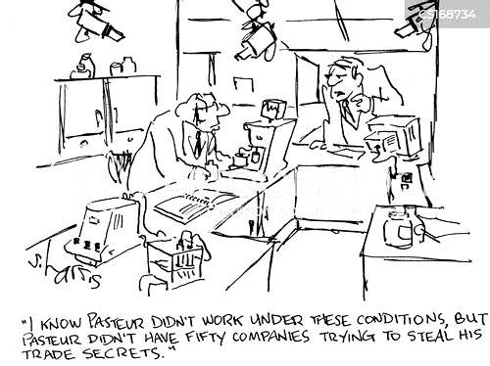
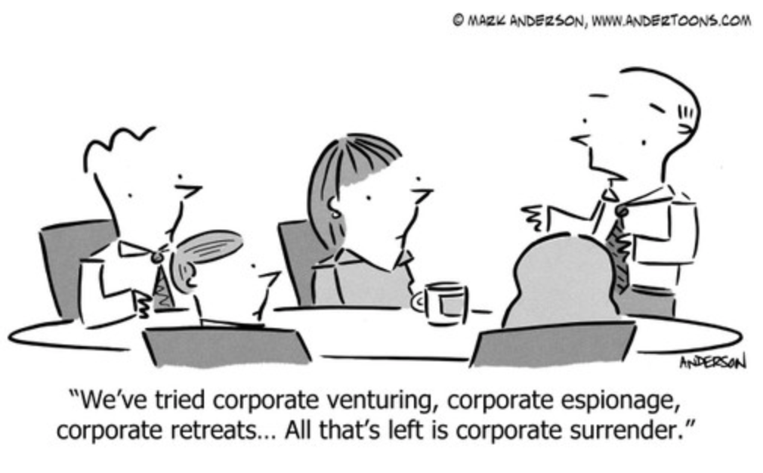
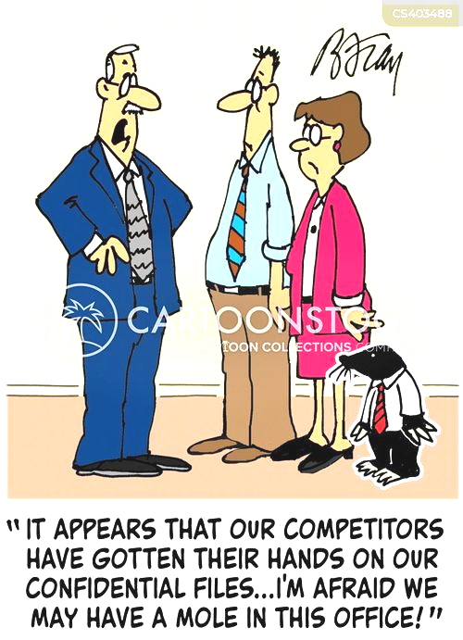
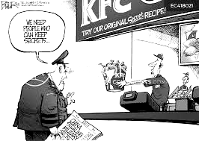
Watch the cartoons below,?

