Slide 2
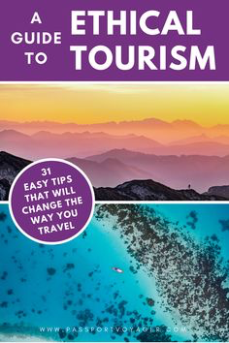
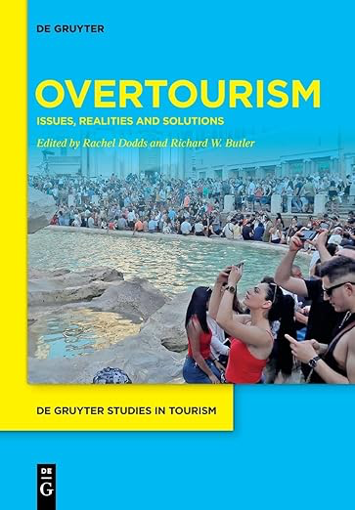
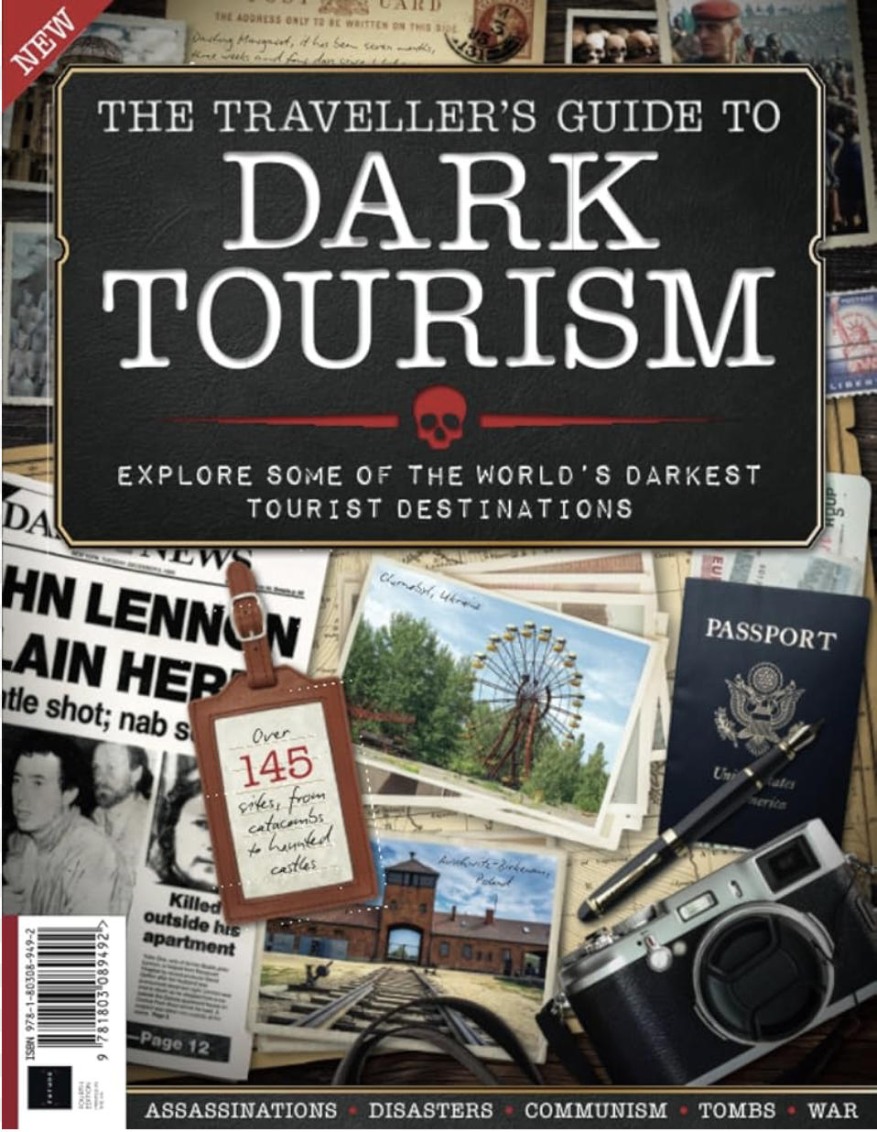
Look at these book covers. Which type of tourism do they promote or denounce? Which travel destinations do they probably recommend / advise agaisnt?

Slide 3
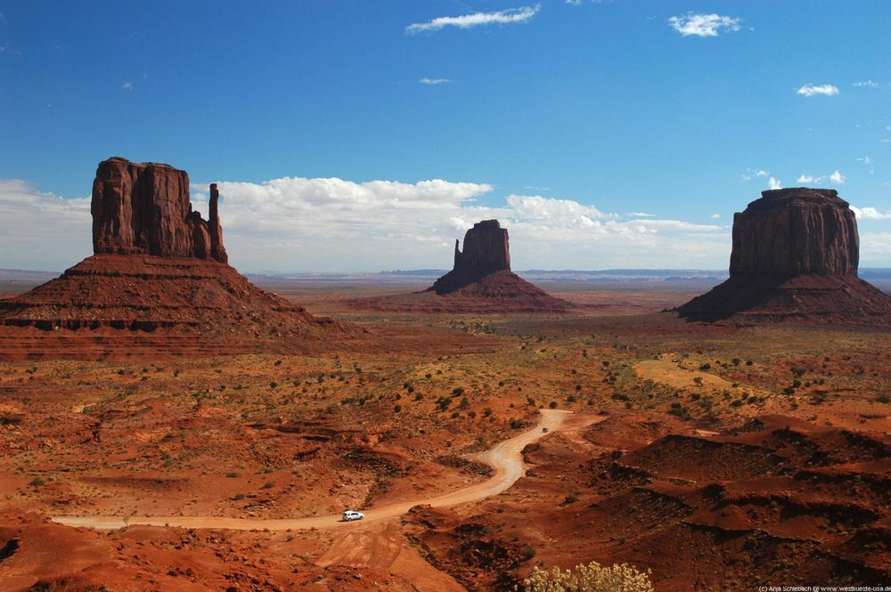
What usually motivates us to travel to a destination? Why do we choose to travel to a certain place?
Have you ever been tempted to travel to a particular city or country after reading about it in a book or hearing about it on TV?
What do you know about the current trend of « Screen tourism » ? If you have never heard the term, can you guess what it refers to ? Give examples.

Slide 4
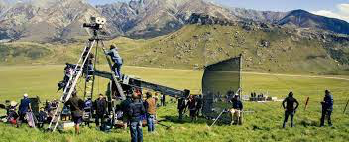
Film tourism, set-jetting or film induced tourism, is a specialized or niche form of tourism where visitors explore locations and destinations which have become popular due to their appearance in films and television series.
OBJECTIVE : exploring this phenomenon, in order to tackle the cultural, economic and social dimensions attached to this trend.

Slide 5
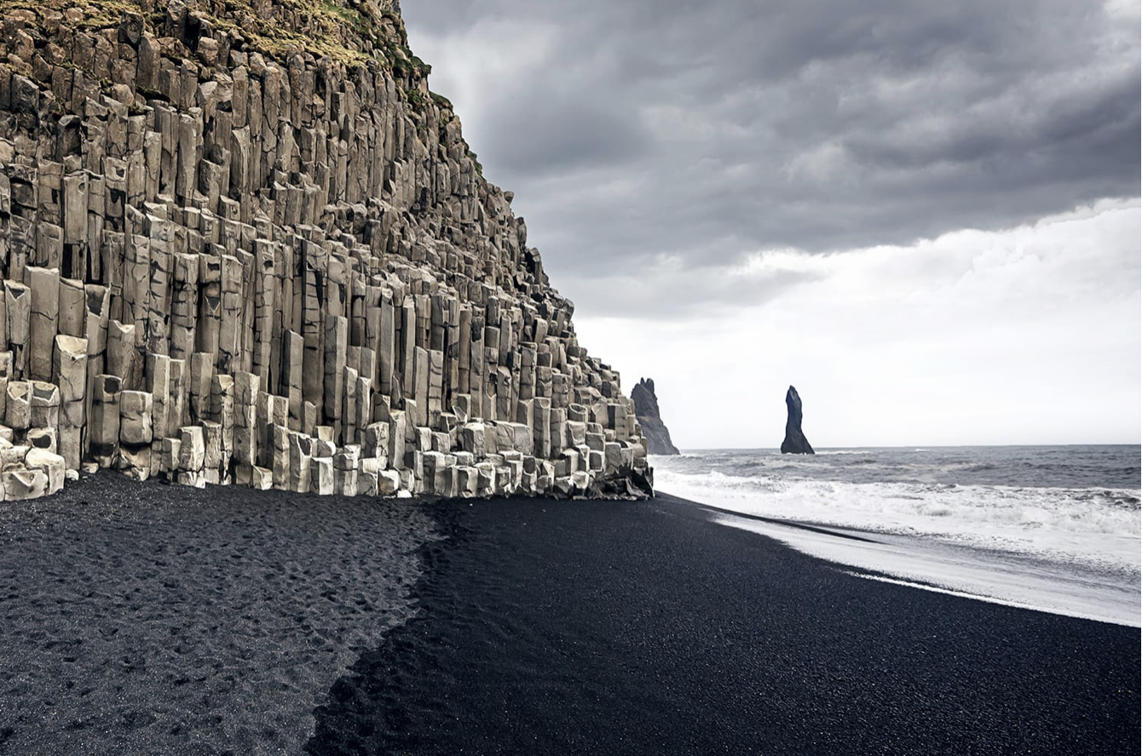
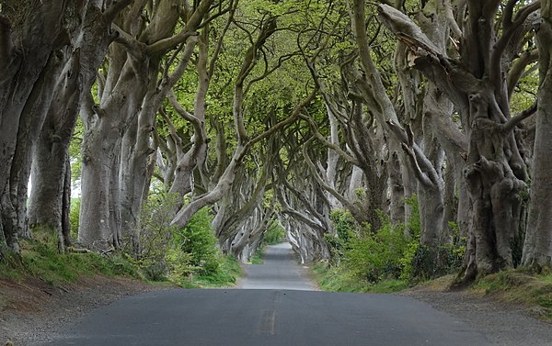
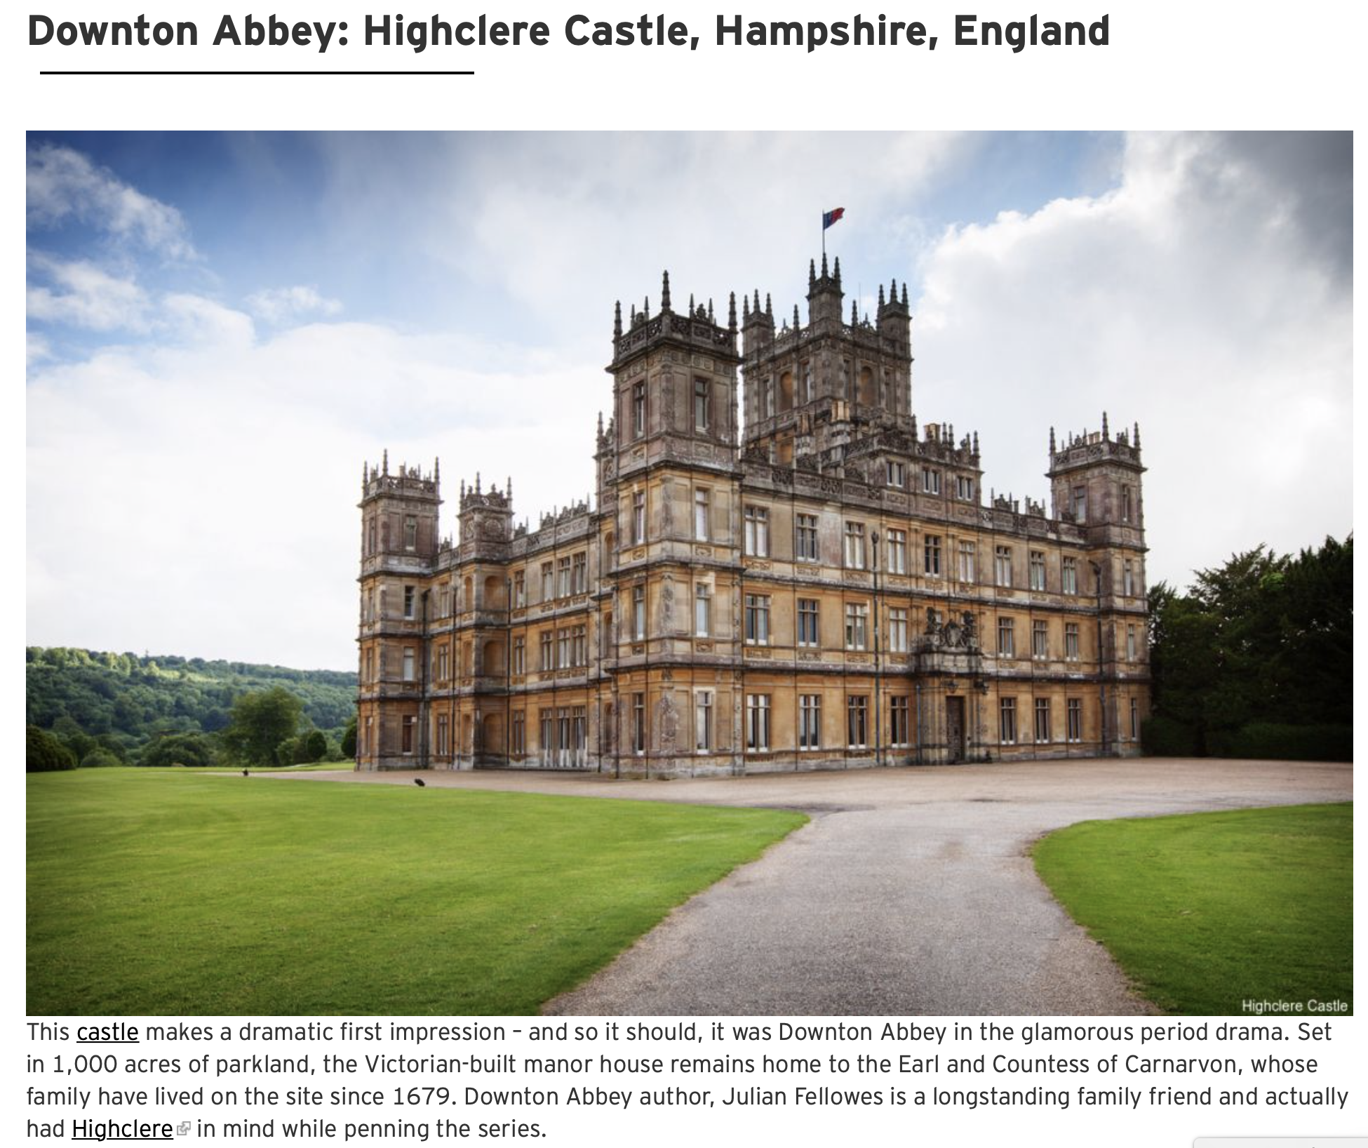
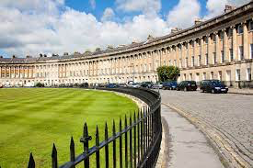
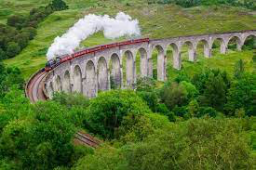
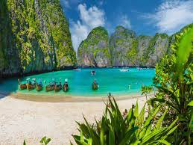
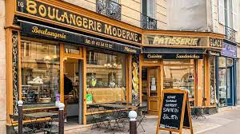
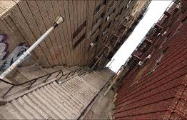
In which films or TV series can the following places be seen? Find as many as possible

Slide 6
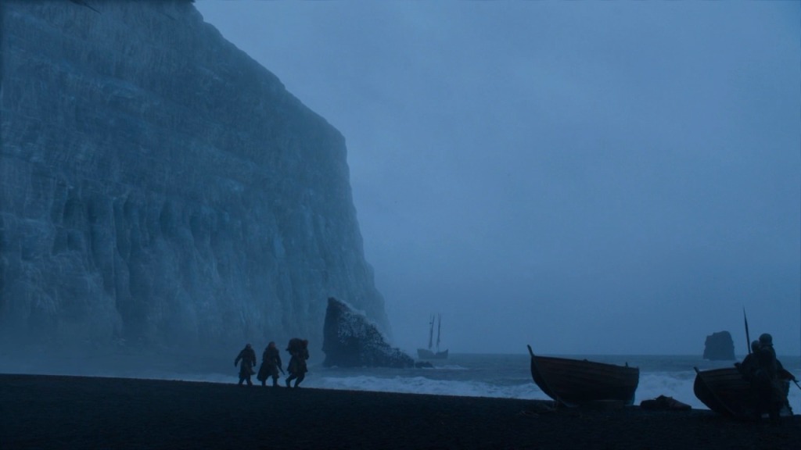
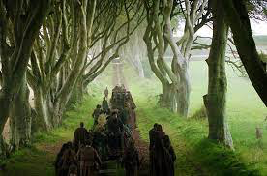
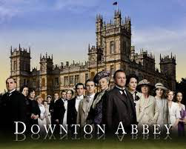
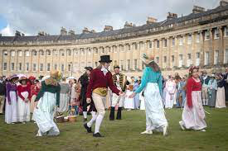
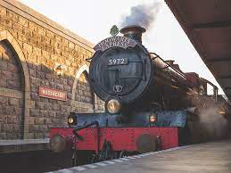
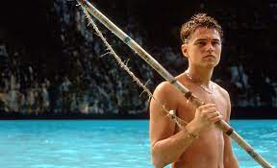
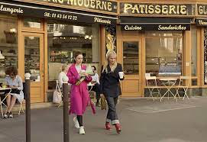
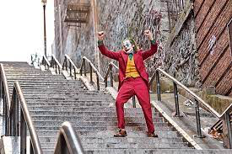
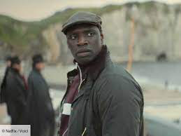

Slide 7
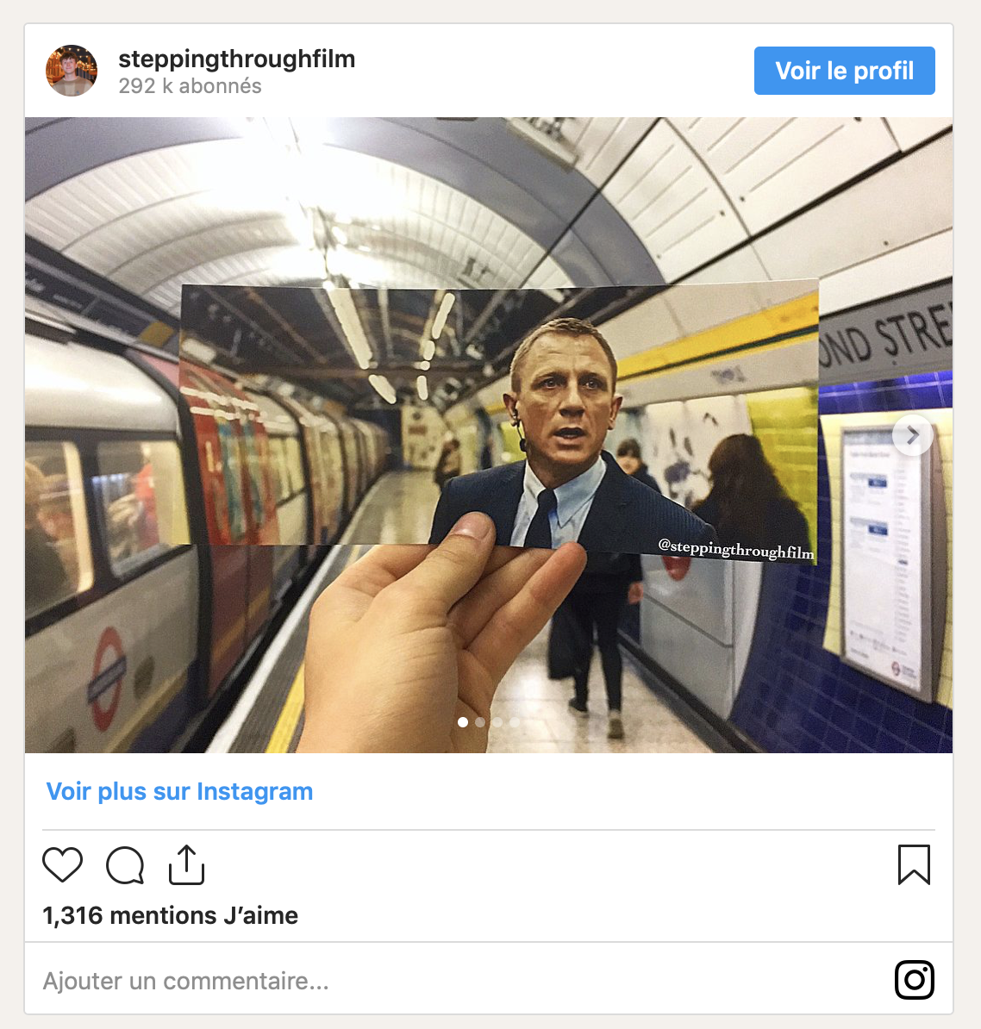
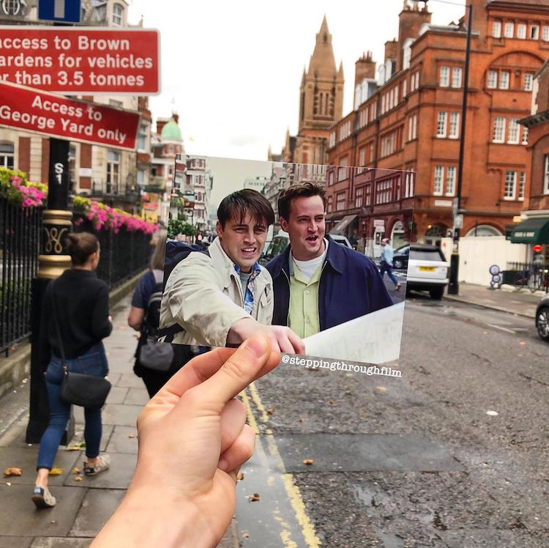
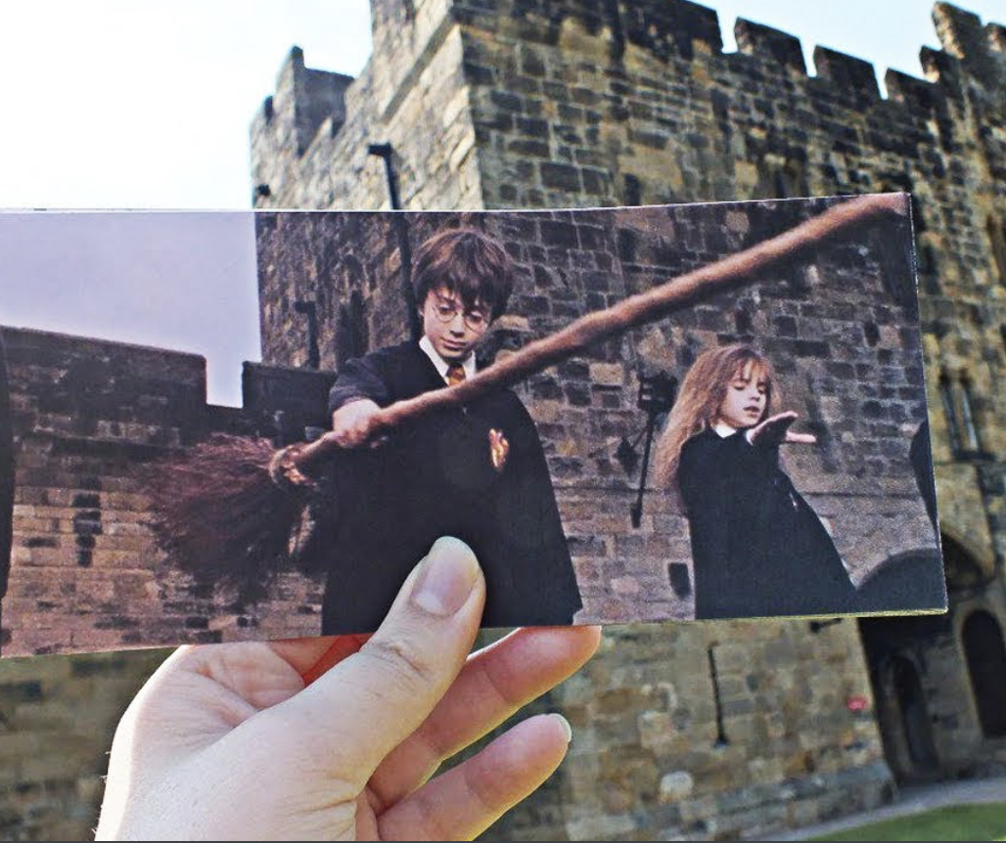
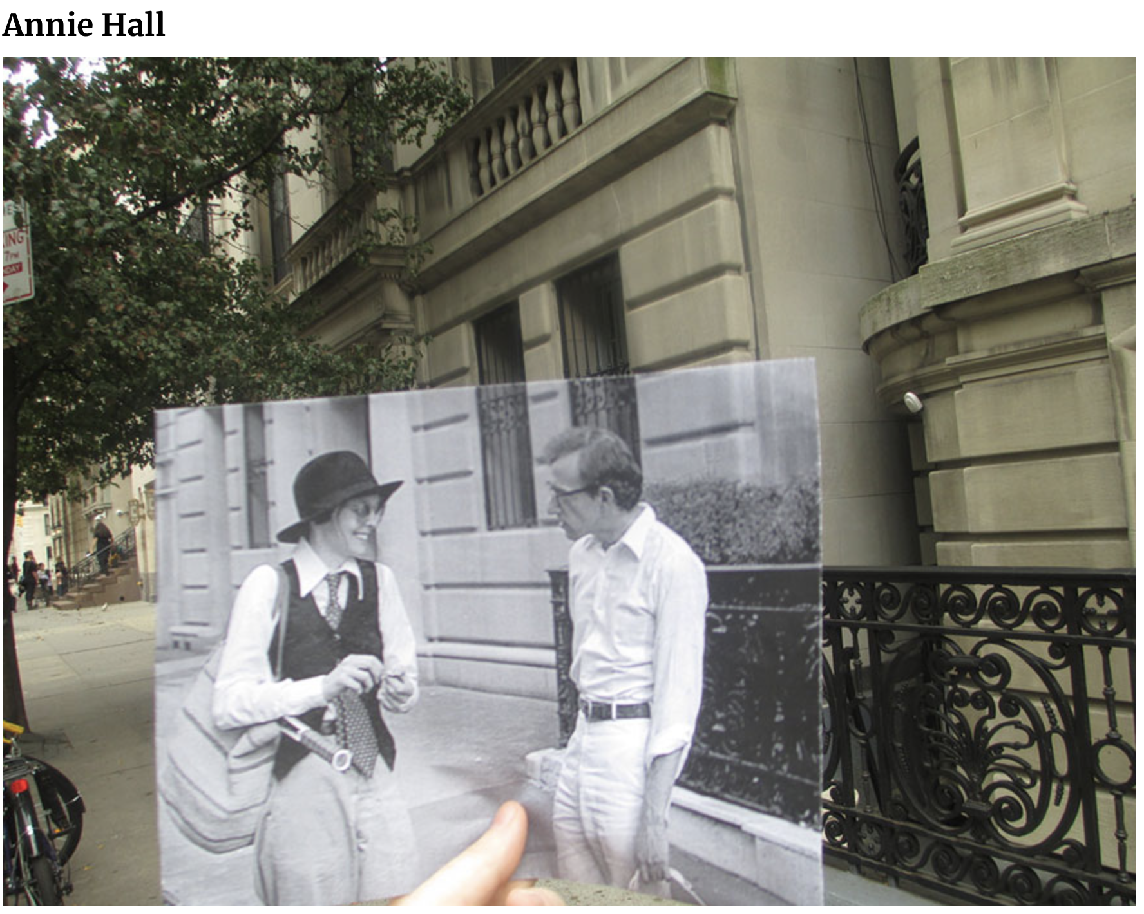
On Instagram (ex: @steppingthroughfilm account) and other social media, people share pictures taken on a number of film locations.

Slide 8
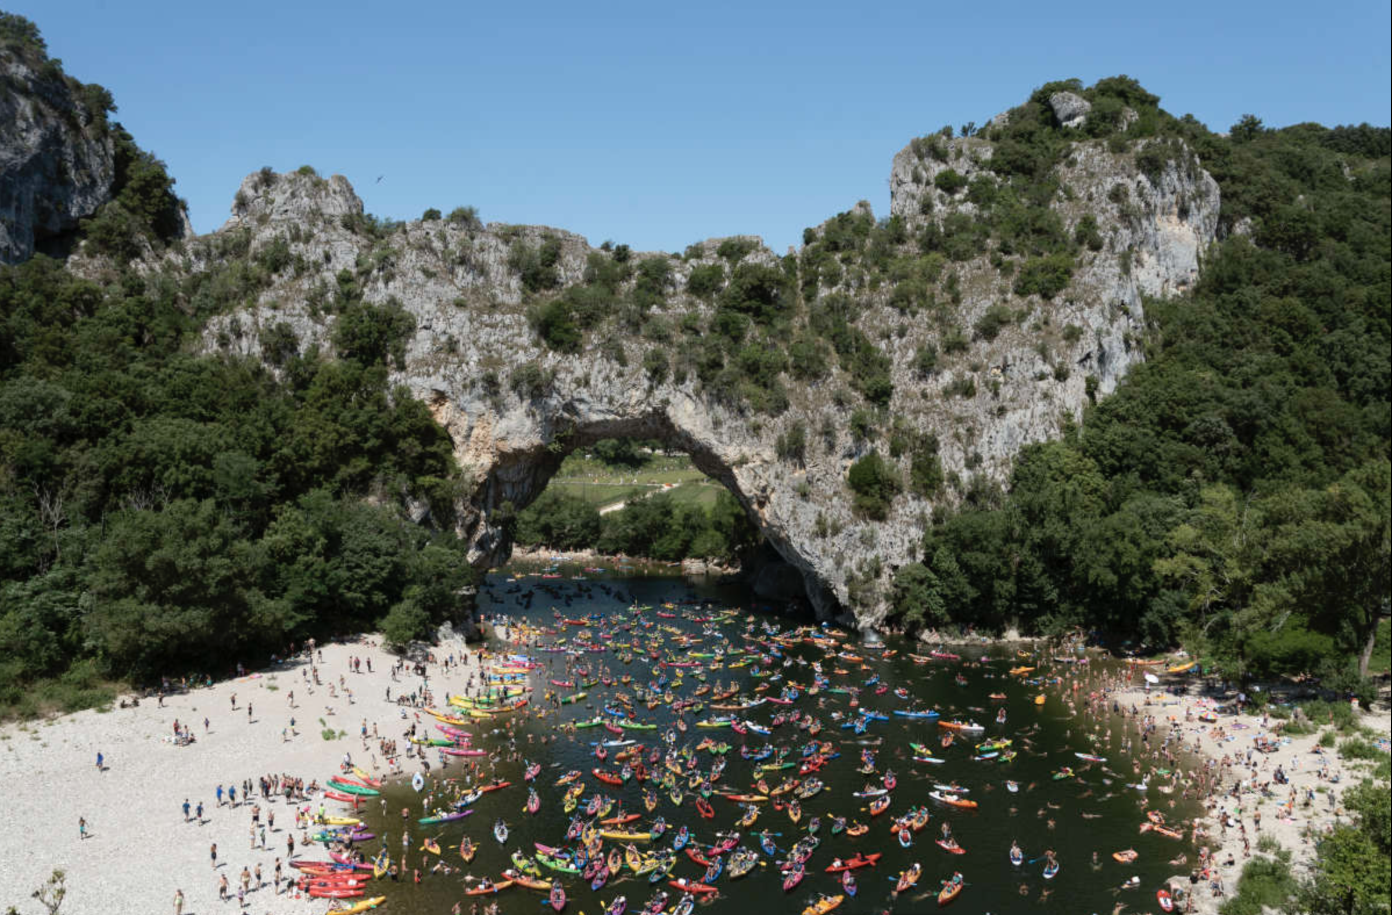
Look at this photograph? Have you ever seen it? Is it real or digitally retouched?

Slide 9
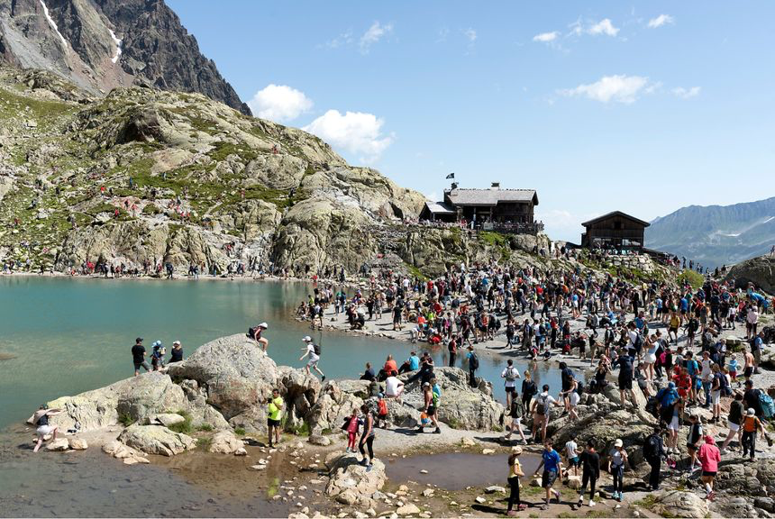
What about this second photograph?

Slide 10
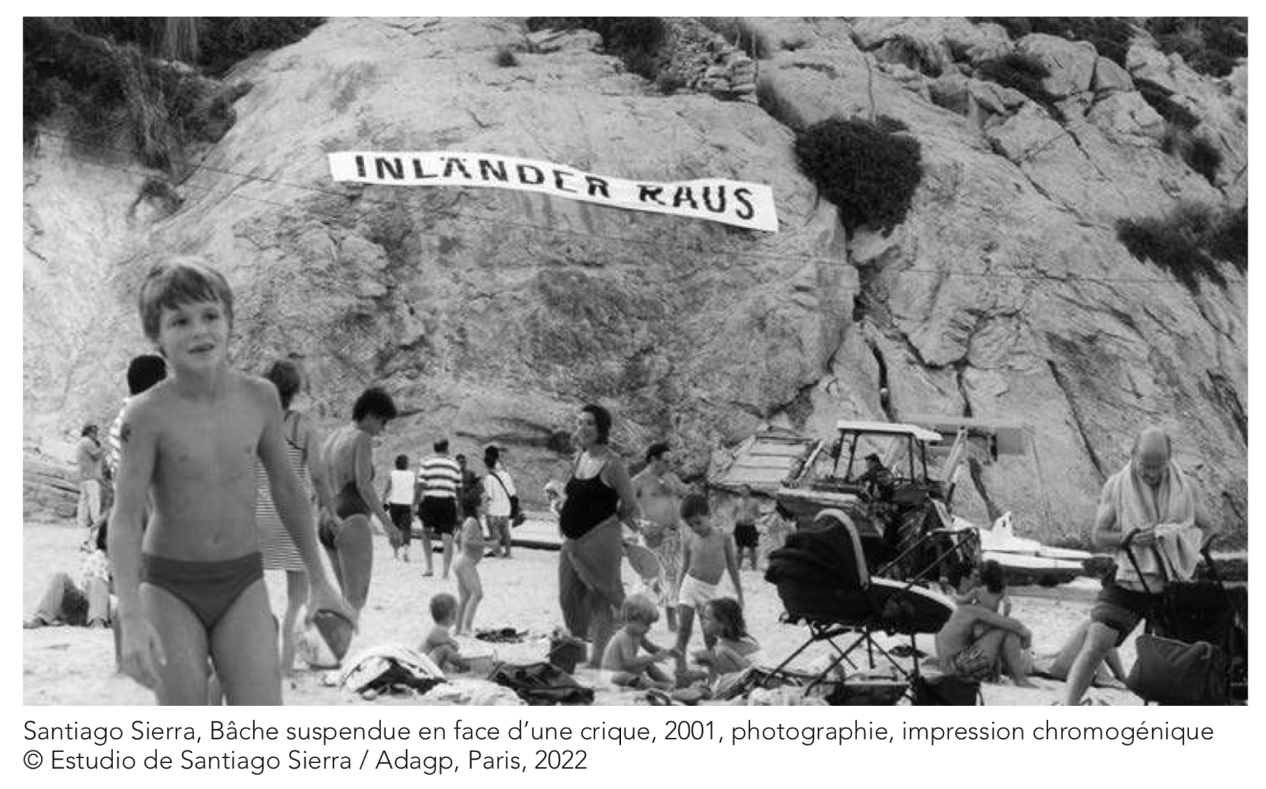
Now look at this photograph, taken during an art performance. How do you understand it?

Slide 11
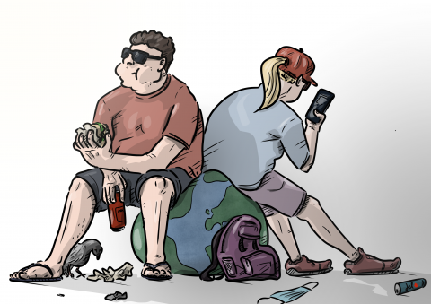
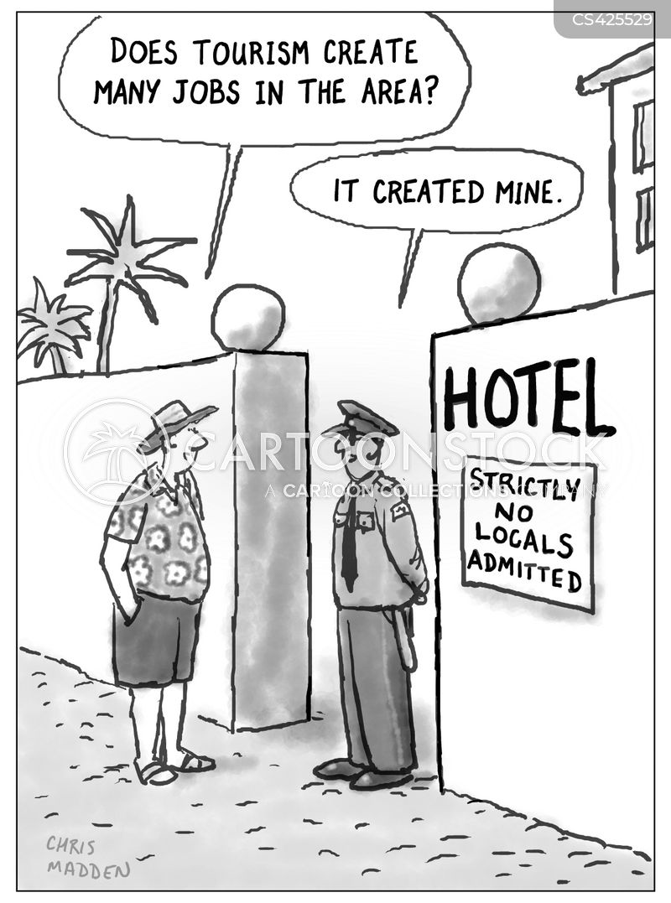
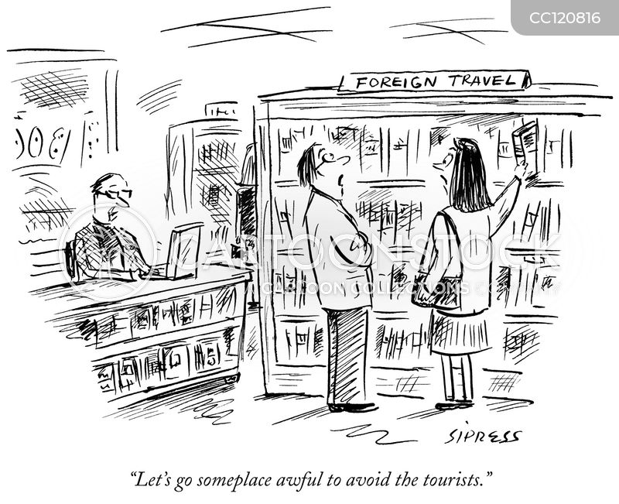
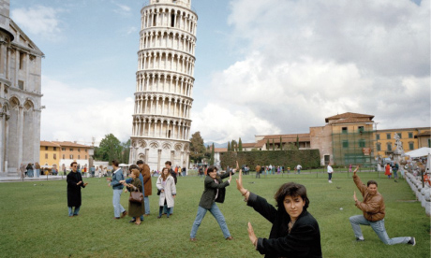
o Look at the following drawings or photographs. Which aspects of tourism do they mock or denounce? :

Slide 12
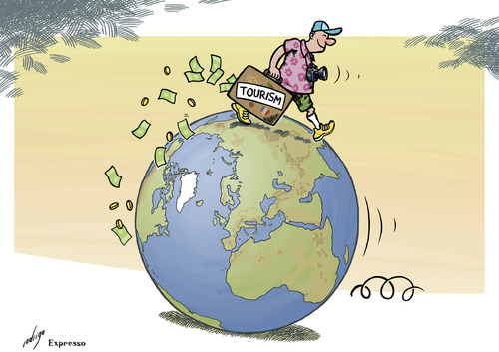
Match the first part of the sentence to the correct part in the second list in order to reconstitute the idiomatic phrases and stock expression about travelling and holidaying:
….. travel bug and is already planning her next trip.
...... track, when there’s no other tourist in sight.
...... the Romans do.
….. of a suitcase for weeks now. I can’t wait to settle somewhere.
…... your oyster!
…... on a shoestring.
trotter.
….......the mind.
With Eric’s new job, we’ve been living out …
She’s been bitten by the…
I like travelling off the beaten…
He’s started his world tour. He’s a real globe-…
They’ll have to camp and stay in cheap hostels. They’re really travelling…
You’re young and you have endless opportunities to explore. Go ahead, the world is…
He who travels far knows much. Travel does broaden…
When in Rome, do as….

Slide 13
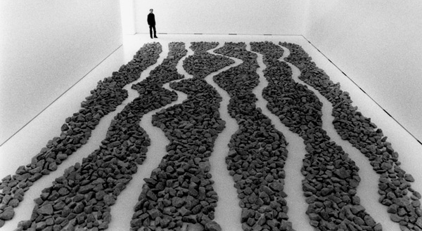
Below is a list of words connected to the semantic field of travel. Which ones are synonyms? Are there words whose meaning you don’t know?
Richard Long, Five Paths. Galeria Mario Sequeira, Braga, Portugal 2004

