Slide 1
European integration

Slide 2
Considering the European integration.
The tragedy of the war demonstrated the need for a united Europe. The post-war period was therefore a time of consultation, dialogue, and the establishment of new alliances and institutions. The OEEC, NATO, the Council of Europe, and then the ECSC were established before 1952. "Making peace and protecting ourselves" was therefore the key objective behind the idea of ​​European integration. The aim was to end the state of war that had reigned in Europe since the beginning of the 21st century. In this regard, linking the economic interests of European countries seemed a decisive step. Furthermore, it was a matter of protecting European states against any possible invasion by the USSR, in the context of the Cold War. The OEEC 1948: Three years after the end of the war in Europe, the United States decided to provide countries that requested it with massive aid to finance their reconstruction: this was the Marshall Plan. The Organization for European Economic Cooperation, headquartered in Paris, took over the distribution of American aid. In 1961, it was renamed the Organization for Economic Cooperation and Development (OECD). Expanded to include the developed world, the OECD now has 30 members. 2. NATO 1949: By the Treaty of Brussels signed in March 1948, the United States guaranteed the security of France, Belgium, Luxembourg, the Netherlands, and the United Kingdom. A year later, five other European countries joined the Brussels Five to form the North Atlantic Treaty Organization, a military alliance against the Soviet threat. The FRG joined in 1955, following the failure of the EDC. NATO now has 26 members spread across Europe and North America. 3. The Council of Europe 1949: Based in Strasbourg, the Council of Europe is responsible for considerable legal work, particularly in the area of ​​human rights. But it plays a modest role in unifying the continent: the Council's operating methods are limited, with the need for agreement among all its members being a source of stumbling blocks.

Slide 3
What is the European Union?
It is a voluntary interstate association.
It is a unique, sui generis political and economic union between 27 member states.
These states delegate or transfer, by treaty, the exercise of certain powers to community bodies, i.e., the EU institutions.
Its institutional structure is partly supranational and partly intergovernmental.
(For example, the European Parliament is elected by universal suffrage, while representatives of each member state sit on the European Council and the Council of the EU. Finally, the President of the European Commission is appointed by the Parliament following a proposal from the European Council.)
It covers a territory of 4.2 million km² and has a population of 443 million. It is the world's third largest economy after the United States and China. 3 treaties govern its operation: 1. The Treaty of Maastricht (TEU of 1992)/ 2. The Treaty of Rome (TFEU of 1957)/ 3. The Treaty of Lisbon of 2007.

Slide 4
The genesis of European construction
1. The Schuman Declaration of 1950:
Made by the French Minister of Foreign Affairs on May 9, 1950, it was conceived as the founding text of European integration and construction. Inspired by Jean Monnet, a French economist and Deputy Secretary of the former League of Nations, it proposed the creation of a European organization responsible for jointly managing the coal and steel production of France and Germany. The choice of these sectors was highly strategic, since the steel industry was closely linked to the arms industry.
2. The Treaty of Paris of 1951 (ECSC):
This was a founding act aimed at bringing together the victors and vanquished of the Second World War. On April 18, 1951, the Treaty of Paris was signed by six European states, thus creating the European Coal and Steel Community (ECSC). These states were: France, West Germany, Italy, Belgium, Luxembourg, and the Netherlands. By pooling their coal and steel production, France and Germany replaced rivalry and resentment with solidarity of interests, just five years after the end of the war. Another innovation: this organization opted for a supranational mode of management, breaking with previous intergovernmental experiments.
The ECSC was the first international organization based on supranational principles and, through the establishment of a single market for coal and steel, was intended to support economies, increase employment, and raise the average standard of living within the Community.

Slide 5
The Failure of the European Defense Community:
In 1952, these six founding states signed a treaty in Paris establishing the EDC. The aim was to allow the rearmament of West Germany within the framework of a common European army. This step was justified in particular by the danger posed by the USSR in the context of the Cold War. However, only five ECSC member states ratified the treaty. The French parliament refused to ratify it in 1954, rejecting the idea of ​​creating a supranational army.
At that time, all attempts to create a common European defense body failed. Concerned about their respective national sovereignty, the member states rejected any initiative in this direction. They were content with the existence of NATO (North Atlantic Treaty Organization), with the participation of the United States, to protect themselves against the USSR and the Soviet Union in Eastern Europe. 4. The Treaties of Rome of 1957 (EEC and EAC):
Based on the 1951 Treaty of Paris (ECSC), the Treaty of Rome broadened the scope of supranational cooperation and thus relaunched European integration, which had been slowed by the failure of the political project of the European Defense Community (EDC) in 1954. The economic sphere, less subject to national resistance, emerged as a consensual area of ​​cooperation.
These two treaties: the first created the EEC, the second the EAC.

Slide 6
The European Economic Community (EEC):
Its mission, through the establishment of a common market and the progressive approximation of the economic policies of the Member States, is to promote the harmonious development of economic activities throughout the Community, continuous and balanced expansion, increased stability, an accelerated rise in living standards, and closer relations between the states it unites.
The single market, or internal market, is a customs union between all EU member states, based on four fundamental freedoms: the free movement of goods and services, capital, and people.
The common market implies a customs union between the member states, i.e., the elimination of customs duties on the goods they trade, as well as the establishment of a common trade policy and customs tariff with regard to third countries. A 12-year transition period is then provided for. In addition to the free movement of goods, the Single Market also provides for "the abolition, between Member States, of obstacles to the free movement of persons, services, and capital." Its operation necessitates the approximation of national legislation and the development of common policies. The Treaty provides for the establishment of common policies not only in the areas of trade and competition, but also in transport and agriculture.

Slide 7
Euratom (European Atomic Energy Community).
The Euratom Treaty, signed in 1957 by the six member states of the ECSC, established the European Atomic Energy Community (EAEC). It aimed to coordinate the nuclear energy research programs of member countries. The primary objective was to ensure energy self-sufficiency.
Euratom's stated ambition was to build a large-scale nuclear industry. However, the initial reluctance of some founding states, institutional obstacles, and the relative inadequacy of the resources deployed prevented this goal from being achieved.

Slide 8
The European institutions:
The Treaty of Rome thus established institutions and decision-making mechanisms allowing the expression of both national interests and a community vision.
These institutions were: the European Commission, the Council of Ministers, the European Parliament, the Court of Justice, and the Economic and Social Council.
The effects of the dismantling of customs duties and the elimination of quantitative trade restrictions during the transition period (1958-1970) were spectacular: intra-Community trade increased sixfold, while EEC trade with third countries increased threefold.

Slide 9
Introduction to EU institutions:
The European institutions are political actors in the European integration process, created by the Treaty of Rome in 1957. They are the bodies that govern the EU. Thanks to these institutions, the EU has a legal personality.
Since the signing of the Treaty of Lisbon in 2007, the European Union has had seven institutions.
These seven institutions:
1. the European Parliament,
2. the European Council,
3. the Council (of Ministers or Council of the EU),
4. the European Commission,
5. the Court of Justice of the European Union,
6. the European Central Bank,
7. the Court of Auditors.

Slide 10
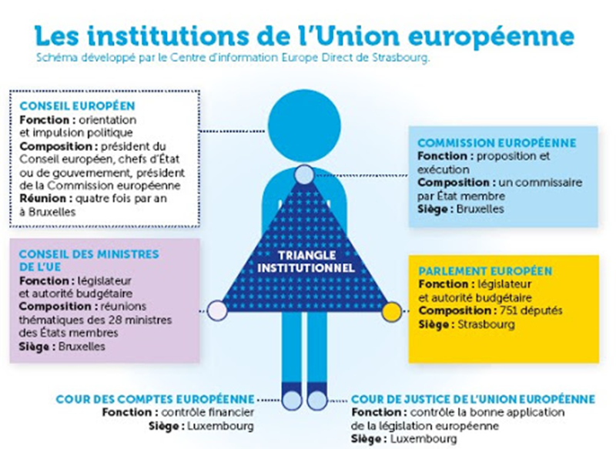
The European Union is a unique structure that does not fall into any other traditional legal category. From a historical perspective, its political system is unique and has continuously developed over a period of more than 50 years. The countries that make up the EU (its ‘member states’) delegate some of their decision-making powers to shared institutions they have created, so that decisions on specific matters of joint interest can be made democratically at European level. The policies and laws are produced by an ‘institutional triangle’ which includes: the European Parliament (EP) which represents the EU’s citizens, the Council of the European Union, which represents the national governments and the European Commission, an independent body which which seeks to uphold the interests of the Union as a whole.

Slide 11
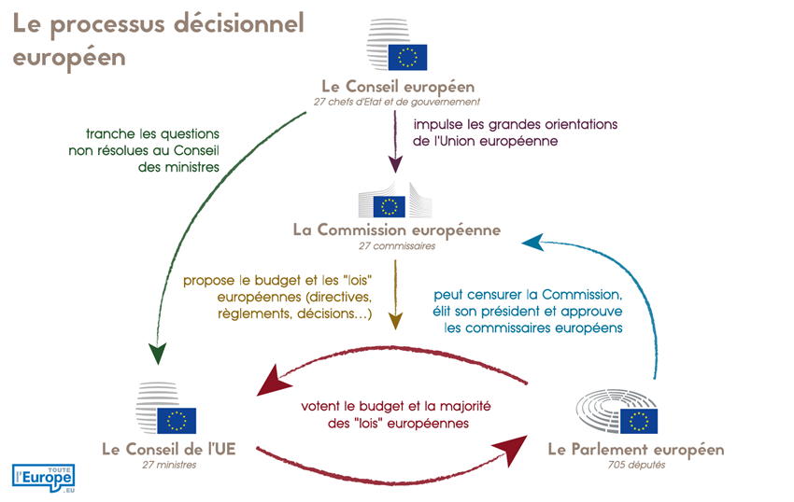
The decision making process in EU:
Decision-making within the European Union involves four main institutions: the European Commission, the European Parliament, and the Council of the European Union, which form the European institutional triangle. The European Council, for its part, plays a role of impetus, guidance, and arbitration.

Slide 12
The European Council:
The European Council should not be confused with: the Council of the European Union, which brings together the ministers of the Member States (by area of ​​competence) and which shares legislative power with the European Parliament; nor with the Council of Europe, which is an international organization outside the European Union and which ensures the implementation of the European Convention on Human Rights (focused on education, culture, and especially the defense of human rights).
The European Council defines the priorities of European integration and indicates the directions that European policies should take, particularly in matters of common foreign and security policy. The European Council is composed of the heads of state and government of the twenty-seven Member States of the European Union, its President, and the President of the European Commission. The High Representative for Foreign Affairs and Security Policy also participates in its work. All major political decisions concerning the construction of Europe are taken by the European Council: reform of treaties and institutions, financing of the European budget, enlargement of the European Union, Europe's positions on the international stage, and economic policy.
It does not exercise a legislative function.
The European Council's decisions have significant political significance since they indicate the will of the Member States at the highest level. To be effectively implemented, the European Council's proposals must then follow the appropriate legislative procedure. Under the ordinary legislative procedure, the European Commission translates the European Council's wishes into legislative proposals, which are then voted on by the European Parliament and the Council of the European Union.

Slide 13
The European Council always decides by consensus, except where the treaties provide otherwise. It then takes decisions by a reinforced qualified majority on the election of its President, the appointment of the President of the Commission, the High Representative, and the President and Vice-President of the European Central Bank. In this case, the rules for reinforced qualified majority voting are the same as for the Council of the European Union. The President of the European Council and the President of the Commission may not vote.
The European Council is composed of the Heads of State or Government of the Member States, the President of the Commission, and the President of the European Council. An innovation of the Lisbon Treaty, the latter's role is to preside over and lead the institution's work. Its creation reflects the desire of European leaders to provide the Union with a stable political power responsible for leading the work of the European Council and ensuring continuity of action.
The latter also fulfills a diplomatic function to give Europe greater visibility. Often accompanied by the President of the European Commission at international summits, he represents the Union externally on matters relating to the CFSP, alongside the High Representative of the Union for Foreign Affairs and Security Policy.
The President of the Council is elected for a renewable term of two and a half years.
The Lisbon Treaty establishes the convening of two meetings every six months, at the President's initiative. If necessary, a minister may accompany the Head of State or Government. If the situation requires it, the President of the European Council may convene an extraordinary meeting, which occurs regularly.

Slide 14
The European Commission:
The European Council always decides by consensus, except where the treaties provide otherwise. It then takes decisions by a reinforced qualified majority on the election of its President, the appointment of the President of the Commission, the High Representative, and the President and Vice-President of the European Central Bank. In this case, the rules for reinforced qualified majority voting are the same as for the Council of the European Union. The President of the European Council and the President of the Commission may not vote.
The European Council is composed of the Heads of State or Government of the Member States, the President of the Commission, and the President of the European Council. An innovation of the Lisbon Treaty, the latter's role is to preside over and lead the institution's work. Its creation reflects the desire of European leaders to provide the Union with a stable political power responsible for leading the work of the European Council and ensuring continuity of action.
The latter also fulfills a diplomatic function to give Europe greater visibility. Often accompanied by the President of the European Commission at international summits, he represents the Union externally on matters relating to the CFSP, alongside the High Representative of the Union for Foreign Affairs and Security Policy.
The President of the Council is elected for a renewable term of two and a half years.
The Lisbon Treaty establishes the convening of two meetings every six months, at the President's initiative. If necessary, a minister may accompany the Head of State or Government. If the situation requires it, the President of the European Council may convene an extraordinary meeting, which occurs regularly.

Slide 15
Council of the EU:
Also called the Council of Ministers or simply the Council,
It, in turn, decides on European legislation and the budget. Composed of ministers from the Twenty-Seven Member States, it meets around 100 times a year to discuss a specific area (Agriculture, Foreign Affairs, Economy, etc.).
It is an institutional body, both executive and legislative, of the EU, and decides on legislative and budgetary acts. It shares its competence in areas subject to the ordinary legislative procedure with the European Parliament, with which it forms a bicameral parliament. Thus, the Council of Ministers represents the governments of the Member States, while the European Parliament represents the citizens of the Member States.

Slide 16
Working with the European Parliament and the European Commission, it is the EU's main decision-making body.
It negotiates and adopts EU legislation, in most cases with the European Parliament, based on proposals submitted by the European Commission. It follows the ordinary legislative procedure, also known as "codecision," which applies to policy areas in which the EU has exclusive competence or competence shared with the Member States.
It coordinates the policies of EU countries.
It develops the European Common Foreign and Security Policy, based on guidelines from the European Council.
It concludes agreements between the EU and other countries or international organizations.
It adopts the EU's annual budget, jointly with the European Parliament.

Slide 17
Depending on the area concerned, the Council of the EU adopts its decisions:
1. by double qualified majority: a vote in favor of 55% of Member States, representing at least 65% of the EU population (i.e., 16 states (before Brexit) and approximately 325 million inhabitants), with a blocking minority requiring at least four states (i.e., three states representing more than 35% of the population cannot, in theory, block the vote).
2. by simple majority: a vote in favor of 14 Member States;
3. by unanimity: all votes are in favor.
Qualified majority voting is the most widely used voting method in the Council, which accounts for approximately 80% of all EU legislative acts adopted. It is used when the Council takes decisions under the ordinary legislative procedure (= the codecision procedure). The ordinary legislative procedure (formerly the codecision procedure) allows the European Parliament to adopt certain Community directives and regulations in partnership with the Council of the European Union: the two powers must agree on the text before it is adopted, then be transposed subsequently in each Member State: it is then that they will have the force of law. The ordinary legislative procedure is the main mechanism for adopting legislative texts.

Slide 18
The European Parliement:
It sits in Strasbourg.
Members are elected by direct universal suffrage by the populations of European countries every 5 years. There are 705 members. These members are grouped by political affinities or groups, not by nationality. The number of members each country has is proportional to its population.
It plays three main roles:
1. Legislative role
It adopts Union legislation jointly with the Council of the European Union, based on proposals from the European Commission
It decides on international agreements
It decides on enlargements
It examines the Commission's work program and invites it to submit legislative proposals

Slide 19
Oversight role:
It exercises democratic control over all EU institutions.
It elects the President of the Commission and approves the Commission as a body. It can vote on a motion of censure, forcing the Commission to resign.
It "grantes discharge," i.e., it approves how the EU budget has been spent.
It examines citizens' petitions and launches inquiries.
It debates monetary policy with the European Central Bank.
It asks questions of the Commission and the Council.
It carries out election observation missions.
3. Budgetary role:
It establishes the EU budget, jointly with the Council.
It approves the EU's long-term budget (the "multiannual financial framework").

Slide 20
ordinary legislative procedure:
https://www.europarl.europa.eu/cmsdata/293607/Diagram.pdf
European parliamentary elections in 2024 (next lecture).

