Slide 1

Why is the English language so weird?

Slide 2






GRAMMAR NEWSFLASH

Slide 3
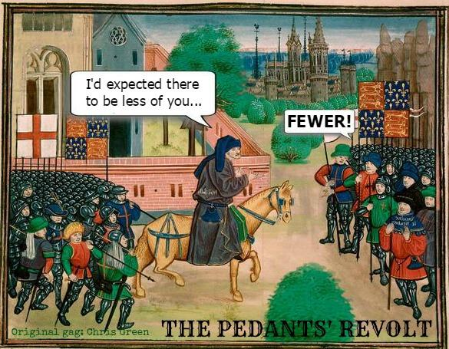
GRAMMAR NEWSFLASH
SINGULAR / PLURAL CONUNDRUMS IN ENGLISH

Slide 4
GRAMMAR NEWSFLASH
SINGULAR / PLURAL CONUNDRUMS, QUICK TEST /20
What is the plural form of the following words:
Thesis
Index
Luggage
Roof
Hoof
Fish
Are these nouns singular or plural?
(sing/plural/depends…)
Data
News
Mathematics
Police
Staff
Family
Means
Species
Alumnus
Person
Shrimp
Fruit
Criterion
Aircraft

Slide 5
GRAMMAR NEWSFLASH
SINGULAR / PLURAL CONUNDRUMS IN ENGLISH
BASIC LEVEL:
Adding ‘s’ modifies noun in the following cases (examples):
- e.g. knife => knives. A few exceptions: proof, roof, etc.
- city => cities (proper nouns and names excepted: Shelby => the Shelbys)
- bonus => bonuses (but see below for exceptions)
- potato => potatoes. Exception: ‘‘loan words’’ consciously borrowed from foreign languages: simply ‘s’ or special rules apply, cf. espresso/espressos).

Slide 6
GRAMMAR NEWSFLASH
SINGULAR / PLURAL CONUNDRUMS IN ENGLISH
Irregular plurals:
From old and middle English: child/children; mouse/mice; ox/oxen etc.
From foreign languages - NB: for foreign‘‘loan words’’, it sometimes depends on speaker pedantry…
      Greek: topos/topoi (or toposes…); criterion/ criteria phenomenon/phenomena (or phenomenons…)
      Latin: curriculum/curricula; cactus/cacti, alumnus/alumni [but viruses not ‘’viri’’, and data ‘’is’’ not ‘‘are’’ mostly nowadays =has become uncountable]
      NB: words ending in –is, -ix or –ex (from either Greek or Latin, sometimes Greek-through-Latin or French) have specific plurals: analysis/analyses; thesis/theses; index/indices (sometimes indexes)
      Hebrew: mitzvah/mitzvot(h); Italian: cello / celli (etc.)

Slide 7
GRAMMAR NEWSFLASH
SINGULAR / PLURAL CONUNDRUMS IN ENGLISH
Tricky situations:
Some words look plural but are in fact singular: e.g. means (’’a means to an end’’), a species, a TV series, mathematics, ethics, news…
Countable/uncountable (well known to you, I just mention it in passing): information, luggage, news, fruit (ambiguous nowadays) and countless other words.
If uncountable = never plural + never counted (not even ‘a’), specific grammar (less not fewer, etc.)
Countable nouns that keep the same form in the plural: fish, deer, shrimp, trout, sheep (many animals in fact): a fish, two fish. But also words like aircraft (two aircraft, not two aircrafts).
Can be plural (fishes) only if it means different types/species of fish or if you impersonate Italian-American mobsters (‘‘sleep with the fishes’’)

Slide 8
GRAMMAR NEWSFLASH
SINGULAR / PLURAL CONUNDRUMS IN ENGLISH
Tricky situations:
Some words look singular but are in fact plural…
Typically: “Cattle” or “police”: never singular in English: ‘The cattle are restless’; ‘The police are coming’.
Individual members = add man/woman or officer: ‘Ten police officers were awaiting them in the lobby’. Reference to several groups that count as “police” = different police forces / departments.
Collective nouns = groups of people are a special case: staff, family, team, squad, platoon, posse, Netflix, Paris 1, the government, etc.
The associated verb can usually be singular or plural depending on what you want to emphasize = as a tightly-knit unit, or as several people.
Example: ‘’The McCoy family comes from Laredo’’ BUT ‘’my family are coming over for Thanksgiving’’.
However American English usually prefers singular over plural <> Brits…

Slide 9
GRAMMAR NEWSFLASH
Bonus: specific nouns of groups of items/animals
A flock of sheep
A pack of wolves
A school/shoal of fish
A herd of wild horses
A pride of lions
A band of coyotes
Sheep
Wolves
Fish
Wild horses
Lions
Coyotes
Puppies
Crows
Ships
Flowers
bees
A litter of puppies/kittens
A murder of crows
A fleet of ships
A bunch of flowers
A swarm of bees

Slide 10

GRAMMAR NEWSFLASH
TEST RESULTS?

Slide 11
GRAMMAR NEWSFLASH
SINGULAR / PLURAL CONUNDRUMS, QUICK TEST /20
What is the plural form of the following words:
Thesis
Index
Luggage
Roof
Hoof
Fish
Are these nouns singular or plural?
(sing/plural/depends…)
Data
News
Mathematics
Police
Staff
Family
Means
Species
Alumnus
Person
Shrimp
Fruit
Criterion
Aircraft

