Slide 1

Politics of Development
M1
2025-2026
Florence.brisset-foucault@univ-paris1.fr

Slide 2
General intro
What this class will NOT do
What this class will do:
Think about the causes of « under-development » + the ways in which different diagnosis are made + by whom
How « development » projects are conceptualised, set up and received
What we will do today:
Review how we will work together this term
A few elements of framing on the politics of development

Slide 3

Organisation of the work
Your level of mastery of the English language will not be assessed
But the level of involvement in the work will be part of the evaluation (20% of the mark)
You have to try and I’m here to help…
One mandatory reading per week
One page essay on the text (manuscript). I will collect randomly some of them (30% of the mark). They can be ‘drafty’
Work in groups (2 or 3 people) on a development project
5 pages essay per group at the end of term (50% of the mark, 15th dec)

Slide 4
Case studies for critical essays
The Addis Abeba Master Plan
The Groundnut scheme in Tanganyika/Tanzania
The Lake Turkana wind farm (Kenya)
The Great Green Wall initiative (Sahel)
The LAPSSET Corridor Program (Kenya-Ethiopia)
The East African Crude Oil Pipeline Project (EACOP)
The fight against sleeping sickness in Cameroun
The Grand Ethiopian Renaissance Dam
The imagination of the Sahel
Urban planning in colonial Casablanca
The malaria vaccine
The President’s Emergency Plan for AIDS Relief (PEPFAR) initiative
Vision City, Kigali (Rwanda)
Plumpy’Nut and the fight against acute malnutrition

Slide 5
The Politics of Development: a Short Intro
« Politics » and « Development »: tentative definitions by the class
« Under-development » not a curse, not natural, not unavoidable: result of patterns and policies of production, allocation and redistribution of resources
Macloughlin, Cheeseman, Hudson, Ali, Xie (2024): « Everything about development is political »
Setting of agendas
Framing of « problems »
No linearity between a « problem » and an « obvious » « solution »
A thick process with many social layers
Involving disagreements
And often contestations
Within socially complex African societies

Slide 6
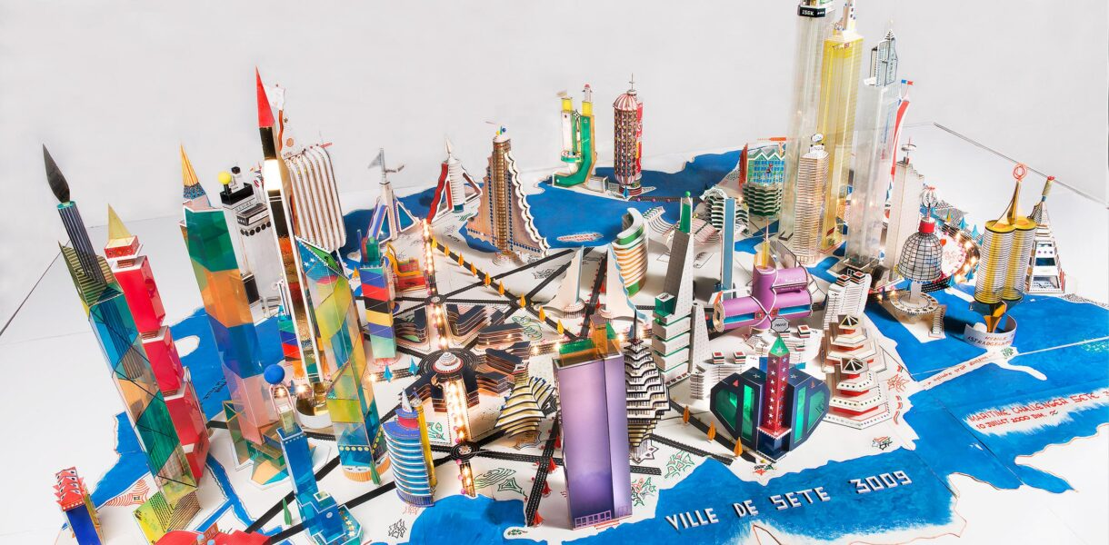
Bodys Isek Kingelez (1948-2015)

Slide 7
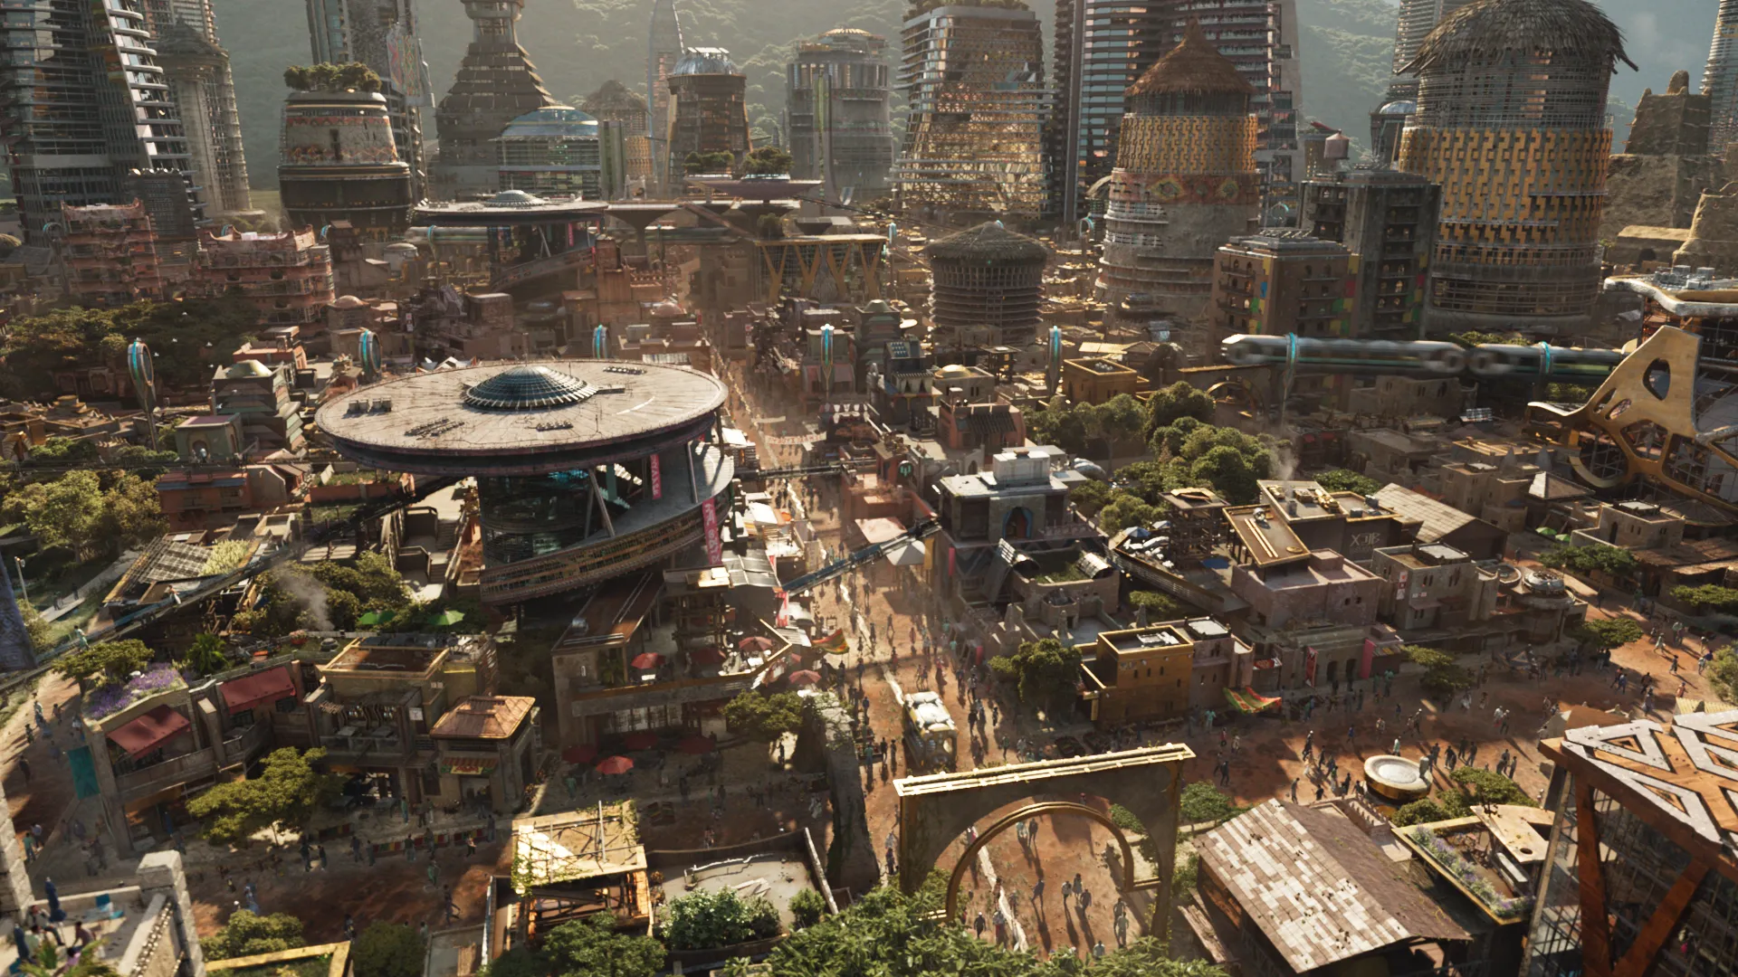
Wakanda, Black Panther, Marvel Studios, 2018.

