Slide 1

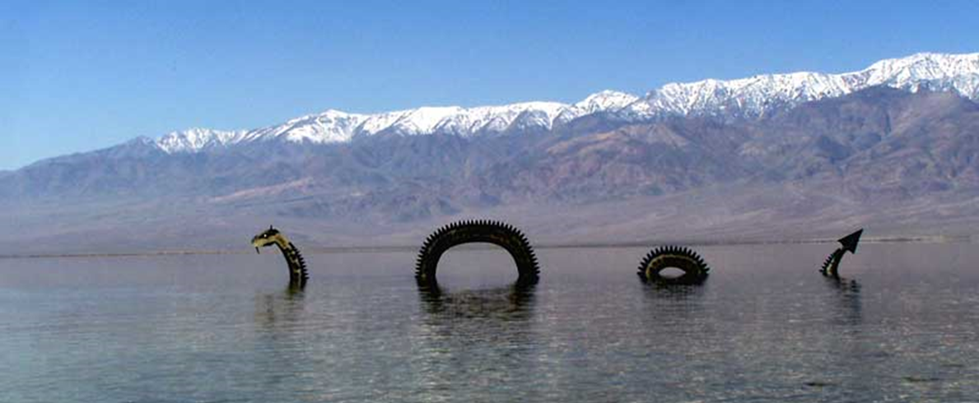




English-is-weird Series

Slide 2
English-is-weird Series:
Silent Letters in English

Slide 3
Sometimes (quite often in fact) some letters in a written word are simply NOT PRONOUNCED or uttered orally = as if they weren’t there! Such letters are called SILENT for a reason…
Silent Letters in English (part one)

Slide 4
First Example: The letter ‘H’

Slide 5
First Example: The letter ‘H’
Contrary to the French language in which the letter ‘H’ has become entirely silent (= it is not pronunced any longer), English has retained a ‘strong’ or ‘hard’ H.
In the following words, the letter is not silent at all, it is sounded as an aspiration:
Hotel Home Honey Harm Hate Horrible

Slide 6
First Example: The letter ‘H’
However, English being English, there are of course exceptions…
E.G.: words like honest / honour / honourable / heir and hour
+ The way the letter ‘H’ iteself is said = ‘aitch not Haitch!

Slide 7
Silent Letters in English (part one)
Kn: know, acknowledge, knight, knife, knee, knot
Gn: sign, gnat, gnashing, foreign, gnome [but ignore, signal, significant etc.]
B: bomb, climb, doubt, plumber, debt, subtle, comb
D : Wednesday, handkerchief, handsome
P: psychology, psychiatrist, pseudo, receipt (but crypto!)

Slide 8
Silent Letters in English (part two)
I: business [cf in French: “le bizness”]/ C: muscle
L: salmon, talk, half, calf / N: solemn, hymn (but hymnal!)
S: island, aisle, / T: fasten, listen, hustle, castle (but casting!)
U: gauge, circuit, build
W: wrap, write, wrong, who (but which!), sword (but swine!)

Slide 9
Conclusion: “if English be weird”=> ADAPT! 1.Pay attention 2. Trust your EARS, not your EYES

Slide 10
English-is-weird Series
Vowels!

Slide 11
Why is the English language so weird?
Vowel sounds in English (I)
The system of vowels in English is different from/than the system of vowels in other languages, particularly French. Some sounds exist in French but not in English and the reverse is true as well.
For example: there is no sound like the French ‘u’ in English. ‘Fureur’ and ‘fourrure’ are very difficult for an English native speaker to utter.
Conversely, there is no real difference between ‘long’ and ‘short’ vowels in French, hence the difficulty experienced by French learners of English in understanding the difference between ‘sheep’ and ‘ship’ / ‘beach’ and ‘bitch’ for example.

Slide 12
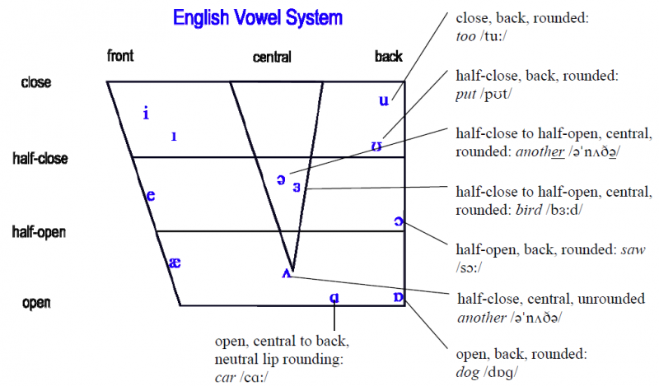
Vowel sounds in English (I) There are about twenty vowel sounds in standard British English, some of them diphthongs (when one sound ‘glides’ into another one: ‘ei’ in ‘tame’ for example).

Slide 13
Why is the English language so weird?
Vowel sounds in English (I):
The Letter ‘U’ in English
The high-pitched French sound ‘u’ does not exist in English, we’ve seen as much. But what sounds correspond to this letter then?
Actually, a ‘U’ can make many sounds : /ju:/, /ʌ/, /uː/, /i/, /ə/, /ʊ/

Slide 14
Why is the English language so weird?
Vowel sounds in English (I): ‘U’ in English
Actually, a ‘U’ can ‘make’ many sounds, here’s six common ones: /ju:/, /ʌ/, /uː/, /i/, /ə/, /ʊ/ [in the IPA]
/ju:/ = ”a university”, ”unique”, ”music”, ”huge”, ”minute” (tiny)
/ʌ/ = ”a cup of tea”, ”gun”, ”cut”, ”upset”, ”umbrella”
/uː/= ”true”, ”blue”,”Uber” => ”an Uber car, ”aluminum” (US)
/i/ = ”business”, ”minute” (time),
/ə/ [the famous ’schwa’ sound]= ”nature”, ”picture”, ”supply”
/ʊ/ = ”put” => ”stay put”, ”push”, ”full”, ”sugar”

Slide 15

Vowel sounds in English (II)
The sound(s) an ‘A’ makes
In English, we’ve seen many times over that we should trust our ears and not our eyes when we have to decide which sound a particular sequence of letters make.
The letter ‘A’ is a particularly good example of that, some linguist identifying up to twelve different sounds for the same letter, even when not taking different varieties of English into account…
Here’s nine of them:

Slide 16
Vowel sounds in English (II)
The sound(s) an ‘A’ makes
Here’s nine utterances of the letter ‘A’:
1. ‘A’ as [æ] as in “cat”, “mat”, “apple”
2. ‘A’ as [a:] as in “father”, “start”
3. ‘A’ as [Ə] as in “umbrella” or “another”
4. ‘A’ as [eƏ] as in “area” or “parent” (British)
5. ‘A’ as [e] as in “many” or “any”
6. ‘A’ as [ei] as in “tame” or “lame”
7. ‘A’ as [ɒ] as in “wash”, “was” or “wand”
8. ‘A’ as [Ɔ:] as in “call”, “formal” or “ball”
9. ‘A’ as [i] as in “village” or “luggage”

Slide 17
Why is the English language so weird?
Vowel sounds in English (III):
The Letter ‘I’ in English
As its sister vowel letters in this weirdo linguo called English, an ‘I’ can make many sounds :,/ɪ/, /i:/, /ai/, /ə/

Slide 18
Vowel sounds in English (III): The Letter ‘I’
Here are six sounds a letter ‘I’ can make (there are more) :
/ɪ/ (very common, and slightly shorter than the French ’i’) =
hit, kid, is, kill, ship, village, wish, privy
/i:/ (long ’i’) = receive, receipt, briefly, to ski,
/ai/ (diphthong) = mice, fire, desire, wire, ice, finally, fiery, night, knight, director (UK mostly), private
/ə/ (schwa sound, usually in UNstressed syllables)= pencil, recipe, possible, audible, terrible [’-ible’ endings], [’ion’=] emotion, reality, ability [’ity’ endings]
/e/ = friend (apax, apparently, see ”fiend”!)
/ɜ:/ (usual with ’i’+’r’)= girl, firm, girdle, first, third, circle

Slide 19
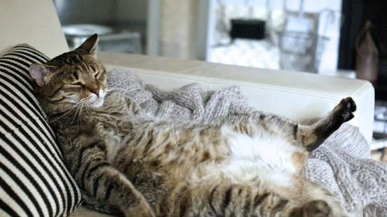
LESSON:
DON’T BE LAZY!

Slide 20

LESSON: DON’T BE LAZY!

Slide 21
English-is-weird Series

Slide 22
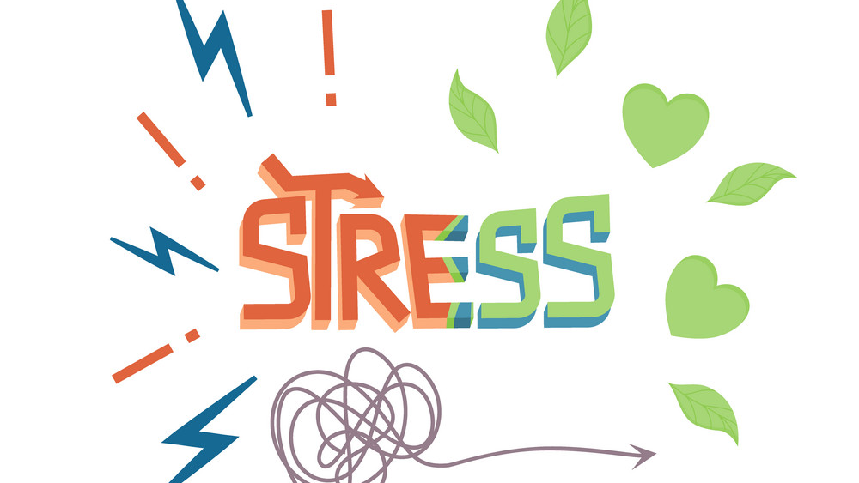

Slide 23
English-is-weird Series:
Stress patterns in English:
Word (i.e. lexical) Stress

Slide 24
English is a STRESSED language with specific word and sentence stress, and a specific rhythm (which is very unlike French and most evidenced in its poetry).
Today we focus on word stress (“accent tonique”), which happens within words: one syllable is usually longer/higher/louder than the other syllables, which are in turn “weakened”, or “in the shadow” of the “syllable Queen/King”.
Examples: represen’tation / ba’nana / ‘comfortable

Slide 25
the syllable on which the stress falls affects pronunciation, and word recognition, quite a lot, and failing to utter a word correctly can lead to misunderstanding.
Examples:
‘MInute (time unit)/ mi’NUte (adjective=tiny)
‘DEsert (sandy place) / de’SSERT (yummy thing)

Slide 26
There are some rules, but (as always with the English language) also exceptions to the rules…
Rule n°1: two-syllable NOUNS and adjectives: stressed on the first syllable (usually)
BUT two-syllable VERBS: stressed on the last syllable (usually)
Increase: ‘increase (noun) but in’crease (verb)
Present
Record
Produce

Slide 27
EXCEPTIONS to rule n°1 (well, that’s English for you!)
Nouns: ho’tel, trai’nee, ma’chine, etc.
Verbs: ‘answer, ‘travel, ‘visit, ‘listen, ‘promise, etc.

Slide 28
Rule n°2: words ending in –ic are usually stressed on the next-but-last (a.k.a ‘penultimate’) syllable = the one before the end one
Examples: I’ROnic / ‘LOgic / eco’NOmic (but e’COnomy and e’COnomist)/ sympa’THEtic
Exceptions: ‘Arabic / ‘CAtholic / ‘POlitics (but poli’TIcian)

Slide 29
Rule n°3: words ending in –tion or –sion or –cian are usually also stressed on the next-but-last (i.e. the one before the final one) syllable
Examples: tele’Vision (but sometimes stressed differently in the US), represen’TAtion, re’PREssion, rationali’ZAtion
Rule n°4: words ending in –ee are usually stressed on the last syllable
Examples: employ’YEE, trai’NEE, guaran’TEE, chimpan’ZEE

Slide 30
Rule n°5: words ending in –cy, -phy, –gy, -ty: stress on the syllable before the penultimate (=third before last).
Example: psy’CHOlogy, phi’LOsophy, pho’TOgraphy

Slide 31
English-is-weird Series

Slide 32
English-is-weird Series:
Words ending in -ed

Slide 33
English-is-weird Series:
Words ending in -ed
If a word ends in –ed, there are three different ways to pronounce them:
- ‘id’ as in ‘‘wanted’’
- ‘t’ as in ‘‘asked’’ ;
(or)- ‘d’ as in ‘‘loved’’
So HOW (on earth) do we know WHEN it is one or the other?

Slide 34
English-is-weird Series:
Words ending in -ed
Rule 1: if the word/root verb ends in a ‘t’ or a ‘d’ sound then it’s ’’-id’’
Examples: tested ; spotted ; minded
Rule 2: if the word/root verb ends in ‘p’, ‘f’, ‘k’, ‘s’, ‘tch’ (=unvoiced consonants) then it’s ’’t’’
Examples: slipped ; tipped ; pissed ; watched ; puffed (but exceptions ! ‘crooked’…)

Slide 35
English-is-weird Series:
Words ending in -ed
Rule 3: if the word/root verb ends in a vowel (a, e, i, o, u) or voiced consonant sound (v,n, l, etc.) then it’s ’’d’’
Examples: canned ; banned ; married ; killed
Exceptions: learned (=savant) ; beloved ; naked etc.

Slide 36
Why is the English language so weird?

Slide 37
Why is the English language so weird?
Pronouncing the letter ‘S’ between vowels
Many phonetic rules that exist in other languages DO NOT apply to English, or partially so (wouldn’t be fun otherwise).
That is the case for the French rule which systematically turns ‘s’ into a ‘z’ sound between vowels, for example.
English does that also, but NOT ALWAYS. There are many exceptions.
Example: basic, basically
to choose (zzz) BUT goose (sss)

Slide 38
Why is the English language so weird?
Pronouncing the letter ‘S’ between, before or after vowels:
Some words have ‘Z’ sound for the VERB, but ‘S’ sound for the noun or adjective:
Examples: to use/use ; to close / close ; to house/house ; to excuse/excuse ;
HOWEVER, there are many exceptions to this itself exceptional rule (e.g.: to promise / a promise)
2. Sometimes ‘s’ is pronounced ‘ʒ’ as in ‘’enclosure’’ or even ‘ʃ’ as in ‘’sugar’’ / ‘’sure’’ => pay attention when you listen to English and try to emulate/imitate/copy what you hear!

