Slide 1






GRAMMAR NEWSFLASH

Slide 2
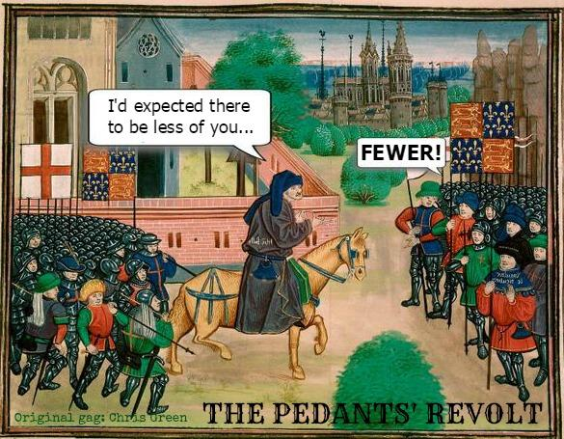
GRAMMAR NEWSFLASH
SINGULAR / PLURAL CONUNDRUMS IN ENGLISH

Slide 3
GRAMMAR NEWSFLASH
SINGULAR / PLURAL CONUNDRUMS, QUICK TEST /20
What is the plural form of the following words:
Thesis
Index
Luggage
Roof
Hoof
Fish
Are these nouns singular or plural?
(sing/plural/depends…)
Data
News
Mathematics
Police
Staff
Family
Means
Species
Alumnus
Person
Shrimp
Fruit
Criterion
Aircraft

Slide 4
GRAMMAR NEWSFLASH
SINGULAR / PLURAL CONUNDRUMS IN ENGLISH
BASIC LEVEL:
Adding ‘s’ modifies noun in the following cases (examples):
- e.g. knife => knives. A few exceptions: proof, roof, etc.
- city => cities (proper nouns and names excepted: Shelby => the Shelbys)
- bonus => bonuses (but see below for exceptions)
- potato => potatoes. Exception: ‘‘loan words’’ consciously borrowed from foreign languages: simply ‘s’ or special rules apply, cf. espresso/espressos).

Slide 5
GRAMMAR NEWSFLASH
SINGULAR / PLURAL CONUNDRUMS IN ENGLISH
Irregular plurals:
From old and middle English: child/children; mouse/mice; ox/oxen etc.
From foreign languages - NB: for foreign‘‘loan words’’, it sometimes depends on speaker pedantry…
      Greek: topos/topoi (or toposes…); criterion/ criteria phenomenon/phenomena (or phenomenons…)
      Latin: curriculum/curricula; cactus/cacti, alumnus/alumni [but viruses not ‘’viri’’, and data ‘’is’’ not ‘‘are’’ mostly nowadays =has become uncountable]
      NB: words ending in –is, -ix or –ex (from either Greek or Latin, sometimes Greek-through-Latin or French) have specific plurals: analysis/analyses; thesis/theses; index/indices (sometimes indexes)
      Hebrew: mitzvah/mitzvot(h); Italian: cello / celli (etc.)

Slide 6
GRAMMAR NEWSFLASH
SINGULAR / PLURAL CONUNDRUMS IN ENGLISH
Tricky situations:
Some words look plural but are in fact singular: e.g. means (’’a means to an end’’), a species, a TV series, mathematics, ethics, news…
Countable/uncountable (well known to you, I just mention it in passing): information, luggage, news, fruit (ambiguous nowadays) and countless other words.
If uncountable = never plural + never counted (not even ‘a’), specific grammar (less not fewer, etc.)
Countable nouns that keep the same form in the plural: fish, deer, shrimp, trout, sheep (many animals in fact): a fish, two fish. But also words like aircraft (two aircraft, not two aircrafts).
Can be plural (fishes) only if it means different types/species of fish or if you impersonate Italian-American mobsters (‘‘sleep with the fishes’’)

Slide 7
GRAMMAR NEWSFLASH
SINGULAR / PLURAL CONUNDRUMS IN ENGLISH
Tricky situations:
Some words look singular but are in fact plural…
Typically: “Cattle” or “police”: never singular in English: ‘The cattle are restless’; ‘The police are coming’.
Individual members = add man/woman or officer: ‘Ten police officers were awaiting them in the lobby’. Reference to several groups that count as “police” = different police forces / departments.
Collective nouns = groups of people are a special case: staff, family, team, squad, platoon, posse, Netflix, Paris 1, the government, etc.
The associated verb can usually be singular or plural depending on what you want to emphasize = as a tightly-knit unit, or as several people.
Example: ‘’The McCoy family comes from Laredo’’ BUT ‘’my family are coming over for Thanksgiving’’.
However American English usually prefers singular over plural <> Brits…

Slide 8
GRAMMAR NEWSFLASH
Bonus: specific nouns of groups of items/animals
A flock of sheep
A pack of wolves
A school/shoal of fish
A herd of wild horses
A pride of lions
A band of coyotes
Sheep
Wolves
Fish
Wild horses
Lions
Coyotes
Puppies
Crows
Ships
Flowers
bees
A litter of puppies/kittens
A murder of crows
A fleet of ships
A bunch of flowers
A swarm of bees

Slide 9

GRAMMAR NEWSFLASH
TEST RESULTS?

Slide 10
GRAMMAR NEWSFLASH
SINGULAR / PLURAL CONUNDRUMS, TEST RESULTS
What is the plural form of the following words:
Theses
Indexes/Indices
Luggage (no)
Roofs
Hooves
Fish (same)
Are these nouns singular or plural?
(sing/plural/depends…)
Data (dep.)
News (sing)
Mathematics (sing)
Police (always plur)
Staff (dep on meaning)
Family (ditto)
Means (sing and plur)
Species (sing and plur)
Alumni
People
Shrimp (same)
Fruit (uncount)
Criteria
Aircraft (same)

