Slide 1

Politics of Development
Political Science M1
2025-2026
Florence.brisset-foucault@univ-paris1.fr

Slide 2
Today:
History of development aid
Bilateral (France and US)
Multilateral: From Bretton Woods to the Washington Consensus (aid for reforms)
Discussion on Thandika Mkandawire’s text
Break
Readings: Yash Tandon and Joseph Stiglitz
Discussion with documents on USAID
Discussion on essays

Slide 3
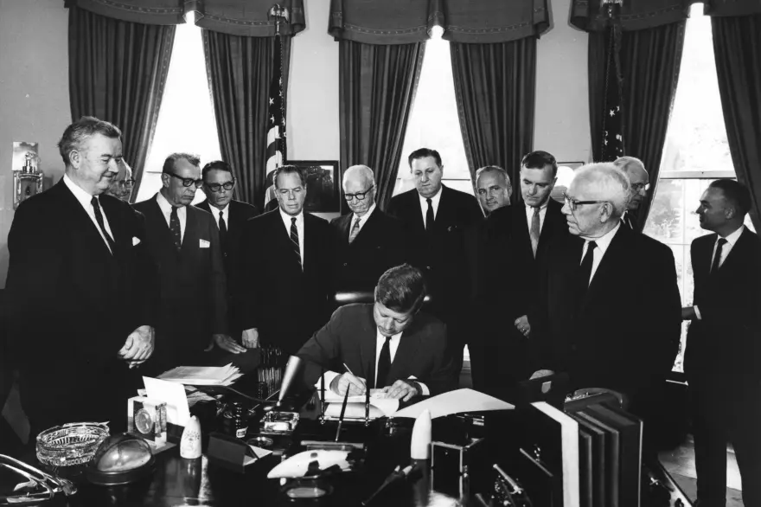
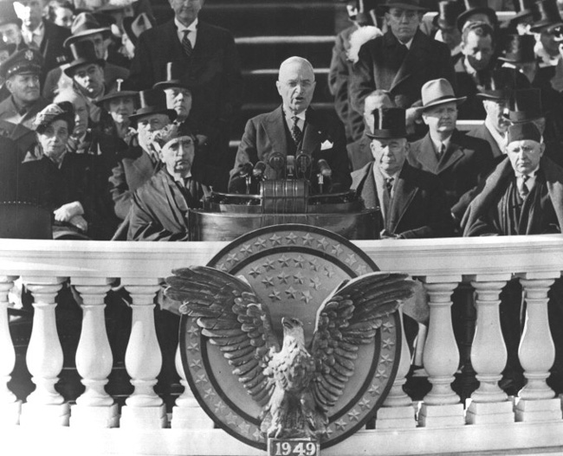
Bilateral aid (1) the US example
President Kennedy signs the Foreign Assistance Act, 3rd Nov 1961. Abbie Rowe. White House Photographs. John F. Kennedy Presidential Library and Museum, Boston.
Source: Truman Library. Inaugural speech 20th Jan 1949.

Slide 4
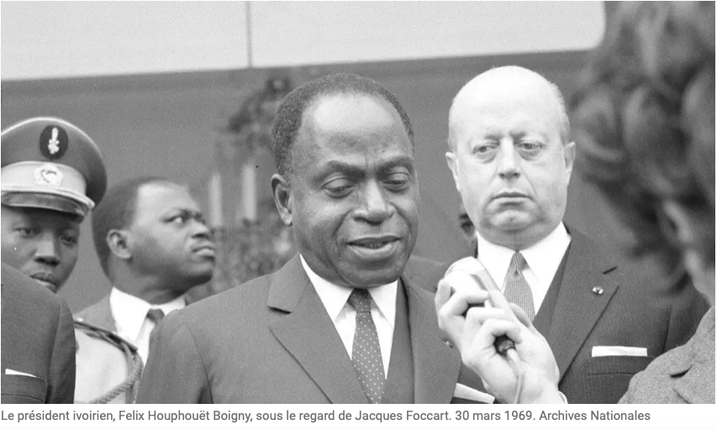
Bilateral aid (2): the French example
Brazzaville conference February 1944
1959: secrétariat d’Etat auprès de la Communauté. Then became the Ministère de la coopération
Missions d’aide et de coopération (MAC)
Fonds d'aide et de cooperation (FAC, former Fonds d'investissement économique des territoires d'outre mer - FIDES, that had been created in 1946)
System was distinct from Foreign Affairs Ministry
Under the influence of the Elysée
Cooperation agreements

Slide 5
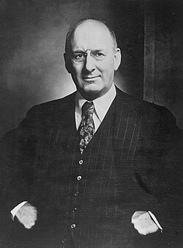
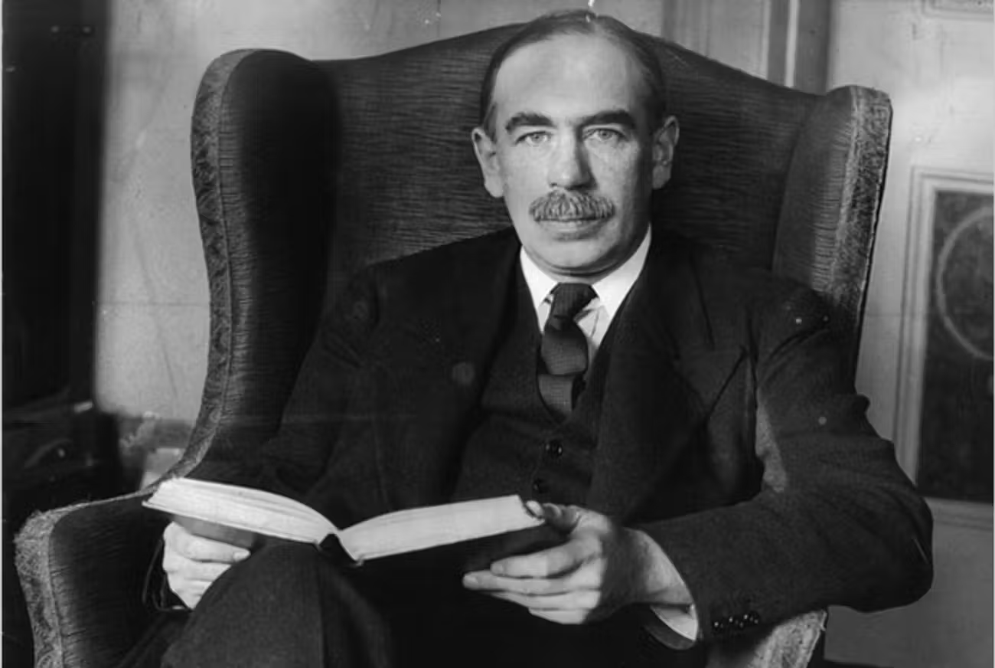
Bretton Woods Institutions
International Monetary Fund (IMF)
World Bank
John Maynard Keynes, source: https://www.tabletmag.com
Henry Morgenthau (source: Wikipedia)

Slide 6
1989: The Washington Consensus
Consequences of debt crisis (early 1980s)
‘Austerity bitter potion’: objective = limit budget deficit, increase credit capacities and productivity and favour financial sanity
Reforms = condition for access to loans
Not completely unilateral
1990s: the ‘good governance’ agenda
See Dezalay (Y.), Bryant (G.), « Le “Washington Consensus”. Contribution à une sociologie de l’hégémonie du néolibéralisme », Actes de la recherche en sciences sociales, 121-122, 1998.

Slide 7
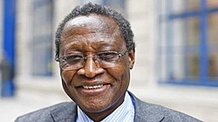
Discussion of Thandika Mkandawire’s text
1940-2020

Slide 8


Readings: Stiglitz / Tandon

Slide 9
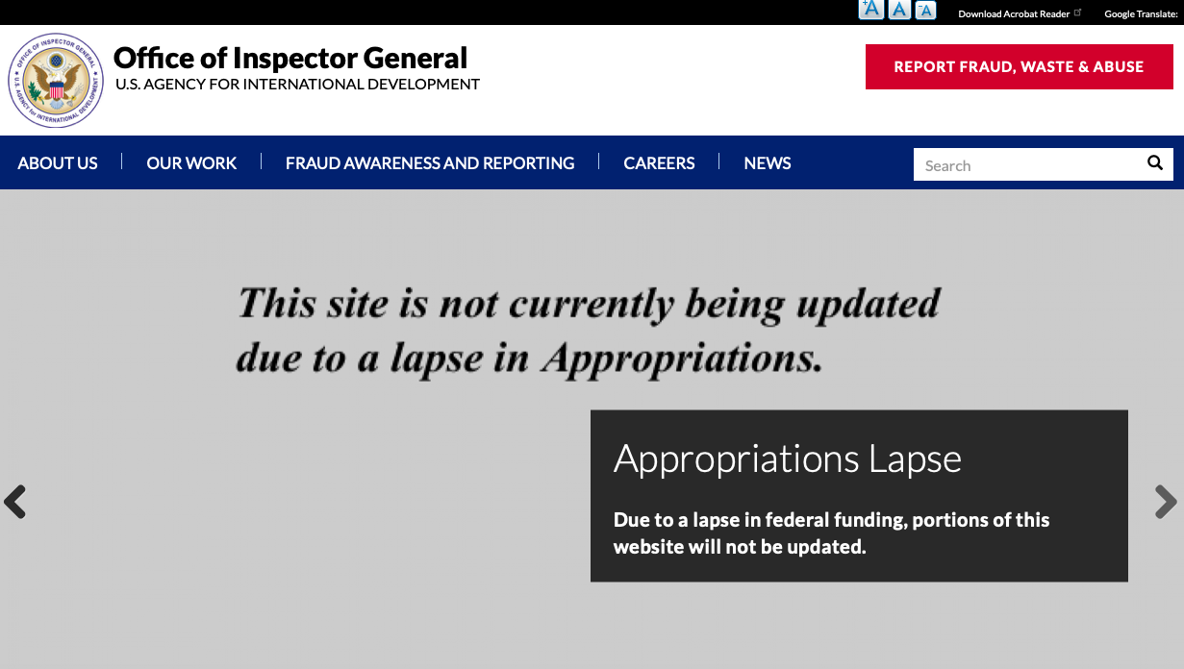
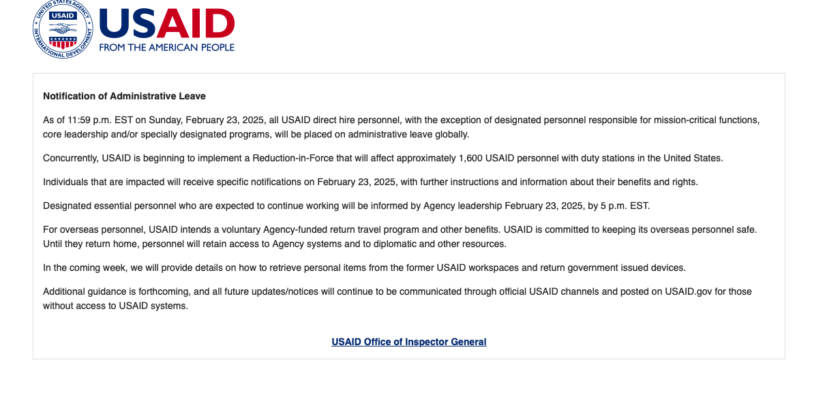
Discussion

