Slide 1
Challenges of diversity in multicultural societies
Patrick Simon – Master Migration
Multicultural Societies 2025-2026

Slide 2
Why and What do we talk about diversity?
Recent migration trends accelerate a diversification of the ethnic and racial composition of the population al around the world
Diversity brought by migrations combine with post-slavery, post-colonial and national minorities
This new historical sequence imposes to update national great narratives and theoretical and conceptual frames in Social Sciences
Reshaping stratification in multicutural societies
Dynamics of Ethnicization and Racialization generate new pan-ethnoracial identities
An issue of visibility, perceptions and ascription, as well as cultures and shared experiences

Slide 3
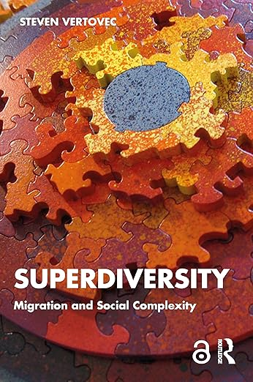
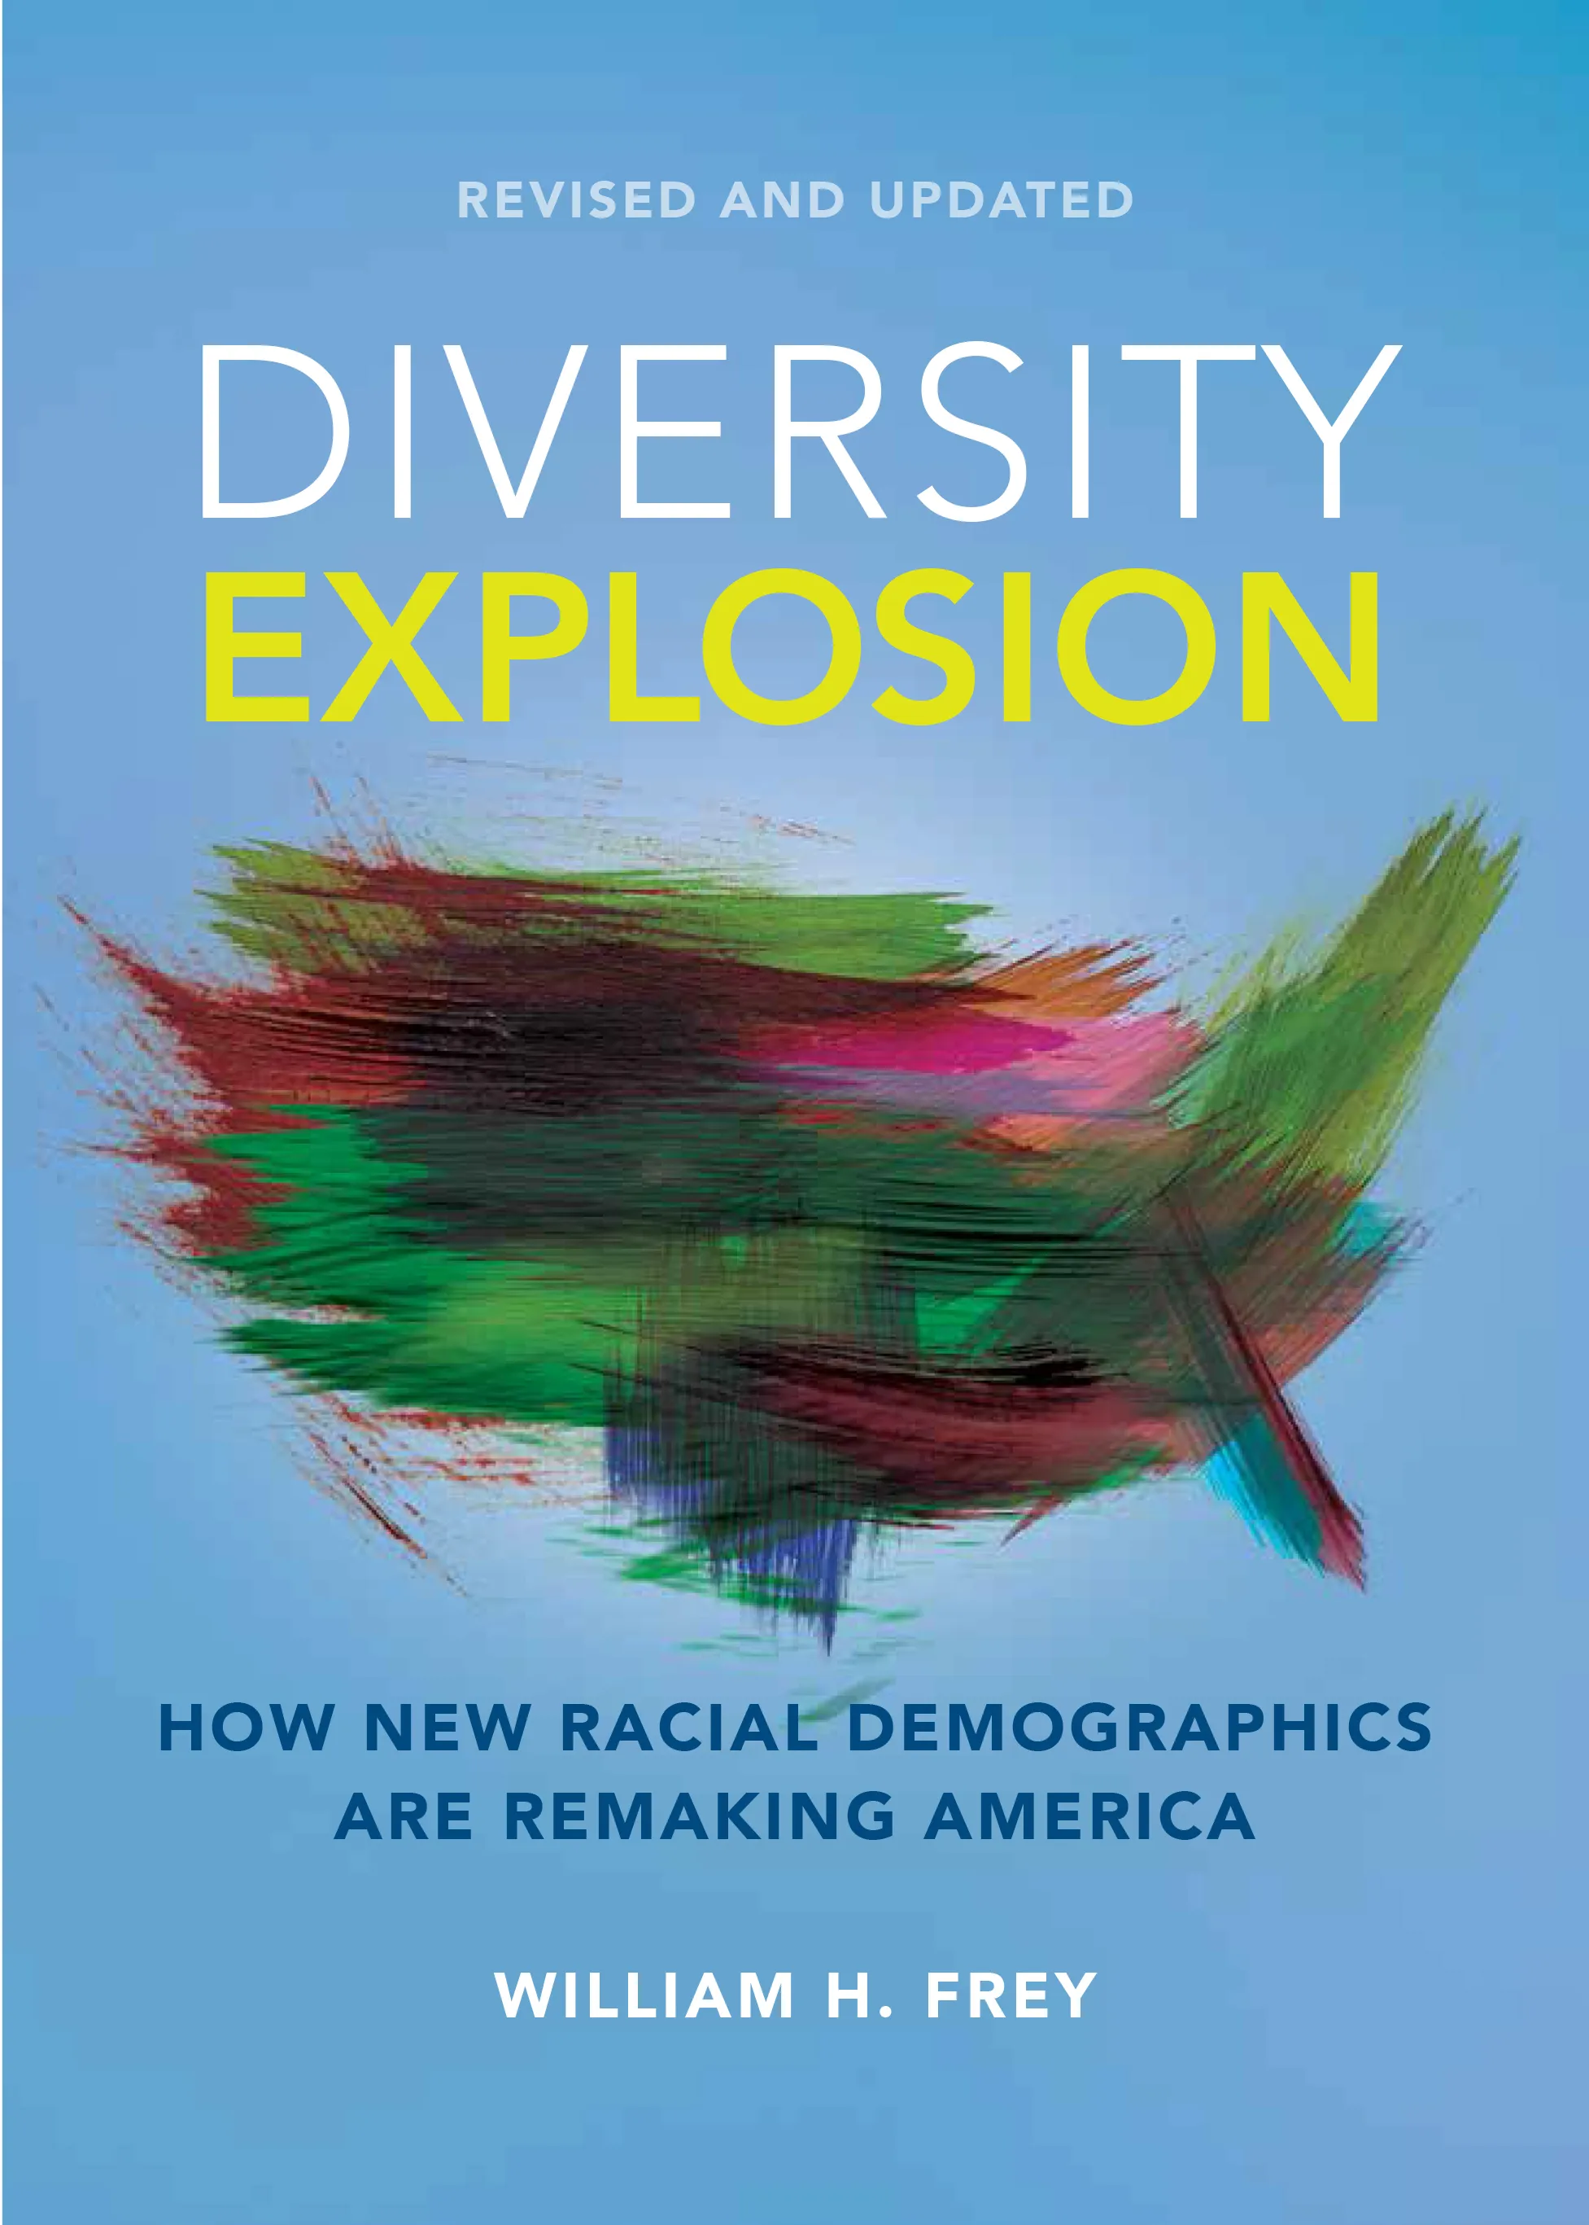
Diversity : a question of demographics?

Slide 4

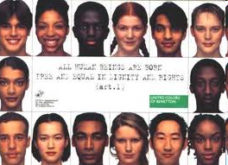

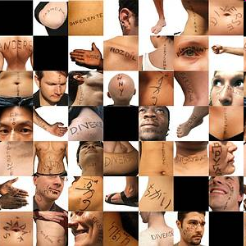
The business case for diversity

Slide 5
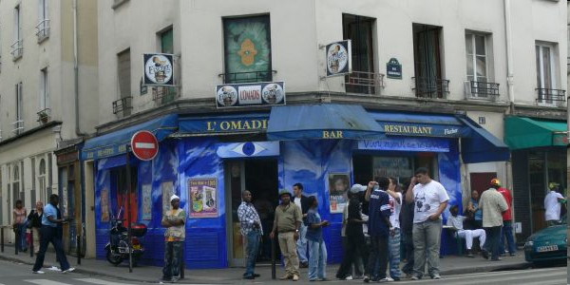
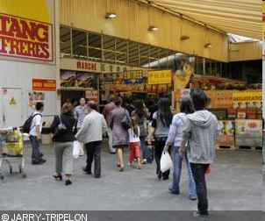
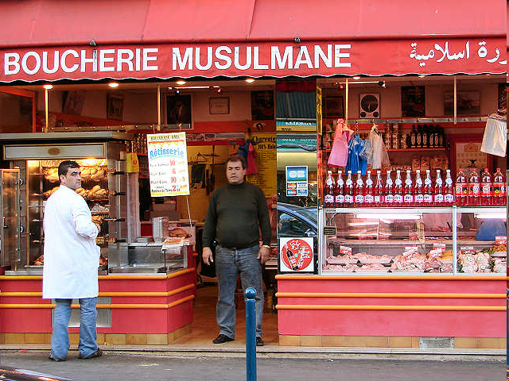
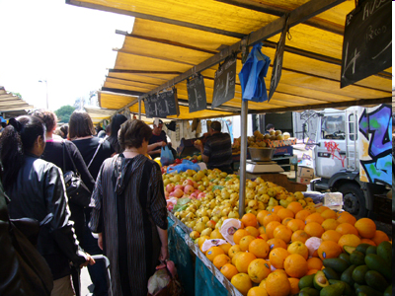
Urban commercial landscape

Slide 6
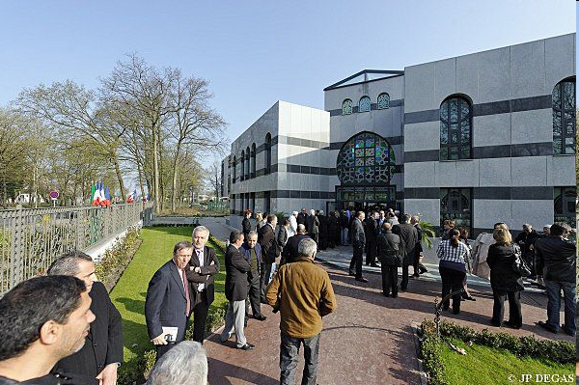
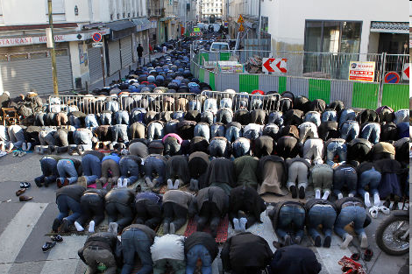

Religious diversity

Slide 7
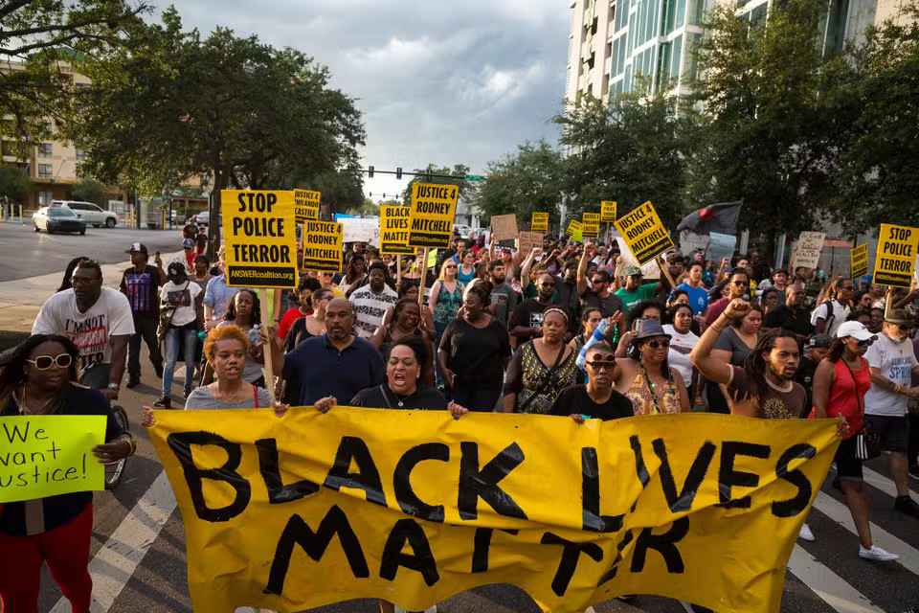
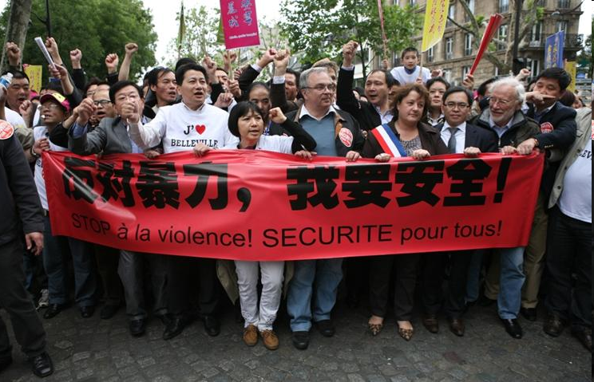
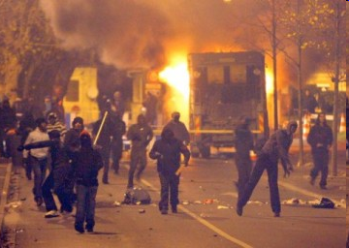
Racism and
political mobilization

Slide 8



Multiculturalism and diversity Backlash

Slide 9
Paramètres historiques de la diversité
First sequence of colonization in the Americas
European demographic transition and the expansion of European settlement
Second sequence of colonization (1800-1920), Independancies and decolonization
Thinking diversity: from colonialism to scientific racism to the disqualification of race
The internalization of ethnoracial diversity in former imperial metropoles

Slide 10
Atlantic Trade (1440 to 1870)

Slide 11
European Emigration(1850-1960) Emigrants by sending countries (in thousands)
 | 1851-1870 | 1871-1890 | 1891-1910 | 1911-1940 | 1941-1960 | Total
Germany | 1450 | 1968 | 801 | 776 | 1490 | 6485
Austria-Hungary | 71 | 294 | 1551 | 490 | 53 | 2459
Spain | 10 | 585 | 1882 | 1998 | 709 | 5184
France | 63 | 185 | 104 | 41 | 155 | 548
Italy | 32 | 1160 | 5195 | 3799 | 1325 | 11511
Norway | 134 | 272 | 286 | 155 | 35 | 882
Portugal | 125 | 316 | 590 | 1505 | 415 | 2951
Sweden | 139 | 430 | 529 | 201 | 66 | 1365
Great Britain and Ireland | 2885 | 5108 | 5299 | 5000 | 2209 | 20501

Slide 12
Colonisation
La seconde séquence de colonisation au 19e et début 20e siècle
Impérialisme, appropriation des ressources et domination politique et militaire
Mise en ordre ethno-raciale du monde avec développements d’une classification hiérarchique des peuples fondés sur un paradigme évolutionniste : les européens/blancs supérieurs aux autres groupes
Formation d’un imaginaire et de représentations réactivées dans la séquence suivant les décolonisations
Migrations des anciens sujets coloniaux dans les métropoles : diversité ethno-raciale sans précédents historiques

Slide 13
Nouveaux contextes démographiques
En 2015, 4,7 millions de personnes ont immigré dans un pays de l’Union Européenne (dont 2,4 M de non européens); 1,2 millions US + Canada
  Taux migration : 3,1 p1000 US, 7,4 p1000 Canada, 10,6 p1000 Belgique, 8,5 p1000 Allemagne, 5,1 p1000 France
35,1 millions de personnes sont nées en dehors de l’Union Européenne et 17,9 millions de citoyens européens vivent à l’étranger (10,1%)
Les Secondes Generations émergentes dans la plupart des pays de migrations de travail dans les années 1960 : citoyens d’origine immigrée (G1 et G2 représentent environ 35% de la pop en SE, B, AT et 30% en NL, FR, D, UK), dont entre 50% et 66% de non européens
La plupart des sociétés européennes sont désormais multi-ethniques, multi-raciales et multi-religieuses :
  Re-activation des imaginaires raciaux et coloniaux dans des sociétés colorblind
  Les Musulmans comme altérité problématique

Slide 14
More diverse societies (OECD 2013)

Slide 15
USA et Canada (2013 and 2011)

Slide 17
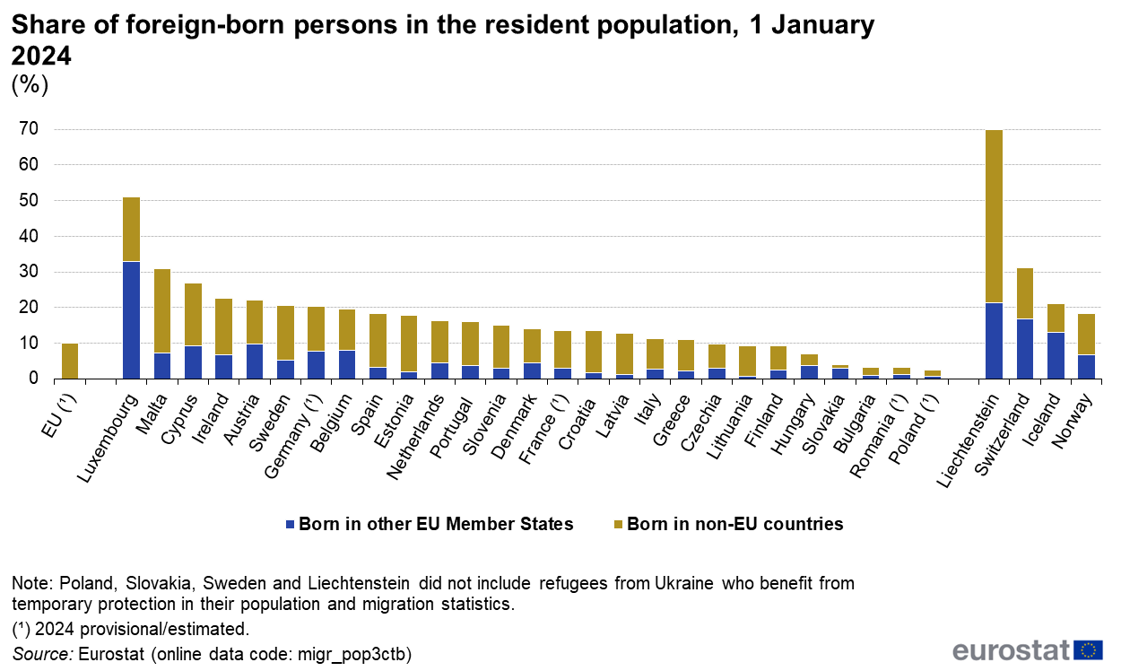
Share of foreign born persons (%), EU27 (2024)

Slide 18
Diverse Cities
Amsterdam: 50% of ethnic minorities in 2019
Rotterdam: 54% of ethnic minorities in 2019
London: 46% Black and Ethnic minorities in 2021
Berlin: 30% with immigrant background in 2013
Paris (area): 47% of immigrant and Second Generation in 2019
Brussels (region): 75% immigrants and second generation in 2021
Vancouver : 52%, Montréal : 20% et Toronto : 49% de minorités visibles en 2011
New York : 67%, Philadelphie : 63%, Huston : 74%, LA: 71%, Chicago : 78% de population non blanche en 2011
In inner cities and disadvantaged neighborhoods, minorities-majority population tends to be a norm: a super or hyper-diversity frame?
A mismatch between these highly diverse neighbourhood/cities and the rest of the countries

Slide 19
Debates in Multicultural Societies
Assimilation, integration, multiculturalism, interculturalism : Theories and political frames to accomodate the relations between minorities and majorities
Multicultural societies from below: a growing gap between local practices and arrangement and national narratives and structures
Contact theory: interactions and share of spaces foster the creation of new norms and the reduction of prejudices
Diversity reinforces social and ethnic fragmentation and undermines civic cohesion (Putnam)
National identities under redefinition stimulate conflicts and tensions, triggering nativism and populism and a backlash against inclusive diversity

Slide 20
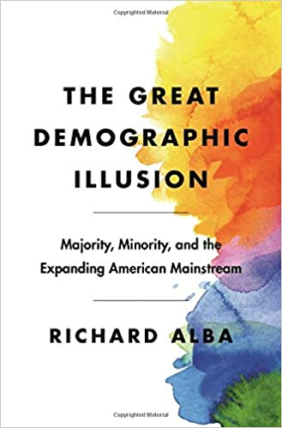
Projections US : Majority-Minority population by 2044
The American Prospect 2016
14% of children live in a mixed family

Slide 21
Populist parties in Europe
Party | Country | General election | élection européenne (2014)
Front National | France | 16,1% (2017) | 25%
Party for Freedom (PVV) | NL | 13,1% (2017) | 13%
UKIP | UK | 12,6% (2015) 1,8% (2017) | 27,50%
Sweden Democrats | Sweden | 13% (2014) | 9,70%
Danish people party | Denmark | 21,1% (2015) | 26,60%
Progress Party | Norway | 23,9% (2024)
Alternative for Germany | Germany | 20,6% (2025) | 15,9%
Finns | Finand | 17,7% (2015) | 10%

