Slide 1

Politics of Development
Political Science M1
2025-2026
Florence.brisset-foucault@univ-paris1.fr

Slide 2
Today’s programme
Discussion of Rama Salla Dieng’s text
The notion of ‘development brokers’
Break ☺
Discussion of Harri Englund’s Prisoners of freedom
Reading and collective analysis of 3 short texts on development brokers

Slide 3
Rama Salla Dieng’s text
What’s to learn in terms of methodology? (work life stories etc.) and conceptually? Cf. ‘Adverse incorporation’ of communities of care
Dive into daily lives of workers and effects of being employed in large horticultural development projects
Gendered effects of horticultural work
Care work as a condition for social reproduction (what effects on)
Gendered and private infrastructure of care allowing capitalist development
Financial emancipation but still obligations
Socially grounded expectations in terms of individual success and collective responsibilities
Vernacular notions of fulfilment, success and failure, historically grounded
Alternative to foreign migration trajectories

Slide 4
‘Development brokers’
Beyond national development rent seekers (cf. Mkandawire): the local development brokers
Intermediaries between donors and potential ‘beneficiaries’
David Lewis and David Mosse (eds.), Development Brokers and Translators: the Ethnography of Aid and Agencies, Kumarian Press Inc, 2006.
Thomas Bierschenk, Jean-Pierre Chauveau & Jean-Pierre Olivier de Sardan, « Local Development Brokers in Africa. The rise of a new social category », Working Papers n°13, Institut für Ethnologie und Afrikastudien, Johannes Gutenberg Mainz University, 2002.
‘Extraversion’ JF Bayart

Slide 5
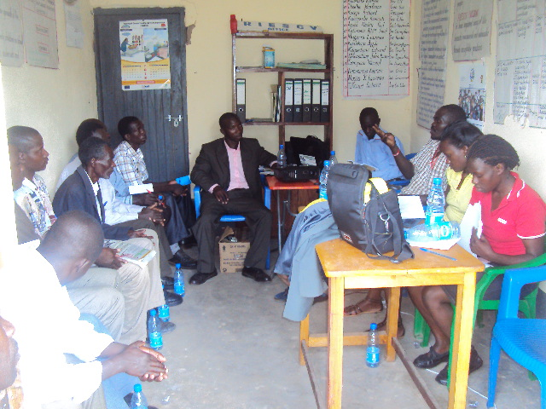
Development brokers and bureaucratic patriotism
Listener’s club ‘Bufunjo citizens concerned’ (Kyenjojo district, Uganda, 2013)

Slide 6


