Slide 1

Politics of Development
Political Science M1
2025-2026
Florence.brisset-foucault@univ-paris1.fr

Slide 2
Today’s programme: Participation and empowerment in development
‘Participation’ and ‘empowerment’ in development: a historical perspective
Participation, empowerment and neoliberalism
Discussion of Ruth Prince’s text: lessons for ethnographic approach of participation and empowerment
Discussion on your essays

Slide 3
‘Participation’ and ‘empowerment’ for you…

Slide 4
Long history of concern for ‘participation’ and ‘community based development’
The ‘tyranny of intermediaries’: the fight against development brokers
History of ‘empowerment’: Brazil, India, USA
The poor as actors of their own emancipation
A cradle for a plurality of ideologies
Who is responsible for poverty?
De-responsabilisation of the State: people should take care of themselves and not wait for State intervention

Slide 5
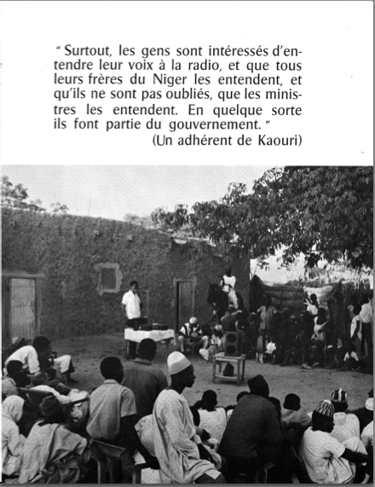

Slide 6
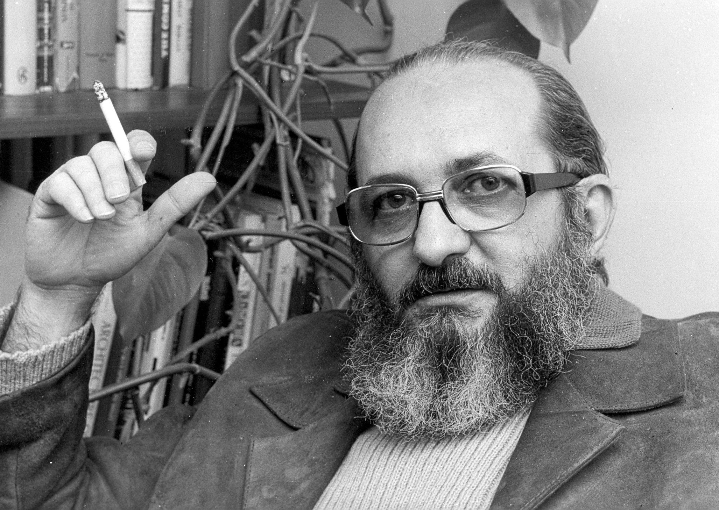
Paulo Freire, 1921-1997. Pedagogy of the Oppressed (1968, Eng translation 1970)

Slide 7
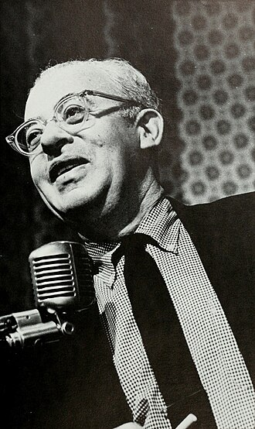
Saul Alinski (1909-1972), ‘community organizing’

Slide 8
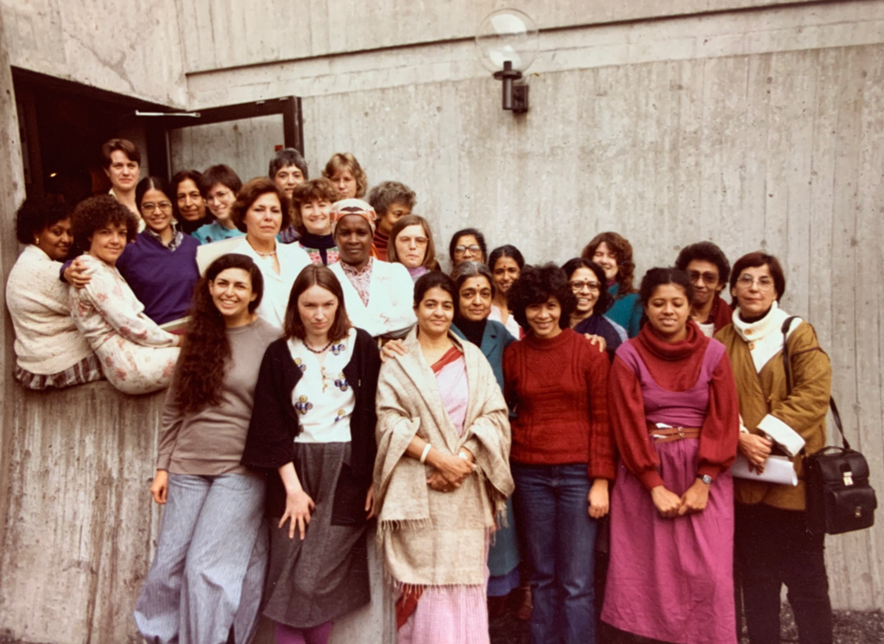
Development Alternatives with Women for a New Era (DAWN) 1984

Slide 9
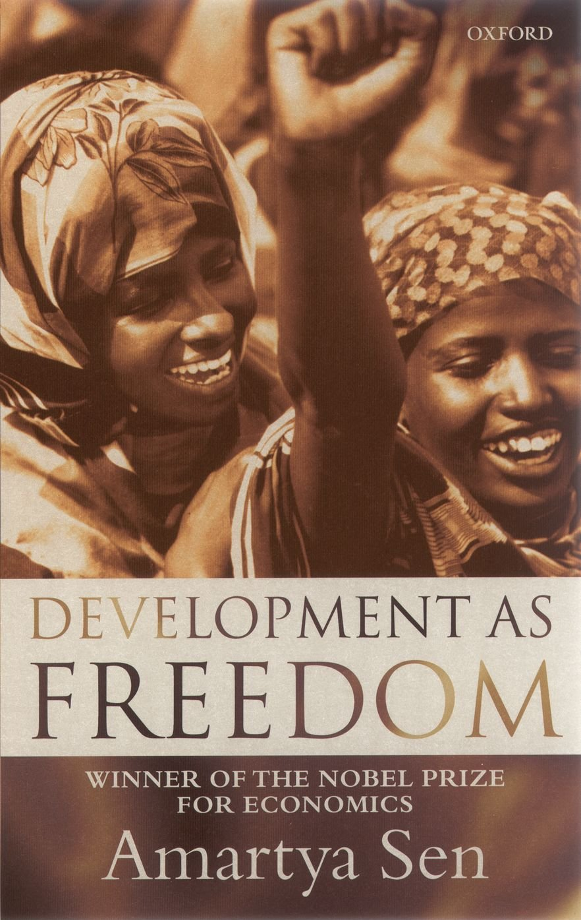
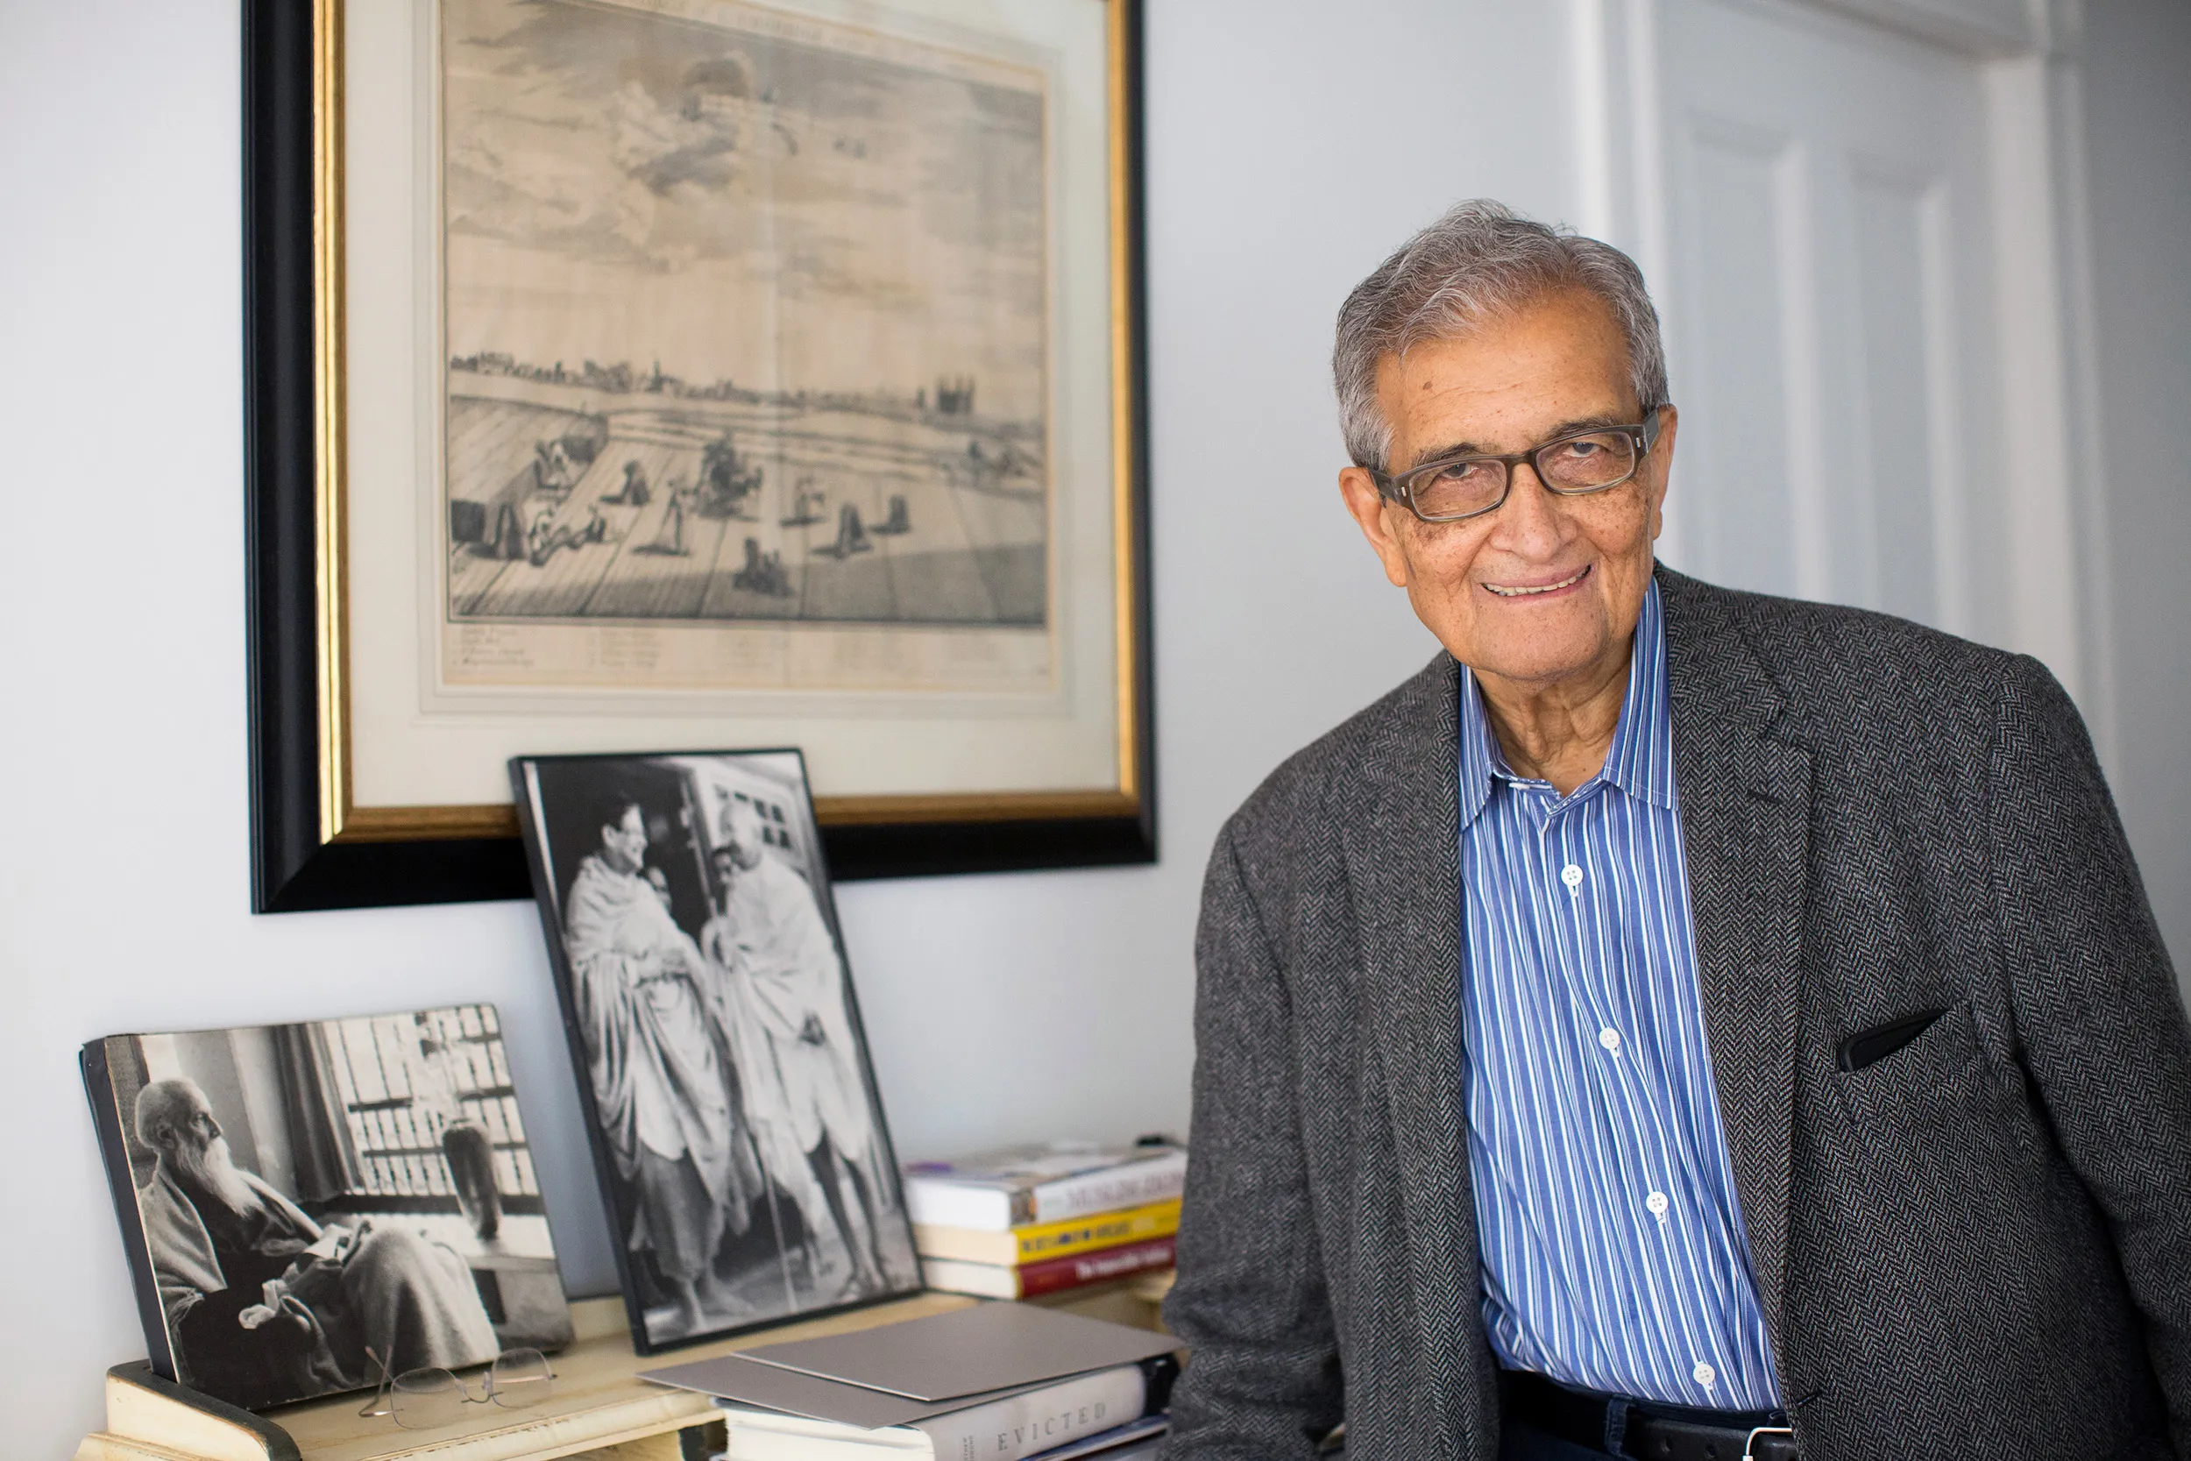
Amartya Sen (b. 1933, Nobel Prize 1998), Human Development and Capability Approach

Slide 10

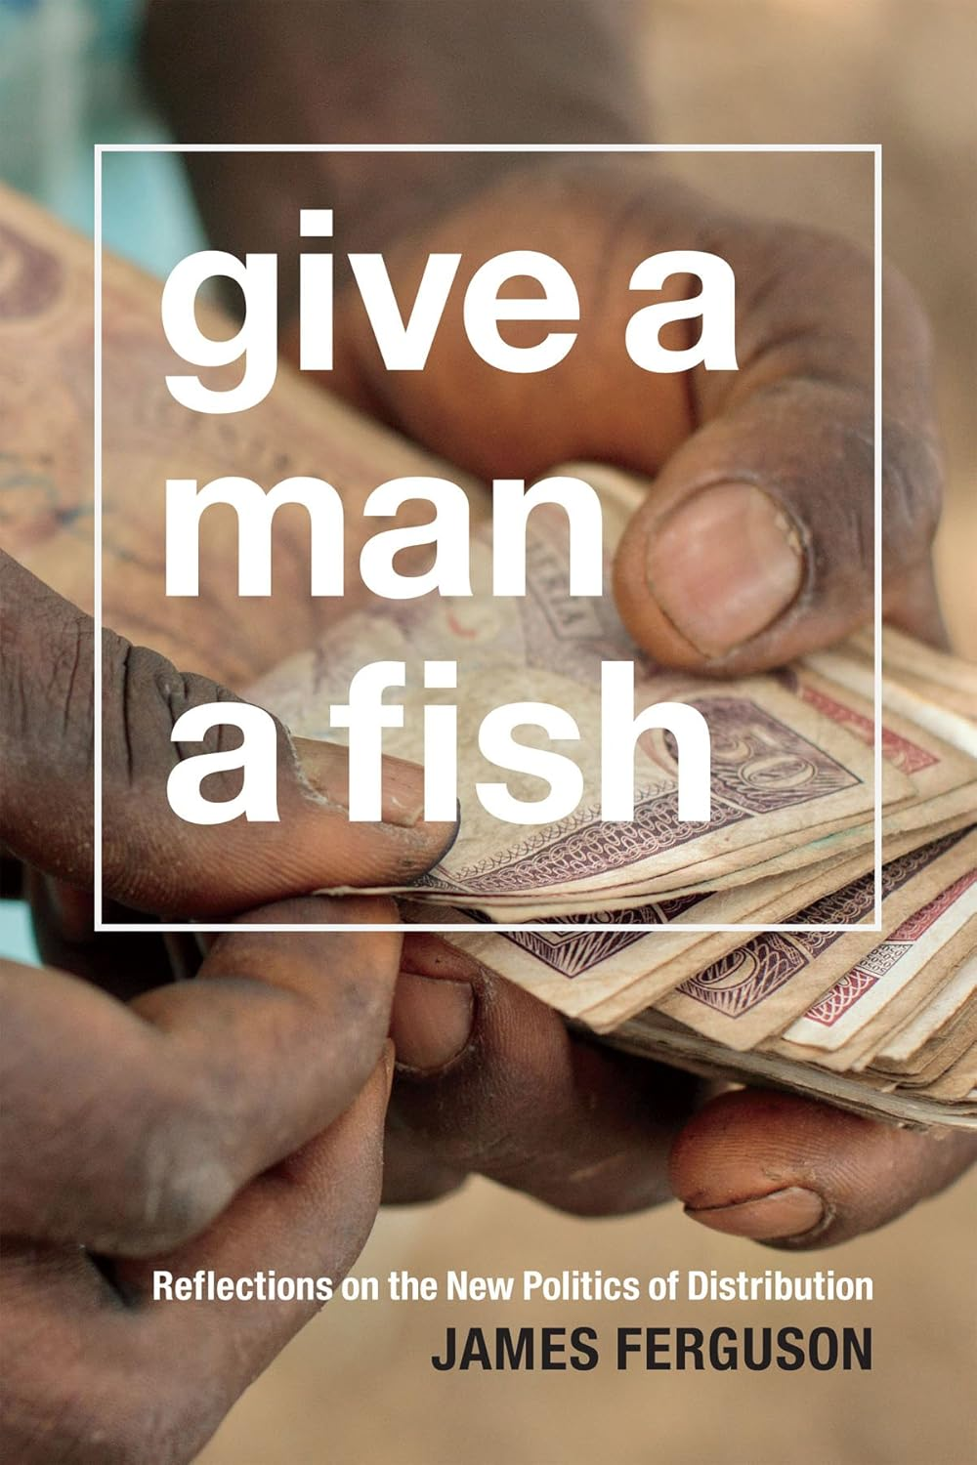

Slide 11
An ethnographic approach of ‘participation’ and ‘development’ (R. Prince)
A global participatory turn?
Explore the ‘lived temporalities of the global health economy’: the social backstage of ‘workshops’
Porosity of participatory apparatus to local contexts
Political, social, spiritual appropriations
The use and appropriation of ‘NGO speak’ and buzzwords
A nuancing of Englund’s model

Slide 12
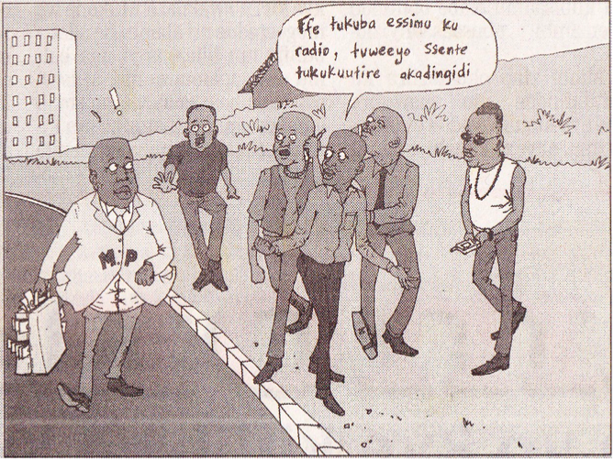
Another example: from participation to representation; avoid normative approaches to reveal local political cultures: the example of ‘serial callers’
Source: Gwanga newspaper

Slide 13
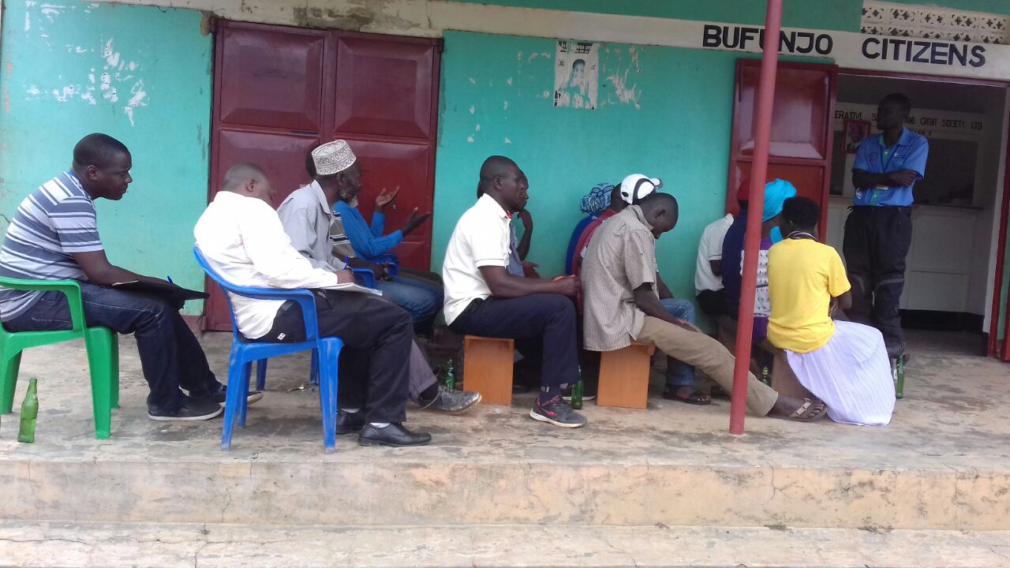
Bureaucratised and authoritarian forms of ‘participation’
Only ‘good citizens’ can participate: they thus need to be taught
Disqualification of other forms of participation (‘anger’, ‘ignorance’)
‘Democracy necessitates pedagogy’
People need to be taught to take care of themselves: reinforcing of hierarchies?
‘Make people participate’

Slide 14
Notes, accountability meeting organised by a citizen forum in Bufunjo (Uganda) in 2013:
The village chairperson blames the (higher) sub-county authorities for “the impassable village roads (because of the) lack of support (from the sub-county) for village leaders who try their best to encourage citizens to clean their village roads and punish locally those who tend to be no compliant.”
Taking himself as an example, he retold how “he was taken to […] court by one of the locals whom he penalized for not attending community work, and the sub-county authority was just looking at this and giving no support which he said put all local leaders at fear of engaging people in such activities.”

