Slide 1

Politics of Development
Political Science M1
2025-2026
Florence.brisset-foucault@univ-paris1.fr

Slide 2
Today’s programme: The politics of development meets the politics of land
Discussion of Sabine Planel’s text
Land regimes in Africa
Land reforms and the securisation of land rights
The politics of land titling
Discussion on 3 texts on land grabbing

Slide 3
Discussion Planel’s text:
Focus on use value rather than property value
Policies of agricultural extension
Distribution of a ‘package’ (fertiliser, improved seeds, advise) to selected peasants: ‘model farmers’ and ‘1 to 5 groups’
Creation of notables
Package distribution as technique for the exercise of power bc distribution underpined by socio-political dynamics (not pure bureaucracy)
Forcing credit (and debt) on peasants
Model farmers as both channels and victims of State domination

Slide 4
The sociology of Development Agents + their own vested interests
The bureaucratic logic of the policy (no attention to local agricultural knowledge)
patterns of control are even tighter because of the social interdependence
So not efficient but has effects (Cf. Ferguson)
Coercion and resistance
Patterns of control are even tighter because of the social interdependence/need to be respectable to borrow oxen (cf. p.430)

Slide 5
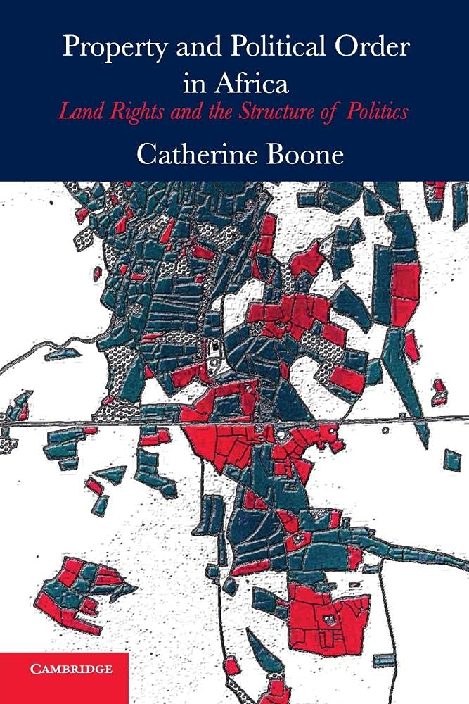
Land often at the heart of violent conflicts (Ivory Coast, Mali, Kenya)
LAND REGIMES (Catherine Boone)
1) Neo-customary regimes: access to land governed by local chiefs
2) State regimes: access to land controled by central State
+ THE MARKET !!
Often an intertwinement of the two, hybrid systems including on the same plot… Straddling of rights on a plot, NORMATIVE PLURALISM + influence between the two (invention of tradition cf. Buganda)
Who grants access? Who defines who inherits? What kind of rights does one have? Who defines these rights?
→ Lineage, gender, post-slavery contexts, use (‘mise en valeur’), capital, loyalties, autochthony/allochthony…
The impact of colonisation

Slide 6
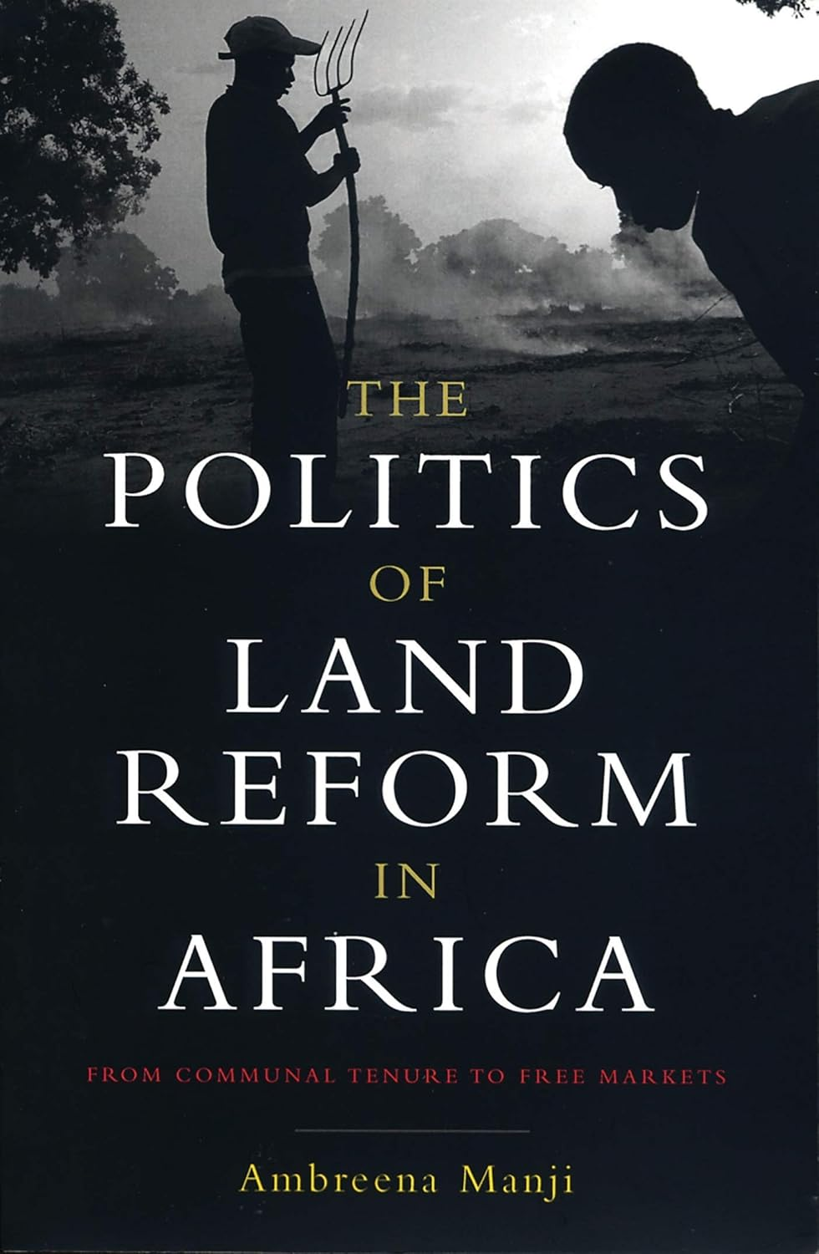
Development needs the law (Hernando de Soto; ‘law is the instrument that fixes and realises capital’)
Need to formalize property rights
Secure people’s rights on land
The poor have resources but they are not inserted in legal circuits
Land is not just a ‘shelter and a means of livelihood’ but a source of capital (World Bank, policy research report, Land Policies for Growth and Poverty Reduction, 2003)
Land becomes loan collaterals: enhance poors’ access to credit
Unregistered land is a ‘dead asset’
Socio: Revival of ‘law in development’ approach

Slide 7
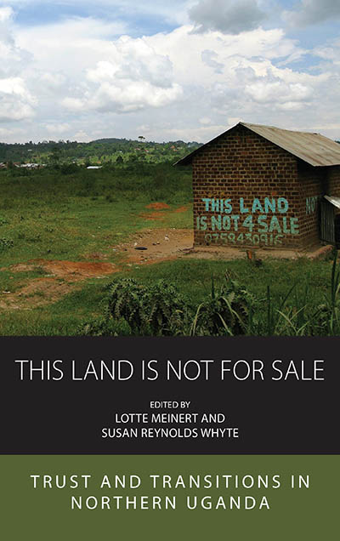
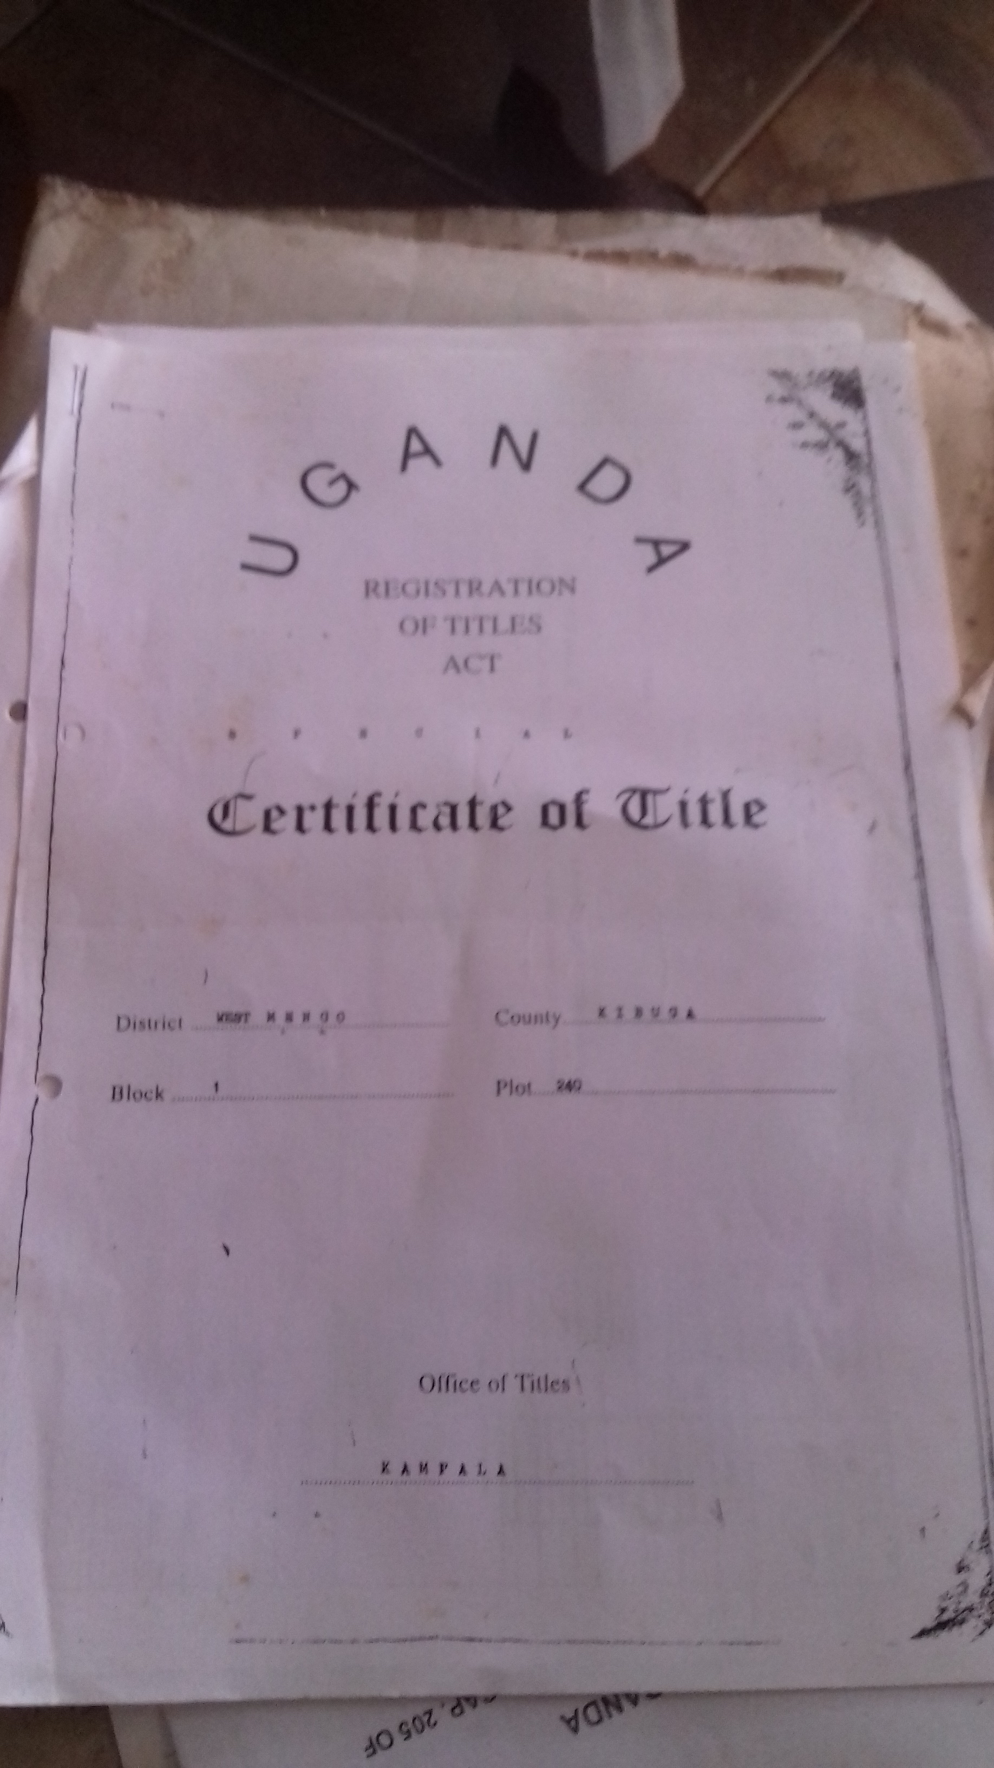
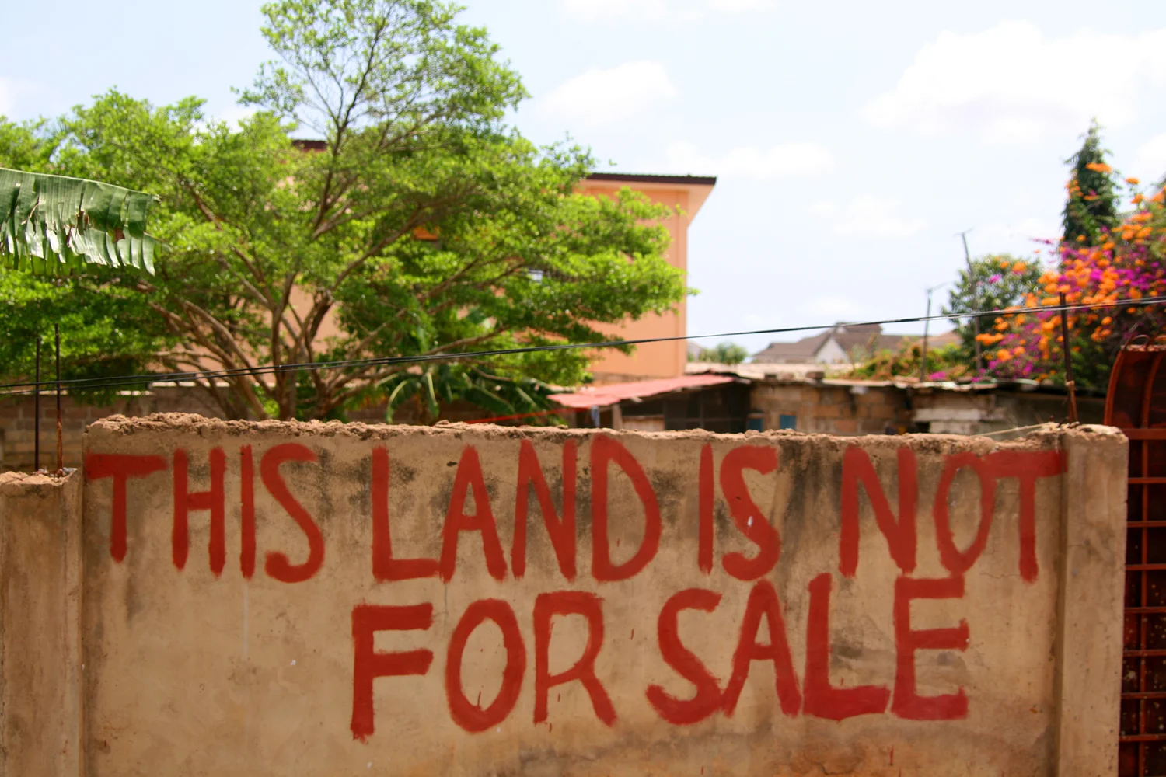
The Politics of Titling: a silver bullet?
Importance of electoral calendar
Clientelism and political control
Some regions with land registry some without
Importance of illegalism and ‘passe droits’ (special favours)

Slide 8
‘Land grabbing’: three readings…

