Slide 1
Cours du 15 octobre

Slide 2
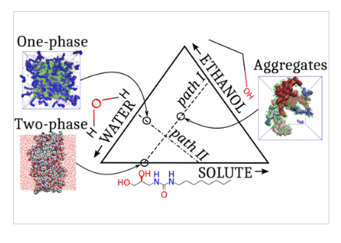
Artificial Water Channels Form Precursors to Sponge-Like Aggregates in Water–Ethanol Mixtures
Arthur Hardiagon, Marc Baaden, Fabio Sterpone, sterpone@ibpc.fr
Laboratoire de Biochimie Théorique, Université Paris Cité, CNRS, 13 rue Pierre et Marie Curie, Paris F-75005, France

Slide 3
Self-assembled artificial water channels (AWCs) are reshaping current water desalination technologies. Recently, the improvements achieved by incorporating hydrophilic compounds into polyamide membranes (PA) at the interface were confirmed experimentally. However, the determination of the nanoscale structures of AWCs remains unclear. An important step in the preparation of PA membranes is the solubilization of a colloidal suspension of the solid phase in a water–ethanol mixture. We perform molecular dynamics simulations to study the nanoscale structures of AWC aggregates. We characterize the size and shape of the aggregates at several key locations in the ternary phase diagram. The role of ethanol in the formation of the interface between the solvent and the solute phase is highlighted. We found that the structure of the aggregates formed in the ternary solution resembled the disordered sponge-like structures observed when AWCs were inserted into lipid membranes. Such permeable sponge architectures allow the passage of water despite their noncrystalline organization and were previously shown to be consistent with AWC permeation measurements in membrane environments.

Slide 4
Théorie des modèles de René Thom - Théorie des catastrophes (complément)
Une théorie des modèles de René Thom
Comment l'utiliser en SVT ? (en travaux 2005-2006)

Slide 5
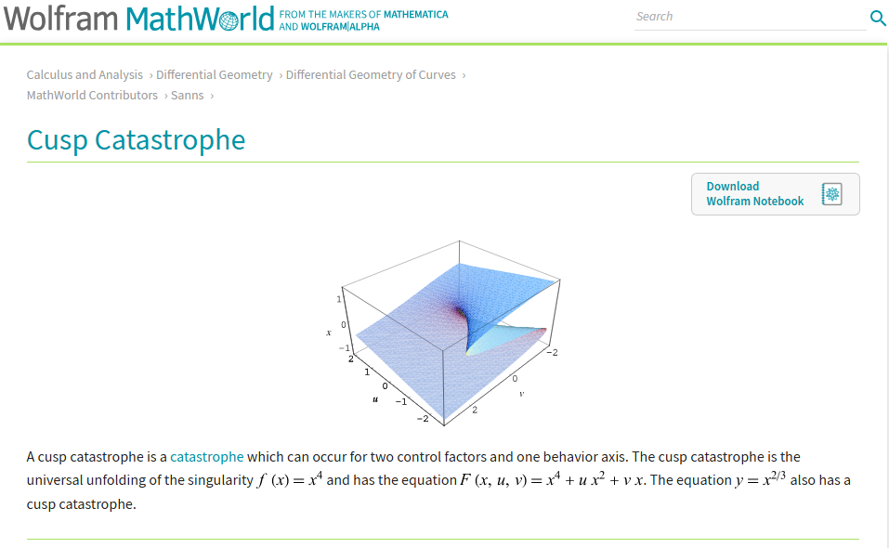

Slide 6
Catastrophe Theory #shorts
YouTube
·
Oliver Knill
·
25 mars 2024

Slide 7
https://youtu.be/NiT4Z3dysVQ

Slide 8
René Thom & Emile Noel la théorie des catastrophes
Sans forme ni chemin
3,92 k abonnés

Slide 9
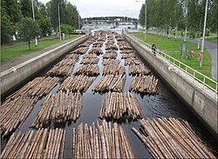

Slide 10
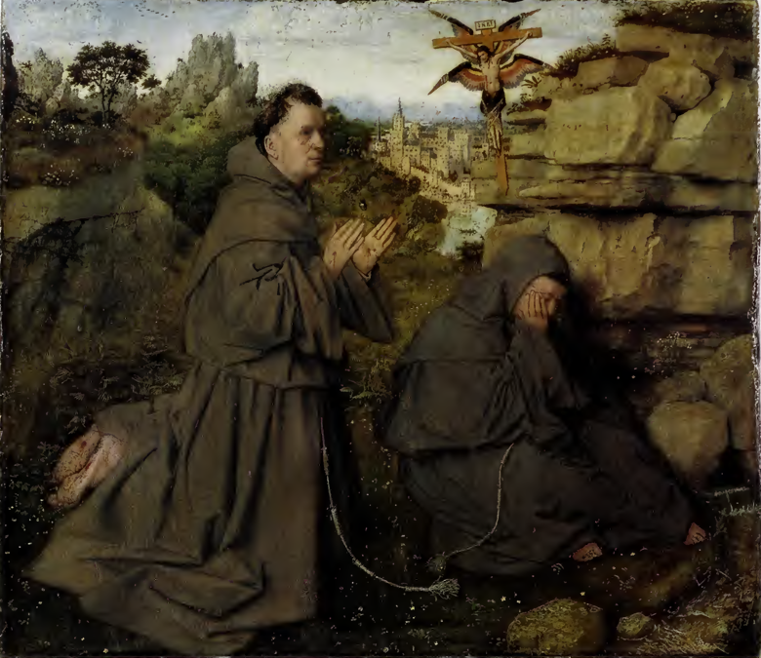
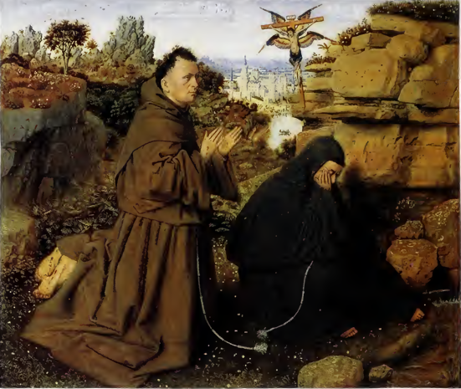
(12.4 x 14.6 cm)
(29.2x33.4 cm),

Slide 11
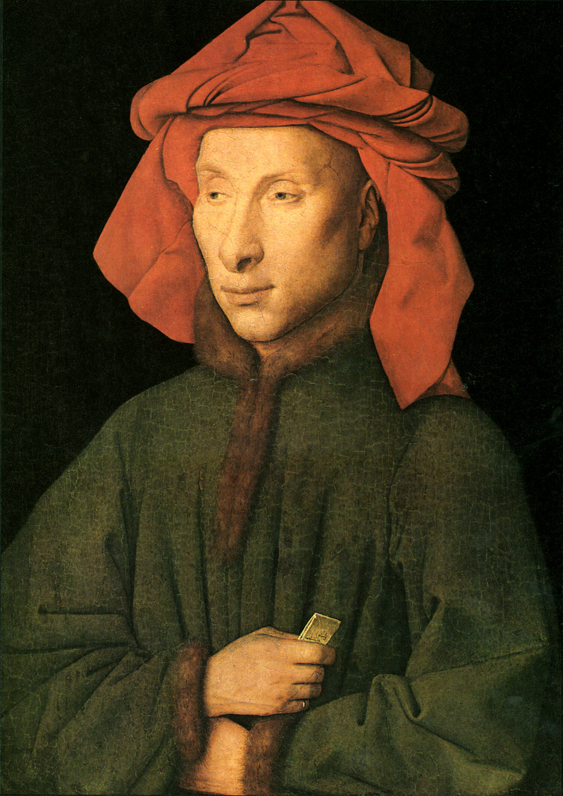
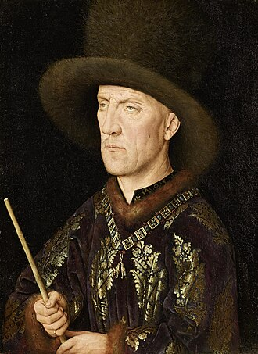

Slide 12
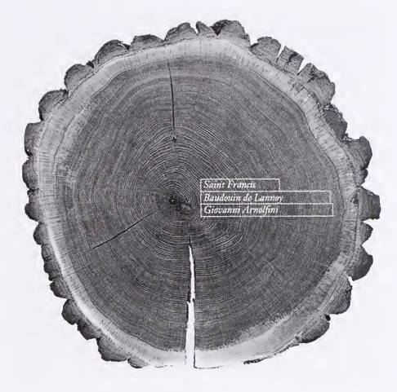
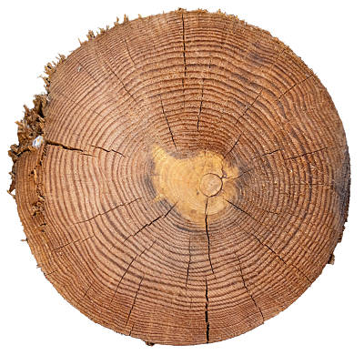
Peter Klein "Dendrochronological Analyses of the Two Panels of "Saint Francis Receiving the Stigmata" “ dans:
Jan van Eyck: Two Paintings of Saint Francis Receiving the Stigmata, Philadelphia Museum of Art, 1997

