Slide 1
Financial reporting
Business combination
Elisabeth Albertini

Slide 2
Overview
Business combination
Revision of IFRS 3 & IAS 27
Major changes
Identifying a business combination
Definitions
The acquisition method
Focus on step 4, 5 and 7
Accounting after the acquisition

Slide 3

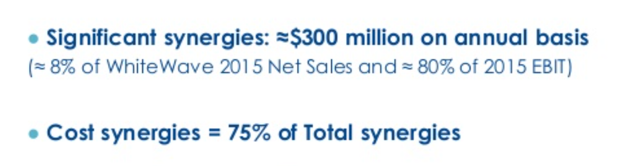
Business combination

Slide 4
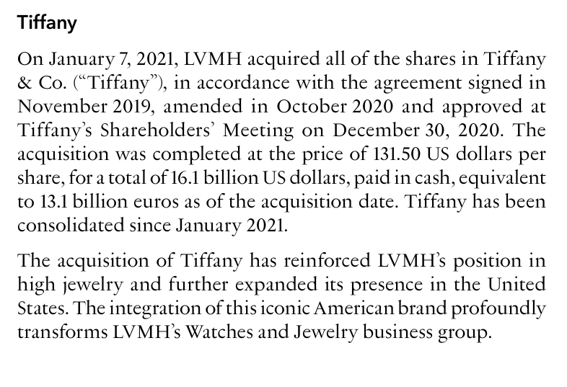



Business combination

Slide 5
Revision of IFRS 3 & IAS 27
Revision in 2008 of :
IFRS 3 Business combinations
IAS27 consolidated and separate financial statements (amendment)
Apply to business combinations occurring from 2009
Common project with FASB (SFAS 141)

Slide 6
Identifying a business combination
Definition : a business combination is a “transaction or event in which an acquirer obtains control over a business by acquisition of shares, or net assets, legal mergers, reverse acquisition”
IFRS 3 does not apply to :
The accounting for the formation of joint arrangement in the financial statements of the joint arrangement itself
Acquisition of an asset or a group of assets that is not a business
A combination of entities or businesses under common control

Slide 7
Definition
Definition of “control of an investee”
“An investor controls an investee when the investor is exposed, or has rights, to variable returns from its involvement with the investee and has the ability to affect those returns through its power over the investee”
Definition of a “business”
Integrated set of activities and assets
Capable of being conducted and managed to provide return
Returns include dividends and costs savings

Slide 8
Definition
Control (defined in IFRS10)
Ownership of more than half the voting right of another entity
Power over more than half of the voting rights by agreement with investors
Power to govern the financial and operating policies of the other entity under statute agreement
Power to remove/appoint majority of directors
Power to cast majority of votes

Slide 9
The acquisition method
IFRS 3 establishes the accounting and reporting requirements (known as the acquisition method) for the acquirer in a business combination
STEP | Details
Step 1 : Identifying a business combination | Analysis to determine whether: What was acquired constitutes a business combination? Control has been obtained? The combination is within the scope of IFRS 3
Step 2: Identifying the acquirer | The acquirer is often be the legal owner. IFRS 3 requires a in-substance approach to identify the party that obtained control of the acquiree
Step 3 : Determining the acquisition date | The acquisition date is the date the acquirer obtains control of the acquiree, usually the specified closing or completion date of the business combination

Slide 10
The acquisition method
STEP | Details
Step 4 : Recognising and measuring identifiable assets acquired and liabilities assumed | The most complex and time-consuming step which require the acquirer to : Recognise identifiable assets acquired and liabilities assumed, including some intangible assets that may not have been recognised in the acquiree’s financial statements Measure identifiable acquired assets and liabilities assumed at fair value Determine the applicability of some specific recognition and measurement provisions Classify or designate the assets acquired and liabilities assumed

Slide 11
The acquisition method
STEP | Details
Step 5 : Recognising and measuring any non controlling interest (NCI) | The acquirer has choice to measure present ownership-type NCI at either fair value or the proportionate interest in the acquiree’s recognised identifiable assets. The measurement of NCI affects the amount of goodwill and can impact the post combination reported results
Step 6 : Determining consideration transferred | Consideration transferred can include cash and other assets transferred, liabilities incurred, and equity interest issued by the acquirer. The acquisition costs are excluded from the transaction price and are considered as an expense

Slide 12
The acquisition method
STEP | Details
Step 7 : Recognising and measuring goodwill or a gain from a bargain purchase | Goodwill is recognised as the excess between : The aggregate of the consideration transferred, any NCI in the acquiree and The identifiable net assets acquired Goodwill can be grossed up to include the amounts attributable to NCI A gain from a bargain purchase is immediately recognised in P&L The consideration transferred in a business combination is measured at fair value

Slide 13
Focus : Step 4 : recognising and measuring assets
The acquisition method requires the acquirer to recognise and measure assets acquired and liabilities assumed
These assets and liabilities are not the same amounts shown in the acquiree’s financial statements
IFRS 3 recognition and measurement principles are applied to determine which assets and liabilities are recognised and how they are measured
Most of these assets are measured at fair value at the acquisition date (the fair value exercise)

Slide 14
Focus : Step 4 : recognising and measuring assets
Measurement period of 12 months for the acquirer to complete the initial accounting for the business combination
Some assets and liabilities may require specific attention:
Intangible assets such as internally generated brand
Restructuring obligations
Deferred taxes
Operating leases
Acquiree’s previous goodwill

Slide 15
Focus : Step 4 : recognising and measuring assets
It is important to identify intangible assets distinctly from the goodwill
Their initial and subsequent value will be normed by IAS 38 Intangible assets
Separate recognition affects post-combination earnings
That’s why, IFRS 3 approach places a strong emphasis on separate recognition rather than subsuming intangibles within goodwill

Slide 16
Focus : Step 4 : recognising and measuring assets
Identifying intangible assets is much more difficult than identifying physical assets
Many intangible assets are not recognised in the acquiree’s financial statements
Ex : Native brands such as Hermes
Native brands can be identified and measured ONLY within a business combination (IFRS3)

Slide 17
Focus : Step 4 : recognising and measuring assets
It is useful to divide the identification of intangible assets process into two steps
Identify the population of ‘potential’ intangibles
Assess each against IFRS 3’s criteria
Potential intangibles:
Potential intangible assets arising from contractual or legal rights (such as trademarks and licences)
Identifiable
Assets arising from contracts or agreements meet this criteria
For the other, the assessment of “separability” is required.
(if the item can be sold, transferred without selling the entire business)

Slide 18
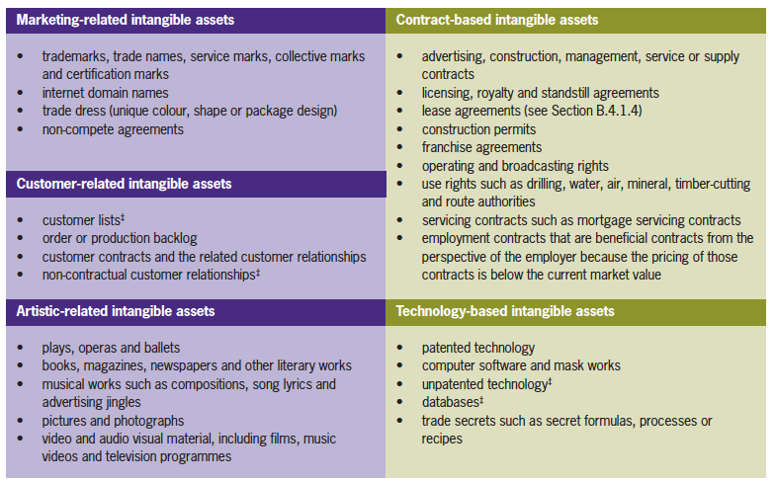
Focus : Step 4 : recognising and measuring assets
Example of intangibles that meet either the separability or the contractual-legal criteria

Slide 19
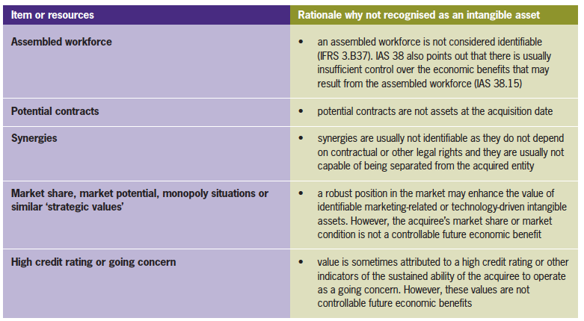
Focus : Step 4 : recognising and measuring assets
In many business combination, the acquirer will detect other items or resources that are valuable to the acquired business. However, these items are NOT recognised as intangible assets since they don’t meet the IFRS 3’s recognition criteria

Slide 20
How are the assets and liabilities measured?
The assets acquired and the liabilities assumed in a business combination are measured at their acquisition-date fair value.
APPROACH | DESCRIPTION
Market approach | Estimates fair value from the transaction price and other relevant information in recent market transactions involving identical or similar assets or liabilities Commonly used to value financial and liabilities and real estate property
Income approach | Estimates fair value based on an asset’s expected future cash inflows, discounted or capitalised at an appropriate rate Commonly used to value working capital type assets and liabilities, intangible assets, liabilities and equity instruments
Cost approach | Estimates fair value based on amount necessary to replace an asset, assuming that a market participant will not pay more for an asset than its replacement cost Commonly used to value certain tangible assets (e.g. specialised machinery) and intangible assets (e.g. software assets to be used internally)

Slide 21
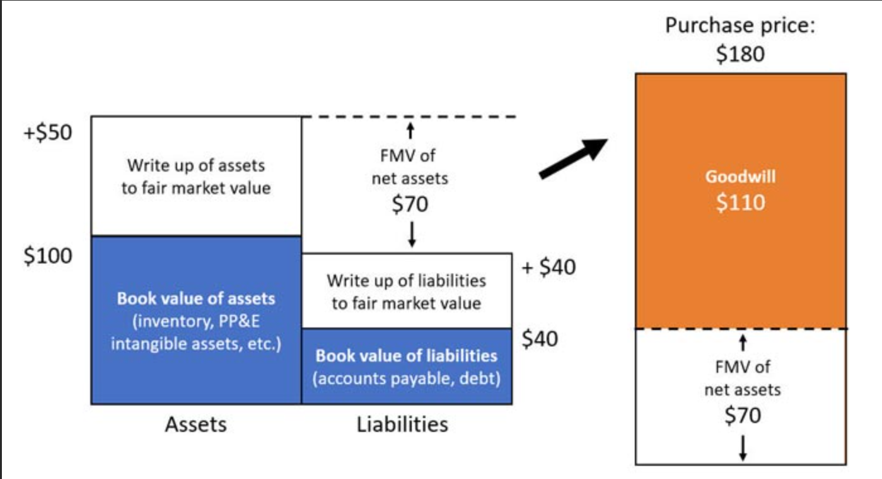
Step 7 : determining goodwill

Slide 22
Step 7 : determining goodwill
Applying IFRS 3’s formula may result in a positive amount (goodwill) or a negative amount (gain from a bargain purchase).
These amounts are accounted for differently:
RESULTING AMOUNT | IFRS 3 TREATMENT
GOODWILL | Recognised as a separate asset in the acquirer’s consolidated financial statements Goodwill is not amortised since it has no useful life Goodwill must be tested for impairment each year
GAIN for a bargain purchase | Recognised in profit or loss immediately

Slide 23
Accounting after the acquisition
The parent company must undertake several practical steps to prepare financial statements that include the acquired subsidiary such as:
Classify the assets acquired and liabilities assumed | The subsidiary’s assets and liabilities should be classified and designated based on their contractual terms, economic conditions and the parent’s accounting policies
Allocate goodwill to CGUs or groups of CGUs and test for impairment (IAS 36) | Before the end of reporting period, test any CGUs to which GW is allocated for impairment When the initial accounting for the business combination is incomplete as of the first reporting date and allocation of GW cannot be completed, the parent : Discloses the amount of any unallocated GW including the reason why such allocation is not completed Completes the GW allocation before the end of the reporting period beginning after the acquisition date

Slide 24
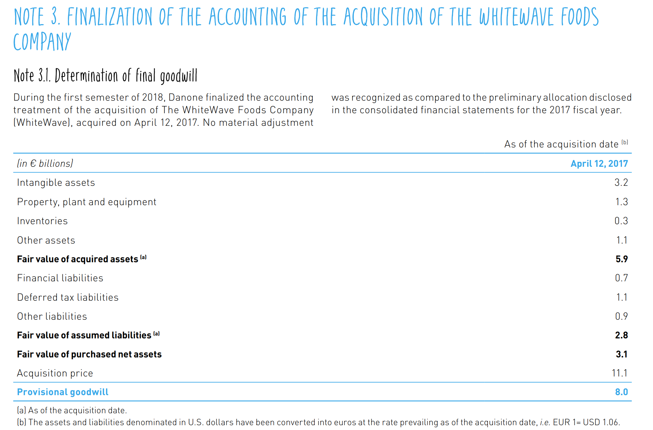
Goodwill, Danone 2018

Slide 25
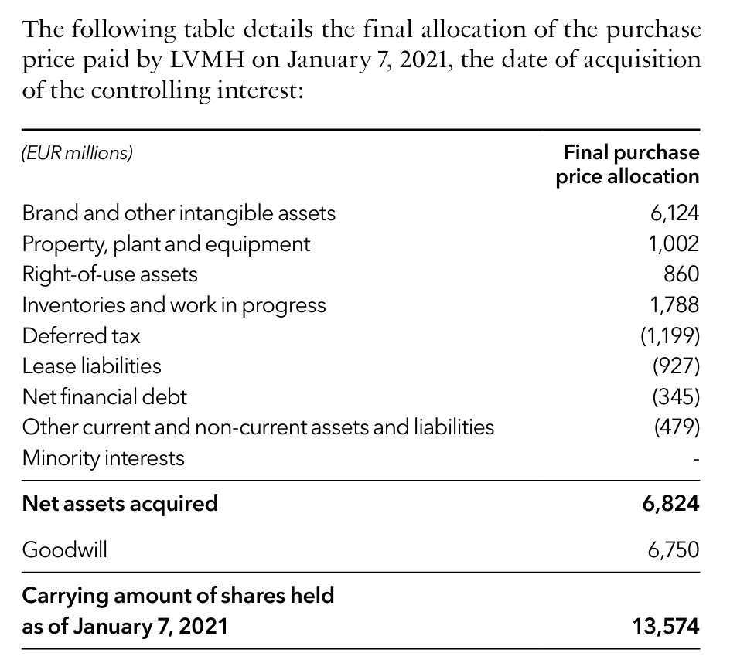

Goodwill, LVMH 2023

Slide 26
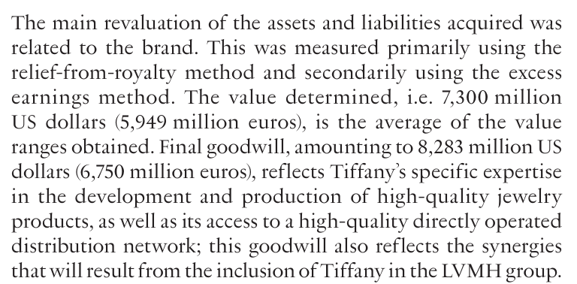





Goodwill, LVMH 2023

Slide 27
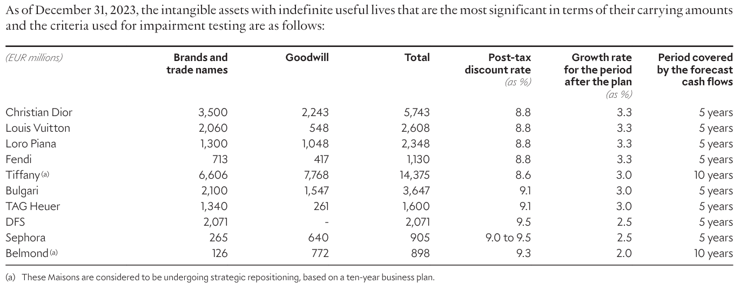












Goodwill, LVMH 2023

