Slide 1
Chapter 1: Transnational society, transnational politics

Slide 2
I/ Follow-up: Tilly and Tarrow, Contentious Politics (2015)
What do you know about the authors?
Charles Tilly (1929-2008)
Sidney Tarrow (born 1938)
What is contentious politics, how do you understand it?

Slide 3
Contentious politics
“People struggling with each other over which political program will prevail.”
“Contentious politics involves interactions in which actors make claims bearing on other actors’ interests, leading to coordinated efforts on behalf of shared interests or programs, in which governments are involved as targets, initiators of claims, or third parties. Contentious politics thus brings together three familiar features of social life: contention, collective action, and politics.”
Contention: “making claims that bear on someone else’s interests.”
Contention always brings together subjects, objects and claims.
Ex. A (subject) wants B (subject) to do sthg (object) = claim.
Collective action: “coordinating efforts on behalf of shared interests or programs.”
The bulk of collective action takes place outside contentious politics (in this classroom for ex.).
Politics: “interactions with agents of government”.
Most of politics involves little or no contention.
Ex.: showing your passport to immigration officers.

Slide 4
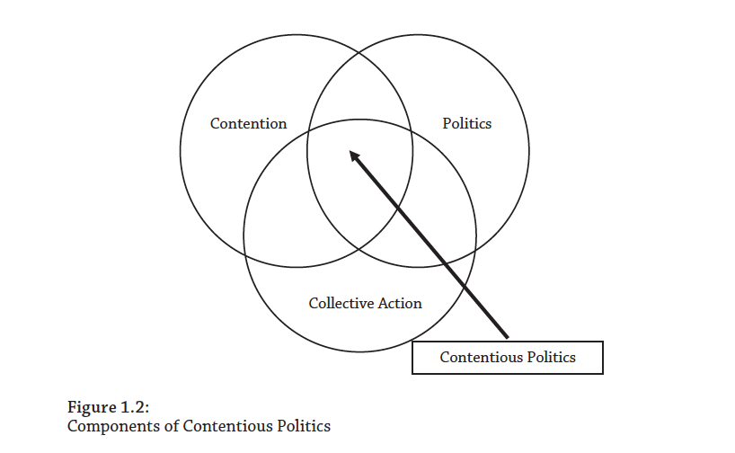

Slide 5
Governments make rules governing contention + people get accustomed to “repertoires” of collective action).
Routinization.
Contentious repertoires/repertoires of collective action (Charles Tilly, Sidney Tarrow)
Arrays of contentious performances that are currently known and available within some set of political actors.
Metaphors of jazz, theater or language to show how much the notion owes to the idea of a pre-existing structure of means of action constraining the choice of agents, but also what it implies in terms of the margin of freedom left to the invention of contestants.
The prevailing patterns of repression are one of the factors that explain the constitution and evolution of the repertoire available to a given population, alongside other factors such as the standards of law and justice it shares, its daily routines, its internal organization, or the accumulated experience of collective action.
Tilly: modification of the repertoires over time.
As a result of macro-historical factors such as the emergence of the centralized nation-state, the development of capitalism and the evolution of forms of communication.
The choice of modes of action by movements is a choice made under constraint, in particular of past experience and of resources available to the contestants.

Slide 6
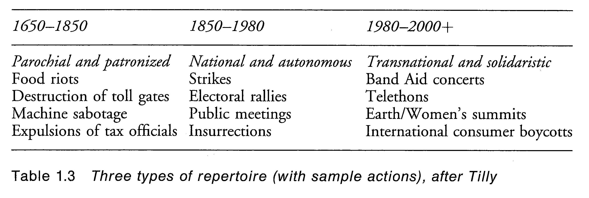
Cohen (Robin) et Rai (Shirin) (eds), Global Social Movements, Londres, Athlone Press, 2000.
Old and new repertoires coexist and vary in space, and the ‘third repertoire’, if it exists, does not seem to be linked solely to the phenomenon of transnationalization.

Slide 7
Meyer & Tarrow Social Movement Society (1988).
Thesis of the routinization of contention.
Wrong: 21st century:
More intensive protests, more disruptive and more violent.
Governments not becoming better accustomed to dealing with protest (more aggressive forms of policing and surveillance).
Examples:
Demonstration against WTO summit in Seattle (November 1999).
Genoa G-8 Conference (July 2001).

Slide 8
Contentious politics is not the same thing as social movements.
Social movement = “a sustained campaign of claim making, using repeated performances that advertise the claim, based on organizations, networks, traditions, and solidarities that sustain these activities.”
Social movement = historical (not universal) category.
Role of digital activism replacing social movements?
Most forms of contentious politics are not social movements.
Contentious performances: “relatively familiar and standardized ways in which one set of political actors makes collective claims on some other set of political actors.”
Contentious repertoires: “arrays of performance that are currently known and available within some set of political actors.”
Contentious campaigns: “combinations of performances that focus on a particular policy and usually disassemble when that policy is implemented or overturned.”
Such campaigns involve “movements”, but also interest groups, political parties, media, interested onlookers, state agents.
Example: ?

Slide 9
II/ Transnational politics

Slide 10
Transnational vs international.
“Transnational” = links, relations, between non-state actors.
Nye, Joseph S., and Robert O. Keohane. “Transnational Relations and World Politics: An Introduction.” International Organization, vol. 25, no. 3, 1971, pp. 329–49.
“Transnational relations = contacts, coalitions and interactions across state boundaries that are not controlled by the central foreign policy organs of governments.”
Examples of transnational phenomena: “multinational business enterprises and revolutionary movements; trade unions and scientific networks; international air transport cartels and communication activities in outer space.”

Slide 11
Transnational relations AND interstate system as centrally important to the understanding of contemporary world politics.
=> Nye and Keohane were reacting against the “realist” paradigm in international relations (emphasis on states as the only important actors in international politics).
Initially, scholars of transnational politics focused on economic relations (multinational corporations).
However, ‘much of transnational organizing deals with political and humanitarian issues such as refugees, violence against women and children, and human rights – and not economics per se.’
(Sidney Tarrow, ‘Transnational politics: Contention and Institutions in International Politics’, Annual Review of Political Science, 2001).

Slide 12
Link with contentious politics: social movements not confined to nation-states:
Transnational stakes cf. anti/alter globalism; climate change.
Transnational NGOs (including Churches!), etc.
Not a new phenomenon: movements against slavery, workers’ movements in the 19th century, etc.
-> Springtime of the Peoples/Springtime of Nations (Revolutions of 1848).
-> International Workingmen’s Association (“First International”), 1864.
Transnational mobilisations can be: simultaneous or coordinated action in various states (May Day celebrations), processes of imitation and transformation of a movement’s strategies due to mobilizations abroad (decolonization, collapse of Eastern regimes... ), the transfer of resources, the construction and consolidation of organizations with an international dimension, the physical commitment to a cause far away or the struggle against practices (of States, peoples or companies) that are far away and questionable (child labour...).
This activism can also bring together non-governmental and administrative actors in the framework of sectoral alliances within international organizations.

Slide 13
Donatella Della Porta and Sidney Tarrow (eds), Transnational Protest & Global Activism, Rowman & Littlefield, 2005.
Identify main reasons for the development of transnational movements and activism:
Shift in the locus of institutional power, from the national to the supranational and the regional levels: World Bank, International Monetary Fund, World Trade Organization, …; European Union, North American Free Trade Agreement, …
Transnational coalitions of NGOs in areas such as Human rights, environment and peace.
Shift in the axis of power from politics to market (neoliberalism): increase of the power of multinational corporations.

Slide 14
Della Porta and Tarrow (2005, p. 2-3) distinguish between 3 processes of transnationalization:
1/ Diffusion: spread of movement ideas, practices, and frames from one country to another (ex. diffusion of practices of mobilizations, such as sit-ins or black blocks).
2/ Domestication: the playing out on domestic territory of conflicts that have their origin externally (ex.: mobilizations of European farmers against national governments).
3/ Externalization: the challenge to supranational institutions to intervene in domestic problems or conflicts (ex.: mobilizations directly targeting EU institutions, the UN, …).
In practice, the processes can be intertwined.

Slide 15
Transnational Collective Action = coordinated international campaigns on the part of networks of activists against international actors, other states, or international institutions.
But transnational mobilizations are not limited to these organizations, they also include trade unions, foundations, religious organizations (the Catholic Church, Sunni Islam, or Pentecostal Churches), contributing strongly to the consolidation of networks and identifications of transnational collective action.
Not all organizations that contribute to transnational social movements are transnational structures.
Tarrow, (‘Transnational politics’ 2001) criticizes the transfer of the category ‘social movement’ to activities that would be more recognizable as lobbying, communication, and educational and service activity if they were observed at home.
Distinguish:
- social movements;
- NGOs (INGOs);
- Transnational networks.

Slide 16
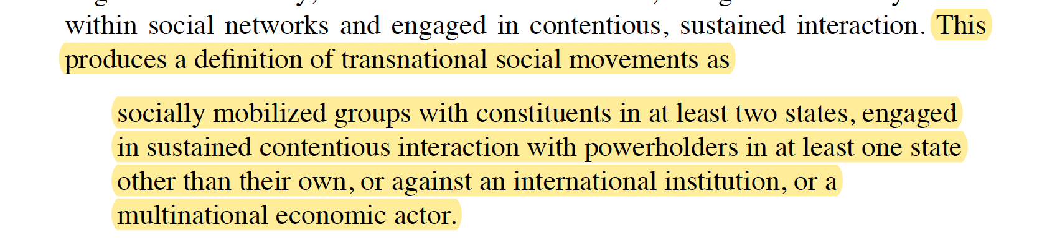
Social movements
European social movements operating in Brussels are often EU-subsidized lobbies (ETUC).
Identify social movements not by their goals, “which they share with many non-social movements”, but by the kind of actions in which they routinely engage, i.e., contentious politics.

Slide 17
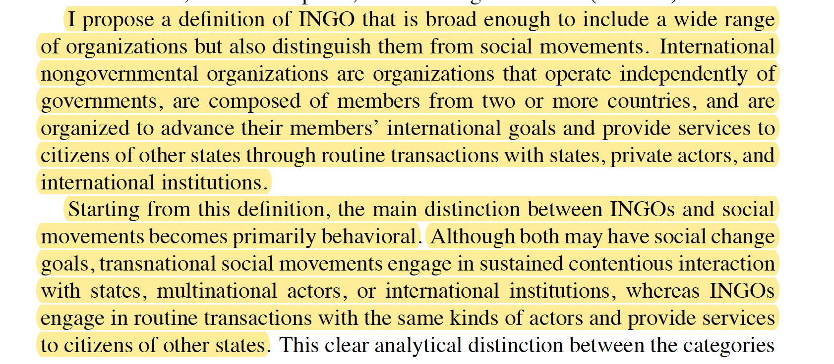
International Nongovernmental Organizations

Slide 18
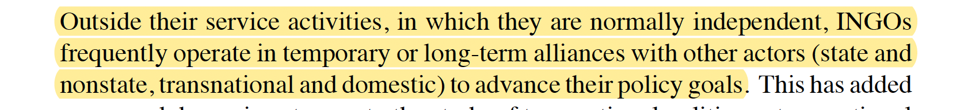
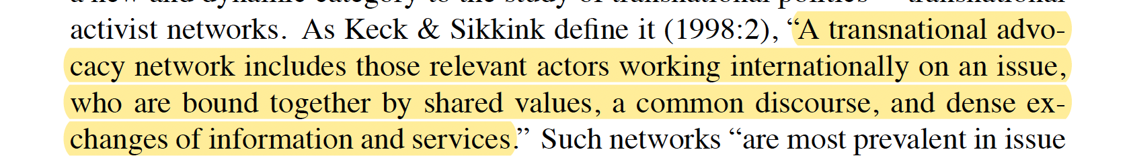
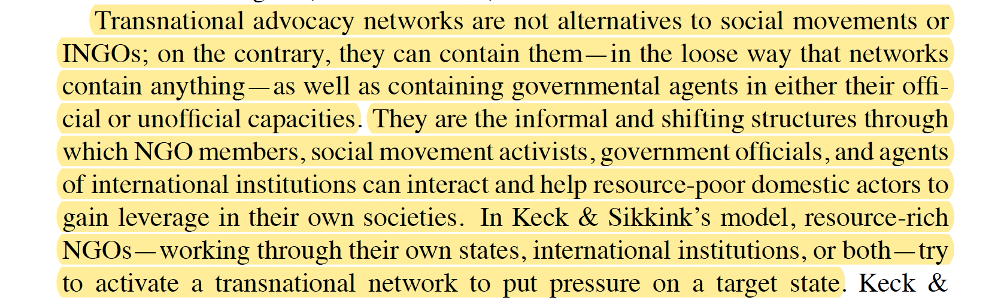
Transnational Activist Networks

Slide 19
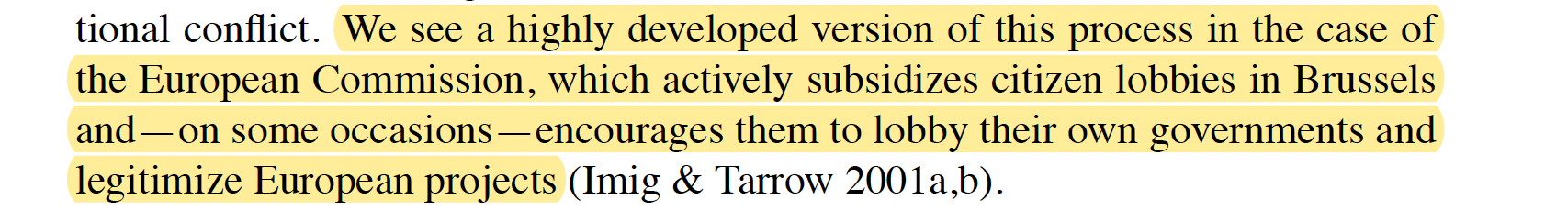
Tarrow, 3 cautions:
- states remain dominant in most areas of policy;
- globalization has been around for at least a century (transnational organizations and contention appeared well before globalization);
- social movements, transnational networks and NGOs are not the only agents operating transnationally.
International institutions are not the antipode of transnational contention: they offer resources, opportunities, and incentives for actors in transnational politics.
International institutions as “coral reef” helping to form horizontal connections among activists with similar claims across boundaries.
Paradox: international institutions, created by states, can be the arenas in which transnational contention is most likely to form against states.

Slide 20
III/ European social movements

Slide 21
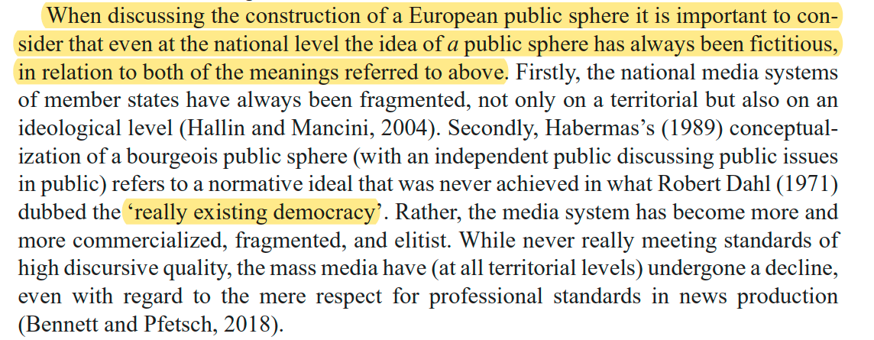
Donatella Della Porta, “Progressive Social Movements and the Creation of European Public Spheres”, Theory, Culture & Society, 2002.
// with De Swaan: challenges to the construction of European public sphere, cf. low level of attention paid to EU in national media and failure to construct proper European outlets.
Challenge of building a European demos.
But this challenge exists at national level too:

Slide 22
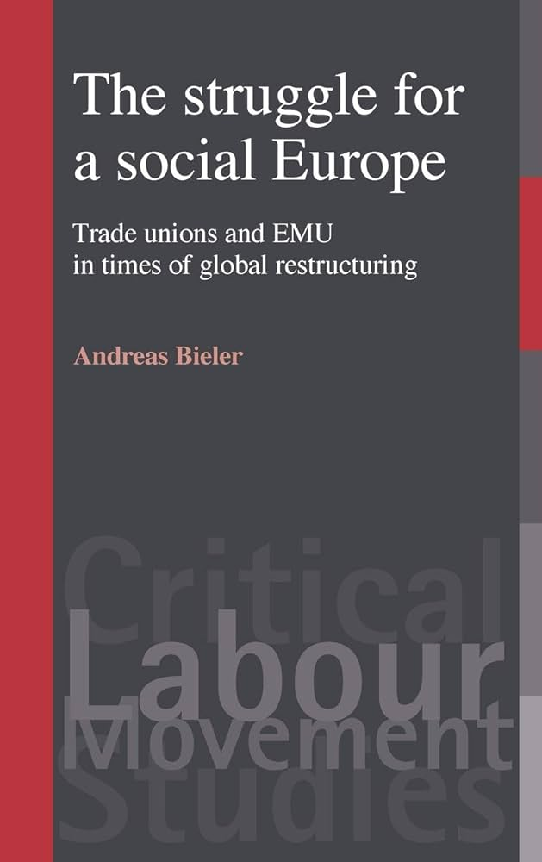
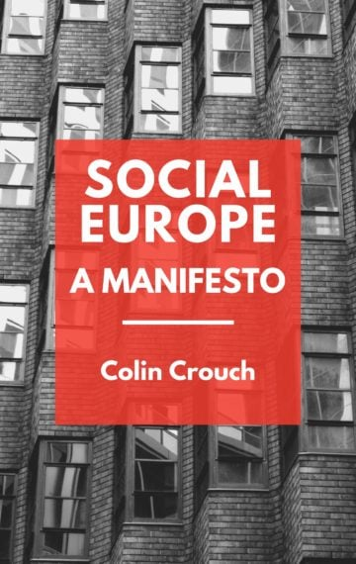
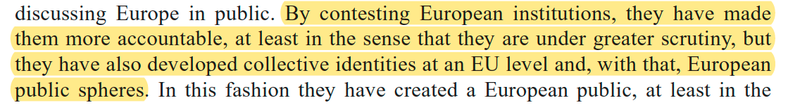
Role of progressive social movements (labour movement) in constructing a European public sphere: targeting EU through supranational protests, developing visions of another Europe (just and democratic).
See: https://www.socialeurope.eu/.

Slide 23
Example of externalization (cf. previous section) and of a European labour movement: Renault Vilvoorde (1997).
Decision of Renault (French car producer) to close one of its plants in Vilvoorde (Belgium).
Triggers the first “eurostrike”.
Transnational solidarity with workers’ protests in France and Spain.
Targets the EU to pressure Renault and their own governments.
https://www.youtube.com/watch?v=kYsrjj0p4MU
https://www.youtube.com/watch?v=Ry-5FdRz7Dg

Slide 24

Example of transnationalization: Global Justice Movement and European Social Forum (early 2000s).
Contestation of international summits with counter summits.
Bernard Cassen (Le Monde Diplomatique, founder of ATTAC), history of the World Social Forum:
https://www.youtube.com/watch?v=IUwelQswa20&t=212s
Annual meeting of civil society organizations, against neoliberal globalization, imagining alternative ways (alter-globalism).
A “counter-Davos” (World Economic Forum), first held in Brazil (Porto Alegre).
Manifestation of a global civil society. NGOs and social movement seeking global solidarity.

Slide 25
European Social Forum (ESF): “Europeanization from below”.
Critique of neoliberalism (‘Europe of the Banks’), the lack of democratic accountability of EU institutions, in a context (political opportunity structure) where the social-democratic left is the dominant political force in EU member states at the time (L. Jospin, G. Schröder, T. Blair, …).
First ESF, Florence, November 2002:
3 main themes of the Forum:
‘Globalization and neo-liberalism’;
‘War and Peace’;
‘Rights – Citizenship – Democracy’.
One of the largest demonstration against war in Iraq (500 000 protesters according to police estimates).
See “Red Florence”: https://www.youtube.com/watch?v=F-GA81I-L4s

Slide 26
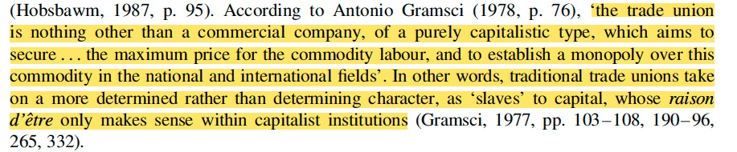
Andreas Bieler & Adam David Morton, “Another Europe is Possible? Labour and Social Movements at the European Social Forum”, Globalizations, 2004.
Challenge of the possibilities of cooperation between established trade unions; new, radical unions; and social movements, in the formation of a strategy against neoliberal restructuring (process of European integration since the mid-1980s).
- Established trade unions (ETUC) as an obstacle to the formation of a counter-neoliberal strategy?
Distant from social movements, “social partnership” approach (tripartism, corporatism).
Many of the most important unions were absent from the ESF: IG Metall, Ver.di (service sector union, Germany).

Slide 27

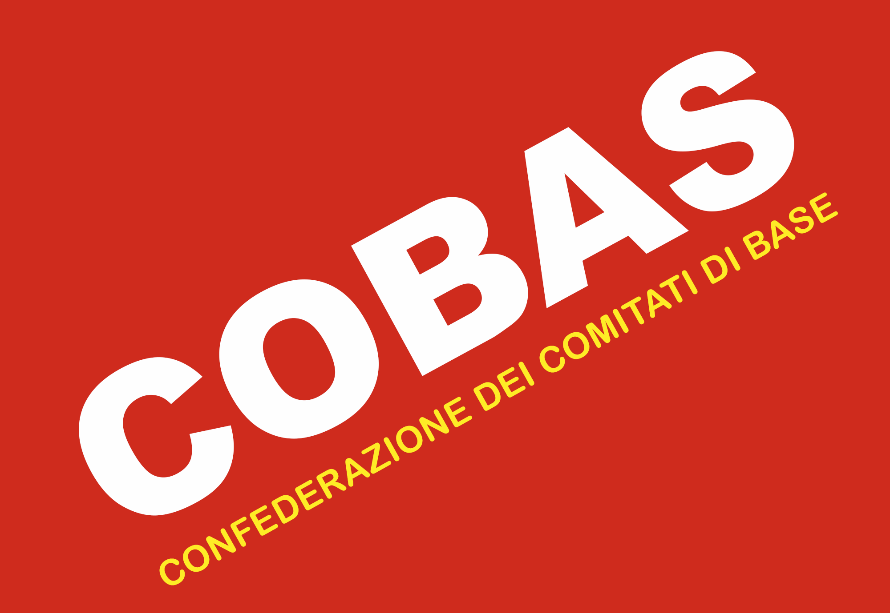
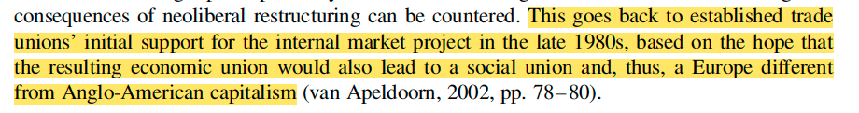
Tensions within the labour movement between established trade unions and new, radical unions (Sud, 1988; COBAS, 1987).
Participatory democratic internal structure of new unions.
Self-management. Rejection of tripartism with employers and the state, at both national and EU level.
New trade unions such as SUD and COBAS point at the intrinsic link between economic and political struggle, while established trade unions concentrate on labour rights (collective bargaining in tripartite institutions).

Slide 28
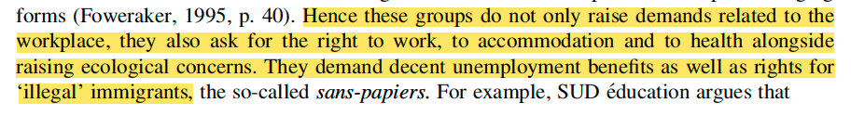
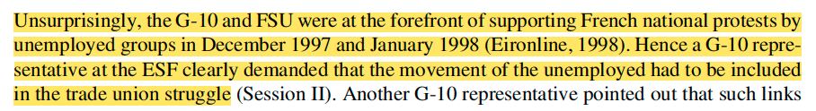
Differences between established and new unions have an impact on their position vis-à-vis cooperation with social movements.
New trade unions define their struggle in a wider sense and are almost by definition more open to interaction with social movements.
They argue that neoliberal exploitation goes beyond the work place (fairer distribution of wealth):

Slide 29
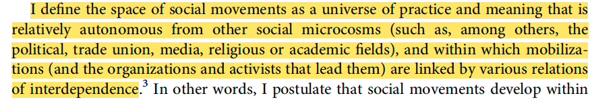
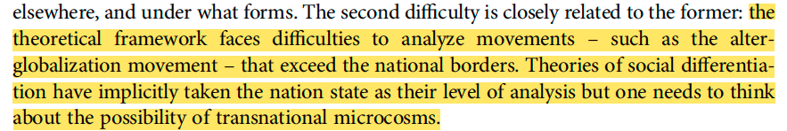
Social movements are not homogeneous actors either: some (ATTAC) focus on lobbying and on the reform of global capitalism, instead of its transformation; differences in terms of life-style ethos, repertoires of action, …
Parallels to the division between established and new trade unions.
See Lilian Mathieu, “The space of social movements”, Social Movement Studies, 2021.

Slide 30
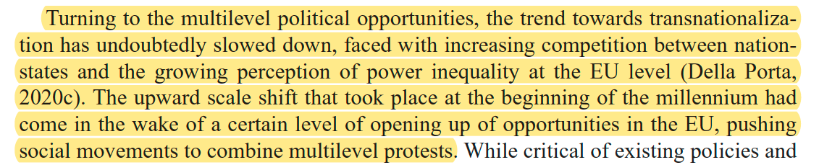
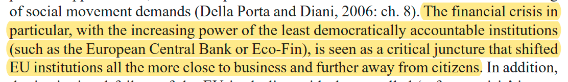
Challenges: a less favourable political opportunity structure since the late 2000s?
Donatella Della Porta, “Progressive Social Movements and the Creation of European Public Spheres”, Theory, Culture & Society, 2002.

Slide 31
Political opportunity structure (Charles Tilly, Doug McAdam, Sidney Tarrow)
Features of regimes and institutions (e.g., splits in the ruling class) that facilitate or inhibit a political actor’s collective action.
Widening of the perspective, initially centered on organizations of social movement, mobilization of the resources.
The fate of a protesting action owes, independently of the mobilizing capacity of the group, to the state and to the conjunctural evolutions of the political system, which make it, according to the circumstances, more or less vulnerable, or receptive, to the contestation.

Slide 32
Tarrow & Tilly, Contentious politics (p. 240):
Political opportunity structure includes six properties of a regime:
1. The multiplicity of independent centers of power within it.
2. Its openness to new actors.
3. The instability of current political alignments.
4. The availability of influential allies or supporters for challengers.
5. The extent to which the regime represses or facilitates collective claim making.
6. Changes in any of the above.
Diachronic approach (McAdam, Freedom Summer).
Synchronic approach: Kriesi (Hanspeter), Koopmans (Ruud), Duyvendak (Jan Willem) et Giugni (Marco G.), New Social Movements in Western Europe, London, UCL, 1995.
‘What makes the concept interesting is the shift away from individual motivation and competence towards the broader social context in which they operate’ (cf. De Swaan).

Slide 33

IV/ Follow-up: De Swaan, Abram: “The European void. The democratic deficit as a cultural deficiency”, in The European Union and the Public Sphere, 2007

Slide 34
‘The institutions of the EU, elected directly or indirectly, have failed to capture the imagination of the electorate.’
No European public space (it is transnational and anglophone, elitist).
// Georgakakis.
“European democracy” invoked since the Maastricht treaty (European citizenship), but EU is mainly a bureaucratic and legal field, oriented towards the production of public policies (Field of Eurocracy).
It relies on elements of undirect democracy (Council) and elements of direct democracy (European Parliament).
=> It is far from a federal government.
European democracy is weakly embedded in European societies (few mobilizations and debates on European issues).

Slide 35
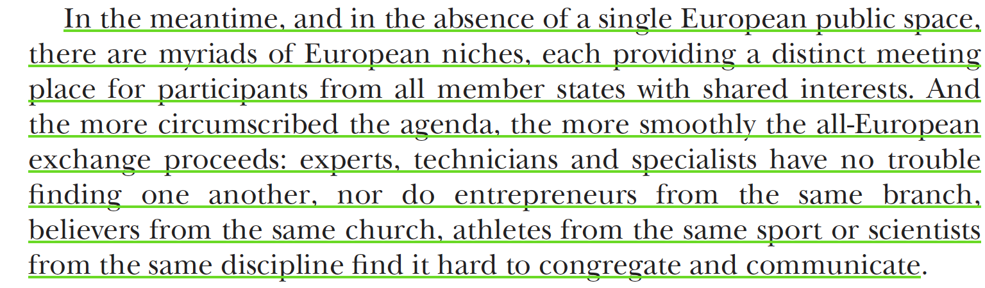
‘Europeans do not speak the same language and hence do not understand each other well enough to differ or agree.’
Opinions shaped within national frameworks: ‘What is passionately debated in one country is often not even an issue in adjacent countries where a different agenda prevails.’
=> Specialised networks that are separated at the national level, too.

Slide 36
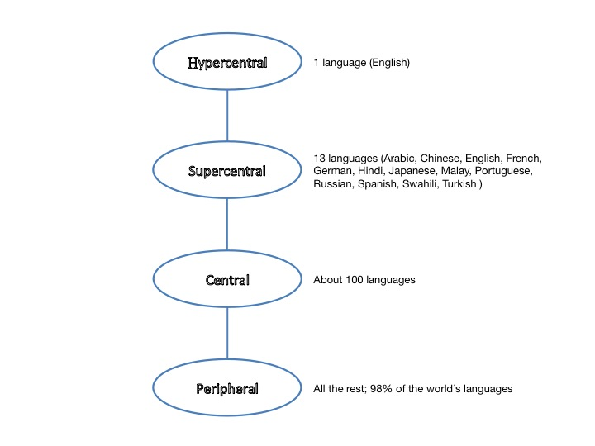
Formation of national public spaces // formation of the nation-state.
Cf. Norbert Elias (The Civilizing Process, 1939), Benedict Anderson (Imagined communities, 1983).
‘In each country, the various regional languages were gradually pushed aside by the language of the court and the capital city, which set the tone for the entire society.’
European constellation of languages.
‘Language differences delimit the scope of attention and delineate networks of affinity among intellectuals.’ (not only intellectuals…)
De Swaan,
Global language system

Slide 37
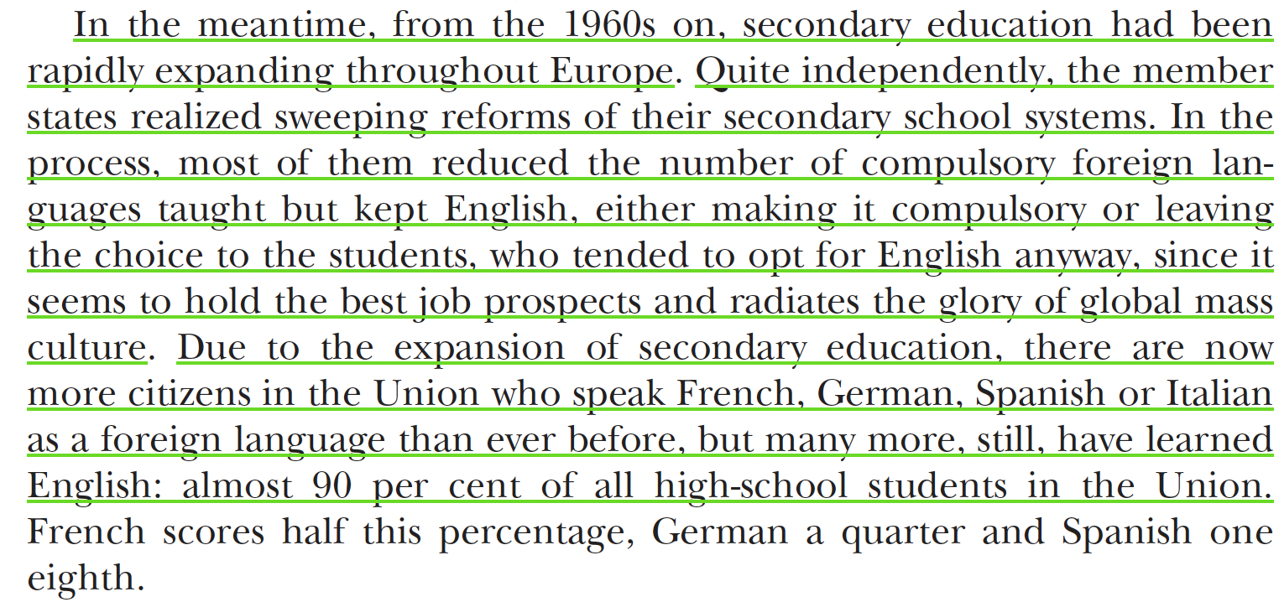
English as the dominant language of EU institutions.
=> English as vehicular language of Europe.

Slide 38
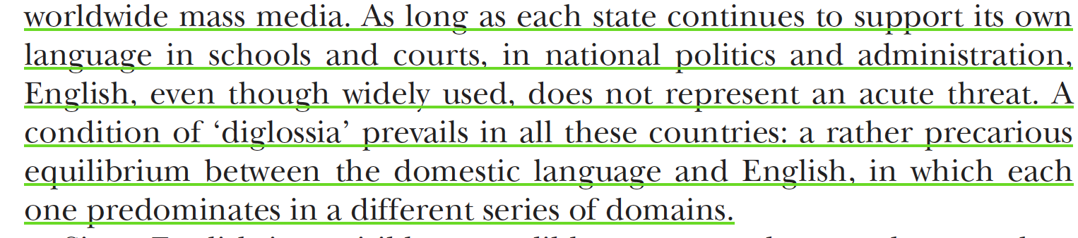
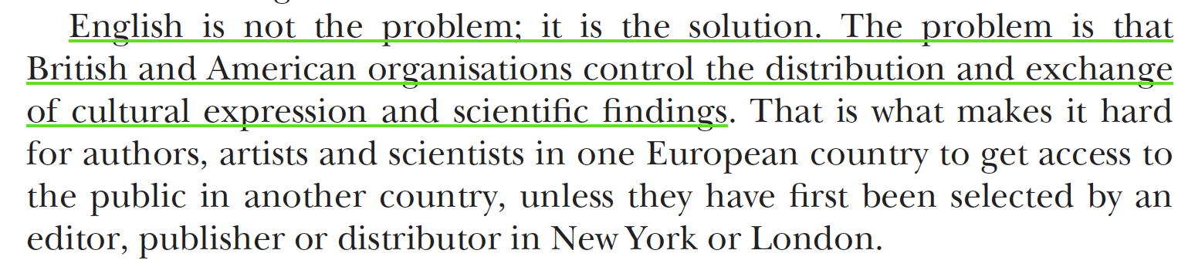
‘Within the prevailing cultural opportunity structure, English is the paramount medium of international exchange.’ (i.e., the ‘constellation of universities, newspapers, reviews and foundations granting subsidies or awards’).
=> ‘Désangliciser l’anglais’?
‘De-anglicize’ the institutional means of communication and distribution.

Slide 39
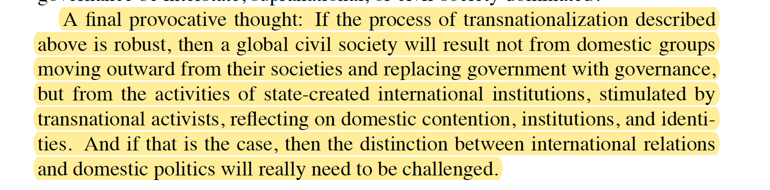
Conclusion of chap. 1
Tarrow, The New Transnational Activism (2005):
‘In today’s world, we can no more draw a sharp line between domestic and international politics than we can understand national politics in the United States apart from its local roots.’
‘Transnational activism is transformative: it may be turning thousands today from occasional participants in international protests into rooted cosmopolitans. That transformation could become the hinge between a world of states and one in which stateness is no more than one identity among many: local, national, and transnational.’

