Slide 1
Séminaire Master 2 Recherche HPE Laurent Le Maux VIII International money
———————

Slide 2
Dollar Swap Lines
Dollar Swap Line amounts outstanding by central banks
October 13, 2008 (full-allotment format)

Slide 3
1910s and 1920s
Paper money and gold bullion standard
Paper money (1914), Genoa conference (1922)
Return to convertibility in Britain at the pre-war parity (1926)
Purchase Power Parity (Cassel, 1916)
Purchase Power Parity theory such as:
S = (P/P*)
P: domestic price level
P*: foreign price level
S: foreign currency price in domestic currency

Slide 4
1910s and 1920s
Interest Rate Parity (Keynes, 1923)
Interest Rate Parity theory such as:
F/S = (1+i)/(1+i*)
i : domestic interest rate i* : foreign interest rate
S: spot exchange rate F: forward exchange rate
(foreign currency price in domestic currency)
Swap basis spread:
(1+i) – (F/S).(1+i*)

Slide 5
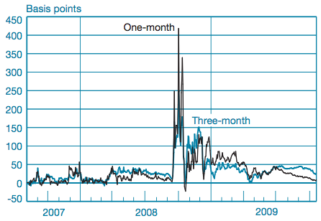
Illustration of the IRP theory
Euro - Dollar Swap Basis Spread = (1+i$) – (F/S).(1+i€)
August 2007 – Septembrer 2009 (Goldberg, Kennedy and Mui, 2011)

Slide 6
1930s and 1940s
Decline of the sterling and rise of the dollar
Ralph Hawtrey (1932), The Art of Central Banking
John H. Williams (1934), “The World’s Monetary Dilemma”, Proceedings of the Academy of Political Science
Charles Kindleberger (1973), The World in Depression, 1929-1939.
Keynes’ Clearing Union (1942)
International money: the bancor
Clearing system and fixed exchange rate
Removal of foreign exchange market.

Slide 7
Bretton-Woods
Keynes Plan versus White Plan
Keynes Plan: Multilateral system of clearings
International money
White Plan: Gold exchange standard or dollar system
Hierarchy between currencies
Hierarchy between currencies
De jure? Bretton-Woods
De facto? Post Bretton-Woods

Slide 8
Bretton-Woods
Triffin versus Kindleberger
Triffin dilemma: U.S. => shortage of dollars
U.S. deficit => excess of dollars
Kindleberger: U.S. short-term debts and U.S. long-term loans
=> The U.S. is the “bank of the world”
Management of Bretton Woods system
International capital control
Balance of payments disequilibrium and the IMF
Foreign exchange rate and the Basle Swap Agreements

Slide 9
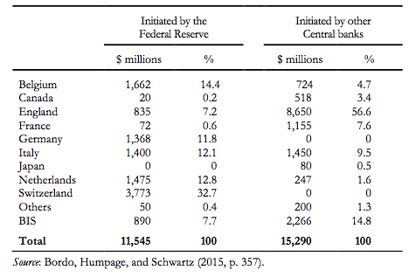
Basel Swap Arrangements
Drawings on reciprocal central bank swaps, 1962-1971

Slide 10
From the 1970s to the 1990s
Optimal currency areas (OAC) and single currency
Mundell (1961): conditions for OCA
Frankel and Rose (1997, 1998): endogenous OCA
Creation of euro (1999)
International liquidity (dollar) and financial globalization
Euromarkets in the 1970s
Financial liberalization in the 1980s
Intervention of the Fed as the global LLR (2007-2009)

Slide 11
Charles P. Kindleberger
Charles Kindleberger (1973, 1978)
The World in Depression (1973)
Manias, Panics, and Crashes (1978)
Milton Friedman and Anna Schwartz (1963)
A Monetary History of the United States, 1867–1960, Princeton, Princeton University Press.
Ben Bernanke (1983)
“Nonmonetary Effects of the Financial Crisis in the Propagation of the Great Depression”, AER, 73(3), 257–276.

Slide 12
Charles P. Kindleberger
Argument 1: Free riding and benevolent leadership
Kindleberger (World in Depression, 1973, p.28): “the international economic and monetary system needs leadership, […] to take on an undue share of the burdens of the system.” => Collective action problem (M. Olson, 1965)
Argument 2: The efficient leadership
Kindleberger (1967, p.26): the “leadership” is “inescapable” and “can operate efficiently in an international setting.”
Kindleberger (1974, p.20): “the lender of last resort in [the case of a run on Eurodollar banks in Europe] should be the Federal Reserve System. But will the Federal Reserve respond to that?”

Slide 13
Charles P. Kindleberger
Shift from limited…
Kindleberger (1974, p.21): “Probably the most logical thing would be to activate the swap network and have it large enough to accommodate everybody. To have limits might be a bit awkward”
… to unlimited provision of international liquidity
Kindleberger (1967, pp.28-9) added: “The great merit of the Basle agreement, and the crucial feature of an international central bank, is the availability of unlimited amounts of assistance through rediscounting in a period of crisis. […] Lines of credit must be unlimited”.

Slide 14
Dollar Swap Line amounts
Dollar Swap Line amounts outstanding by central banks
October 13, 2008 (full-allotment format)

Slide 15
Kindleberger’s rule
Harsch penalty?
Kindleberger (1976, p.298): “If the lender of last resort is too stringent […], it fails to provide the brake to the deflationary spiral which is its purpose; […] harsh penalties accompanying the discounting process may be as bad as the default.”
Lending freely without penalty rate
Thus, in Manias, Panics and Crashes, Kindleberger (1978, p.225) set recommendations, which went beyond Bagehot’s rule: the “swap network is better at lending freely, with its speed in decision making and elastic limits.
It lacks the penalty rate, but among the insider group of the Bank for International Settlements [that is, among central banks] the chances of abuse seems minimal.”

Slide 16
Dollar Swap Line rates
The interest rate set by the Federal Reserve
September 15 – October 31, 2008 (%)
October 13, 2008

Slide 17
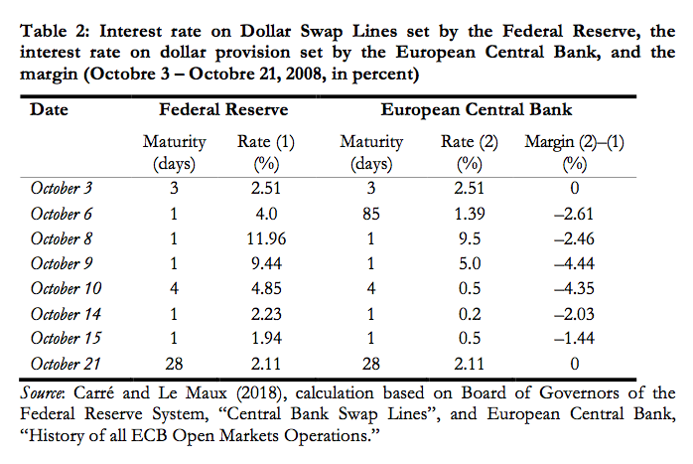
Who shared the burden? Not the U.S.
Dollar swap Line rate and ECB dollar interest rate

Slide 18
Charles P. Kindleberger
Argument 1: The benevolent leadership
Kindleberger (World in Depression, 1973, p.28): “the international economic and monetary system needs leadership, […] to take on an undue share of the burdens of the system”
Argument 2: The efficient leadership
Kindleberger (1967, p.26): the “leadership” is “inescapable” and “can operate efficiently in an international setting.”

Slide 19
Kindleberger’s moment
Bill Dudley (FOMC Transcripts, 2008, Sep. 16, p. 17)
The important thing here is credibility. In a crisis you need enough force—more force than the market thinks is necessary to solve the problem.
Ben Bernanke (FOMC Transcripts, 2008, Sep. 16, pp. 3, 17)
I would like to put on the table a request for authorization for swap lines. I prefer not to put a limit on it.
We want to have the flexibility in case of an emergency to respond, and we also don’t want to communicate to the markets somehow that we have a hard limit that is not going to be changed. That would be potentially bad for confidence.

Slide 20
Kindleberger in central banks
Liikanen (2013)
“The idea that the stability of the international monetary system needs leadership and the conduct of monetary policy from an international perspective originates from research by Charles Kindleberger (1973).”
Fischer (2015)
“My teacher Charles Kindleberger argued that stability of the international financial system could best be supported by the leadership of a financial hegemon. […] But I should caution that the responsibility of the Fed is not unbounded. ”

Slide 21
Conclusion
Bernanke (1983)
Charles Kindleberger, in “argu[ing] for the inherent instability of the financial system, […] had to depart from the assumption of rational economic behavior.”
Kindleberger (1978)
Manias and panics are “based on rational behavior on the part of each participant that is irrational overall.”

Slide 22
Conclusion
Bernanke and Gertler (1999)
As a “possible source of nonfondamental movements in asset prices that has received much attention is irrational behavior by investors, for example, herd behavior” (page 19).
Although “it is difficult to identify any particular episode conclusively as a bubble, even after the fact […], episodes of ‘irrational exuberance’ in financial markets are certainly a logical possibility” (page 19).
“With this concern as motivation, we present simulations of the economic effects of bubbles” given that asset price bubbles are “exogenous” (page 24).

Slide 23
Conclusion
Bernanke and Gertler (1999)
“Although our framework […] is silent about certain types of lender-of-last-resort interventions that the central bank might undertake, we believe that these omissions are unlikely to affect our central bank conclusions about aggregate stabilization policy” (p. 42)

Slide 24
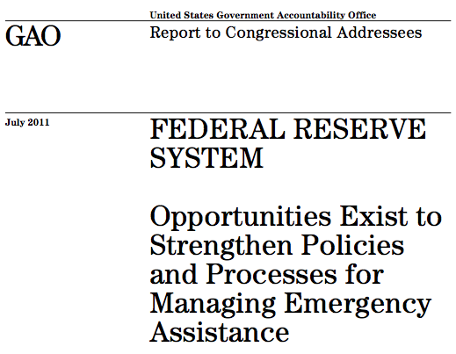
Congress and Federal Reserve

Slide 25
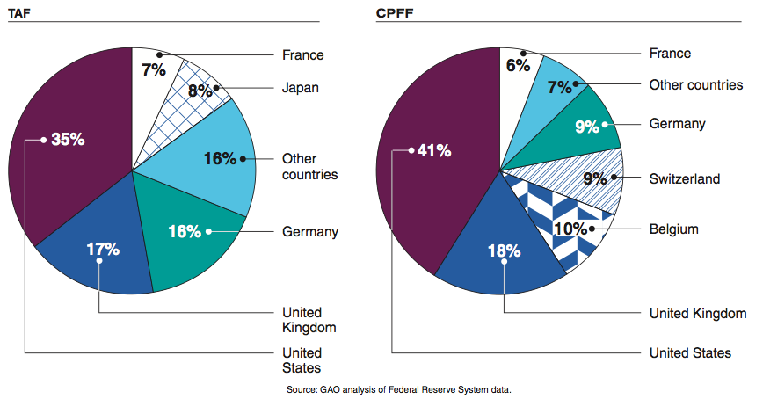
Stylized facts
Facility amounts by parent bank country of domicile (%)

Slide 26
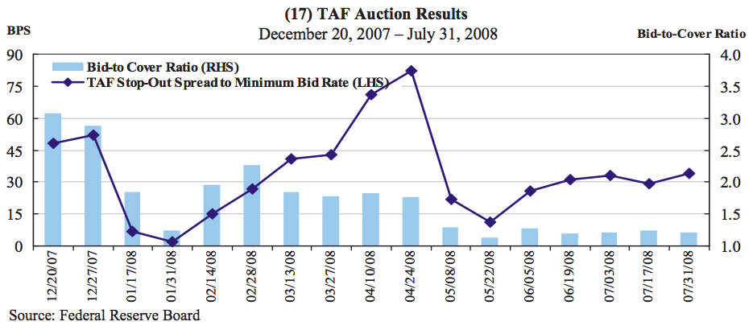
Stylized facts
Term Auction Facility (FOMC, August 5, 2008, Materials, Figure 17)

Slide 27
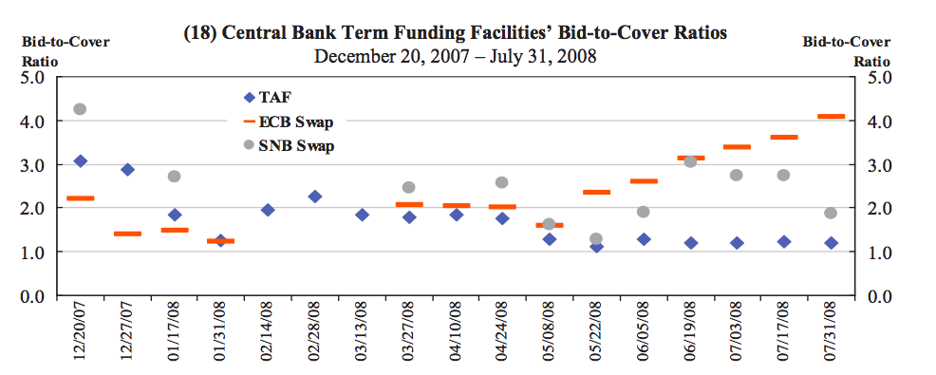
Stylized facts
Dollar Swap Lines (FOMC, August 5, 2008 Materials, Figure 18)

Slide 28
The ECB and the dollar provision
Ratio of the subscribed amounts in dollars by the eurozone banks to the offered amounts in dollars by the ECB

