Slide 1
Tutoring session 1 : S2I / IKSEM
Title of the Master Thesis
Thesis Author:
Thesis Supervwisor:

Slide 2
Motivation
Why the problem you are trying to tackle is interesting (economic, social, technical impact ...)?
  Support your point by providing at least one reference to the literature
  or
  Support your point by providing a synthesis of one or several articles (research and other)

Slide 3
Research Problem / Research Question
Present your Research Question (RQ) :
  Be focused: define precisely your perimeter of action (application domain, technology, stakeholder(s) etc);
  Be specific: disambiguate the terms.
    If cross-domain – present the terms from both domains (ex: Healthcare, Sociology, Law, Engineering, Finance..)
  Check for hidden assumptions
  See the checklist of 6 from Skribber
HINT: Present a list sub-questions that may precise your question
Notes:
The question must be;
Focused
Researchable
Feasible
Specific
Complex
Relevant
https://www.youtube.com/watch?v=71-GucBaM8U&list=PLjBMY3HggCpAjmtPByI_MkFI6lrguHatL&index=2

Slide 4
Key words / Query / Simulation of search / Feasibility check
What are your key words?
What is your query to
  Search for related works? (for all research methods)
  Search for the primary articles (dataset)? (for SMS/SLR)
Simulate a literature search (https://scholar.miage.dev/, google scholar, scopus..) :
  How many papers have you got?
  Are they relevant?

Slide 5
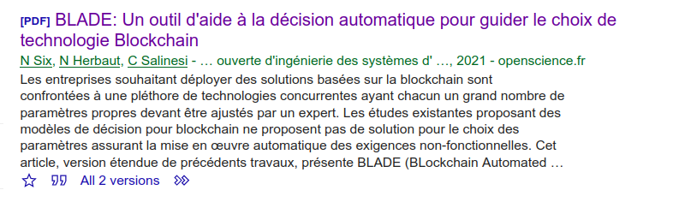
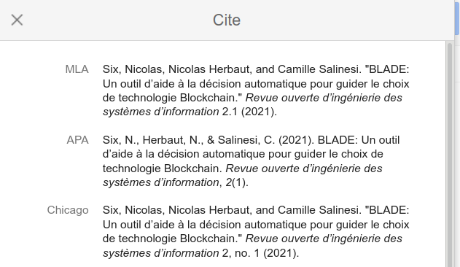
Related Literature
Present some related research on your topic
Search for references in Google Scholar or use MIAGE Scholar (https://scholar.miage.dev/)
ALWAYS use the complete references and put them in the same format !!! (e.g. Chicago )
Six, Nicolas, Nicolas Herbaut, and Camille Salinesi. "BLADE: Un outil d’aide à la décision automatique pour guider le choix de technologie Blockchain." Revue ouverte d’ingénierie des systèmes d’information 2, no. 1 (2021).

Slide 6
Research Question : Details
To better explain / detail your RQ, you can complete it with, on your choice:
  Sub-questions
  Hypothesis
  Conceptual Framework
These elements must give a specific idea about _how_ you are planning to answer your RQ through collecting and analyzing _some_ data, for example:
  What are your main concepts? How are they related?
  What are you expecting to find?
  What are you NOT expecting to find?
Notes:
The question must be;
Focused
Researchable
Feasible
Specific
Complex
Relevant
https://www.youtube.com/watch?v=71-GucBaM8U&list=PLjBMY3HggCpAjmtPByI_MkFI6lrguHatL&index=2

Slide 7
Research Strategy 1/2
What are you planning to deliver as a result?
Explain what Data you plan to collect in order to answer your research question / subquestions?
Where and How you plan to collect it? (e.g., field study or desktop study; observations, interviews, simulations etc..)
What resources will you need? (data, programming skills, other people’s time..) – show that your RQ is feasible
Justify: How your research is different from the related works you have found?
Notes:
The question must be;
Focused
Researchable
Feasible
Specific
Complex
Relevant
https://www.youtube.com/watch?v=71-GucBaM8U&list=PLjBMY3HggCpAjmtPByI_MkFI6lrguHatL&index=2

Slide 8
Research Strategy 2/2
What research methodology is most suitable for your RQ?
Justify your choice based on the above
Notes:
The question must be;
Focused
Researchable
Feasible
Specific
Complex
Relevant
https://www.youtube.com/watch?v=71-GucBaM8U&list=PLjBMY3HggCpAjmtPByI_MkFI6lrguHatL&index=2

Slide 9
Research Protocol and Planning (for those who continues with Master Thesis)
Based on your selected research methodology, define the specific steps of your research protocol (for data collection, analysis, validation etc)
Make a planning for the rest of the thesis:
  Oct-Nov 2021 : what have been done
  Nov-Jan 2022 : what are you doing now
  Feb-Avril 2022 : …
  Avril-Mai 2022 : .. .
  Juin-Juillet 2022: …
  Defence on July ou defence on Sept ?
Notes:
For each methodology a protocol is explained in the literature (ref in the lecture notes)

