Slide 1
Tutoring Session 2
This Template summarizez the list of “must have” items for your presentation.
(to adjust based on your selected methodology!)
The color scheme / layout are to customize up to your taste ☺
Presentation durtion: 15 min.

Slide 2
Title of the Thesis
Author
Supervisor
Class/Year

Slide 3
Reminder:
Research domain (Context)
Research problem: short statement
Selected Research Methodology: SLR/SMS/Case study/ Other

Slide 4
Background
Give definitions for all _specific_ terms used in your work
Use references / citations for that!

Slide 5
Related work
Related = same research method, same (or similar RQ)
Present a list of Related works
Explain: what is the difference between these works and YOUR work?

Slide 6
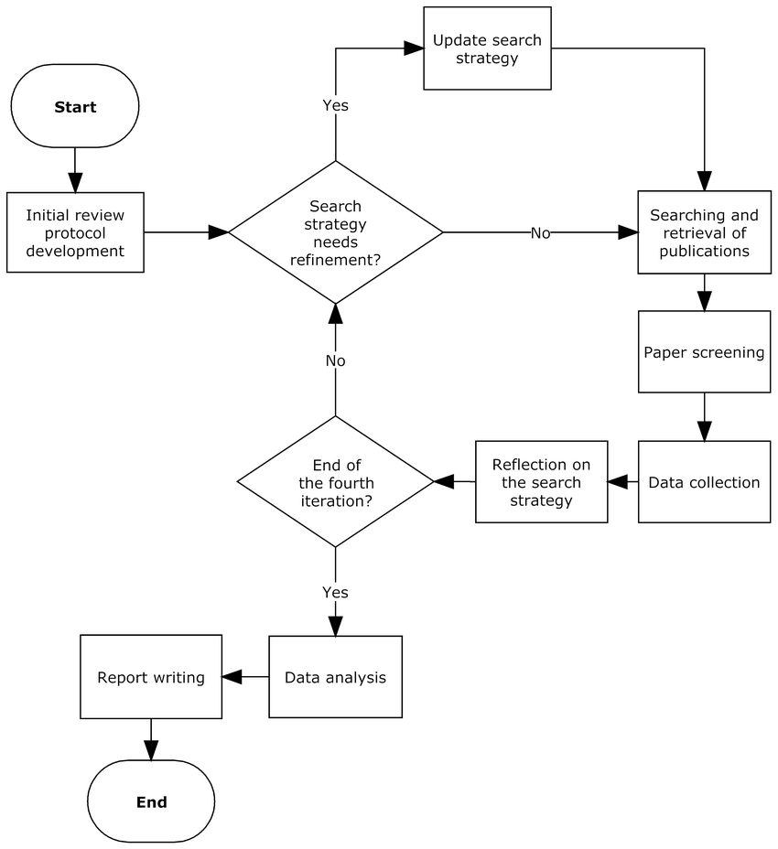
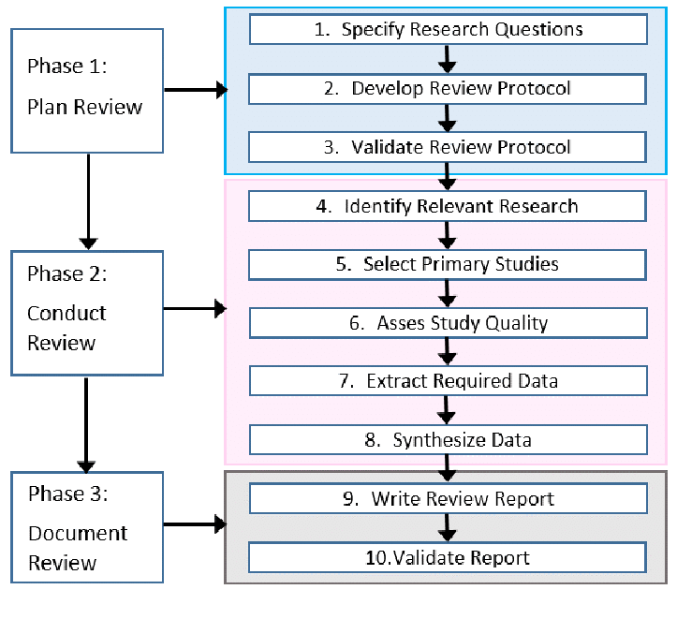
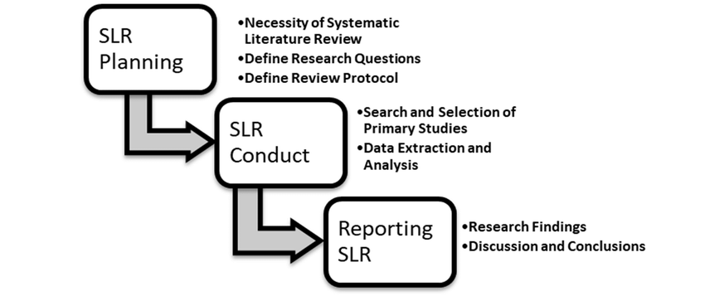
Research Methodology , RQ and Protocol
Research methodology
Research questions
Research protocol
define the research protocol based on the selected research methodology: steps, goals, outcomes.
Step 1
Step 2
Step 3
Step N
… some examples of how we can document a protocol..
…
Goal of the step / outcome

Slide 7
Research protocol: Implementation…
In the next 2-3 slides, explain each protocol step from the previous slide
Present the developed outcomes
Define what is yet to be done

Slide 8
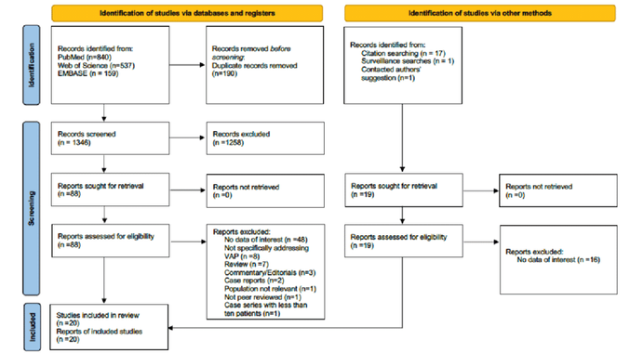
Step: Data collection (for SMS/SLR)
You can use PRISMA method to formalise / present the results of data collection:
Identification (Automated search (using Scopus, Google Scholar, other db..))
  Definition of the Key Words and Query
Screening
  Definition of Inclusion / Exclusion criteria
  Screening title/abstract / applying filtering criteria
Eligibility assessment
  Readinf full text, applying filtering criteria
Snowballing/Injection of other sources
Quality assessment (optional)
  Definition of quality criteria
  Applying criteria
Final selection
Example of PRISMA flow diagram
Template is here: http://www.prisma-statement.org/PRISMAStatement/FlowDiagram.aspx
Page, M.J., McKenzie, J.E., Bossuyt, P.M. et al. The PRISMA 2020 statement: an updated guideline for reporting systematic reviews. Syst Rev 10, 89 (2021).

Slide 9
Step: Data collection (for other methodologies)
For Experiment : Present the experimental settings
  What is the set up? (algorithms, metrics, input/ output, how implemented?)
  What is collected / calculated/observed?
For Case studies : present the case, describe data sources and the way of collection
  People, documents
  Interviews others..
For interviews:
  Describe the sampe: how many people, why is it representative?
  Present the interview guide (questions)
  Explain how the answers will contribute to the RQ? (see data extraction form)

Slide 10
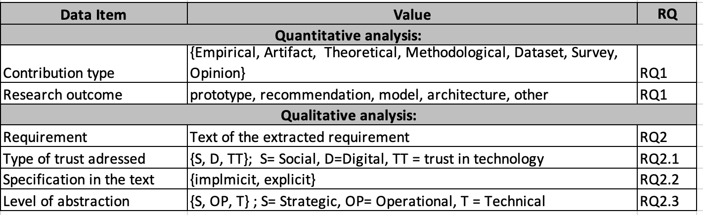
Step: Data Analysis (For SMS/SLR)
Present your data extraction form (see Kitchenham)
Explain, how the extracted data items are supporting you research questions?
Some examples..
TIP: You need to check the form by extracting data from 3-5 articles: is it feasible? → adjust if not..

Slide 11
Step: Data Analysis (for all methodologies)
GOAL: To explain, how the extracted data items are supporting you research questions?
QUANTITATIVE RESEARCH:
  Use theoreticel model
  Formulate hypotheses
  Create your measurement model / Asses its validity
  Use SEM / PLS-SEM (.. other statistical tools..) to empirically validate your hypotheses
  Use graphs, tables, plots, schemas to illustrate your findings

Slide 12
Results (if applicable at this time..)
Present the initial results of the data collection /extraction / analysis
TIP: For SMS/SLR, you can use Use excell sheet with the articles

Slide 13
Validation Strategy (if applicable at this time..)
Are your findings valid?
How can you proove it?
What can make them unvalid? (threats to validity)

Slide 14
Plan of the Manuscript
Present the detailed plan of the manuscript.

