Slide 1
Tutoring Session 3
This Template summarizez the list of “must have” items for your presentation.
(to adjust based on your selected methodology!)
The color scheme / layout are to customize up to your taste ☺
Presentation durtion: 15 min.

Slide 2
The objectives of this ST3:
Show the progress in implementation of your selected research methodology
Demonstrate that the collected data is sufficient to answer the research questions defined for your thesis
Discuss validity of your findings
Show the status of the manuscript
Identify the ToDo before the defence
For the students who prepares to defend the thesis on July, validate the defence on July with the thesis director! (GO or NOGO?)
FOR ALL: DO NOT FORGET TO CHECK THE Thesis Evaluation Guidelines (EPI)

Slide 3
Title of the Thesis
Author
Supervisor
Class/Year

Slide 4
Reminder:
Research domain (Context)
Research problem: short statement
Selected Research Methodology: SLR/SMS/Case study/ Other

Slide 5
Background
Give definitions for all _specific_ terms used in your work
Use references / citations for that!

Slide 6
Related work
Related = same research method, same (or similar RQ)
Present a list of Related works
Explain: what is the difference between these works and YOUR work?

Slide 7
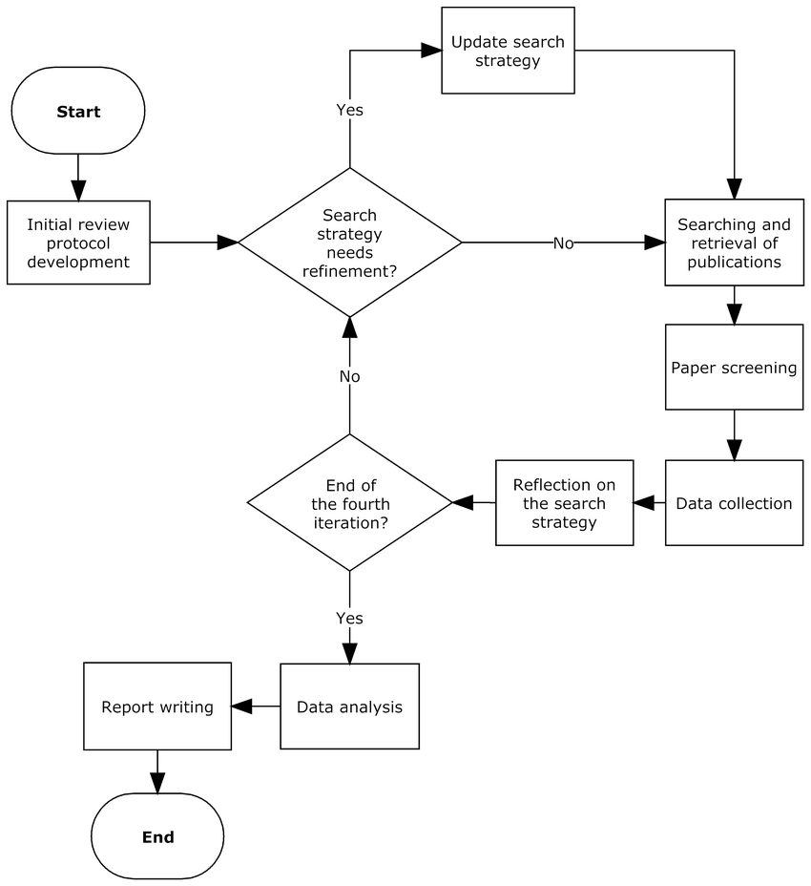
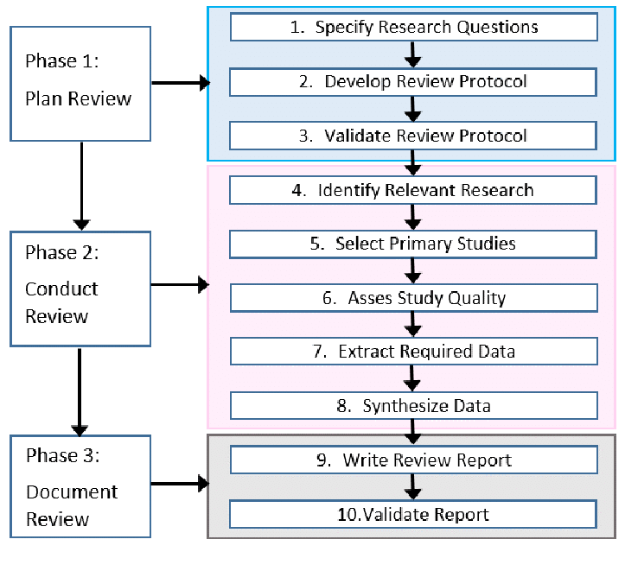
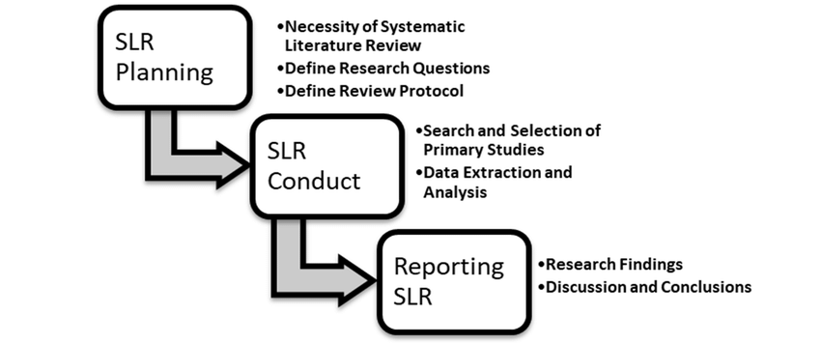
Research Methodology , RQ and Protocol
Research methodology
Research questions
Research protocol
define the research protocol based on the selected research methodology: steps, goals, outcomes.
Step 1
Step 2
Step 3
Step N
… some examples of how we can document a protocol..
…
Goal of the step / outcome

Slide 8
Research protocol: Implementation…
In the next 2-3 slides, explain each protocol step from the previous slide
Present the developed outcomes
Define what is yet to be done

Slide 9
Results
Present the results of the implementation of your research protocol
Provide the answers to the RQ
TIP:
  Use graphs, tables, plots, schemas to illustrate your findings

Slide 10
Validation Strategy
How can you demonstrate that your results are VALID?
  Empirically?
  Formally?
  Statistically?
  Other..?
You can reason about Internal / External validity

Slide 11
State of the Manuscript
Present the detailed plan of the manuscript.
Indicate what is done and what remains to be done
Retroplanning for the defence:
  Defence : Day X
  Deposit final version: X-14
  .. Other ToDos ..

