Slide 1
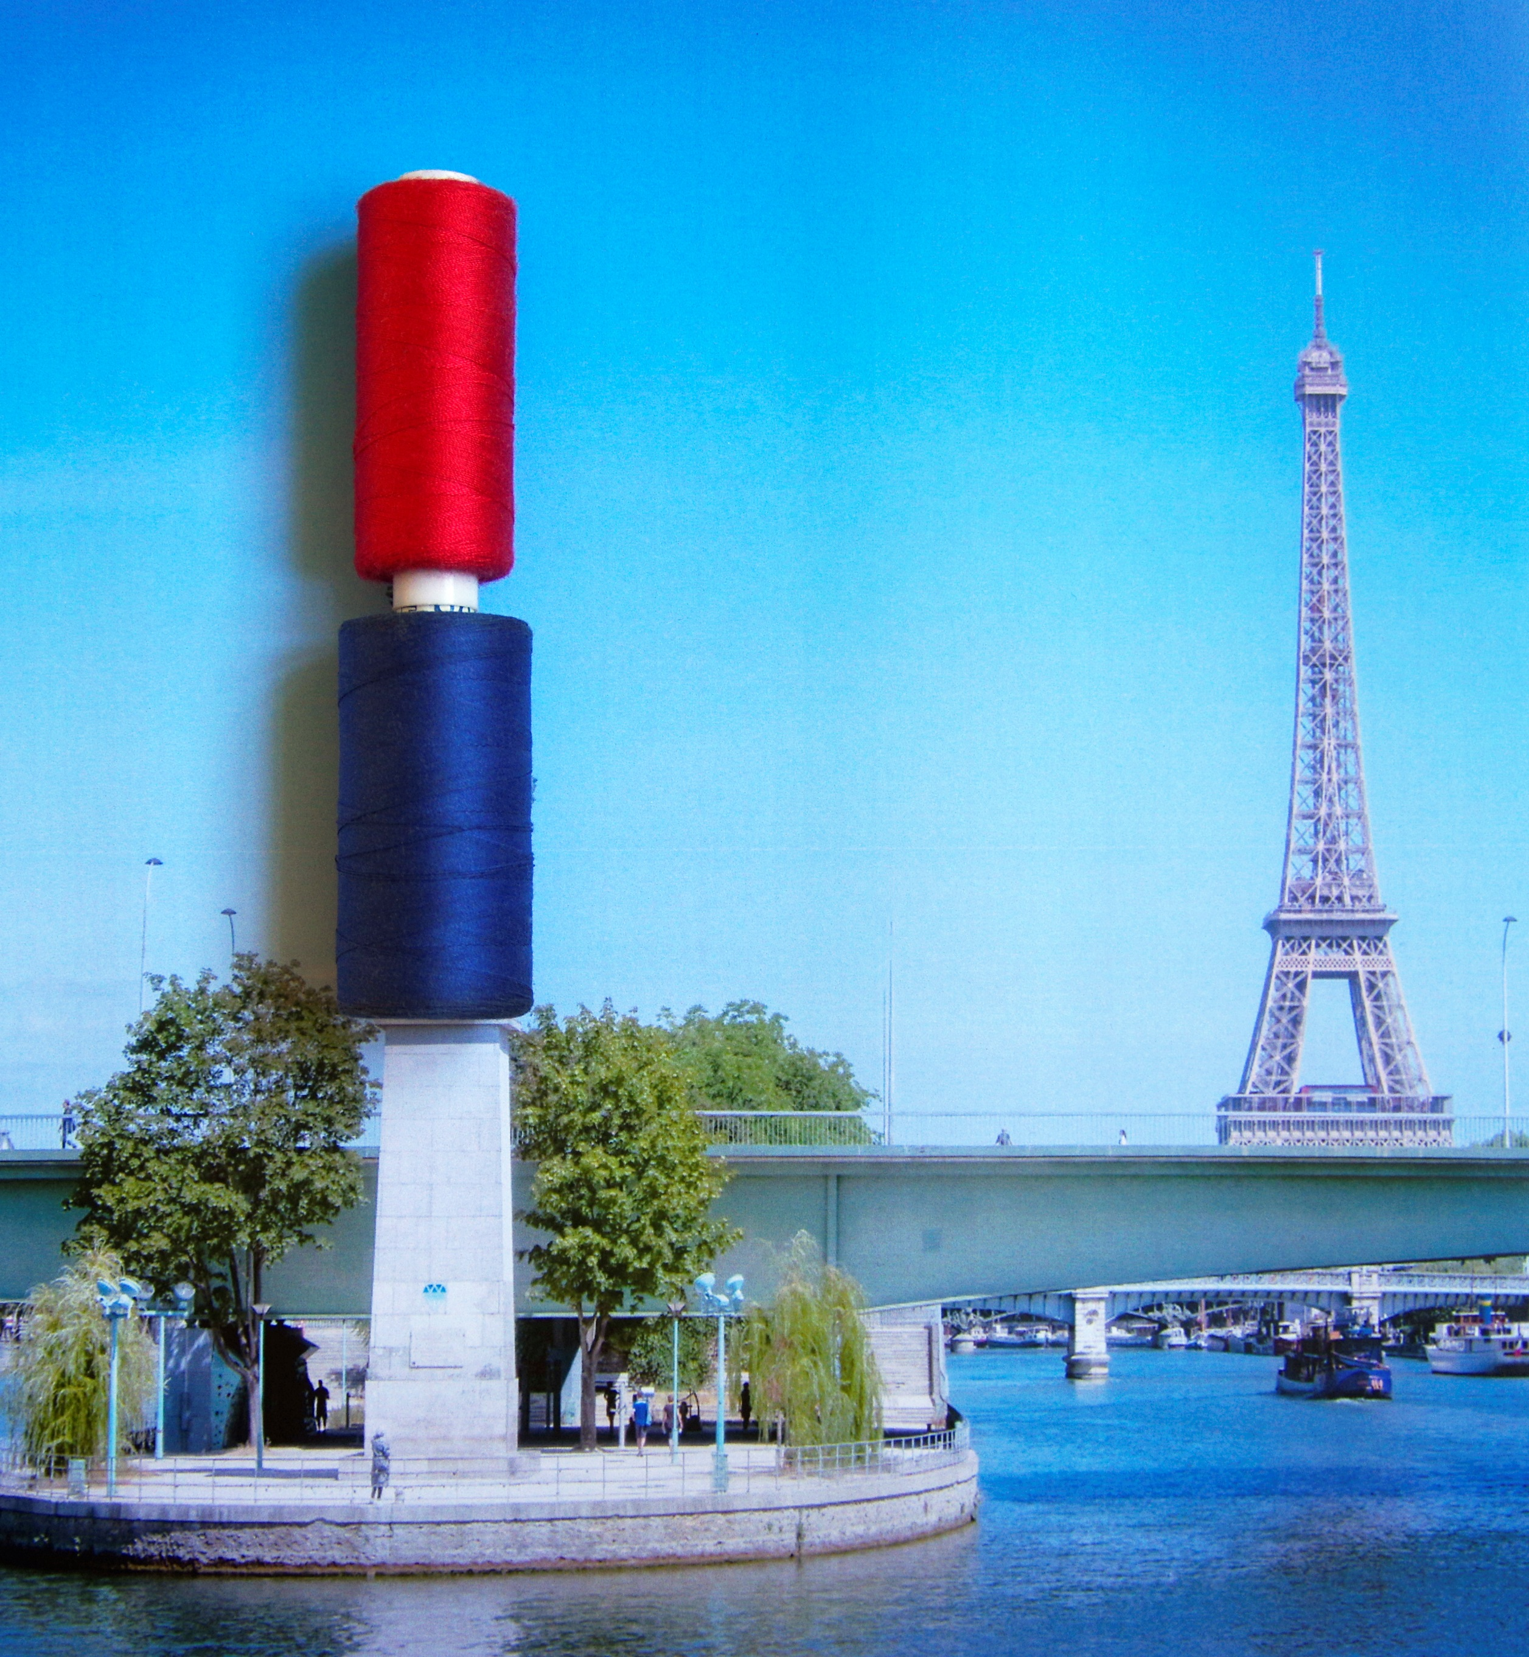
institut FRANÇAIS de la MODE
David Zajtmann
Part 1
October 21st, 2025

Slide 2
Prêt-à-porter and «créateurs »: new actors of the Parisian fashion scene
First collection or store:
1962: Dorothée bis
1962: Daniel Hechter
1968: Sonia Rykiel
1969: Chantal Thomass
1970: Kenzo
1971: « Créateurs et Industriels »
1973: Claude Montana
1973: Issey Miyake
1973: Thierry Mugler
1974: Jean-Charles de Castelbajac
1976: Jean Paul Gaultier
1976: Agnès B

Slide 3
The créateurs de mode
The role of the media
Question: right-left opposition modeled ?
‘No, I think there were people in the 60s (...) who made the first articles, I think it was Christiane Collange on Paco Rabanne and on Courrèges. At the Express, we never waited for it to become fashionable. It was on obvious designers, but when the Super 100 fabric came out for men, we were the first to talk about it. That is to say that Jean-Jacques Servan-Schreiber had instilled in us the religion of the scoop and so we wanted to be the first.’
(interview with Alice Morgaine, March 7, 2011)
Institut Français de la Mode

Slide 4
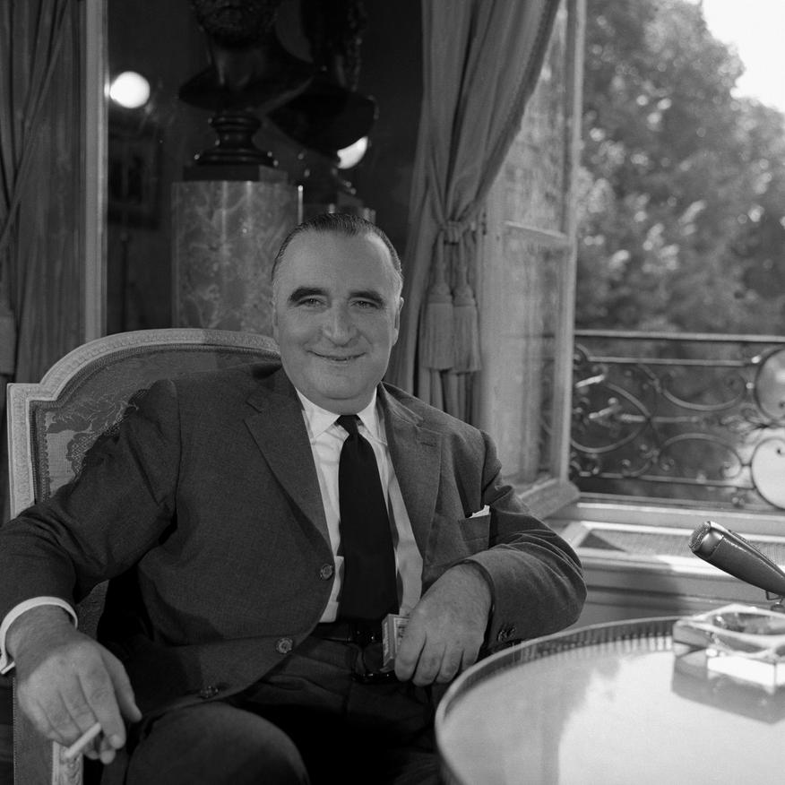
Georges Pompidou
September 21, 1972
‘Haute couture and good exports, cognac, champagne, burgundy or bordeaux! It's all over! France has begun and largely started an industrial revolution.’

Slide 5
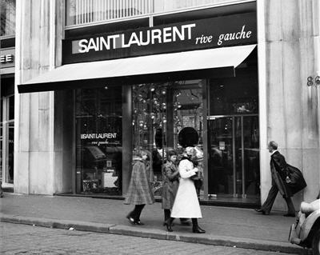
Saint Laurent rive gauche
‘Franchising was beginning to exist in France for specific products - knitting yarn, children's clothing, etc. - but it was not yet a reality. -But until then, it had not been used in fashion, and even less in luxury ready-to-wear. Suddenly I saw a solution: Saint Laurent rive gauche would be the first brand to adopt this model. It was biblically simple, extremely easy to develop and inexpensive. ’.
Didier Grumbach (2020), page 73.
Saint Laurent rive gauche,
Avenue des Champs-Elysées, April 1977

Slide 6
Saint Laurent rive gauche
The creation of Saint Laurent Rive Gauche was based on factors not found in other couture houses. The designer, like the president of Saint Laurent, lived on the left bank of the Seine in Paris, where they rubbed shoulders with a new generation of artists and designers such as the American visual artist Andy Warhol and the British dancer Margot Fonteyn. At the time, there were very few boutiques in the world bearing the name of couture companies.
At the same time, most other couture companies in France were in a less favourable situation. Ready-to-wear was therefore both an industrial phenomenon, the setting up of ready-to-wear factories, and a social phenomenon, the adaptation to a new lifestyle. Yves Saint Laurent's lifestyle corresponded to that of a new fringe of the population. It also makes it possible to sign franchise agreements for boutiques with people attracted by art and creation, as was the case in Beirut and Zurich. In total, there will be more than 150 Saint Laurent Rive Gauche boutiques around the world.
Saint Laurent rive gauche,
Avenue des Champs-Elysées, April 1977

Slide 7
The reaction of the Parisian fashion scene
Vogue France, N°543, February 1974
A new club, the G.M.C. by Francine Crescent
‘They are eight ready-to-wear designers, three of whom are involved in haute couture, who have just formed a small ultra-private club, the Groupement Mode et Création.
The eight members of the club are: Yves Saint Laurent, Karl Lagerfeld, Sonia Rykiel, Jacqueline Jacobson, Philippe Guibourgé representing Christian Dior, Emanuel Ungaro, Emmanuelle Khanh and Kenzo. They co-opted each other by unanimous vote, recognising each other's creative talent.
Until now on only existed a Chambre Syndicale de la Couture.
Today there is a Fédération Française de la Couture, du Prêt-à-Porter des Couturiers et des Créateurs de Mode which will gather the Chambre Syndicale de la Couture, a Chambre Syndicale du Prêt-à-Porter des Couturiers et des Créateurs de Mode, and a Chambre Syndicale de la Mode Masculine des Couturiers.’

Slide 8
The reaction of the Parisian fashion scene
‘Pierre Bergé has been elected president of the Chambre Syndicale du Prêt-à-Porter des Couturiers et des Créateurs de Mode, as Sonia Rykiel and Karl Lagerfeld have been elected vice-presidents.
(…)
This reorganisation merely sanctions the evolution of modern society, the rise of ready-to-wear clothing on the international scene, and the talent of a small group of designers who, from now on, with the help of the Federation, will be able to give themselves the means for a prestige policy with regard to the public authorities, the media, radio and especially television.’

Slide 9
1973:
The new institutional structure
Chambre syndicale de la couture
Chambre syndicale du prêt-à-porter des couturiers et des créateurs de mode
Chambre syndicale de la mode masculine
Fédération de la couture, du prêt-à-porter des couturiers et des créateurs de mode

Slide 10
Elle 1945-2011 – French edition – most quoted brands on the covers
Ranking | Brand | Quotations
1 | Dior | 177
2 | Saint Laurent | 112
3 | Chanel | 105
4 | Agnès B | 59
5 | Alaïa | 58
6 | Gaultier | 54
7 | Fath | 49
8 | Kenzo | 44
9 | Rykiel | 42
10 | Lanvin | 39

Slide 11
Examples haute couture brands (Elle)
Covers Elle – French edition
Most quoted brand per period (from 3 quotations)
Period | Chanel | Dior
1945-1954 | N.S. | 5
1955-1964 | 2 | 6
1965-1974 | 0 | 0
1975-1984 | 0 | 0
1985-1994 | 0 | 0
1995-2004 | 4 | 3
2005-2011 | 2 | 4
Total | 8 | 18

Slide 12
Vogue 1965-1974 – French edition
Most quoted brands on the cover
 | Brand | Quotations
1 | Saint Laurent | 20
2 | Dior | 13
3 | Cardin | 8
4 | Ungaro | 6
5 | Chloé | 4
6 | Courrèges | 4
7 | Dorothée Bis | 3
8 | Lagerfeld | 3

Slide 13
Elle 1975-1984 – French edition
Most quoted brands on the cover
Ranking | Brand | Quotation
1 | Agnès B. | 26
2 | Saint Laurent | 24
3 | Dorothée Bis | 20
4 | Kenzo | 17
5 | Castelbajac | 14
6 | Rykiel | 12
6 | Thomass | 12
8 | Mugler | 10
9 | Rech | 9
10 | Missoni | 8
10 | Monica | 8

Slide 14
The créateurs de mode
Kenzo
‘in 1980 the turnover reached 19 million French francs.
1981: 28
1982: 38
1983: 67
1984: 135
1985: 185
1986: 243’ (François Baufumé, Kenzo’s CEO)
Institut Français de la Mode

Slide 15
The créateurs de mode
Kenzo
‘I buy, if it doesn't sell, it doesn't matter (...)
And so the possibility of selling when you had talent, you were known, and you had 250 or 300 or 400 shops in the world, who were people who were trendy, who knew their trade etc., who came to Paris.
They were the ones who did the ready-to-wear, the fashion shows (...). We had half of them, we had 200 customers in the world (...) I'm talking about top-of-the-range.’
Institut Français de la Mode

Slide 16
The créateurs de mode
Kenzo
‘You had a lot of them, about fifty in Italy, you had about twenty in France, etc., etc., etc.. (…)
These people, for various and varied reasons, one because they held the market, they were the best in the city, two because they had a taste for it, (...) they were real (...) specialists who knew their trade and who were of a certain level, came, bought, trusted (...).
The campaign credits have arrived’.
Institut Français de la Mode

Slide 17
The créateurs de mode
Thierry Mugler
‘At the beginning of 1976 (...) So the first question you asked me (...): why a designer, why not a great couturier?
I would say that there are two fundamental reasons: the first is obvious and is a reason of means.
Because sewing with rules, structure, workshop, the house of Haute Couture was unthinkable for a house like ours.’
Institut Français de la Mode

Slide 18
The créateurs de mode
Thierry Mugler
‘We started out, we were extremely poorly capitalised, we started out with (...) €100,000 today (...). It was ridiculous. So the first reason, obviously this financial capacity (...)
We knew that Haute Couture would be very difficult to finance, that it would be difficult to find funds (...).’
Institut Français de la Mode

Slide 19
The créateurs de mode
Thierry Mugler
‘If the designer wants to assert himself, in this movement, we say: we're not ready to wear (...)
But we are not Dior, Chanel or Saint Laurent either.
We're somewhere in between, we're different, we're very creative, we're independent.
And we work and we are capable of attracting the press and the large clientele eager for novelty and creation, without falling into the classic scheme of Haute Couture’.
Institut Français de la Mode

Slide 20
The créateurs de mode
Thierry Mugler
‘It was a risky gamble (...) because at the time, women's ready-to-wear who wanted us, especially at the women's ready-to-wear fair at Porte de Versailles.
And on the other, there was Haute Couture’.
Institut Français de la Mode

Slide 21
Evolutions
1973 | Creation of the Fédération de la couture, du prêt-à-porter des couturiers et des créateurs de mode
1983 | Opening of the palais du Louvre to the presentations of collection
1997 | Creation of the guest member status in the Haute Couture category
1998 | Couture: exclusive and national Prêt-à-porter: inclusive and international
2001 | Reformation of the Haute Couture regulations
2011 | Opening of the couture week to the high jewelry houses

Slide 22
A succesful adaptation
2005: ‘The amended statutes allowed a controlled evolution of the federal organisation.
The Chambre syndicale de la haute couture remained exclusive and Parisian.
However, the new procedure for "invited members" has made it possible to expand the calendar and integrate new brands.
The 1945 decree was revised in 2001 so that the old qualitative criteria (sponsorship, election) once again took precedence in the establishment of the "haute couture classification" over the quantitative criteria laid down at the Liberation.’

Slide 23
Elle 1945-2011 – French edition – most quoted brands on the covers
Ranking | Brand | Quotations
1 | Dior | 177
2 | Saint Laurent | 112
3 | Chanel | 105
4 | Agnès B | 59
5 | Alaïa | 58
6 | Gaultier | 54
7 | Fath | 49
8 | Kenzo | 44
9 | Rykiel | 42
10 | Lanvin | 39

Slide 24
2000-2024
The Tokyo fashion week:
April 1985.

Slide 25
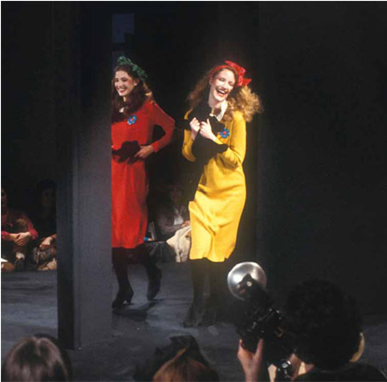
1970s – 1980s: fashion shows and designers
Kenzo Spring-Summer1979
Fashion shows become dramatic
The frenzy for designers: Kenzo, Thierry Mugler, Jean Paul Gaultier

Slide 26
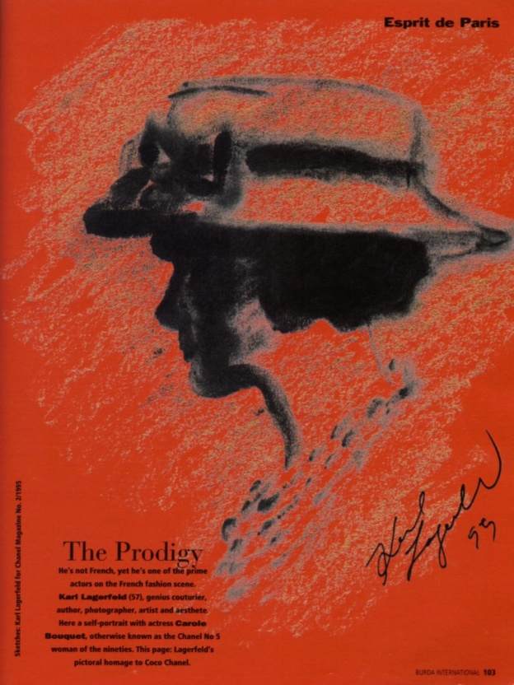
1980s and 1990s
Couture houses hire artistic directors
Karl Lagerfeld 1995

Slide 27
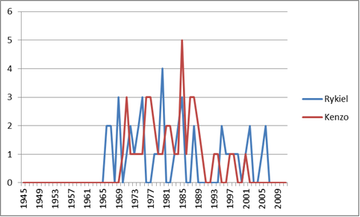
Fashion designers and the media
Kenzo & Rykiel
covers Elle France – 1945-2011

Slide 28
From 1998
Systeme with two levels:
Haute Couture « exclusive & national »
  10 to 15 companies
The Paris fashion week « inclusive & international »
  100 to 150 companies

Slide 29

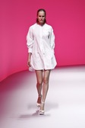
2000-2024
The internationalisation of Parisian fashion shows
Armani privé
Shiatzy Chen

Slide 30
2017:
The institutional structure institutionnelle
Chambre syndicale de la haute couture parisienne
Chambre syndicale du prêt-à-porter des couturiers et des créateurs de mode
Chambre syndicale de la mode masculine
Fédération de la haute couture
et de la mode

Slide 31
The evolution of the professional structures
Date | Event
1868 | Creation of the Chambre syndicale de la couture et de la confection pour dames et fillettes
1911 | Creation of the Chambre syndicale de la couture parisienne
1945 | The haute couture houses in a list written by the minister of Industry
1973 | Creation of the Fédération de la couture, du prêt-à-porter des couturiers et des créateurs de mode
2001 | Reformation of the haute couture status
2017 | Fédération de la Haute Couture et de la Mode (FHCM)
Institut Français de la Mode

Slide 32
References
Givhan Robin, The Battle of Versailles, Flatiron Books, New York, 2015
Grumbach Didier, History of International Fashion, Interlink, New York, 2014 .
IFM, 19 Takes on Fashion, Institut Français de la Mode, Paris, 2022.
Mode et Luxe / Fashion & Luxury, Collectif, Éditions IFM/Regard, Paris, 2014.

Slide 33
Thank you for your attention! dzajtmann@ifmparis.fr

