Slide 1
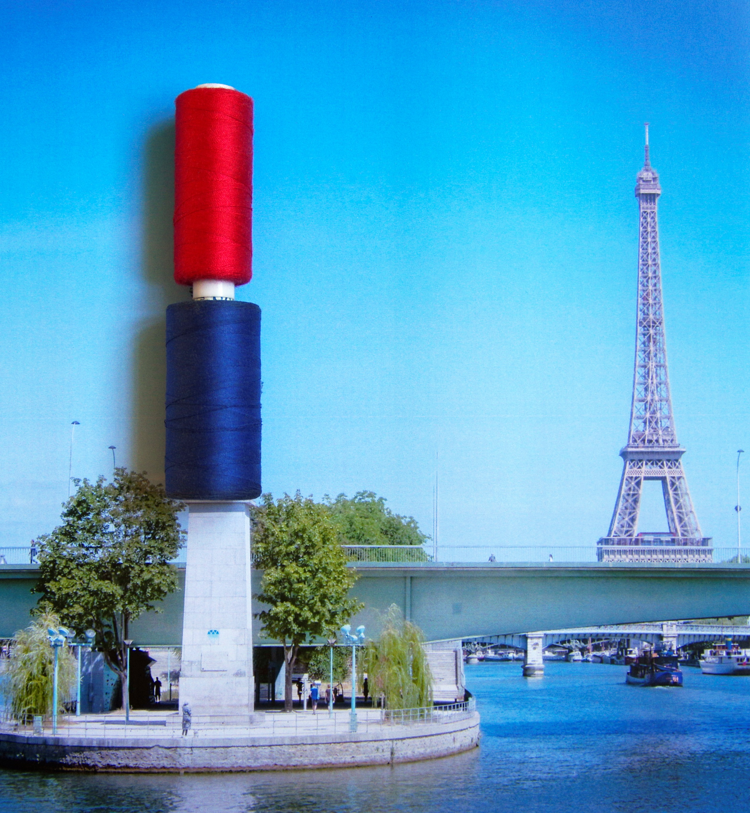
institut FRANÇAIS de la MODE
David Zajtmann
Fashion Management

Slide 2
In Schramme & alii. Fashion Management (2013, p. 43)
Independent designers | Luxury / fashion corporations | Middle-market segment | Retail chains
Focus on the creative talent of the designer ; designer push | « Dream world » couture sells licensed products | Fashion for a defined target group in the middle class | Fashion for the masses at competitive prices; market pull | PRODUCT
Value network dedicated to creative input | Value network dedicated to exclusivity | Value network dedicated to added value for the customer | Value network dedicated to cost-price reduction and speed | VALUE NETWORK
Micro-business or SME around the designer | Powerful groups of consolidated companies | SME owned by a fashion entrepreneur | Large company or group of consolidated companies developed around the distributor | CHAIN DIRECTOR

Slide 3
Timeline of different overlapping seasons
In Schramme & alii. Fashion Management (2013, p. 166)
Feb | March | April | May | June | Aug | Sept | Oct | Nov | Dec | Jan | Feb | March | April | May | June | July | Aug | Sept

Slide 4
Timeline of different overlapping seasons
Cash-in
Development & Prototyping
Distribution
Fabrics
Fabric Samples
Pre-sales
Production
Research & Design
Sales

Slide 5
Thank you for your attention! dzajtmann@ifmparis.fr

